Slide 1
CEDAR
Clinical Element Design and Review
Notes:
Partnership between informatics/clinical modelers/software engineering.
ASN1 models, XML CEM, CDL, CEML

Slide 2
CEDAR use within Intermountain Healthcare
10 Clinical Modeling Engineers use CEDAR as part of their regular work.
RNs
MDs
Informaticists
CEDAR is used in research by other individuals within Intermountain Healthcare.
Over 5,475 models in the model repository

Slide 3
Projects | Models | Deliverables | Status
Activity Based Design(iActivity or ABD) | Nursing Assessments Radiology Rule Out Pneumonia Synoptic Element Reporting Lung Cancer Screening Mammography Screening | xcemc FHIR (some models) | In development. ‘Rule Out Pneumonia’ is being tested in clinical settings.
Growth Chart |  |  | In planning
PE Projects |  | FHIR | In planning
ACOG | Family Planning Reporting | Clinical Information models FHIR Value sets for reporting | In planning
Family History |  |  | In planning
Bilirubin App | Bilirubin | FHIR | complete
Notes:
ACOG – American Congress of Obstetricians and Gynecologists –
project from the Office of Population Affairs for national Family Planning Annual Reporting.

Slide 4
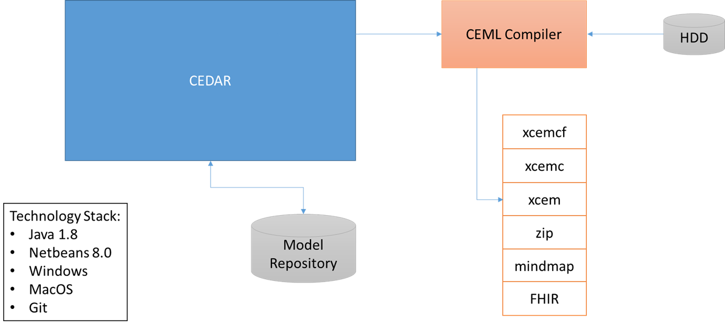
CEDAR Technology

