Slide 1
MDHT on FHIR® Overview and Roadmap for Model Driven Health Tools (MDHT)
Dave Carlson, Ph.D.
MDHT Project Lead
http://ClinicalCloud.solutions
dcarlson@xmlmodeling.com
December 13, 2016
FHIR & flame logo are registered trademarks of Health Level Seven International. Reg. U.S. TM Office.

Slide 2
MDHT Summary
Model Driven Health Tools (MDHT) is an open source software project at Eclipse.org
Supported by VA, ONC S&I, FHA, IBM, & others since 2008
MDHT supports a full lifecycle standards development process, providing a solution that allows standards designers and implementers to actively collaborate
Consolidated CDA (C-CDA)
Continuous ONC contract support for creating and maintaining all versions of C-CDA specifications in UML using MDHT editor
Complete UML models containing all conformance rules for HL7 specifications from C-CDA 1.0 through current C-CDA 2.1
MDHT Generated Java programming library for C-CDA is adopted by several major EHR vendors and 100’s of other developers

Slide 3
MDHT at Eclipse.org
Open Health Tools (OHT) organization merged with HL7 and is defining charter for a new “Open Source” work group
Model Driven Health Tools (MDHT) project has migrated to Eclipse.org
https://projects.eclipse.org/projects/modeling.mdht
MDHT source code at Eclipse.org
Initial contribution to Eclipse git repository completed in Nov 2015
Core
CDA tools
FHIR profile import/export and design
MDHT project intends to be active participant in new HL7 WG

Slide 4
MDHT Roadmap
MDHT on FHIR
Profile design in UML, with terminology services
Import/Export FHIR conformance resources
StructureDefinition, ValueSet, ImplementationGuide, DataElement, Operation, etc.
Integrate with FHIR profile registry/repository, location(s) TBD
Clinical Information models with terminology bindings
TBD, begin development of MDHT tooling for HL7 CIMI models using OMG standard Archetype Modeling Language (AML) UML profiles
Looking for organizations to support development of this new capability
Model & Instance Mapping: MDHT + MDMI
Model-Driven Message Interoperability (MDMI) OMG Standard
Support from Federal Health Architecture (FHA) for prototype tooling enhancements and mapping FHIM to FHIR, plus FHIR profile generation

Slide 5
MDHT on FHIR: Initial Scope
Define UML profile and representation for FHIR specs
Import FHIR StructureDefinition & ValueSet resources
Datatypes, Core Resources, Constraint profiles, Extension definitions
Export FHIR StructureDefinition & ValueSet from UML
MDHT UI enhancements for FHIR profile design
Reuse UML table editor (same as CDA editor)
Add customized menu commands and property view tabs for FHIR UML stereotypes
Integrate FHIR terminology services for ValueSet design
This initial feature set was supported by an ONC Federal Health Architecture contract (summer 2015, spring 2016)

Slide 6
Import FHIR STU 3 to UML

Slide 7
HL7 FHIR Publication for Condition

Slide 8
FHIR Condition Resource in UML

Slide 9
UML FHIR Condition (Dynagram)

Slide 10
FHIR Constraint Profiles in UML
FHIR profile must have one base type:
Core data type (e.g. Quantity)
Core resource (e.g. Observation)
Another profile (no limit to profiles constraining other profiles)
See http://hl7.org/fhir/profiling.html
MDHT UML modeling style for FHIR
Define mapping for FHIR StructureDefinition and ValueSet to UML model elements
Reuse existing UML semantics, whenever possible (e.g. Property subset or redefine)
Define UML stereotypes for additional FHIR metadata
UML modeling style is similar to MDHT CDA templates

Slide 11
FHIR Profiles: DAF-ResultObs

Slide 12
UML DAF-ResultObs (Dynagram)

Slide 13
FHIR Terminology Services

Slide 14
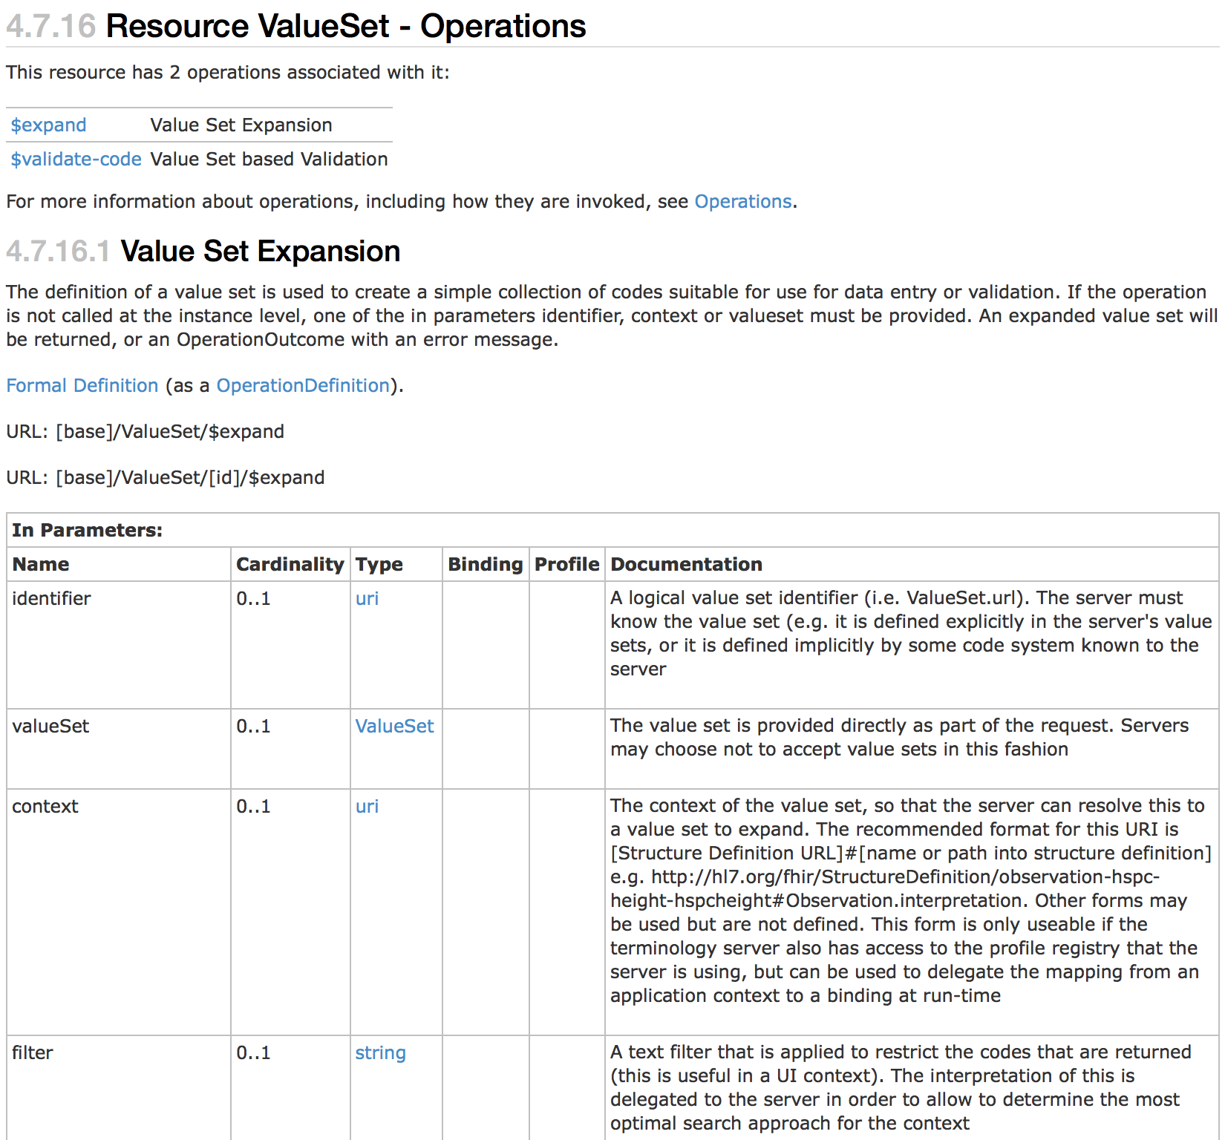
FHIR Terminology Services

Slide 15
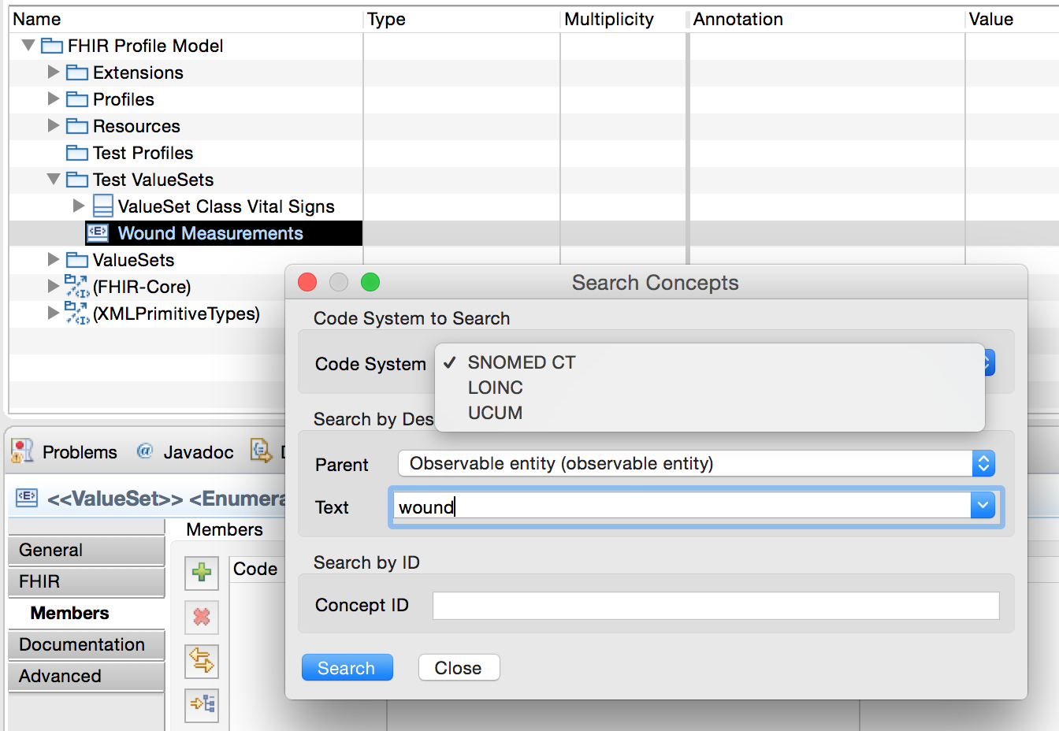
Creating FHIR Value Sets

Slide 16
Profile ValueSet Binding

Slide 17
MDHT on FHIR: Next Steps
Complete UML profile for FHIR
Stereotypes for UML extensions and FHIR metadata
Evaluate use of ISO 11179-3 MDR profile as part of FHIR profile
Complete FHIR to UML mapping and import/export
Complete customized UI for editing UML FHIR profile models and FHIR metadata
Integrate FHIR terminology services
Browse/search/create FHIR Value Sets
Assign concept semantic meaning to FHIR elements
Validate FHIR structure definition models
Assure that UML FHIR profile models are valid structure definitions for base resource/profile
Generation of Java APIs for FHIR constraint profiles

Slide 18
Questions for MDHT Users
What can MDHT project do for FHIR that is of most benefit to clinicians and developers?
FHIR profile design and artifact generation
Transform CIMI clinical models to FHIR models
Publish FHIR implementation guides
Validate FHIR profiles and instances
How would YOU like to get involved as a contributor to Eclipse.org MDHT?

