Slide 1
ABD Stereotypes and clinical modelling
T Beale

Slide 2
Activity-Based Design (ABD)
A project to go beyond content modelling (CEMs, archetypes, etc) and model workflows, on the assumption that workflows need to be adaptive and collaborative
An ‘Activity’ is a unit of clinical work in an ABD Workflow definition
It is formally a level up from a templated archetype or CEM, i.e. it includes workflow-related elements, e.g. chaining, cost-capture.
For today, we can think of an Activity as an uber-CEM or archetype, and has many of the same modelling concerns
There is an authoring tool – Activity Composition Tool (ACT)

Slide 3
ABD modelling approach
~ same needs as CEM, archetypes etc
No Reference Model
Based on an approach called ‘stereotypes’ designed by Alan

Slide 4
What is an ABD Stereotype?
A self-defining set of building block meta-types that can be used to construct Semantic Models (=DCMs, =Archetypes)
= a ‘language’ of semantic models

Slide 5
What is an ABD Stereotype?
Stereotypes (as they are today) include:
Node documentation: description, label
Primitive types: Boolean, Integer, Real, Date, Duration, Text, String, Uuid, …
Define in terms of constraints, similarly to ADL
Coded types: Code, ValueSet
Assertion: a special meta-type in the form of a rule/action
Currently available for Codes: Accept | Reject | Ignore with optional actions
Evaluation: a set of assertions covering a value domain
Currently covering a value set, i.e. Accept/Reject/Ignore for all values that code a node
Multiplicity: cardinality and existence constraints (like ADL)

Slide 6
What is an ABD Stereotype?
Stereotypes (as they are today) include:
Constructed types: these are ‘up for grabs’; currently include IHC ‘StdLabObs’ and related types
Rules for connecting together: defined mainly via enum markers on nodes
Logical view / UI definitions: rules for how to display

Slide 7
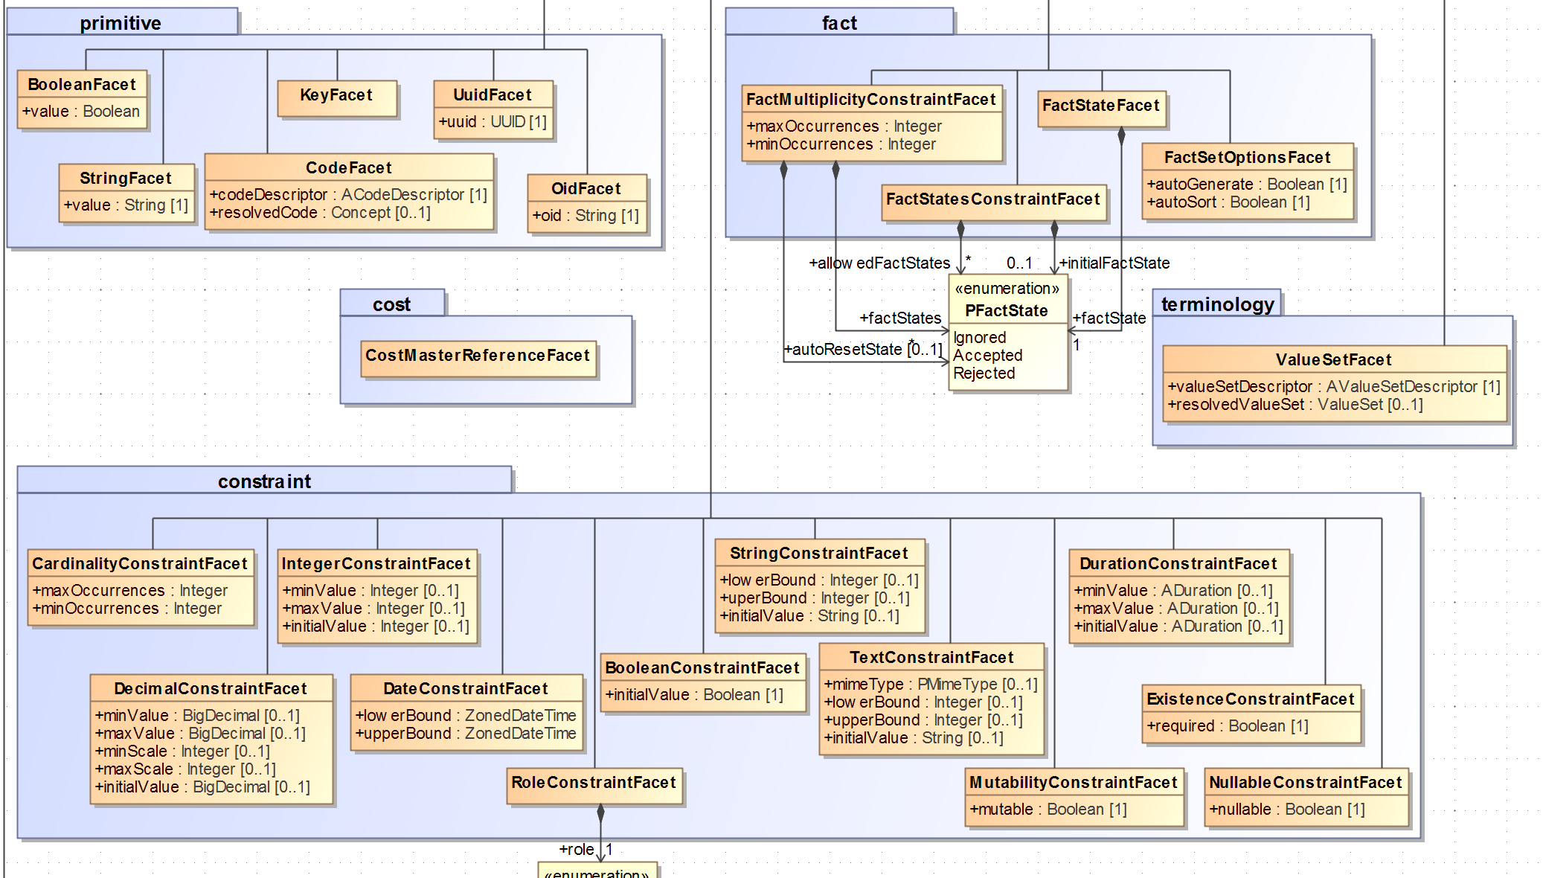

Slide 8
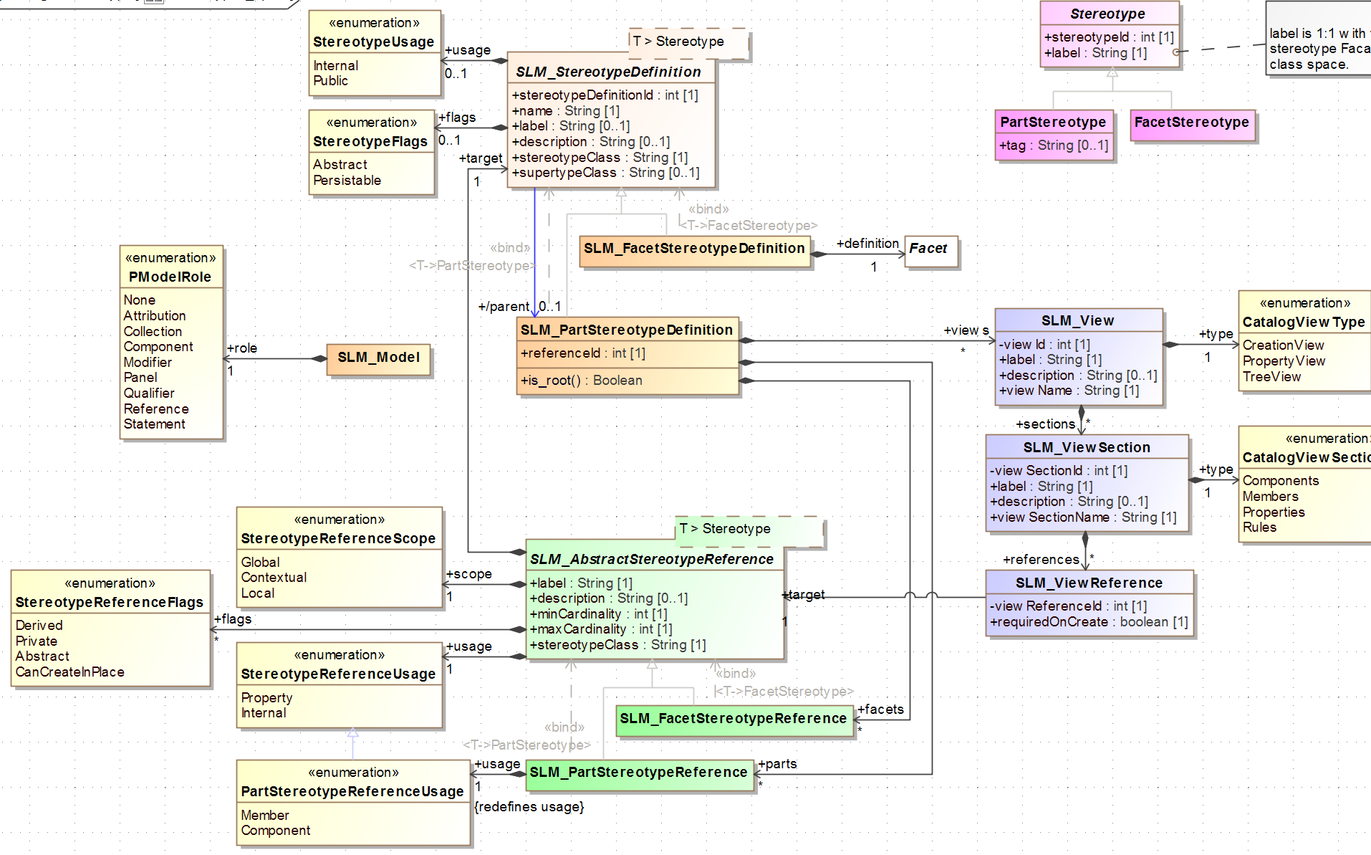

Slide 9
Compare to Archetypes / ADL / AOM
Some smart types like Assertion, Evaluation
No external reference model
Concretely, the nodes don’t mention external types like in ADL
i.e. no CLUSTER [id101], only [id101]
But … the non-primitive stereotypes act like a reference model, e.g. StdLabObs etc is an IHC form of an openEHR RM type OBSERVATION

Slide 10
Can we have ‘modelling-lang agnostic tool’?
We can have an RM-agnostic tool
Can we have a tool that doesn’t know about ADL or similar?
Not really … the ABD Activity Composition Tool (ACT) knows about Stereotypes, including the primitive ones like IntegerConstraint etc, the special ones like Assertion, Evaluation, and constrainers for cardinality and composition rules
These are similar to ADL/AOM types (we’ll add something like Assertion as well)
At least these primitives need to be formalised. ADL does it in its way, Stereotypes do it in a slightly different way
But it must be formalised

Slide 11
Can we have ‘modelling-lang agnostic tool’?
Why not just a mindmap tool?
Yes, that’s possible
But consider what an ‘Integer’ node looks like – somewhere you want to define value limits; same for a ‘Code’ node (which mindma doesn’t understand)
Pretty soon you are back to AOM, Stereotypes or something else that does the same job (maybe CQL?)
In openEHR we use mindmap to just develop the backbone structure and node naming; then modellers convert to AOM-based model, i.e. formal archetype. Stereotypes would not change this.

Slide 12
Next steps
We will publish a Stereotype formal syntax shareable language definition (i.e. equivalent of ADL + AOM)
Based on the inbuilt primitives (types, cardinality, composition rules)
Treat complex types as constructions, like reference archetypes
And some Java libraries that implement this and convert in and out of it

Slide 13
A Stereotype Library
Constructed Stereotypes can then be openly published and worked on across the domain, i.e. IHC, VA, HL7, …. whomever

