Slide 1
HSPC Terminology and Information Model Initiative
Susan Matney, PhD, RNC-OB, FAAN (Initiative Lead)
Stan Huff, MD, FACMI, FHL7
11/6/2016

Slide 2
Agenda
HSPC Initiatives
Terminology and Tooling Initiative
Terminology and Tooling Deliverables

Slide 3
HSPC Initiatives
Be a provider led collaboration agent by convening healthcare providers, professional organizations and vendors to facilitate the creation and sharing of applications and services
Create a reference implementation of common services-oriented architecture (SOA) and define the governance, behavior/functions and APIs
Develop terminology and information models as a foundation for true semantic interoperability
Support reliable authoring and sharing of a variety of knowledge content to support clinical decisions and processes.
Obtain consistent implementation and adoption of standards such as HL7 FHIR, HL7 CIMI, IHE, LOINC, SNOMED Argonauts and other related industry efforts (SMART, SOLOR, C4MI, Commonwell, Sequoia etc.)
Create a shared technical environment to enable simple and efficient development and discovery of HSPC compliant models, applications and services

Slide 4
Terminology and Tooling Initiative:
Develop terminology and information models as a foundation for true semantic interoperability
Based on real world, technical, high priority use cases brought to us by the member community.

Slide 5
The Interoperable App Development Process
Domain
Analysis
Create Logical
Models
(CIMI)
Approve
Models
Model
Repository
Project Needs
Pediatric Growth Chart
Neonatal Bilirubin
OPA Data Collection
MQIP
ACC registries
Comm Acq Pneumonia
Etc.
Terminology
Server
(SOLOR)
Create
Physical
Artifacts (FHIR
Profiles)
Create
Software
(Apps, CDS)
Artifact
Repository
(FHIR profiles)
Conformance
Testing

Slide 6
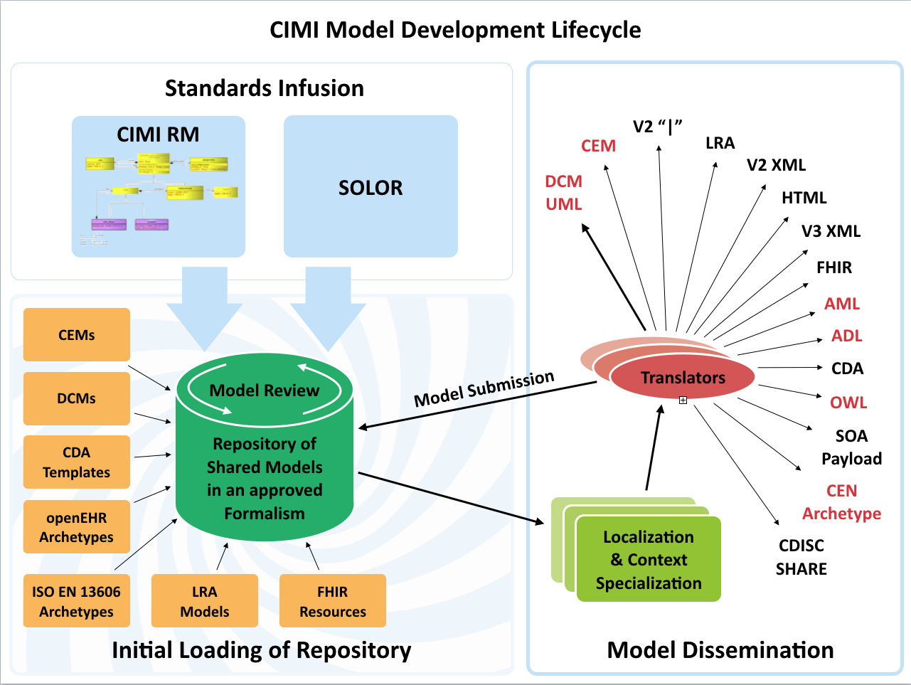

Slide 7
Deliverable 1: Develop the CIMI Content Architecture (overseen by HL7 CIMI WG)
Goal 1: Develop the high level reference archetypes (patterns) and ballot
Assigned to : Susan/Claude
Develop CIMI Model Style Guide
Archetype Development E.g. Encounter, Observation, Procedure, Assertion, Medication…
Goal 2: Finalize and ballot the CIMI Reference and Foundational Archetypes
Assigned to : Claude Nanjo
Goal 3: Create detailed clinical models to test the reference archetypes and implement
OPA/ACOG FPAR
Skin/Wound Assessment
Notes:
Need to discuss order of how patterns are created. Move 2 to 1

Slide 8
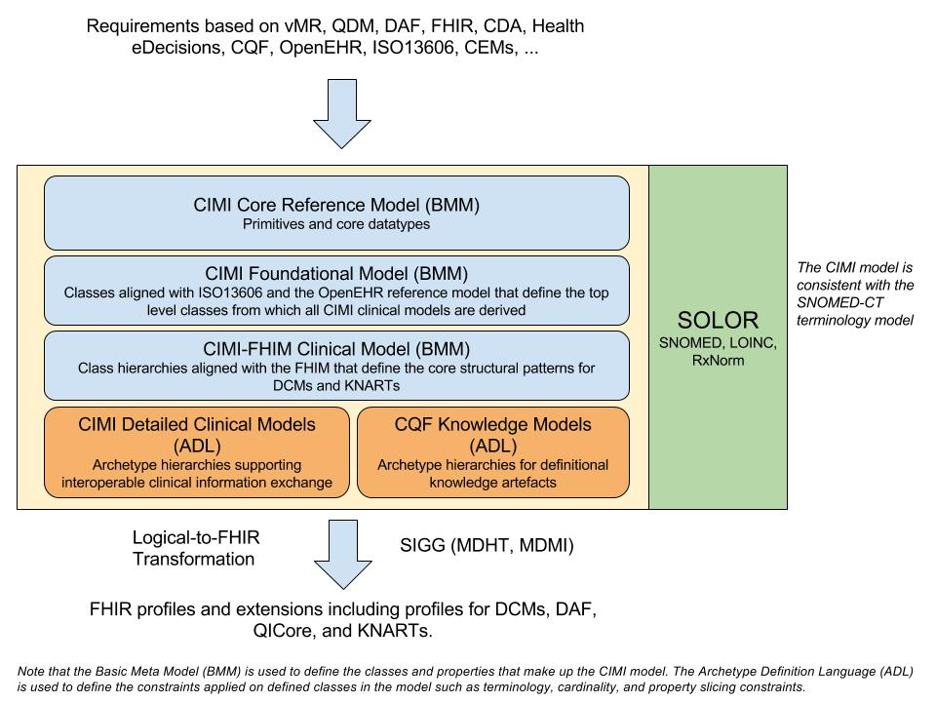
Model Driven Architecture Vision to seamlessly support developers and implementers
Notes:
Claude Nanjo, https://docs.google.com/drawings/d/1xQF5SZxwi8DiFG1C7uI9eBo6RkgYtA3iIekeuDOC8Es/edit
The core reference model which define the very foundations of the model. Right now, it is very generic. It can almost be compared to FHIR's Structure Definition with some of its datatypes, etc... At this time, it is really a meta-model layer.
The foundational archetype layer - these are closely aligned to ISO13606 and the OpenEHR reference model and provide the foundation for a clinical document more generally and a clinical record in the case of CIMI. This is important because KNARTs can use this same foundation as well which is key when we define a logical model for CQF.
The reference archetype layer - these will consist in the case of CIMI of the 'schematic anchors' so to speak (to borrow Richard Esmond's term) from which detailed clinical models will be derived. Requirements for this layer will come from FHIM, vMR, QDM, QUICK, FHIR DAF, SDC, etc... The goal is to define this layer so that the transformation cost to FHIR profiles is lowest despite some divergence which we know we will have. Note that within the hierarchy of archetypes that will make up this layer, we will derive the DAF and QICore profiles. However, I would not call this layer the FHIM/DAF/QICore layer. It is more than that. Also, as Galen pointed out, not all of the expressivity of FHIM will carry over to CIMI given the models' different requirements.
The detailed clinical model layer which, ideally, are simply constraining profiles on the layer above to create families of archetypes that only vary in their terminology bindings and cardinality constraints.
An additional note on the Reference Archetype Layer: There will ultimately be two general categories of archetypes in this layer - the CIMI archetypes which we are working on now as part of the CIMI/FHIM effort - and the HeD archetypes which will consist of those archetypes that define the CQF logical model. Note that for both of these categories, there might be common archetypes used for both CIMI and HeD (e.g., the procedure topic of a clinical statement in CIMI can also be used as a definitional archetype for a procedure order item - ActivityDefinition - in an order set for instance).
Then, from layers 1-4, we would define the set of transformations to generate the corresponding FHIR profiles including DAF and QICore. Note that FHIR profiles can be generated from the various levels of the archetype hierarchy depending on requirements. The lower down the hierarchy, the more prescriptive the profile in terms of constraints.
It is important to note that some FHIR profiles may be derived from the Reference Archetype Layer (e.g., DAF, some QICore profiles, some CQIF profiles on PlanDefinition, Questionnaire and ActivityDefinition, etc...) and others from the DCM Layer (e.g., bilirubin, HgA1c, etc...). In other words, the arrow for FHIR Profiles stems out of the outer box rather than the last of the inner boxes (the DCM box).
CQIF is an implementation guide that stems out of the CQF initiative. I hope this helps.

Slide 9
Deliverable 2: Develop Model Transform Methodologies (overseen by HL7 CIMI WG)
Goal 1: Develop Transforms to CIMI
CEM to CIMI transform (Assigned to: Joey Coyle)
FHIM UML to CIMI transform (Assigned to: JP Systems/Claude Nanjo)
Goal 2: Transforms out of CIMI
CIMI to FHIR Profiles (Assigned to: Dave Carlson, Claude Nanjo)
CIMI to FHIM UML (Assigned to: JP Systems/Richard Esmond)
Goal 3: CEM Transforms to FHIR
CEM to FHIR Profiles (Assigned to: Joey Coyle)

Slide 10
Deliverable 3: Define Model Development Pipeline
Goal 1: Model Request Process Model Development
Assigned to : Susan
Define Scope Templates
Use Case Template Development
Define Analysis Process
Identify content curation process
Define and Document Model Development Process
Goal 2: Model Prioritization
Assigned to : ??

Slide 11
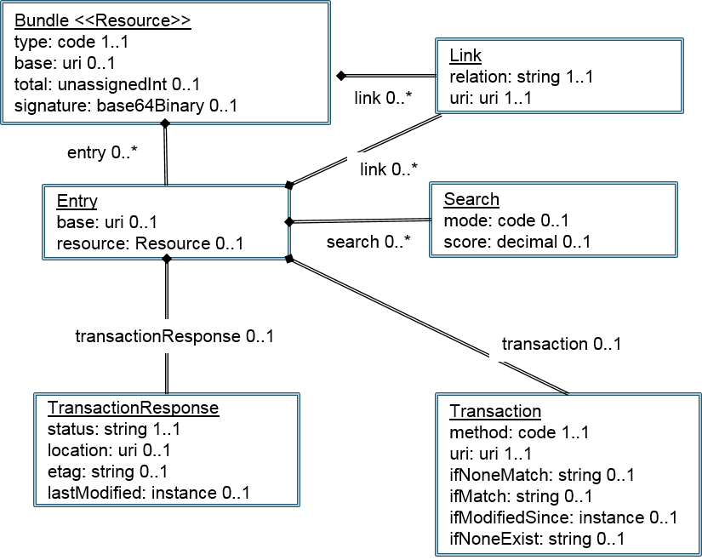
Model Request Workflow
Identify Use Case
Document Use Case
Send Use Case to HSPC
Review the Use Case with HSPC
Agreement between HSPC and Partner
Model Request
Content Mapping
Request New Standard Content
Partner Completes Model Request.
Create Models and SMART on FHIR Profile
Model Exists.
Develop the App
on
Adapted from a workflow diagram developed by Rick Freeman

Slide 12
Deliverable 4: Provide SOLOR terminology support (overseen by Keith Campbell)
Goal 1: Determine Terminology Editing Environment
Assigned to : Keith Campbell
Identify provider and location
Determine content
Develop long term maintenance process
Goal 2: Define process for terminology development
Assigned to : Monique van Berkum, John Kilbourn
Goal 3: Determine Terminology Services required for model binding
Assigned to : CIMI Pattern Development Subgroup (Susan will lead)
Goal 4: Implement Terminology Services for model binding
Assigned to : XXX

Slide 13
Deliverable 5: Define versioning and governance processes for terminology and models
Goal 1: Terminology Versioning and Governance Processes
Assigned to: Keith Campbell
STAMP
Goal 2: Model Versioning and Governance Processes
Assigned to: Susan Matney
Notes:
Move to knowledge content initiative

Slide 14
Deliverable 6: Define terminology and modeling tooling roadmap (Overseen by Keith and ?)
Terminology Tools (assigned to: XXX)
Goal 1: Determine tooling required for terminology development and maintenance
Goal 2: Develop and implement terminology tools
Modeling Tools (assigned to: XXX)
Goal 3: Determine tooling required for model development and maintenance
Goal 4: Develop and implement modeling tools
Model Transform Tools (assigned to: XXX)
Goal 5: Develop implement and transform tooling

Slide 15
Tooling Vision / Challenge; where, tools
seamlessly support developers and implementers
Requirements derived from business use-cases, SMEs
Requirements derived from existing specifications
Tools using Terminology Model and Content
Versioned SNOMED, LOINC, RxNorm (SOLOR)
clinical requirements (reusable DCMs)
Versioned CLIM = {SOLOR Term., FHIM Domains,
QDF{(DAF, QICore, KNARTs, eCQMs}, CIMI {DCMs}}
MDA Tools (e.g., SIGG = MDHT + MDMI)
UML Profile: KNART
UML Profile: CDA
UML Profile: FHIR
UML Profile: NIEM
UML Profile: DCM
Use round-trip to confirm process
NIEM IG
NIEM IG
NIEM IG
NIEM IG
NIEM IG
NIEM IG
NIEM IG
NIEM IG
ADL & AML
CDA IG, Java, XML
FHIR IG, Java, JSON
NIEM IG.
ADL & AML
Mappers
Translators
Notes:
However, FHIM has the capability for generating these models. So if we adopted CIMI information requirements, we could generate CIMI archetypes and compare them to the source archetypes to confirm the process. FHIM & MDHT could then serve as one of the “translator” tools CIMI is hoping to develop.
ISSUE (Keith)
From: Keith Campbell [mailto:kecampbell@mac.com] Sent: Wednesday, August 31, 2016 1:04 PM To: SHufnagel@ApprioInc.com Cc: Jay Lyle <jay.lyle@jpsys.com>; Keith Campbell <9540296706@informatics.glip.com>; Steven Wagner <switconsulting@comcast.net>; Nona Hall <Nona.Hall@hhs.gov>; Galen Mulrooney <Galen.Mulrooney@JPSys.com> Subject: Re: Updated slide please ... please
I agree that the top box is where the terminology lives.
I recommend that the top box be given two layers, or split into two boxes.
Dependencies seem to be going from top to bottom, so terminology would be on the top:
Terminology model & Terminology Content (SOLOR)
———————
CLIM
For tool type activities, I would add a balloon pointing to Terminology model & Terminology Content that says something like “add new terminology content as necessary to meet requirements derived from existing specifications.
Then add a versioning and publication step between the SOLOR box/layer and the CLIM box/layer.
Then add a versioning and publication step between the CLIM box/layer and MDHT/MDMI. I think the arrows you are using conveys publication, so you could stick with that metaphor.
For the box MDHT/MDMI, I would not put IHTSDO workbench in that list, it would be more in the SOLOR box/layer balloon.
For the other goods, ADL workbench, enterprise architect, etc, they need to be able to import SOLOR content, so they can build the profiles using the agreed terminology foundation…
ACTION (Jay) Please update slide IAW with Keith’s guidance.
ORIGINAL NOTE
SOLOR
Creates Lightweight Expression of Granular Objects using SNOMED, LOINC, RxNorm within Detailed Clinical Models. It is an integration of SNOMED, LOINC, and RxNorm that can be treated as a single, coherent terminology systems with description-logic semantics.
FHIM
is Federal Healthcare Information Model, which is a high-level logical healthcare model, which covers approximately 36 clinical domains and has been vetted by Federal Agency SMEs and clinicians.
CIMI
is Clinical Information Model Initiative which defines Terms-of-Reference AKA Principles and modeling style guidelines; where, a CIMI Model is a clear, complete, concise, correct and consistent logical semantic-and-syntactic description of a healthcare concept, which can be instantiated as a computable implementation object that is interoperable among systems.
FHIR
defines a set of "Resources" that represent granular clinical concepts. The resources can be managed in isolation, or aggregated into complex documents.
CQF
is Clinical Quality Framework to support Continuous Quality Improvement (CQI) with a Quality Improvement and Clinical Knowledge or QUICK data model, Clinical Quality Language (CQL) supporting clinical decision support (CDS) and clinical quality measures (CQM).
Others
Standards Coordination initiatives (DAF, SDC, etc)
Interoperability Proving Ground
MDHT
MDHT is a suite of tools that is used to support the design and implementation of healthcare standards
MDMI
MDMI is an open standard (OMG) that specifies a UML Model for interoperability
For the FHIM, MDMI provides semantic alignment between the different Interoperability specifications and different logical models
SOLOR Terminology Model ….what it really means
FHIM = Use
CIMI = Offers via DCMs the specifics supportive for detailed applications
FHIM = Provides the conceptual / logical view of all the data in your enterprise even though you would never build it that way; it none the less is there to consistently offer all the spokes that need to come together anchoring them all via the hub. It gives you common language all can talk Grants that understanding to the semantics Treat FHIM as in support of what’s needed for a shopping list whereas you are collecting the necessary components. With
CIMI is the taxonomy among the terms
C-CDA is about the data sharing
FHIR is about transport model; standardizes the FW built for moving resource / enables the exchange of info within the system and ideally it will conform to the FHIM/CIMI;
Domain model: An explicit description of a domain in terms of concepts, properties and attributes, and constraints, defining a common vocabulary. Domain model characteristics: Closed (but extensible), useful for defining objects, properties, and relationships, often (not exclusively) expressed in UML. Sometimes called “conceptual” or “domain analysis” model.
Example: Pressure Ulcer Prevention Domain Analysis Model (http://wiki.hl7.org/images/b/be/PressureUlcerPreventionDomainAnalysisModel_May2011.pdf)
Information model: A representation of what data is associated with a domain and how that data is structured. Similar to a domain model, but with a focus on representing the information associated with the domain, rather than the domain objects themselves. Information models commonly are developed at the logical level, that is, they are specific about what data is captured, but do not specify database structures. Should include metadata (information about the information collected). Information model characteristics: Closed, includes metadata, useful for constructing artifacts using Model-Driven Architecture.
Example: FHIM
Ontology: A formal naming and definition of the types, properties, and interrelationships of the concepts that really or fundamentally exist for a particular domain. An ontology can be developed for specific domain model or it can also be used across multiple domain models. Ontology characteristics: Open, useful for automated reasoning, often (but not exclusively) expressed in OWL.
Example: SNOMED-CT
Taxonomy: A taxonomy is similar to an ontology, but taxonomy is usually only a hierarchy of concepts, while an ontology supports complex relationships between concepts.
Example: CMS Healthcare Provider Taxonomy Code Set (https://www.cms.gov/medicare/provider-enrollment-and-certification/medicareprovidersupenroll/taxonomy.html)
Data Element: A unit of data for which the definition, identification, representation, and permissible values are specified. May not, in itself, provide complete context. May also be posed as a question-answer pair.
Example: US National Library of Medicine Data Element Catalog (https://www.nlm.nih.gov/healthit/dec/)
Exchange Package: A set of information that is transferred between systems. The logical contents of exchange packages will be defined in terms of individual or groups of data elements. The logical content is independent of the wire format (syntax), but often the definition of an exchange package includes a specific syntax (how the information is serialized for transport).
Example: HL7 V2.5 ADT message, Continuity of Care Document
Transformation (often just called mapping) is the process of mapping between data fields and the translation of terminology needed when the source information model, the local contents of the exchange package, or the target information models are not identical.
FHIM / CIMI are information models (conceptual / logical) they are not physical / implementation models
HL7 2.3, 2.8,3.0 separate chunks of data to get transported…..transport mechanism – more about data sharing

Slide 16
Questions

