Slide 1
VistA 4 Solution Architecture
Dr. Aaron J. Drew

Slide 2
Overview
VistA 4 will rely upon secure infrastructure, data models, and services that support an open, modular, and extensible EHR platform.
This will allow the VA to provide high-quality solutions at increased speed and decreased cost.
The resulting system will be flexible and agile, accommodating new technology advances and achieving optimal results more efficiently.

Slide 3
Overview
A service-oriented architecture (SOA) approach will be utilized to enable interoperability, innovation, reduce system redundancies, and enable key clinical capabilities.
This will include a new web-based user interface, a data management services capability, and clinical decision support.
VA’s SOA approach will enable integration between VistA and envisioned ancillary systems, such as Pharmacy and Laboratory.

Slide 4
Overview
The VistA Evolution Program will ensure that while this information becomes more easily accessible, the right information assurance controls will be in place to restrict access to authorized users.
A new messaging middleware solution will be deployed to enable these new capabilities.
The deployment environment for VistA Evolution will adhere to a “cloud first” policy, involving data center consolidation and a move to virtualization of both back-end and front-end systems.

Slide 5
“To-Be” Architecture
The following is a summary of the areas addressed in the VistA 4 “To-Be” architecture:
Identity Management
Security and Authorization
Privacy and Compliance
SOA and Enterprise Service Bus Based Solutions
Enhanced User Experience
ONC Electronic Health Record Certification
VA/DoD Interoperability
Terminology Services
Care Coordination: Activity Management, Communication, and Veteran Goals
Health Information Standardization
Clinical Decision Support
Specialty Clinical Applications and Medical Device Integration
Ancillary Services: Laboratory, Pharmacy and Radiology

Slide 6
“To-Be” Architecture
Security and Authorization
Identity Management
Health Information Standardization
Clinical Decision Support
Specialty Clinical Applications and Medical Device Integration
Privacy and Compliance
SOA & Enterprise Service Bus Based Solutions
Enhanced User Experience
ONC Electronic Health Record Certification
VA/DoD Interoperability
Terminology Services
Care Coordination
Ancillary Services

Slide 7
“To-Be” Non-Functional Requirements
The following is a summary of the VistA Evolution non-functional requirements that impact the system of systems architecture.
Measure, collect, and report via a dashboard performance measurements for responsiveness, capacity, and availability.
Export performance reports in standard formats such as comma separated list and PDF.
Report key meta-data for planned and unplanned maintenance events.
Provide notification to the user community on events and incidents.
Utilize virtualized environments.
Configurable systems and services.
Components must be portable and be interoperable.

Slide 8
“To-Be” Non-Functional Requirements
Less than a 0.25% chance of receiving a system error due to packet loss.
Latencies not to exceed 100ms round trip time (RTT) anywhere in the Continental United States.
The application shall be available 24 hours a day, seven days a week, with an uptime of 99.9% and a reduced maintenance cycle capacity of no more than 25%. All system updates and scheduled maintenance should occur between the hours of 1800 and 0600, when clinical usage would be lightest. Availability is 24x7 with 99.99% availability between 0600h to 2359h and 99.9% availability between 0000h-0559h.
0.5 seconds or less transaction completion time.
95% of screen renderings shall be fully populated within 60 seconds 99% of the time.
Data originally external to VA databases shall display with the same latencies as data from VA databases.

Slide 9
“To-Be” Non-Functional Requirements
Provide the ability to securely transfer large files (in excess of 4 gigabyte) from an external source to VA systems.
Messaging and middleware infrastructure needed to support both Legacy VistA and future VistA 4 deployments.
Provide a deployment environment that adheres to a “cloud first” policy.
Direct patient care capabilities must provide instantaneous failover to secondary systems. Lost transactions at time of failure must be apparent to user to allow appropriate patient care.
Support VistA 4 with appropriate geographically dispersed data centers that are efficient, adaptable, and scalable.

Slide 10
“To-Be” Non-Functional Requirements
Data protection measures, such as back-up intervals and redundancy shall be consistent with systems categorized as mission critical.
Comply with VA Directive 6300 Records and Information Management and with VHA Records Control Schedule (RCS) 10-1, in general and specifically with Electronic Final Version of Health Record: Destroy/Delete 75 years after last episode of patient care, or longer (if specified).
Adhere to all VHA Security, Privacy, and Identity Management requirements including VA Handbook 6500.
Population size is estimated to be 130,000 VA clinical users. Peak usage would occur between 0800 Eastern and 1930 Eastern. VistA 4 will be in use 24/7.
Estimate that over 500,000 new users will access the MHV portal each year.
Employ an industry recognized User Centered Design (UCD) process

Slide 11
Product Sets
Capabilities to be Deployed

Slide 12
Product Set 1

Slide 13
Product Set 1 Capabilities to be Deployed
Product Set 1 Capabilities to be Deployed
Business Capability | Description
VistA Standardization | Standardization of 74 VistA application routines to provide a common code set upon which we can build new functionality.
VistA Immunization Enhancements | Provide Immunization Information makes available a comprehensive standardized list of immunizations for clinicians to review.
Improved User Interface | Initial deployment of the new User Interface that includes Joint Legacy Viewer (JLV) View, search, info-buttons, medication reviews, single sign-on, crisis notes, warnings, allergies/adverse reactions, advanced directives, patient record flags, task functionality, clinical decision support, patient-specific education resources.
VistA Exchange | Initial support of improved user interface utilizing VistA Data Service.

Slide 14
Product Set 2

Slide 15
Product Set 2 Capabilities to be Deployed
Business Capability | Description
Clinical Capabilities for ONC EHR Certification | Clinical capabilities for ONC EHR Certification are: eMAR VLER Health-External Data Exchange Enhance GUI for Clinicians Clinical Quality Measures
Automated Measures | Automated Measures for reporting both MU Stage 1 and Stage 2 performance will be created. Steps involved in meeting this requirement include: Writing the measure logic and conducting a gap analysis to determine if new data elements are required for ambulatory and/or inpatient measures, elaborating requirements for adding the new data elements at the VistA, eHMP GUI, and the Clinical Data Warehouse (CDW) levels, developing and testing the measure logic, developing and testing the measure reports, preparing for certification, complete testing and certification.
Other Clinical Capabilities | Alpha release of VA Informatics and Computing Infrastructure (VINCI) Chart Reviewer: deploy pilot functionality with capability to “highlight” spans of text and structured data with a virtual pen and indicate that the collection of annotations correspond to a classification (such as a diagnosis).
Enhance GUI for Veteran (MyHealthEVet) | ONC team will provide or enhance the following for MyHealthEVet: Provide the ability to View, Download and/or Transmit to 3rd Party a summary of care record (i.e., human readable Consolidated Clinical Document Architecture (CCDA)). WCAG testing will need to occur for this task. Based on the results, changes may be needed to MyHealtheVet (MHV) site. Provide the ability to View the user activity history log for views, downloads, and transmissions of a summary of care record Enable a patient to electronically send messages to and receive messages from providers.
Enhance SOA to include new models | Software applications will use common enterprise services to facilitate re-use, achieve economies of scale, and to reduce development and maintenance costs. Both application services and infrastructure services (such as messaging or ESBv software) will adhere to SOA principles.

Slide 16
Product Set 2 Capabilities to be Deployed
Laboratory | Goals for Laboratory as it relates to ONC: Provide the ability to use the HL7 2.5.1 Standards & Interoperability Lab Results Interface to electronically incorporate lab test results from external sources. Enable hospitals to electronically create and transmit inpatient lab tests and values/results to ambulatory providers using the HL7 2.5.1 Standards & Interoperability Lab Results Interface. Enterprise deployment of current LOINC tables with updating capability (to retain current versioning of LOINC) Demonstrate system ability to display LOINC tables enterprise-wide (100% of sites). Upgrade to LOINC to minimum required version 2.40 dated 06/2012
VistA Exchange | The goal is to get to operational status of the VistA Exchange and interoperability DMS/CTS via FHIR (standardized, computable, real time health data exchange with DoD) to include VistA Exchange and DICOM, Standard (VA/DoD). This is directly tied to the FY17 VistA Radiology deliverable.
Legacy/Infrastructure Support | Legacy/Infrastructure Support will involve deploying servers in production environment at the Product Set 1 deployment sites and four additional pilot sites. One outcome expected is to demonstrate system ability to generate radiology protocol during radiology ordering process. Demonstrate system ability to customize templates based on condition via semantic reasoning. Demonstrate system ability to task team members and auto assemble care plans based on protocols.
VistA Standardization | The overall goal is to complete the foundational standardization for all 133 VAMCs. Two VAMCs have been completed.
Interoperability/Data Standards | Interoperability/Data Standards is spread throughout the ONC WBS and involve several ONC criteria and VistA Evolution (VE) systems. The list below shows some of the areas where interoperability applies. This is not an all-inclusive list of all the interoperability requirements within the WBS. It is meant to be a high level example.

Slide 17
Product Set 3

Slide 18
Product Set 3
Major Milestone 3, Product Set 3 Improved Care Management Platform, is to demonstrate VA and DoD interoperability by December 31, 2016.
This milestone is to achieve interoperability of EHR per FY 2014 NDAA, Section 713.
The functional focus areas for the third increment of VistA 4 will:
Be interoperable with the EHR systems of the DoD and other healthcare partners.
Enhance patient-centered, team- and evidence-based care by giving healthcare providers a complete picture of a patient’s care and treatment history.
Complete ability to reliably transport and store data.
Achieve semantic standardization on national standards for most clinical data domains.
Support more and better data sharing with DoD and private providers;
Collect and send all available clinical data from/to DoD and private providers.
Leverage standardized data and assemble into longitudinal health record for computing and viewing.
Enterprise Scheduling Solution

Slide 19
Product Set 4

Slide 20
Product Set 4
Major Milestone 4 is to deploy Product Set 4, Core Care Coordination Platform, to the enterprise by September 30, 2017.
The functional focus areas for the final increment of VistA 4 will:
Continue the adoption and implementation of interoperability standards for sharing clinical records and images across organizations.
Complete a coherent but flexible end-user experience in which VistA 4 features can be seamlessly deployed to improve user adoption, productivity and satisfaction.
Support business process re-engineering to bring full-featured, patient-centered care coordination as the care model woven throughout the design to enhance quality and value in care.

Slide 21
Product Set 4
Complete enhancements to existing Pharmacy and Radiology systems.
Propagate the usability features and end-user experience throughout all VistA 4 enhancements to improve user adoption, productivity and satisfaction.
Enable patient-centered care coordination as the care model woven throughout the design;
Leverage the DICOM reporting and transmission standard for radiology, which will allow imaging interoperability with our partners, including the DoD.
Complete enhancements to women’s health and other specialty-care functionality.
Complete initial deployment of the LIS in FY16 at two VA medical facilities. Further deployments will take place at 50 VA medical facilities per year, starting in FY17. By the end of FY19, the LIS will be deployed at all 152 VA medical facilities.

Slide 22
“To-Be” Solution Architecture Diagrams

Slide 23
December 2014

Slide 24
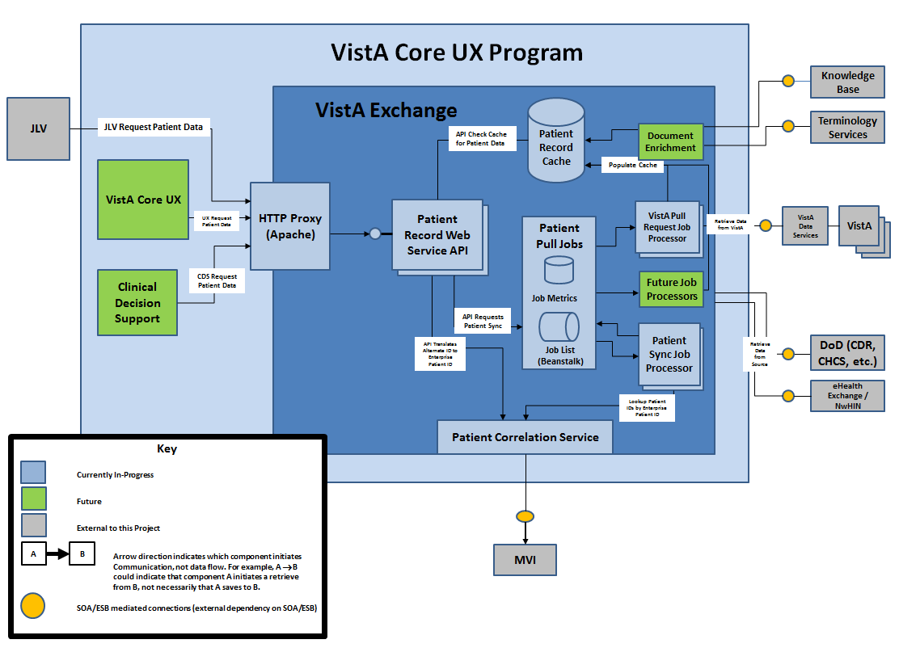
VistA Exchange Overview

Slide 25
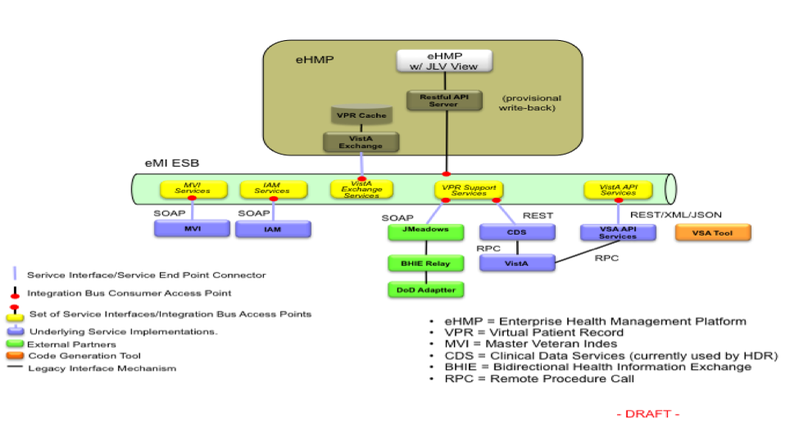

Slide 26
September 2015

Slide 27
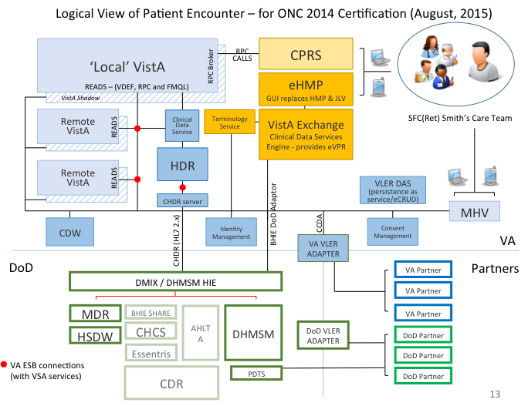

Slide 28
September 2016

Slide 29
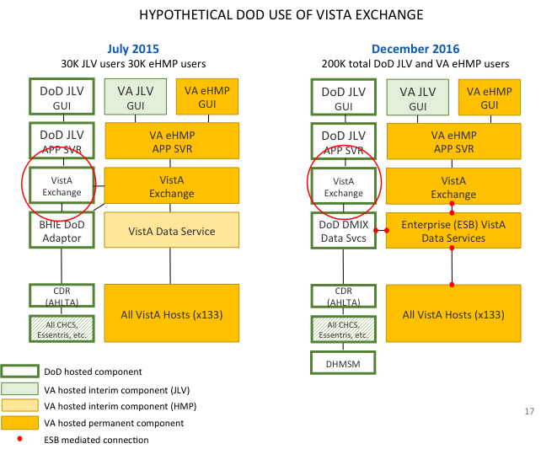

Slide 30
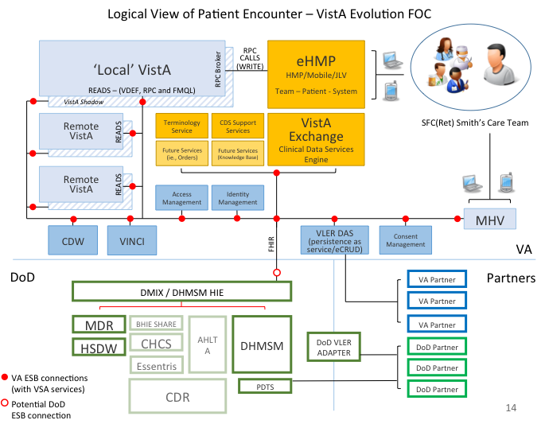
FOC Architecture

Slide 31
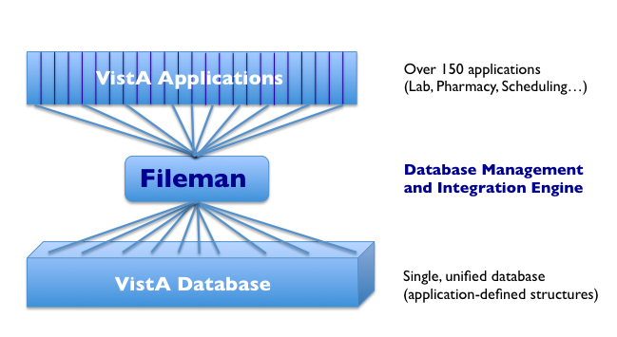
Fileman Modernization
Fileman is the database management system of VistA. It manages the data access, data structures, and data query for all of the (over 150) applications of VistA.
Modernizing Fileman will “standardize” the database of any application, providing an enterprise view of application data.

Slide 32
Fileman Modernization Overview
Fileman modernization is about standardizing and modernizing VistA’s data.
This involves pointing the application-specific structures in any VistA database to common, shared data structures across all VistA databases.
This will enable structured data query and exchange across all VistA instances, creating an enterprise view of VistA data in standardized, computable form.
This is essential for enterprise interoperability

Slide 33
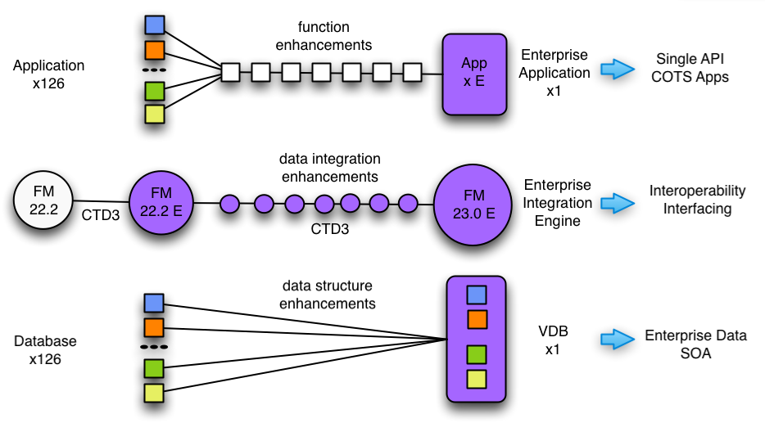
Fileman Modernization

Slide 34
Fileman Modernization
There are three interrelated layers to modernizing VistA’s data which are:
Application (data function)
Fileman (data integration)
Database (data structure)
In this example, 12 VistA systems each has its own unique application-database structure pairs (denoted with corresponding colors).
With Fileman modernization, these diverse data structures converge to a common “virtual” structure (denoted by a common database color).

Slide 35
Fileman Modernization
The foundation phase includes:
convergence on common code and functionality (Fileman 22.2).
establishing a collaborative testing, development, documentation, and deployment (CTD3) framework.
enterprise testing, documentation, and deployment (Fileman 22.2 E).

Slide 36
Fileman Modernization
The ensuing eight phases involve incremental updates to the three layers in parallel:
exposing Application data structures,
teaching Fileman these structures, and
then pointing these to a new standardized enterprise database structures.
The result is a single “virtual” database (VDB) that can concurrently represent (point to) data from all VistA databases as one enterprise database.
This transforms VistA applications into “enterprise applications” with single enterprise interfaces to any other application, service, or commercial system.

