Slide 1
SOA Suite

Slide 2


Overview
Service-Oriented
Architecture
SOA:
Defending the Effort of Healthcare Systems to Illustrate Compliance with the HIPAA Act of 1996 and the HITECH Act of 2010’s Privacy and Security Rules and Regulations
Current customer:
  Department of Veterans Affairs
Challenge:
  Highly-available (99.999%), fault tolerant environment
  Highly capable, supporting 52,000 MPS
  Fully monitoring and auditing of systems and services
  Cost-effective modification of capabilities without significant impact to the enterprise
  Keep deployment costs low for new consumers and services and amortize costs of shared services
  Deploy consumer and producer solutions independent of each other
  Deliver shared enterprise-level services/ capabilities into the VA architecture, across new and legacy systems

Slide 3
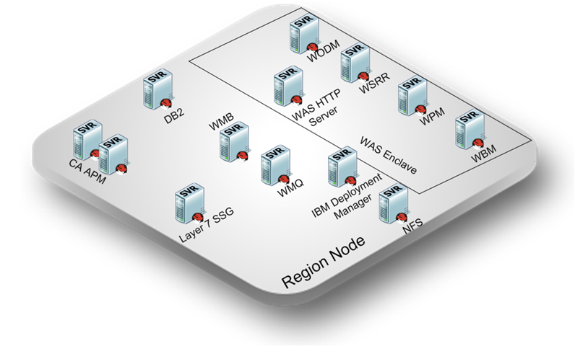
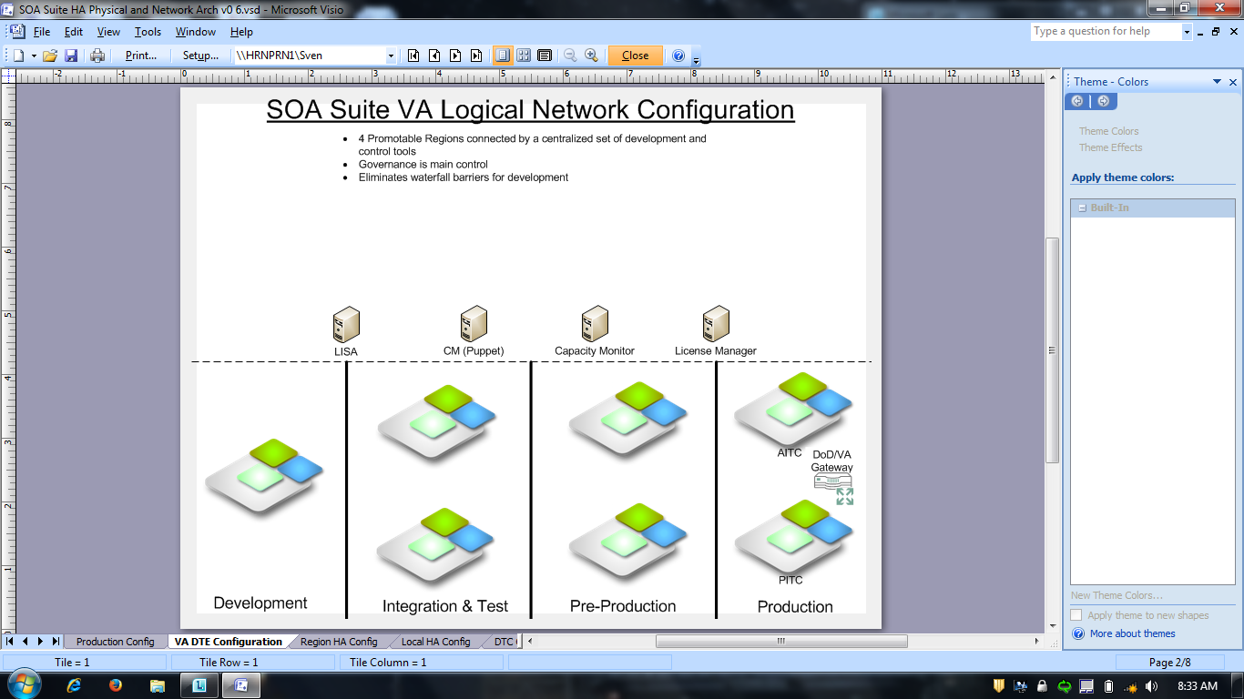
Sandbox
  Design field intended to connect to existing platforms
  Build as you would execute
  Typical Service Build time ~1-2 weeks

Slide 4
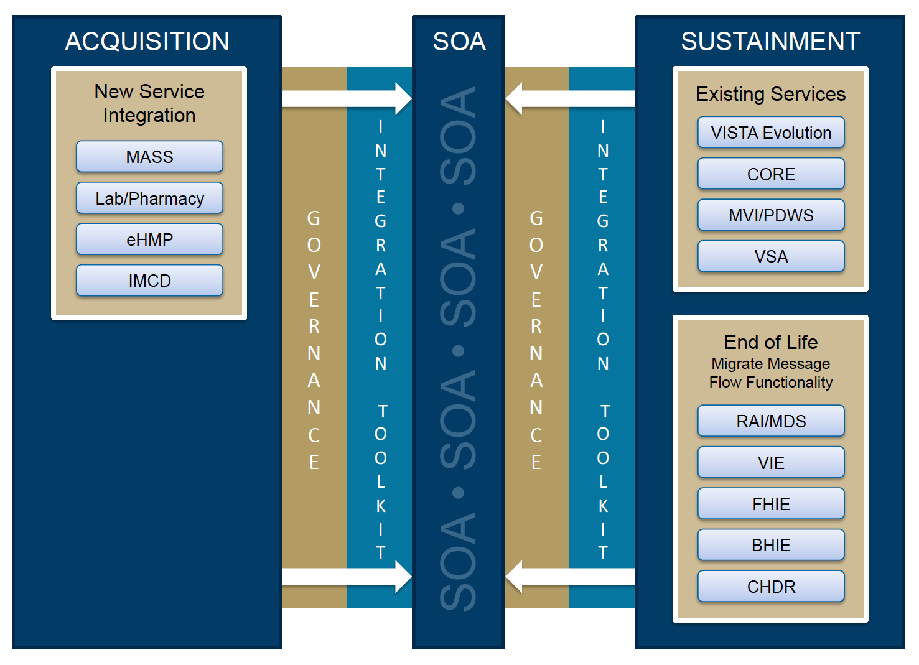
Customers Planned (VA Announced)

Slide 5
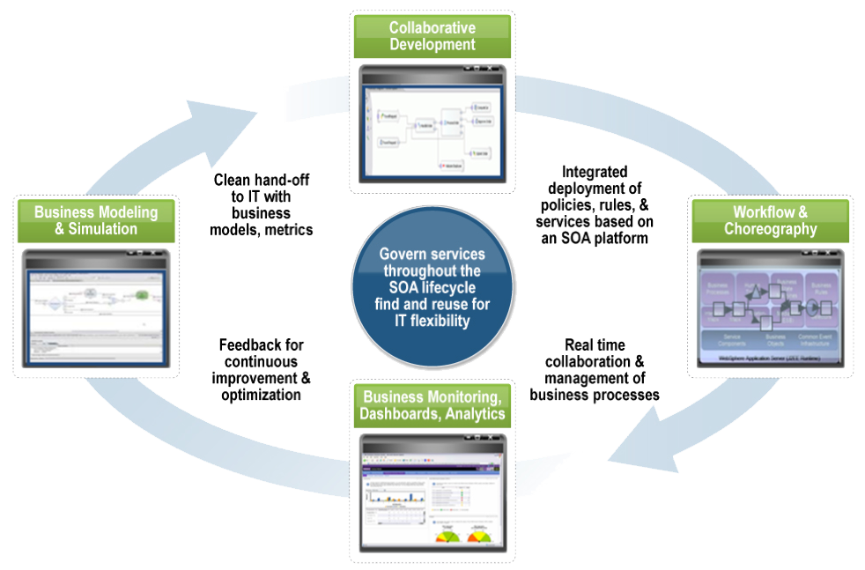
SOA Governance

Slide 6
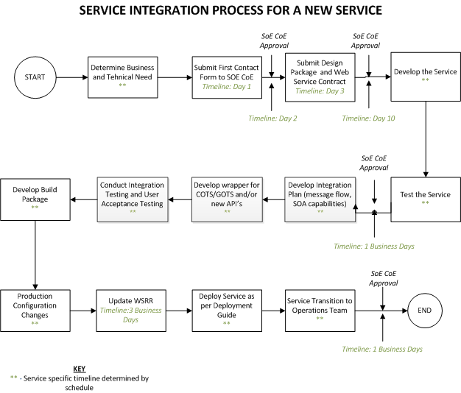
Current SOE COE Governance Steps

Slide 7
Service Inception (VA)
Planning
Pre-acquisition
End User focused
Inception
Quasi-acquisition
Governance driven
Specification
First Development Step
Agile Focused
Capacity Ideation
  All steps align with SOE COE decision processes
  Step align with ProPath models
  Allows for early identification of end-user needs against current service registry
  Utilizes automated promotion via WSRR
Provisioning
First Testing Steps
“Build a little, test a little”
Certification
User needs fulfilled
Meets the Enterprise Standards
Operational
Service is Deployed to Production
Re-use Focused
Capacity Ideation
Deprecation
Planned Retirement
Allows Consumers to Transition Off
Retirement
Service No Longer Supported
End of Investment
Any service in Red or Blue stages can be “Rejected” at any time

