Slide 1
ACC Registry Programs in the Current Healthcare Environment
James E. Tcheng, MD
Duke University Health System
Michael Simanowith, MD
Carolina Nadel, MD
Kathleen Hewitt, MSN, RN, AACC
American College of Cardiology

Slide 2
The Intersection of Clinical Information, Informatics, Health IT and Registries
Aspiration – the promise
Practical – concepts to action (& NCDR successes)
Technical … and then the magic happens …

Slide 3
Everyone wants data
Federal government
Consumer websites
Insurance Providers
Independent groups
State government

Slide 4
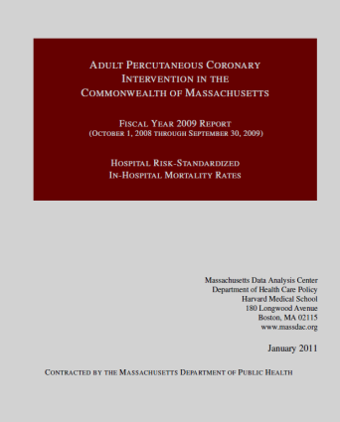
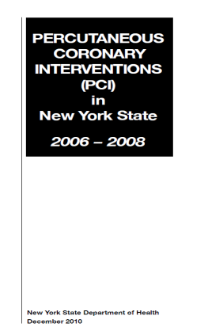


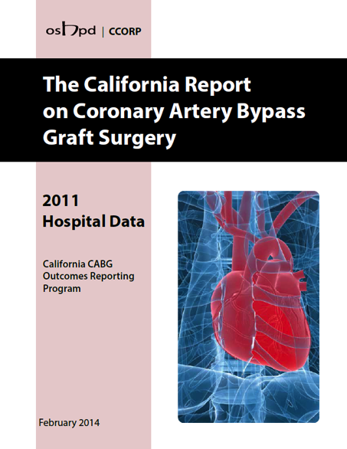
State Agencies –
MA, NY, PA, CA, TX, . .

Slide 5
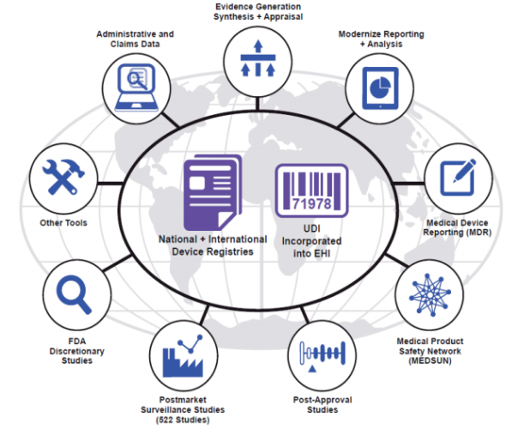

Strengthening Our National System
for Medical Devices (FDA)

Slide 6
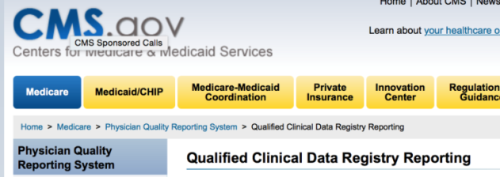
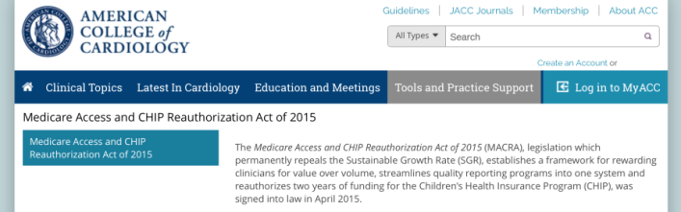
QCDR and MACRA (CMS)

Slide 7

JACC December 2015
“Involvement in the NCDR such as PINNACLE allows clinicians to submit Physician Quality Reporting System to CMS. Additional NCDR-related practice improvement programs are being developed to leverage NCDR registries to make it easier for the 21,881 unique providers to successfully engage MACRA.”

Slide 8
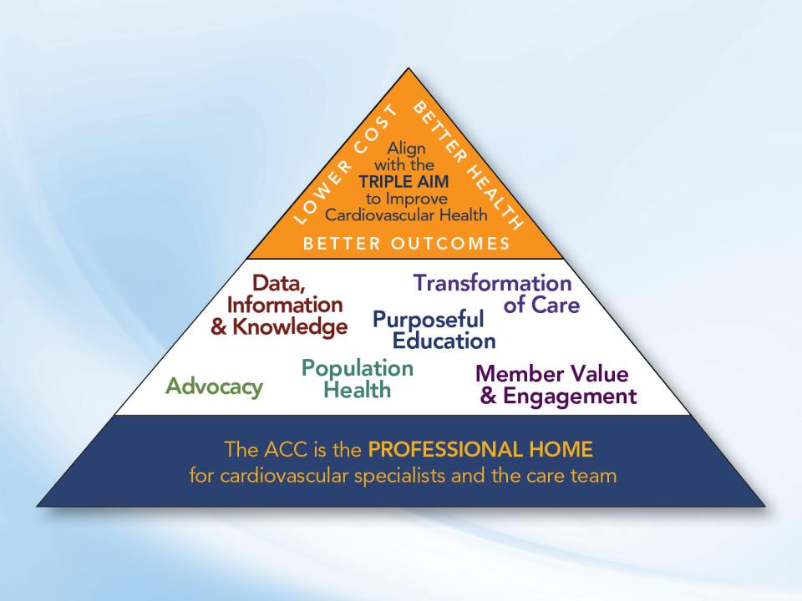
NCDR
NCDR
NCDR

Slide 9

National Cardiovascular Data Registry
Nearly 20 years of experience
Largest outcomes-based cardiovascular patient data repository in the world
Ten registries

Slide 10

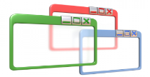

Data are collected once and used for many purposes
Leveraging Agents
Administrators
Providers
Regulators
Consumers
Researchers
Payors
Evidence-Based Performance Measures
Data Quality Program
DATA USES
Reimbursement
Retro- and Prospective Research
Evidence based medicine
Surveillance
Quality and performance improvemnt
Public reporting
State and federal reporting
System & practice monitoring
Software Vendors
Data Capture

Slide 11
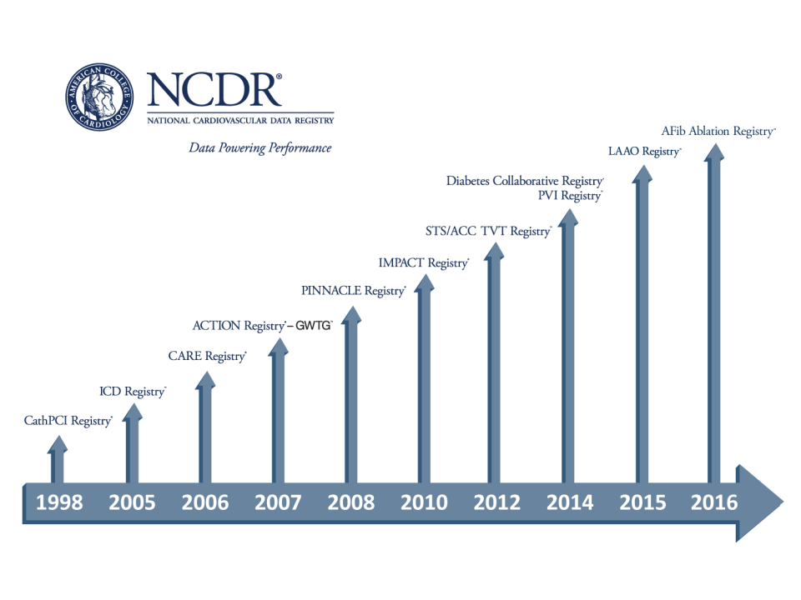
>2,500 hospitals
>5,700 cardiologists
>40 million clinical records

Slide 12
Name | Disease or Device | Facility | Sites (or Providers) | Records 7/1/16
PINNACLE | Coronary artery disease, heart failure, atrial fibrillation, hypertension, diabetes, peripheral arterial disease | Outpatient | 6,876 providers | 36,000,000
Diabetes | Diabetes and cardiometabolic care | Outpatient | 4,182 providers | 1,000,000
CathPCI | Percutaneous coronary interventions Diagnostic catheterizations | Hospital/Free Standing | 1,771 | 20,000,000
ICD | Implantable cardioverter defibrillators | Hospital | 1,848 | 2,000,000
ACTION-GWTG | Acute coronary syndrome STEMI and NSTEMI | Hospital/EMS | 1,076 | 1,200,000
PVI | Carotid artery revascularization Lower extremity | Hospital/Free Standing | 229 | 350,000
IMPACT | Congenital heart disease Pediatric and Adult | Hospital | 103 | 70,000
STS/ACC TVT | Transcatheter Valve Therapy | Hospital | 462 | 75,000
LAAO | Left atrial appendage occlusion procedures | Hospital | 159 | NA
AF Ablation | AF ablation procedures | Hospital | 41 | NA

Slide 13
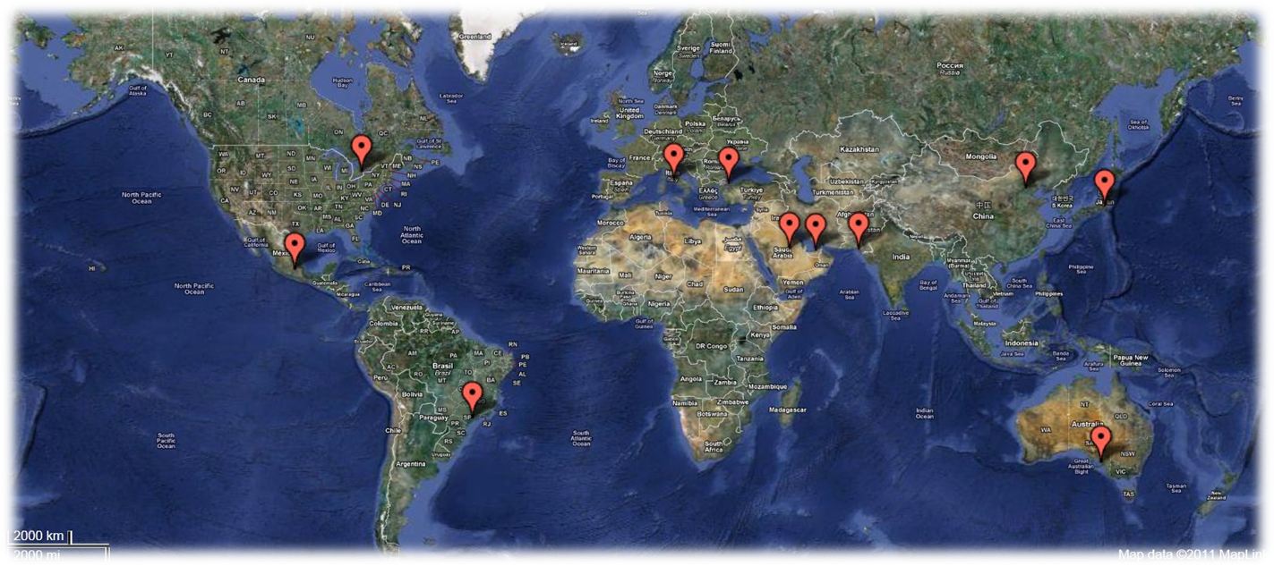
NCDR Global

Slide 14
EDW
XML
ETL
ETL
XML
And New Databases….
Enterprise Data Warehouse
Registry | Tables | Columns
Shared | 186 | 2393
ACTION | 33 | 507
CathPCI | 34 | 484
ICD | 53 | 651
IMPACT | 65 | 914
LAAO | 58 | 800
PINNACLE | 15 | 376
PVI | 73 | 1237
TVT | 102 | 1414
Grand | 619 | 8776
600+ Tables
8500+ Columns!!!!

Slide 15
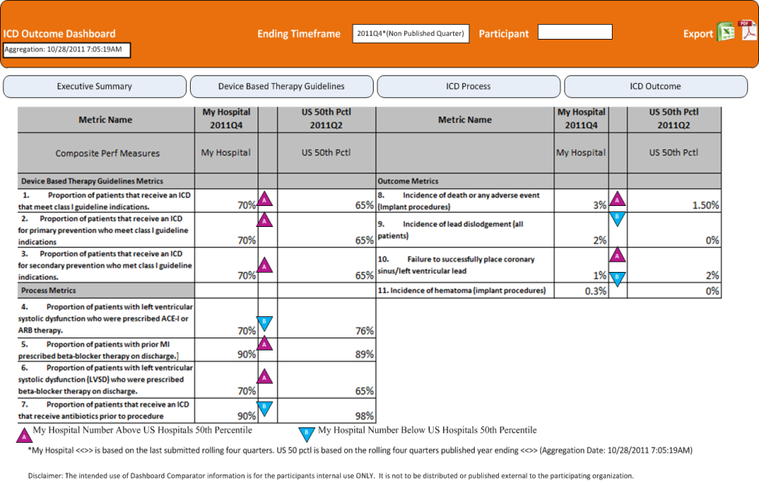
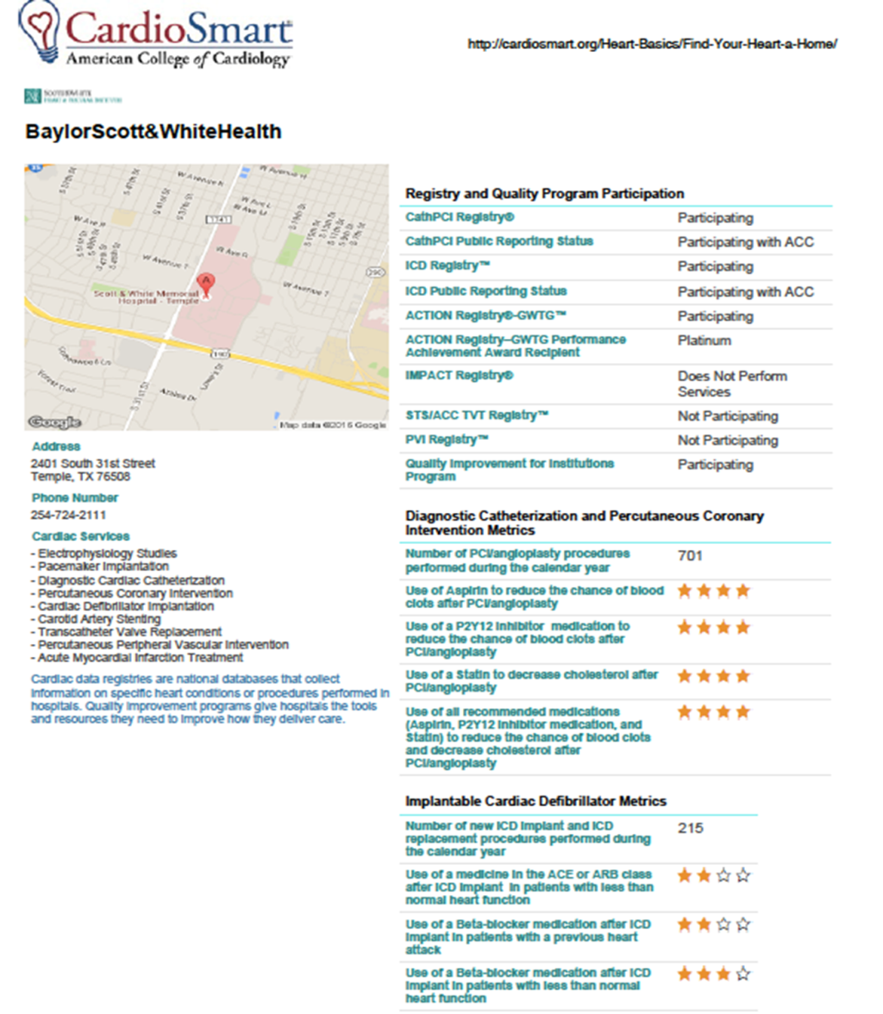

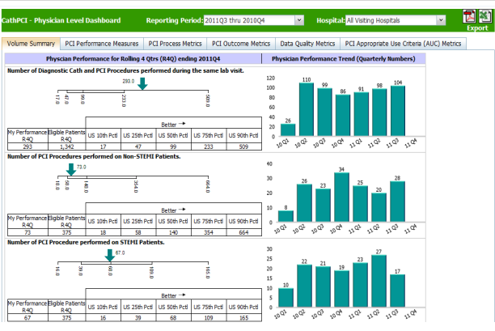
And data used/reported in new ways
… that move closer to point of care and decision support for both Clinician and Patient
NCDR Site-level Dashboards
Public Reporting
Physician Dashboards

Slide 16
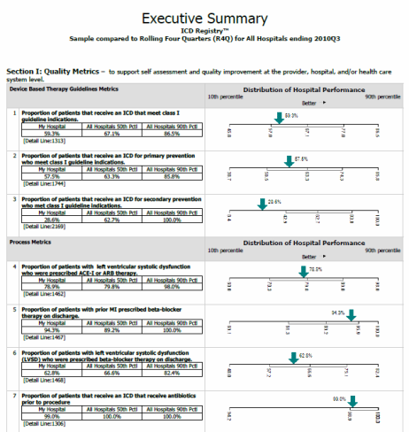
Dashboard
National benchmarks
Risk-adjusted
Comparisons
Drill Downs

Slide 17
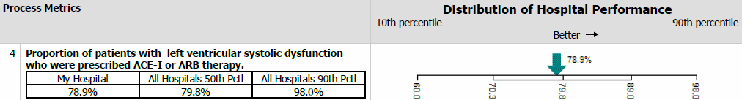
Benchmarking Facilitates QI
A hospital can see where it stands…
… with respect to a national average…
… and against top performers
Sample excerpt from NCDR ICD quarterly outcomes report

Slide 18

CathPCI Physician Dashboard
Metrics include:
Volumes
Vascular complications
Door to balloon time
Appropriateness of PCI
Hospital metrics reported at the physician level
Secure & confidential access via ACC.org login
  Click “My ACC”
  Click “NCDR Physician Dashboard”
Use for:
  Awareness
  Quality improvement
  ABIM MOC part IV

Slide 19

Physician Dashboard View

Slide 20

Data Quality Program
Pre data Capture
Data Submission
Post data Submission
Training
Software Certification
Clinical Support
Data Quality Report
Data Outlier Program
National Audit Program
State / Regional Audit Program
Self Audit Program
Adjudication
Publications
March 30-April 1, 2016 in Chicago, IL

Slide 21
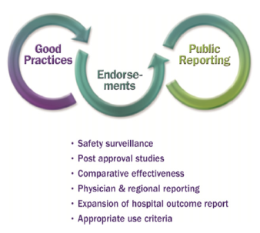
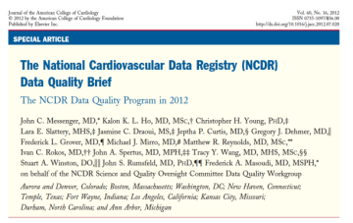
Registry Data Quality
JACC 2012;60:1484-88.
Notes:
Cite recent article comparing vascular complications via NCDR with those of in house QI database (Blankenship @ Geisinger) NCDR stops at DC so misses later events like pseudoaneurysm

Slide 22
National Audit Program
Methodology
  Prior year data
  Subset of data elements
  Random and targeted site selection
  Remote and onsite review
  Blinded data abstraction from medical charts
  Inter-rater reliability assessment
  Adjudication
Scope
  6 onsite review (Targeted) + 267 remote reviews
  2,850 records
  Review hospital medical records
  Assessment of submission completeness
Data
Submitted
Audit
Data
Independent Auditor
Adjudication
Confidential Site Reports
Educational Module
Overall Report
Notes:
Methodology
Review of data submitted the previous year
Review of a subset of data elements (rotating each year)
Remote and onsite review
Hybrid of Random and targeted selection of sites (
Stratified selections for records
Blinded data abstraction from medical charts
Inter-rater Reliability Assessment
Adjudication Phase
Criteria for selecting sites/records
Remote audit :
Sites passing their quarterly DQR for 2 quarters within audited year
Sites submitting at least the number of records/sites being reviewed
Onsite audit:
Sites identified with an outlier and not contacted with the data outlier program

Slide 23



Where Are We Really??
1990s-2000
2000-2010
2010-Now

Slide 24
Enabling Direct HIT Integration
Goals & Objectives
Overarching Goal:
Registry participation to be more about performance and outcome measurement and not about data collection
Improve time-to-market for new evidence-based data capture needs
Capture data once – REALLY!
Save time and $$$

Slide 25



Say goodbye to “fat finger” data collection
Hello “data capture”
STAKEHOLDERS
Administrators
Providers
Regulators
Consumers
Researchers
Payors
Registry Platform:
Evidence-Based Performance Measures
QI Network
Data Quality Program
Retrospective and Prospective Research Infrastructure
Public Reporting
DATA USES
Reimbursement
Retro and Prospective Research
Evidence based medicine
Surveillance
Health system & practice monitoring
Quality and performance improvement
Public reporting for consumers
State and federal reporting
Data Entry

Slide 26

STAKEHOLDERS
Administrators
Providers
Regulators
Consumers
Researchers
Payors
Health Info Exchange
Registry Platform:
Evidence-Based Performance Measures
QI Network
Data Quality Program
Retrospective and Prospective Research Infrastructure
Public Reporting
DATA USES
Patient Reported Outcomes
Reimbursement
Retro and Prospective Research
Evidence based medicine
Surveillance
Health system & practice monitoring
Quality and performance improvement
Public reporting for consumers
State and federal reporting
Remote Devices
Labs
Cost

Slide 27







NCDR In-Patient Data Intake
1998
Snail Mail
2005
Internet Submissions
(Proprietary .xml)
Software Vendors
ACC certification
ACC certification
“Non-standardized”
NCDR
Hospitals using home grown systems
Hospitals using software vendors
Hospitals using ACC’s web tool

Slide 28





NCDR Out-Patient Data Intake
System Integration Process
Data are natively
collected in
your EHR
SI software installed on
server, data mapped to
PINNACLE Registry elements
Data extracted and
sent to the ACC for
report generation

Slide 29
Data Model
Common In-Hospital
Events
CAS
Medications
ICD
Labs
H & P
AFib
PVI
Patient
TVT
IMPACT
(structural)
DxCath
PCI
ACS/MI

Slide 30
Clinician Documentation 2016
Mired in ancient paradigms
  Authoring of novella encouraged (starts in med school)
  Play by play description – fear of malpractice
  Demonstration of physician prowess
  Justification of actions
75% is garbage – E&M coding requirements, EHR MU
  Fosters cut and paste
Team-based documentation actively discouraged
  By regulation
  By job description
  By HIT (built to enhance the ancient paradigms)

Slide 31
Clinician Desired State
Best approach for the task – defined by usability, efficiency and effectiveness – not regulation!
  Meld technical approach to best-practice workflow – even if this means disruptive change
  Consistency at the task level (e.g., procedure reporting), rather than the system level (e.g., EHR) – one size does NOT fit all
Capture information as data – but only where “data” are actually useful (e.g., conveying clinical / administrative info, risk calculation / stratification, predictive modeling)
Procedures a “natural” for the process of structured reporting
  For device implants, this is where it all starts

Slide 32
What is Structured Reporting?
Data management integrated into workflow
Data acquisition by those closest to (handling) the data → also improves data quality
Multiple authors contribute to documents
Reduced MD time to report completion, MD focuses on cognitive activities
Improved clinical communication with care team, physicians, patients
Paradigm: collect once, use many times (e.g., clinical report, PI analysis, data to registries, distributed analysis → device surveillance)

Slide 33
What is Needed for SR?
Vocabulary & data interoperability standards
  CLINICAL CDEs to registries to SDO
Best-practice workflows (industrial engineering)
  From cath order through data use
New professionalism standards for clinicians
  Conversion from dictation to structured data model
  Expected content and format
    Procedure documentation (technical / procedure log)
    Physician report (structured report)
IT systems (vendors)
  Information model, systems aligned with clinical model

Slide 34
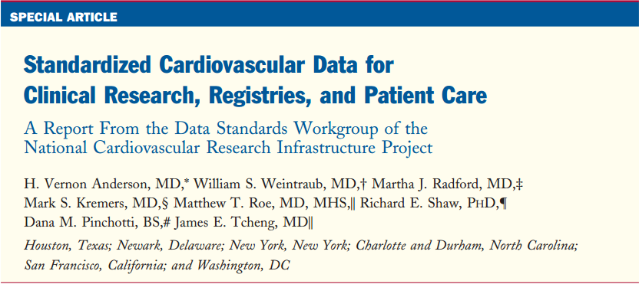
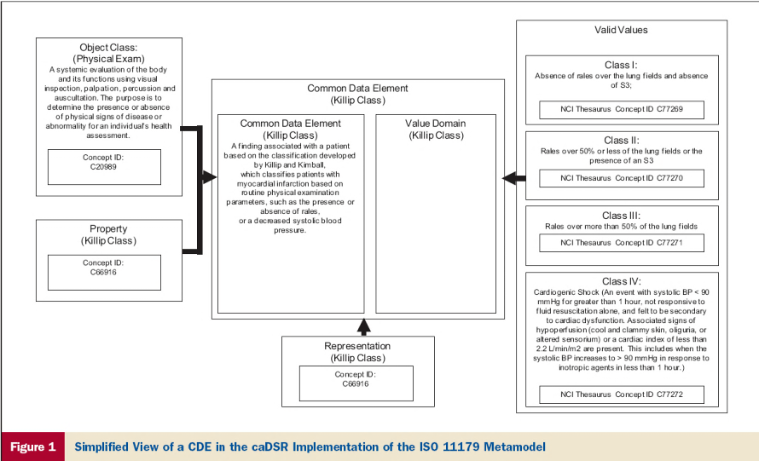
CV vocabularies – NCRI
Balloted via HL7 CIC
Available on NCI-EVS (caDSR)
J Am Coll Cardiology 2013;61: 1835

Slide 35
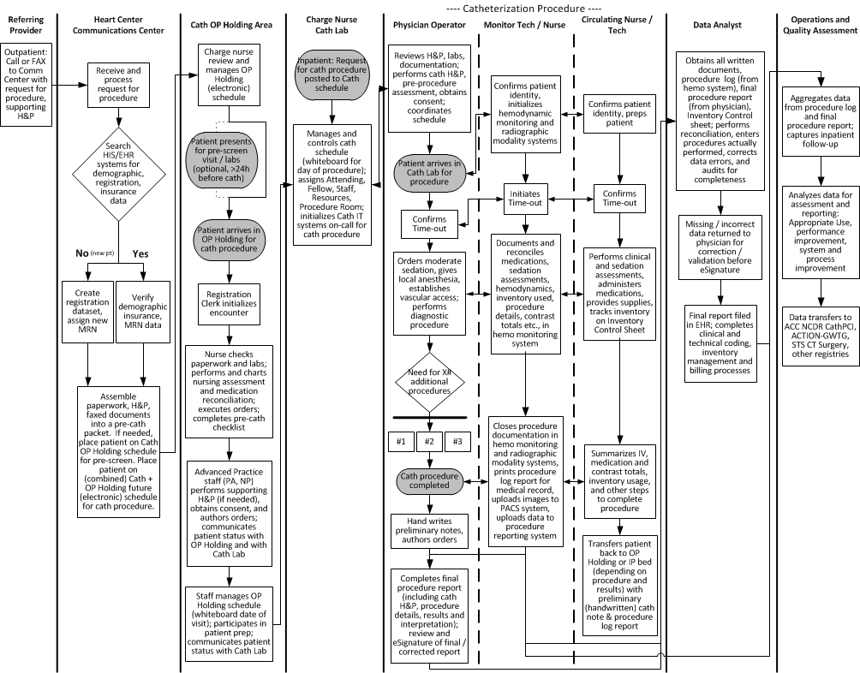

Slide 36
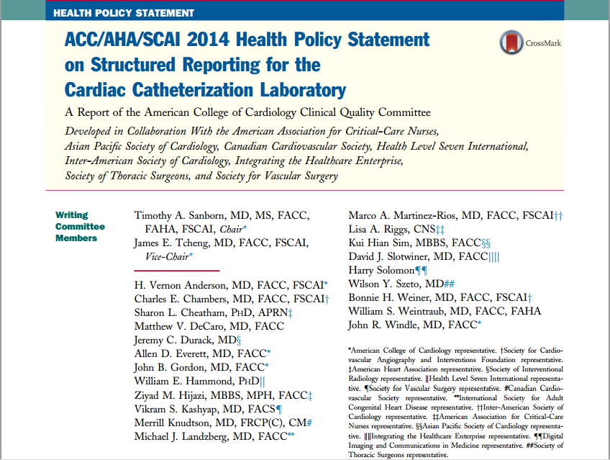

Slide 37
Procedure Reports
Pre-Procedure
Who
  Ordering physician
  Pre-procedure evaluation by care team
What information
  Patient demographics, requested procedure, scheduling logistics, procedure indications, clinical history
What information as data
  Demographics, ICD-9 indications, structured history
Output
  Structured H&P (data for risk modeling, quality measurement, and registry submission)
Notes:
37
This is the Bulleted List slide.
To create this particular slide, click the NEW SLIDE button on your toolbar and choose the BULLETED LIST format. (Top row, second from left)
The Sub-Heading and footnote will not appear when you insert a new slide. If you need either one, copy and paste it from the sample slide.
If you choose not to use a Sub-Heading, let us know when you hand in your presentation for clean-up and we’ll adjust where the bullets begin on your master page.
Also, be sure to insert the presentation title onto the BULLETED LIST MASTER as follows:
Choose View / Master / Slide Master from your menu.
Select the text at the bottom of the slide and type in a short version of your presentation title.
Click the SLIDE VIEW button in the lower left hand part of your screen to return to the slide show. (Small white rectangle)

Slide 38
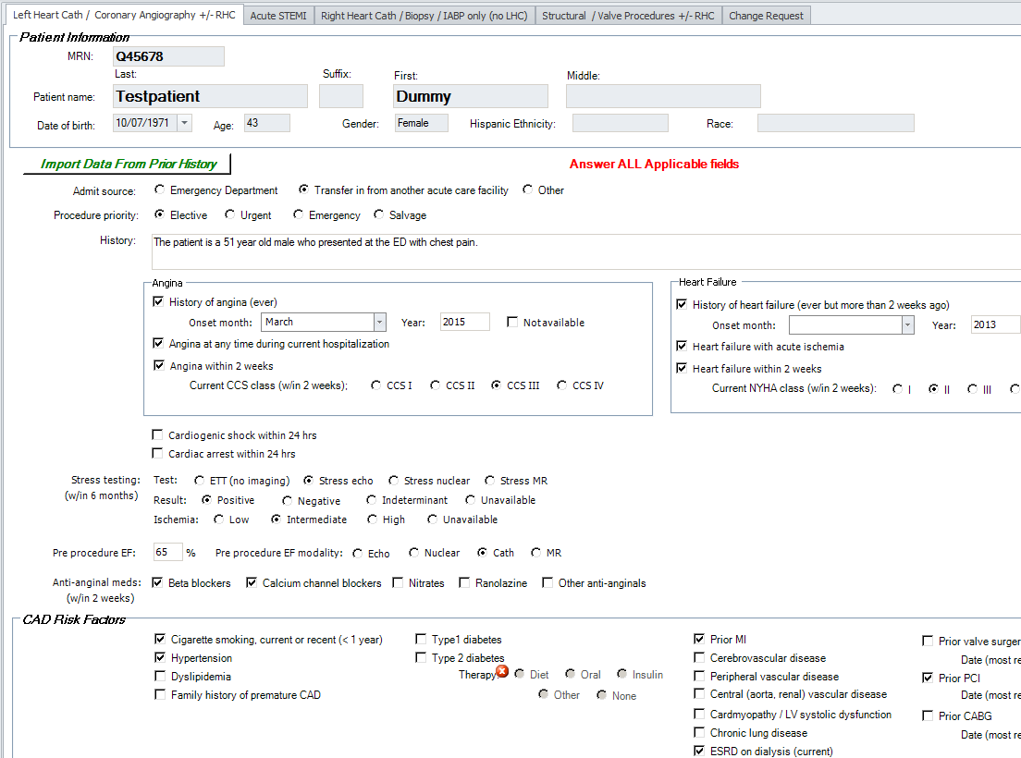

Slide 39
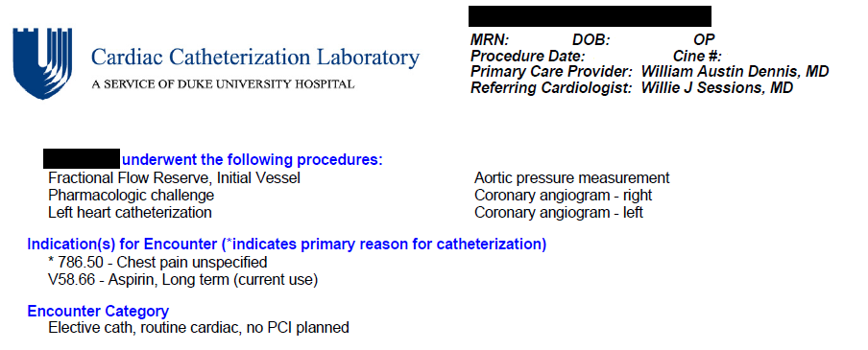
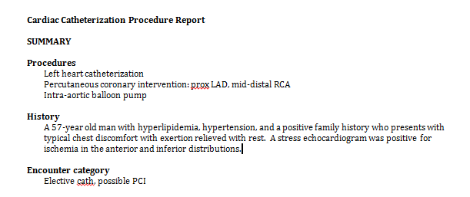
Procedure Reports
The Front Page – The Summary
Notes:
39
This is the Bulleted List slide.
To create this particular slide, click the NEW SLIDE button on your toolbar and choose the BULLETED LIST format. (Top row, second from left)
The Sub-Heading and footnote will not appear when you insert a new slide. If you need either one, copy and paste it from the sample slide.
If you choose not to use a Sub-Heading, let us know when you hand in your presentation for clean-up and we’ll adjust where the bullets begin on your master page.
Also, be sure to insert the presentation title onto the BULLETED LIST MASTER as follows:
Choose View / Master / Slide Master from your menu.
Select the text at the bottom of the slide and type in a short version of your presentation title.
Click the SLIDE VIEW button in the lower left hand part of your screen to return to the slide show. (Small white rectangle)

Slide 40
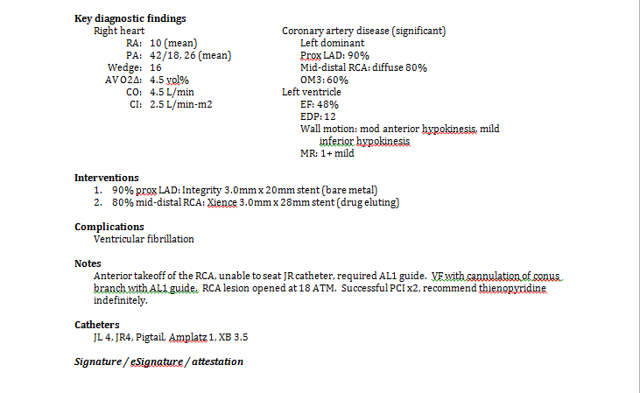
Data input via tree
Data by staff, from hemo system
Limited text

Slide 41
Procedure Reports
Pages 3+ – Everything Else
Patient demographics
Healthcare facility information
Operators, staff
Referring care provider information
History and physical (categorical) data
Previous procedures
High risk allergies (e.g., contrast)
Laboratory data
ICD diagnoses
AUC indications
Procedures performed
Logistics (e.g., time in, time out)
Baseline data (e.g. height, weight, eGFR)
Vascular access details
Hemodynamic support
… and the rest of the details …
Notes:
41
This is the Bulleted List slide.
To create this particular slide, click the NEW SLIDE button on your toolbar and choose the BULLETED LIST format. (Top row, second from left)
The Sub-Heading and footnote will not appear when you insert a new slide. If you need either one, copy and paste it from the sample slide.
If you choose not to use a Sub-Heading, let us know when you hand in your presentation for clean-up and we’ll adjust where the bullets begin on your master page.
Also, be sure to insert the presentation title onto the BULLETED LIST MASTER as follows:
Choose View / Master / Slide Master from your menu.
Select the text at the bottom of the slide and type in a short version of your presentation title.
Click the SLIDE VIEW button in the lower left hand part of your screen to return to the slide show. (Small white rectangle)

Slide 42

Journey to EHR Integration

Slide 43

43
CathPCI
ICD
ACTION
IMPACT

Slide 44
Strategic Objectives
CathPCI
PVI
ACTION
Unified Model
Harmonize existing registry dictionaries into a single agnostic specification
Utilize a single data transmission format
Adopt (and steward) standard terminologies and coding systems
Incorporate within EHR certification
Registry participation should be about measurement and quality improvement - NOT about data collection
Capture data once – Use often – REALLY!
Minimize labor and technology costs
Reduce analysis latency while maintaining/improving accuracy
Why?…
HL7
ICD 9
RXNorm
SNOMED
LOINC

Slide 45
Expected Benefits
Minimize labor and technology costs associated with development of additional registries
Reduce data collection burdens while expanding information content and shrinking latency
Minimize inconsistencies across registries
Better integrate with healthcare systems and products that support standards
One step closer to EHR integration

Slide 46
Potential Challenges
Optimized for machine data extraction and not web data entry
Maintaining compatibility with legacy registry versions
Completely new implementation by vendors
Data standard maintenance and stewardship
Data quality

Slide 47

The grass isn’t always greener
Data quality will rely on standardized clinical documentation
“Bottom up” clinical / quality metrics-based standards
New documentation and professionalism standards for clinicians

Slide 48

The interconnected future of NCDR depends on standards (and resources, and governance, and informatics, and vendors, and …)
Notes:
Judge Harry Pregerson Interchange

Slide 49


