Slide 1
Advancing Registries Through Common Data Elements
Julia Skapik, MD, MPH
July 25, 2016

Slide 2
Technical Debrief– CDEs: What is a CDE?
Common Data Element (CDE):
“Clinical concepts that contain standardized and structured metadata, have unambiguous intent, and clearly delineated value domains. These CDEs, such as “systolic blood pressure,” would define a curated, universal specification for each clinical or administrative concept, optimizing the data to be reused across the QI ecosystem”
“A data element that is common to multiple data sets across different studies. Commonality may be intentional or unintentional; this portal places an emphases on the intentional use of CDEs to improve data quality and promote data sharing”
“is a question or unit of data collection that is presented uniformly across one or more applications and which has value across multiple settings or contexts. A common ISO definition of data element is use which includes the name of the data element, the values, and the definitions.”
“named definition for a single piece of data”
“are standardized terms for the collection and exchange of data. CDEs are metadata; they describe the type of data being collected, not the data itself.”

Slide 3
Where do we find separately defined CDEs?
Some Current Definitions:
Meaningful Use (MU) Common Clinical Data Set
Patient Centered Outcomes Research (PCOR)
Structured Data Capture (SDC)
FHIR Core
PCOR Clinical Decision Support (CDS) under AHRQ
IMPACT (Improving Medicare Post-Acute Care Transformation) Act of 2014

Slide 4
What are the drawbacks of current approaches? Current State
EHR2 DATA ELEMENT
CQM DATA ELEMENT
REGISTRYDATA ELEMENT
CLINICAL RESEARCHDATA ELEMENT
AGENCY DATA ELEMENT
CDS DATA ELEMENT
EHR1 DATA ELEMENT

Slide 5
Potential Paths Forward: Harmonizing Data Elements for Multiple Use Cases
Gender [HL7 v3.0] 72143-1(LN)
Data Element
Gender [HL7 v3.0]
72143-1(LN)
Data Element Concept
Person
125676002 (SCT)
Object Class
Gender 263495000 (SCT)
Property
Gender Code
Value Domain (E)
Administrative Gender (HL7 V3)
Value Set
M (Male)
Permissible Values
F (Female)
Permissible Values
UN (Undifferentiated)
Permissible Values
Male
248153007 (SCT)
Value Meaning
Female
248152002 (SCT)
Value Meaning
Undifferentiated
184115007 (SCT)
Value Meaning
Research CDEs = have up to all CDE Elements
EHR CDEs = the minimum required CDE Elements (purple outline)
Notes:
Graphic Obtained From: SDC CDE examples (ISO 11179 -3); Mark Roche, MD October 6, 2014

Slide 6
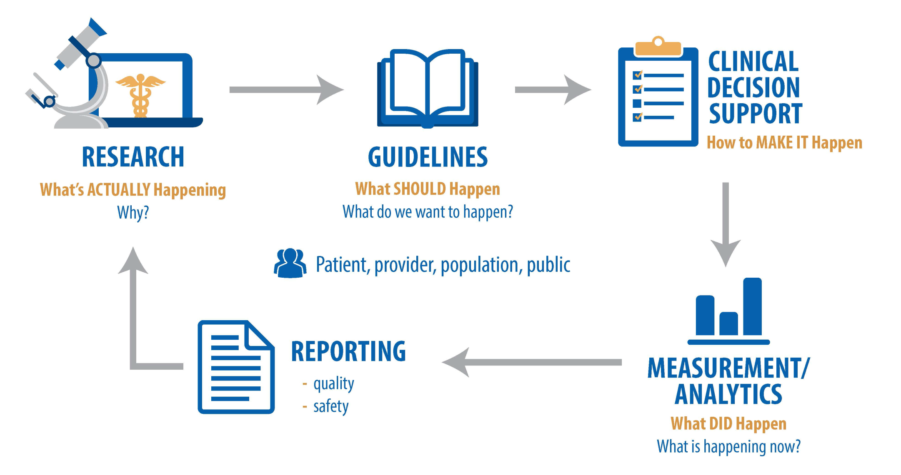
True Common Data Elements:
Like Registries, Provide Unification
EHR Based CDEs
Registries/CDEs
Research CDEs
eCQMs
Agency/ Org CDEs
Notes:
Graphic Obtained from: Health IT Enabled Quality Improvement- A vision to Achieve Better Health and Health Care

Slide 7
Future Vision
CLINICAL RESEARCH
REGISTRY
CQM
COMMON DATA ELEMENTS
EHR2
AGENCY
EHR1
CDS

