Slide 1
VHA Registry Perspectives and Strategies
Jonathan R. Nebeker MS MD
Deputy CMIO, VHA

Slide 2
VA Perspective
Mandated & High Priority Registries
Dialysis
Embedded Fragment
Amputee
Hearing
Transplant
Multiple Sclerosis
Airborne Hazards
Open Burn Pit
Oncology
Brain Injury
Clinical Case
Many other internal and external registries
Issues
Because of inflexibility of EHR GUI and database, VA uses multiple stand-alone new and antiquated solutions.
Most data collection and analysis is completely separate from clinical workflows.
Notable exception is CART-CL
Information representation is all over the place, including codified data that uses national standards
(Re)creating separate tech and data models for many registries

Slide 3
Healthcare System Perspective
Need to simplify workflows and IT
Focus on quality of system and health of individual not on “registry for that”
Conceptual simplicity: Registries = Cohort management
Cohort defined for purpose
Supports analysis and intervention
Supports individual and population health management
Allows separation of some data from legally discoverable record and clinical workflows
Technical simplicity
Minimize technical platforms and data interchanges

Slide 4
VA Strategies
Workflow
No double data collection
Support analytical workflows
More than dashboards’ roll up and drill down
Understand what is happening to cohort and why
Support clinical workflows
Provide decision support products from registry data to clinical workflow.
Move seamlessly to intervene in cohort or individual member

Slide 5
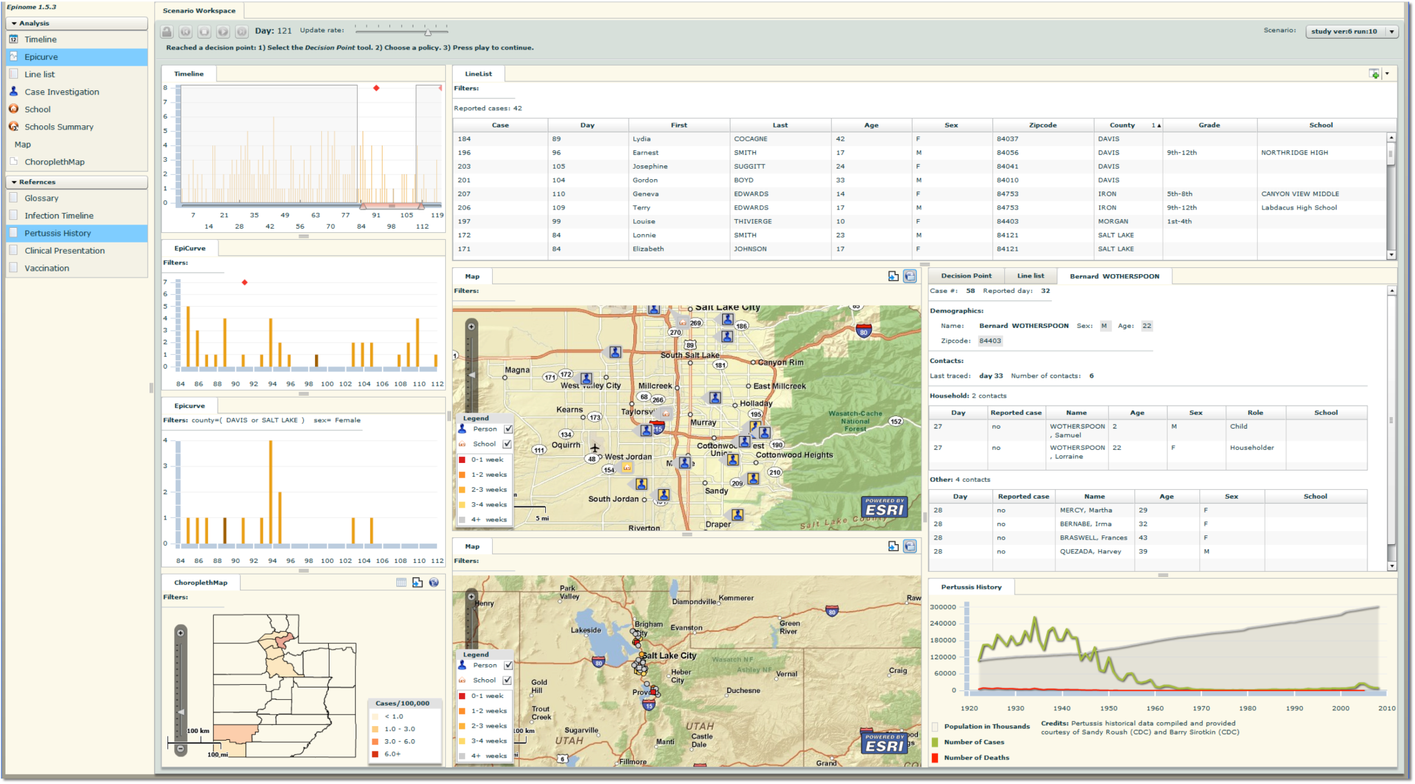
Beyond Dashboards to Analytical and Intervention Workflows

Slide 6
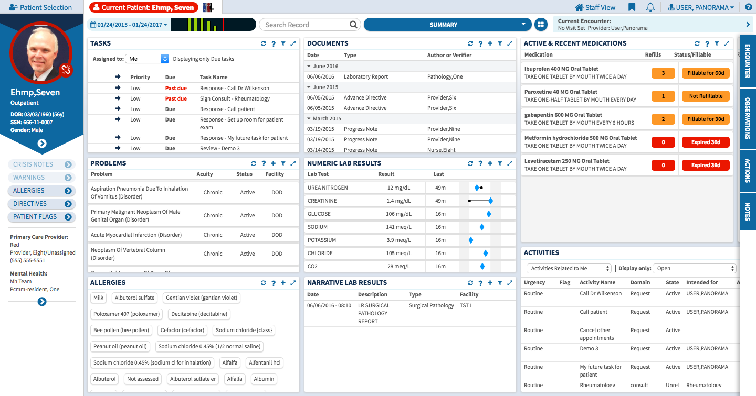
eHMP
GUI
eHMP
Applications
Pt view
Pop view
VistA
EHR 2
Regtry

Slide 7
VA Strategies that HSPC will help with
Workflow
No double data collection
Support analytical workflows
Support clinical workflows
Data integrity and interoperability
Master Data Management: Appropriate data is same for clinical and registry functions
Standards must provide high level of semantic integrity to allow reuse
General solution agnostic to EHR or registry
Support transition to new EHR (not focus of today) via eHMP an HSP
Data exchange
Document-based exchange is cumbersome, gets into “document for that”
Need more modern web-based exchange. Looking to HSPC for practical standards

