Slide 1
HSPC Relationships to other Organizations and Activities
August 21, 2014
Stanley M. Huff, MD
Chief Medical Informatics officer
Intermountain Healthcare

Slide 2
Agenda
HSPC and SMART
HSPC and Center for Medical Interoperability
HSPC and CIMI
HSPC and openEHR
HSPC and Isaac and SOLOR (Keith Campbell)
HSPC and DoD (Stephen Hufnagel)
HSPC and S&I Framework Projects

Slide 3
Context and Disclaimer
This is just my (Stan Huff’s) current best thoughts on how the different initiatives fit together
Everything is open for discussion and correction
This presentation is biased toward modeling topics (because that is where I live!)

Slide 4
HSPC and SMART

Slide 5
HSPC and SMART
Entirely different groups
  No plans to merge
  Hold separate meetings
Highly aligned goals and values: open, standards based services
Mutual respect
  Invite and encourage participation in each other’s meetings
HSPC has decided to use SMART technology as the initial strategy for integration of applications into EHRs
The success of SMART is in the best interests of HSPC

Slide 6
HSPC and Center for Medical Interoperability

Slide 7
HSPC and C4MI
To be determined!
Goals of the two organizations are perfectly aligned
Possible C4MI activities
  Certifier of apps and services
  Builder and keeper of reference implementations
  Provide the vendor independent “healthcare app store”
  Public relations and promotion of HSPC as a solution
  Creation and distribution of “How to” articles and implementation guides

Slide 8
HSPC and CIMI

Slide 9
The CIMI View of the World
9

Slide 10
Current Process
Standard
Terminologies
FHIR
Resources
Translator
(or manual)
HSPC approved
HL7 FHIR
Profiles
Intermountain
CEMs

Slide 11
Future Process
Standard
Terminologies
HL7 FHIR
Resources
Translator
(or manual)
HSPC approved
HL7 FHIR
Profiles
CIMI
Models
Intermountain
CEMs
openEHR
Archetypes

Slide 12
Even more Future Process
Standard
Terminologies
HL7 FHIR
Resources
Translator
(or manual)
HSPC approved
HL7 FHIR
Profiles
CIMI
Models

Slide 13
HSPC and openEHR

Slide 14
Possible openEHR Strategy 1
Standard
Terminologies
HL7 FHIR
Resources
Translator
(or manual)
HSPC approved
HL7 FHIR
Profiles
CIMI
Models
openEHR
Archetypes

Slide 15
Possible openEHR Strategy 2
Standard
Terminologies
HL7 FHIR
Resources
Translator
(or manual)
HSPC approved
HL7 FHIR
Profiles
openEHR
Archetypes

Slide 16
HSPC, Isaac, and SOLOR

Slide 17
Possible Isaac/SOLOR Strategy 1
HL7 FHIR
Resources
Translator
(or manual)
HSPC approved
HL7 FHIR
Profiles
CIMI
Models
Isaac
(LEGOS)
SOLOR

Slide 18
Possible Isaac/SOLOR Strategy 2
HL7 FHIR
Resources
Translator
(or manual)
HSPC approved
HL7 FHIR
Profiles
SOLOR
Isaac
(LEGOS)

Slide 19
HSPC and DoD

Slide 20
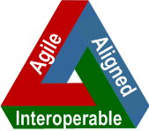

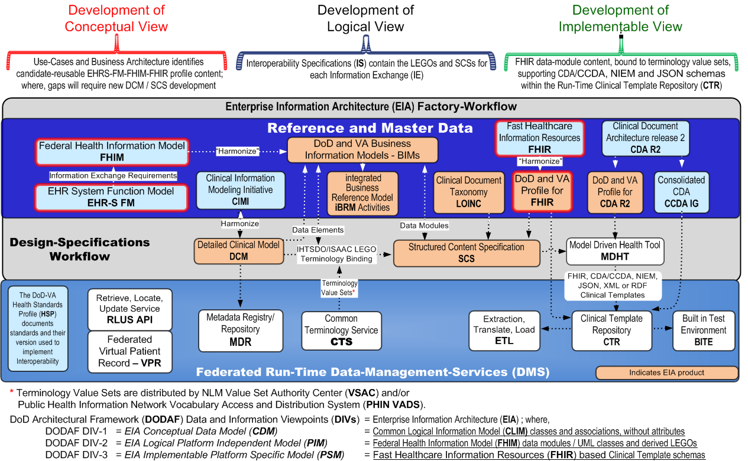
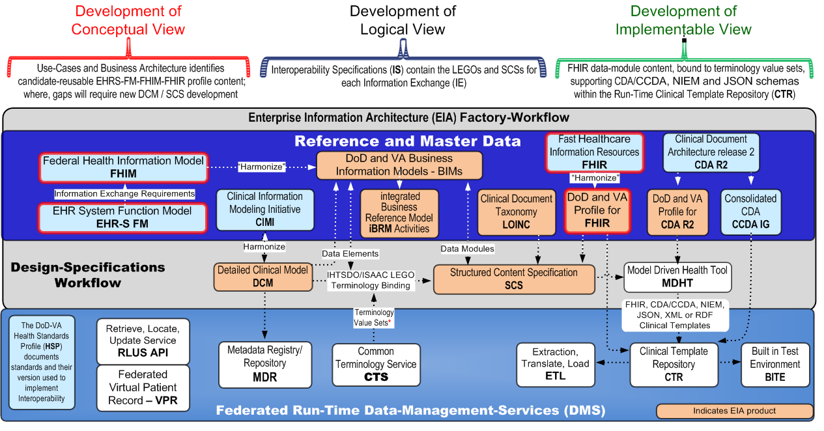
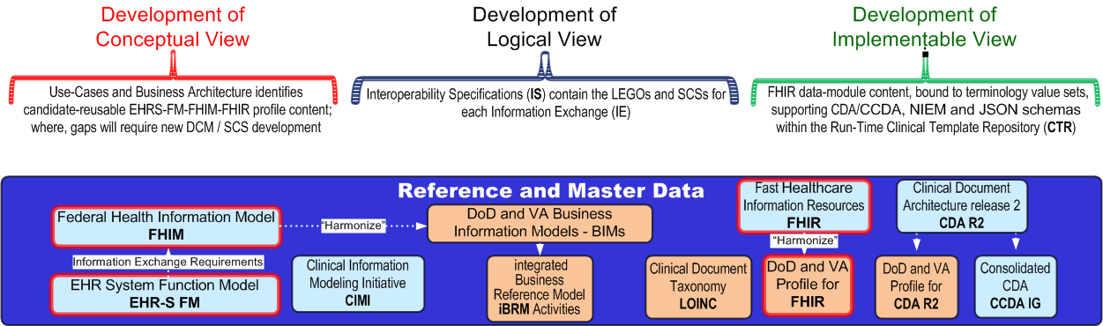
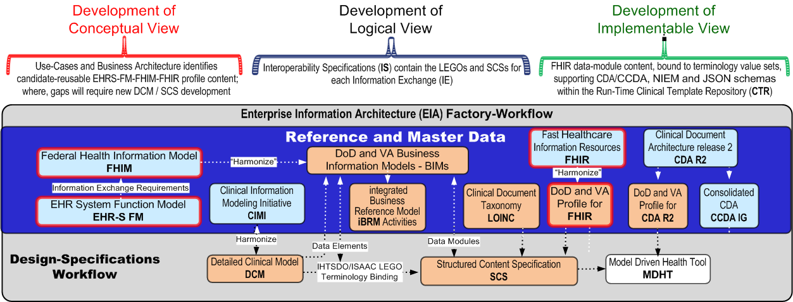
Interoperability-Specification Factory
EHRS-FM, FHIM-LEGO-based FHIR-CDA/CCDA-NIEM
Draft Working-Document; NOT-Approved for Official-Use
Notes:
This slide shows how Informatics tools and concepts can be integrated into a factory-like process to develop Interoperability Specifications and Implementation Guides to support a run-time environment.
InformaticS Architecture Acceleration (ISAAC) Lightweight Expression of Granular Objects (LEGOs) for Semantic Interoperability
EHRS-FM functions can organize Information Exchange Requirements (IERs)
IHTSDO/ISAAC Open-Tooling Framework (OTF) eclipse-plugin for SNOMED CT, with extended EL++ classification can transform FHIM classes or Detailed Clinical Models (DCMs aka CIMI Archetypes), using highly-reusable SOLOR (SNOMED, LOINC, RXnorm) pre-or-post coordinated terminology value-sets into Lightweight Expression of Granular Objects (LEGOs), defining a bottom-up Informatics architecture for the construction of IER Interoperability Specifications.
Based on the IHTSDO Observables Model, LEGO self-contained units of knowledge transform patient data into a normalized SCS; where, the SCSs are the foundation for the large-scale exchange of computable medical information in support of analytics and decision support applications that can enhance the quality, safety, efficacy of patient care.
IHTSDO/ISAAC workbench can combine LEGO pieces into complex Structured Content Specifications (SCS); where,
MDHT (Model Driven Health Tool) can transform these SCSs to FHIR profiles for DoD-VA Data Management Services (DMS), NIEM messages, CDA/CCDA documents.

Slide 21
HSPC and S&I Framework Activities

Slide 22
HSPC and S&I Framework Projects
Use CIMI models as logical models for S&I wherever logical models are needed
Create language specific models using translators
Use HL7 FHIR services (which use HSPC developed FHIR profiles)
EHR Integration – use SMART

Slide 23
S&I Framework Process
Standard
Terminologies
HL7 FHIR
Resources
C-CDA
Templates
Translator
(or manual)
CIMI
Models
HSPC approved
HL7 FHIR
Profiles

Slide 24
Questions and Discussion

