Slide 1
HSPC Meeting Introduction
August 21, 2014
Stanley M. Huff, MD
Chief Medical Informatics officer
Intermountain Healthcare

Slide 2
Healthcare Services Platform Consortium
Short Version: Create a new marketplace for plug-n-play interoperable healthcare applications
Long Version: Enable the acceleration of application development through an open, standards based, services oriented architecture platform and business framework that supports a new marketplace for interoperable healthcare applications
Why?
To improve the quality and decrease the cost of health care.

Slide 3
HSPC History
Initiated by Intermountain and Harris
Meetings
May 2013 Salt Lake City
August 2013 in Phoenix
January 2014 Salt Lake City
May 2014 in Phoenix
July 2014 Salt Lake (Technical modeling meeting)
August 21-22 2014, Washington DC, hosted by IBM and VA
The HSPC incorporation document was signed August 19, 2014 and the document is in the process of being officially filed in Delaware
For more information about HSPC contact : Craig Parker, Oscar Diaz, Stan Huff

Slide 4
Essential Functions of the Consortium
Select the standards for interoperable services
Standards for models, terminology, security, authorization, context sharing, transport protocols, etc.
Modeling: SNOMED, LOINC, RxNorm – FHIR Profiles – do it together
Publish the models, and development instructions openly, licensed free-for-use
Provide testing, conformance evaluation, and certification of software
Gold Standard Reference Architecture and its Implementation
We will work with an established company to provide this service
Fees that off set the cost of certification will be charged to those who certify their software
Commitment from vendors to support the standard services against their database and infrastructure
Everyone does not have to do every service
There must be a core set of services that establish useful applications

Slide 5
Other Functions of the Consortium
Participation in “other” functions is optional for a given member
Enable development “sandboxes”
Could be provided by companies or universities
Could be open source or for-profit
Set up an actual “App Store”
Many companies already have their own app stores
Vendor certification that a given application can be safely used in their system
Accommodate small contributors that won’t have their own app store
Create a business framework to support collaborative development
Pre-agree on IP, ownership, co-investment, allocation of revenue
Try to avoid unique contracts for each development project
Provide a way for people to invest (Venture capital)

Slide 6
Principles
Not-for-profit entity
There could be an associated for-profit entity
Simple majority of providers on the Board of Directors
All organizations will have equal influence and opportunity
Intermountain and Harris will not be “special”
Start small, be effective, and then grow
We want to allow everyone that is interested to participate
Allow diverse strategies and participants
Open source and for-profit
One person business up to multi-national corporations
Healthcare providers and healthcare software developers
Students and professional software engineers
Initially, focus on the minimum set of standards and technology
Increase options as we gain experience and success
HSPC is not producing software (mostly)
HSPC members or groups of members produce software
HSPC may need to provide a reference implementation for purposes of certification
No “central planning” by HSPC of app development
Participants decide what they want to build and invest their own resources
We DO need to agree about the minimum set of services that will enable a marketplace

Slide 7
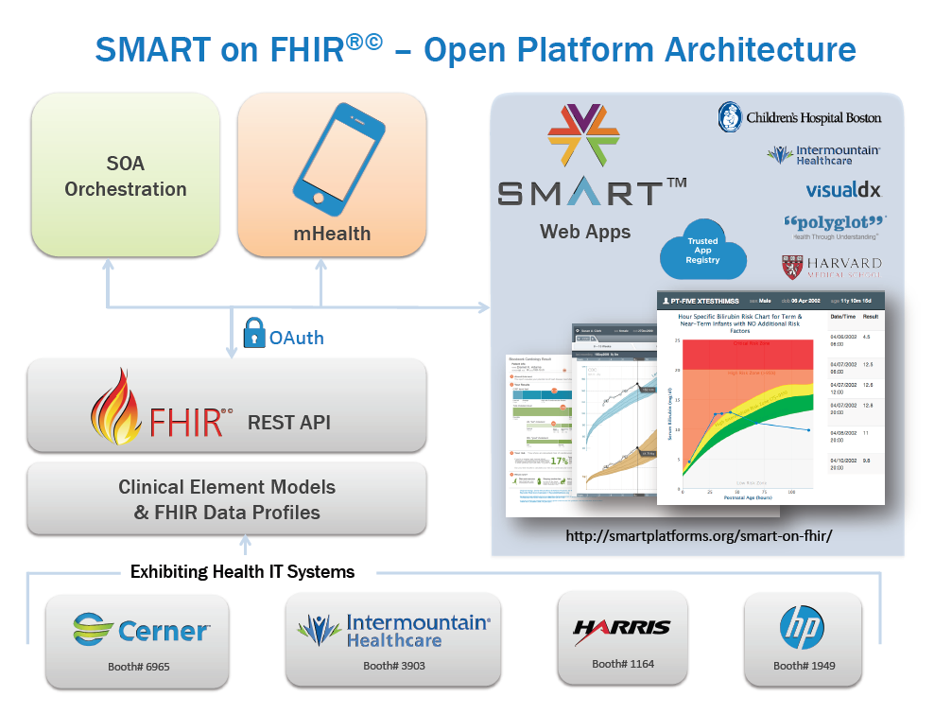

Slide 8
Relevant Core Assumptions
We use existing standards whenever possible
We need comprehensive and unambiguous models of clinical data (hematocrit, white count, temperature, blood pressure, adverse reactions, health issues (problems), prescriptions, substance administration, etc.)
The models are the basis for querying and retrieving data and for storing data through services
We need a single set of consistent models for HSPC based interoperability
It would be even better if there was one common set of FHIR profiles industry wide
We want to create needed FHIR profiles from existing content

Slide 9
HSPC Technology Assumptions (already decided)
Services – FHIR
Generate FHIR profiles from existing model content
Data modeling
Clinical Element Models (now)
CIMI models as soon as they are available
Terminology
LOINC, SNOMED CT, RxNorm, HL7 tables
EHR Integration – SMART

Slide 10
Outcomes from July 7-8 Meeting

Slide 11
FHIR
Determine the best way to represent explicit detailed clinical model information in FHIR
Modeling decision
Create FHIR profiles to the level of structural difference
Lab Results Example: numeric, coded, ordinal, textual, titer
Additional essential information in a knowledge resource
Hematocrit, white count, glucose, BP, temperature, HR, etc.
Binding terminology to models
The HL7 FHIR Value Set resource appears to meet all of our current needs

Slide 12
SMART Discussion
Determine as much detail as possible about strategies for
Authorization
Authentication
Context passing
Conclusion: OAuth2 use as described and constrained by the SMART team appears to meet our needs

Slide 13
Goals for this meeting

Slide 14
Major Goals for This Meeting
Advance the technical specifications for interoperable services
Based on use cases and market experience, enhance and prioritize the list of services that we will focus on first
Share information on the formation of HSPC as a business entity
Review and update the HSPC business plan
Make a plan for what HSPC would like to demonstrate at HIMSS 2015

Slide 15
SMART Goals for This Meeting
Determine as much detail as possible about strategies for
Authorization
Authentication
Context passing

Slide 16
Questions and Discussion

