Slide 1
Driving use case for HSPC and implications for terminology and services
Jonathan Nebeker
Craig Parker
Marc Overhage

Slide 2
Overview
What healthcare problem are we trying to solve?
Propose a driving use case, not for applications
If we focus on technology/tooling, we are dead.
How does this inform terminology work?
How does this inform technology (services)?

Slide 3
Healthcare Provider Problem
Context of Triple Aim of many providers
Individual health, Population Health, Efficiency
Get there through new models of care
Patient centric, Team based, Quality driven
Needs to happen across EHRs
Problem
Current EHRs provide poor support for Care Coordination and for handoffs between EHRs

Slide 4
Care Coordination
Quality driven
• Analyze activities and outcomes and drive process improvement
• Coordinate with other providers in VA, DoD, and community.
• Pop Health
KP
Care Coordination
Team Based
• One plan
• Communication
VA
DoD
Patient Centric
• Disease goals
• Patient’s goals
• Plan
Care Planning
Care Management

Slide 5
Driving Use Case
Create a single plan of care used by all team members, tailored to patient goals, feeding Lean-style management, consumable by other EHRs.
Patient-centric, team-based, quality-driven care
Interoperable systems

Slide 6
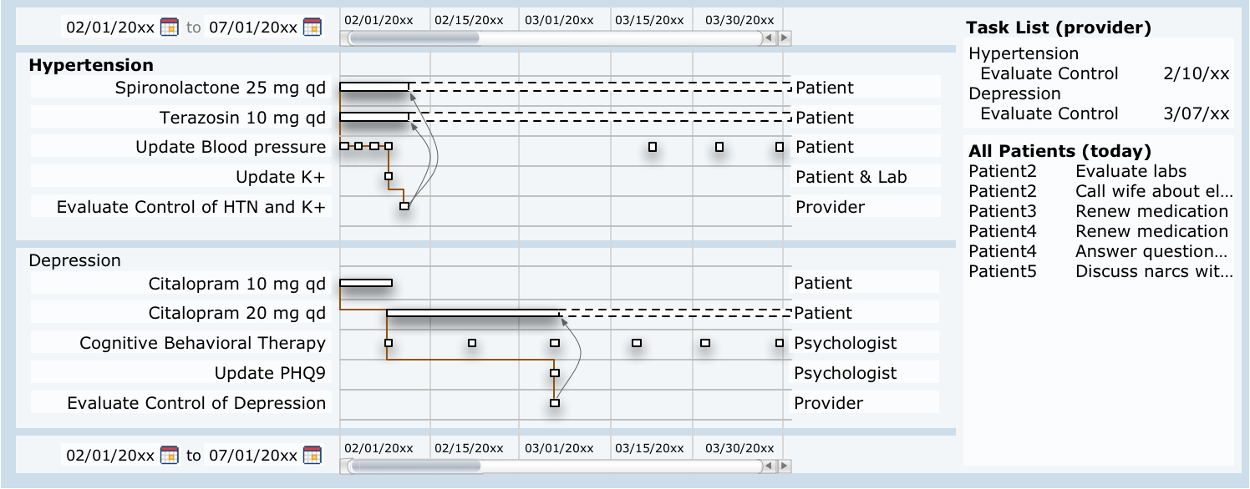
Illustrative User Interface
Disease management
Care Reconciliation
Patient-Tailored
Goals
Explicit Activity Management
Enables Lean-like quality management
Notes:
Disease Management: Makes explicit associations among interventions, conditions, and goals to ensure that interventions are appropriately planned. This approach also allows reconciliation of medications and other interventions to ensure that interventions of the right intensity are working to achieve goals of care.
Patient-Tailored Goals: There are two innovations here. The first is explicit statement of clinical goals in the context of disease management. These goals are not reference ranges for values but tailored to patient’s clinical status. The second innovation is explicit statement of patient’s goals for function, comfort and dignity. Explicit exposure and prioritization of these goals helps the clinical team further tailor clinical goals and care plan to achieve outcomes that matter to patients.
Explicit Activity Management: Each significant intervention is represented as a resourced activity on the care plan. This granular activity tracking allows measurement of productivity in terms of goal realization (the true measure of productivity) instead of effort. It also allows analytical systems to determine which sets of interventions are likely to have the most favorable outcomes. This information can be fed back to point-of-care computerized decision support.

Slide 7
Single Plan of Care
Matches people to resources for activities across time to accomplish goals.
Characteristics
Granular, tractable, reasonably complete

Slide 8
Tailored to Goals
Patient goals
Function, comfort, dignity, risk, patient cost
Other goal owners
Clinician, System, Population, Society

Slide 9
Lean-style Management
Lean=process control/optimization
Forget 6-sigma
Feeds analytical systems

Slide 10
Interoperable
Understands roles, resources, goals, business processes

Slide 11
Implications for Terminology
Craig Parker, Intermountain Healthcare

Slide 12
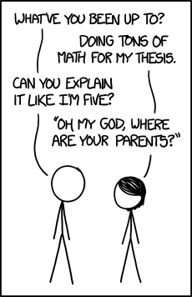
xkcd.com/1364
‘Am I taking care of you? I have a thesis to write!” My parent are at their house; you visited last—’ ‘No, no, explain it like you are five.’

Slide 13
Quality Driven
Data Models and Terminology need to be created with quality measurement in mind
Clinical Data Models
Quality Data Models

Slide 14
Clinical Data Models
Clinical Data Models
Used for primary capture of data
Rely on standard clinical terminologies
Granularity needs to be appropriate for quality assessment
Precoordination, Categorization
Associated information needed for quality assessments
Setting, Participants, Timing, Payer,

Slide 15
Quality Driven
Quality Data Models
Isosemantic with clinical models
Optimized for quality assessment
Terminology oriented towards quality
Adequately controlled hypertension
At risk for diabetes

Slide 16
Team Based
Terminology and Data Models to support a robust team model
Definition of Roles
Relationships between Roles
Who can do something on behalf of someone else?
Relationships between Roles and Activities
Who can place and order?
Who can administer a medication?
Configurable based on organization, regulation, etc.

Slide 17
Patient Centric
Patient oriented representations of concepts
“Heart attack”
Concepts for patient goals
“Having more energy”
Lifecycle for goals (provider and patient)
Models and Terminology for Care Plans

Slide 18
Implications for Services
Marc Overhage, Siemens

Slide 19
General Issues
Authorization/Authentication
R/R vs CRUD
Request to Create/Update/Delete
Read

Slide 20
A Minimal Notional Service Set
Terminology services
patient lookup/matching
provider look-up/matching including role they may play
R/R care team members including roles
post an asynchronous message with patient linkage
Initiate a secure synchronous messaging (video/audio/chat) session
R/R a goal including status/stage/responsible
R/R an observation
R/R a problem list
R/R a plan to meet the goal (BIG) including responsible role
R/R an appointment
R/R an order (all classes)
R/R a patient contact action

