Slide 1
Solor Architecture and Analysis Normal Form
October 9, 2019

Slide 2
Presentation Overview
Healthcare Interoperability at a Glance
Introduction to Solor
Understanding the Solor Knowledge Architecture
Clinical Statements
Clinical Input Forms
Introduction to Analysis Normal Form (ANF)
ANF Model
ANF Examples
ANF Next Steps
Appendix
Solor Content Integration
Solor Use Cases and Future Development

Slide 3
Healthcare Interoperability At a Glance
Back to Presentation Overview

Slide 4
The Promises of Healthcare Interoperability
Improve the quality and safety of healthcare
Measure the cost and quality of services
Integrate multiple providers across organizations in a continuum of care
Integrate and automate high-quality decision support into the clinical workflow across the continuum of care
This promise depends on interoperability across organizations in a continuum of care

Slide 5
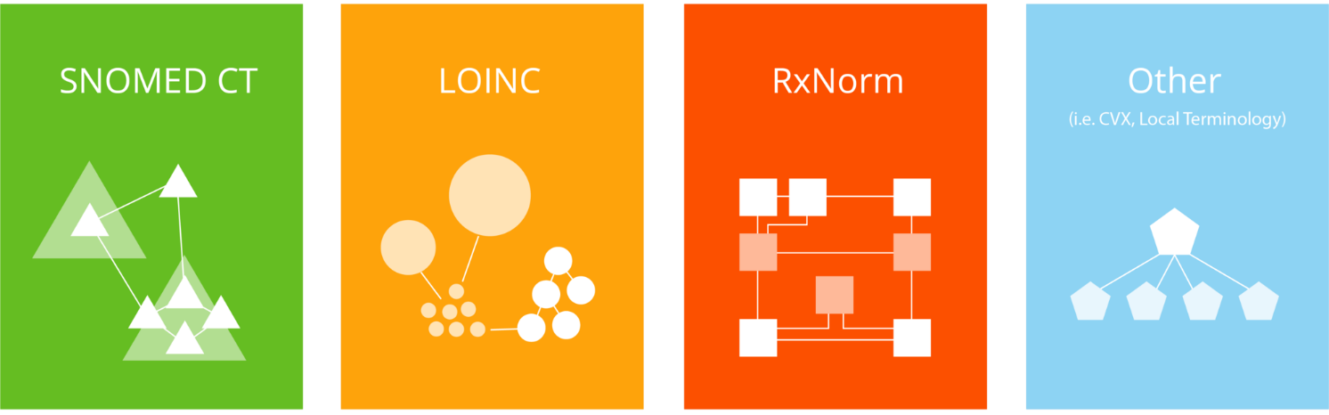
Working Across Data Standards
Today's health care data standards encompass methods, terminologies, and specifications for the exchange, storage, and retrieval of information associated with health care systems.
Major STANDARDS include:
MAPPING only works when dealing with data that are exact equivalents between different systems.
These standards contain terminologies and concepts that are used in medical records to describe patient symptoms, lab results, prescription medication, etc.
Source: ncbi.gov and library.ahima.org
5

Slide 6
Becoming a High Reliability Organization
Since the IOM report (2000), 'To Err is Human: Building a Safer Health System,’ health care has been working to adopt High Reliability Organization (HRO) practices, including overcoming issues of interoperability in health care data.
HROs avoid potentially disastrous scenarios and prevent catastrophic errors in a high-risk environment, all while delivering consistently safe and high-quality service.
other industries focusing on hro status
Aviation
Law Enforcement
Nuclear
Semantic interoperability, or safely, accurately, and effectively recording, transforming, and using health data, can lead health care organizations to become HROs.

Slide 7
Today’s Health Care Data Challenges
In today's health care industry, the standard approach to integrating multiple disparate health data sources is to conduct mapping, a manual process that is...
Difficult to maintain and operationalize
Not scalable using local terminology
Inconsistent and information loss at each transformation
Unnecessarily complex and incoherent
No universal standard approach and structure
How do we operationalize different standards (SNOMED, LOINC, RxNorm, etc.) in a uniform and highly reliable way?
Notes:
Current data standards do not meet operational needs, hindering true interoperability, or the sharing and usage of data across health systems, which compromises patient safety.

Slide 8
Interoperability today
How can we make it easier?

Slide 9
Introduction to Solor A pathway to high-reliability semantic interoperability
Back to Presentation Overview

Slide 10
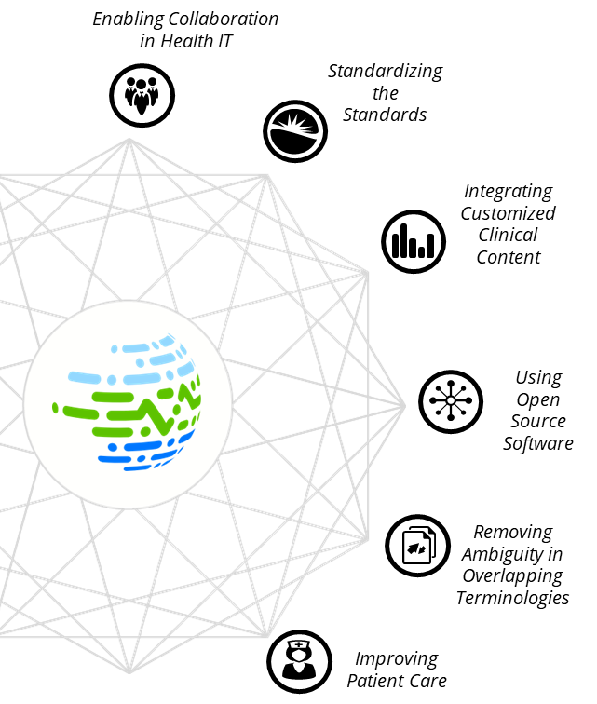
What is Solor?
Solor is an open-source ecosystem that brings together data-encoding standards with an extensible, single model to help health care organizations avoid errors in the interpretation of clinical data.
KEY BENEFITS OF SOLOR
Saves time and money from maintaining standards by streamlining data integration.
Enhances product development by focusing on collaboration in an open-source ecosystem.
Improves patient safety by reducing reliance on error-prone mapping practices.
Enables interoperability of sharing clinical data across the entire health care ecosystem.

Slide 11
Types of Interoperability
There are three major types of interoperability in health care:
Foundational: Data exchange from one system to another
Think of it as two people trying to communicate. You agree to speak (foundational) in English (structural) and interpret the vocabulary used the same way (semantic).
Structural: Syntax of the data exchange at the data format/field level
Semantic: Exchange of information in a way that the receiving system can interpret the data
^{Source: Himss.org}

Slide 12
Highly Reliable Semantic Interoperability
Mapping does not consistently provide semantic interoperability.
Semantic: Exchange of information in a way that the receiving system can interpret the data
Mapping can provide semantic interoperability but is not always successful and highly reliable.
But Solor can provide high reliability semantic interoperability!
^{Source: Himss.org}

Slide 13
Solor Enables HRO
Solor enables semantic interoperability, which allows health care organizations to become HROs.
Solor’s HRO Approach
Empowering Health Care Leaders
Solor empowers health care providers and organizations by providing a common data representation foundation, which enables better decision support applications for improved patient care, patient monitoring, and patient outcomes.
Developing Robust Process Improvements
Empowering Health Care Leaders
Fostering Culture of Safety
Fostering Culture of Safety
Solor operationalizes clinical integration, which fosters the reporting of potential safety threats and promotes a just culture focused on removing hazards that contribute to errors before they harm patients.
Developing Robust Process Improvements
Solor prioritizes continuous improvement at every level through its open-source ecosystem that enables health data integration and synchronization within a clinical environment.

Slide 14
Current Situation: Overlap in Content
SNOMED CT
LOINC
Lab LOINC
LOINC: Gentamicin is a component of laboratory tests
SNOMED CT
SNOMED: Gentamicin is a component of laboratory tests
SNOMED CT
LOINC
RxNorm
RxNorm
LOINC: Gentamicin is a component
SNOMED: Gentamicin is a substance
RxNorm: Gentamicin is an ingredient
SNOMED CT
RxNorm
SNOMED: Gentamicin is a product
SNOMED: Gentamicin 0.3% preservative-free eye drops
RxNorm: Gentamicin sulfate 0.3% Ophthalmic Solution
RxNorm: Gentamicin is a product
Notes:
Different languages interpret the same content differently leading to duplication & inconsistency

Slide 15
Current Situation: Mapping Process
Currently, hospitals manually translate and map health data for their own needs, which is costly, inefficient, and error-prone.
LOINC code 1111
SNOMED code 2222
SNOMED code 3333
RxNorm code 4444
Hospital A
Hospital B
Local code: 12345
Local code: 67890
Information Loss
Lack of Interoperability
Patient Safety Risk

Slide 16
Current Situation: SNOMED Mapping Example
Organization A
Lab LOINC
Organization B
SNOMED CT
Local code: 12345
Infiltrating ductal carcinoma of lower inner quadrant of breast
Local code: 54321
Infiltrating ductal carcinoma of lower inner quadrant of breast
RxNorm
Provider A
Provider B
SNOMED Code:
408643008
Infiltrating ductal carcinoma of breast
SNOMED Code: 373080008
Malignant neoplasm of lower inner quadrant of breast
Lose location of the carcinoma
Lose morphology of the carcinoma
Notes:
In SNOMED, if different organizations code the same observation differently, specific information on the diagnosis can be lost, leading to medical error and patient danger.

Slide 17
Current Situation: LOINC Mapping Example
Organization A
Organization B
Local code: 23456
Birch Ab.IgE, Serum Quantitative
Local code: 65432
Birch Ab.IgE, Serum Quantitative
Lab LOINC
SNOMED CT
RxNorm
Lab A
Lab B
LOINC code: 15283-5
Silver Birch IgE Ab [Units/​volume] in Serum
LOINC code: 41874-9
White Birch IgE Ab [Units/volume] in Serum
Mapping can add
false information
Notes:
In LOINC, if different organizations code the same observation differently, additional information on the diagnosis can be added, leading to medical error and patient danger.

Slide 18
Solor Extension Process
Rather than choosing a narrower or broader than estimate when mapping, Solor allows the creation of a new sharable Solor extension code.
LOINC code 1111
SNOMED code 2222
All viewable alongside extensions in the Viewer
SNOMED code 3333
RxNorm code 4444
Hospital A
Hospital B
An extension adds additional information in the form of a new concept, a new description or a new relationship to a data standard if the required information does not exist.
Local code: 12345
Solor Extension
Local code: 67890
No Information Loss
Sharable with Others
High Reliability Interoperability
Improved Patient Safety
18

Slide 19
The Solor Extensions
Solor enables the creation of local data within its semantic environment.
Medical Practice
Search: “Infiltrating ductal carcinoma”
Results:
Local code: 12345
Infiltrating ductal carcinoma of lower inner quadrant of breast
AND
Local code: 67854
Infiltrating ductal carcinoma of right breast
Hospital A
Local code: 12345
Infiltrating ductal carcinoma of lower inner quadrant of breast
Hospital B
Local code: 67854
Infiltrating ductal carcinoma of right breast

Slide 20
Solor Extension to Standards Process
Solor provides a process for constant improvement of data standards and an ability to sustain the effectiveness of clinical decision tools.
Issues in local content are fixed in real time, improving the semantic foundation
Solor team submits extensions to standards (proposed)
Continuous improvement for health data
Continuous improvement for health care standards
Hospital and organizations’ local content
Solor allows new concepts in local extensions to integrate back into the semantic foundation
Standards accept the new content within the extension

Slide 21
Lessons Learned So Far
Solor eliminates the risks inherent in mapping
Solor integrates data even if the sources are not exact equivalents
Solor makes continuous improvements to health data quality
Solor supports a knowledge-based architecture...
Let’s take a closer look at the knowledge architecture
Back to Presentation Overview

Slide 22
Understanding the Solor Knowledge Architecture
Back to Presentation Overview

Slide 23
Solor Knowledge Architectural Layers
Definition: An architectural design principle for clinical information that is organized into distinct layers, such that each higher layer relies upon artifacts from the lower layer.
Procedural Knowledge
P
Decision support and analytics
Define how to process measurements
(Decision support, analytics…)
Each architectural layer addresses separate concerns that can be reused, developed, and updated independently.
Solor can individually resolve issues in the data within their layers vs a whole system, leading to much more agile improvement.
A
Assertional Knowledge
HL7 FHIR, CIMI, …
S
Define how to record a measurement (Numerical and subject of information)
Statement
Model
T
SNOMED, LOINC, RxNorm, …
Terminology Knowledge
Define what can be measured (Description Logic and Language)
F
Foundational Architecture
Shared module system
Provides the interoperability foundation

Slide 24
Addressing All Architectural Layers
In the future, Solor would like to offer improvements and enhancements to all layers of separation of concerns by:
Procedural Knowledge
P
Standardizing billing codes.
A
Influencing health data analysis applications and sharing terminology best practices between hospitals.
Assertional Knowledge
S
Tying Analysis Normal Form (ANF) into population health analysis and influencing clinical statements.
Statement
Model
T
Terminology Knowledge
Currently, Solor is standardizing data, improving the quality of enterprise terminology, and optimizing work flow.
F
Foundational Architecture

Slide 25
Knowledge Architecture: Foundational
Clean separation of concerns between layers is promoted by Solor, with each layer building on the preceding layers and sufficient to support the next layer
Procedural Knowledge
P
A
Assertional Knowledge
S
Statement
Model
T
Terminology Knowledge
Common elements of interoperability such as object identity, versioning, modularity, exchange paradigms, and knowledge representation.
F
Foundational Architecture

Slide 26
Knowledge Architecture: Terminology
Procedural Knowledge
P
A
Assertional Knowledge
This layers builds upon the foundational architecture to create artifacts of medical terms and codes (i.e. SNOMED CT, LOINC, RxNorm) that define concepts of interest, including descriptions, dialects, language, and semantic hierarchy.
S
Statement
Model
T
Terminology Knowledge
F
Foundational Architecture

Slide 27
Knowledge Architecture: Statement
Procedural Knowledge
P
A
This layer reuses artifacts defined in the Terminology Knowledge layer to define the combination of data elements into statements.
This also includes standards-based clinical statements like ANF and CIMI and statement models that may be implemented using HL7 V2, CDA, FHIR, etc.
Assertional Knowledge
S
Statement
Model
T
Terminology Knowledge
F
Foundational Architecture

Slide 28
Knowledge Architecture: Assertional
Procedural Knowledge
P
Makes use of Terminology and Statement Knowledge to specify non-defining facts that may be used by procedural knowledge algorithms based on relationships between data elements.
It may be used to indicate what symptoms may be associated with a disorder or what treatment is optimal for a condition.
A
Assertional Knowledge
S
Statement
Model
T
Terminology Knowledge
F
Foundational Architecture

Slide 29
Knowledge Architecture: Procedural
Procedural Knowledge
P
This is the action-oriented layer that uses information from the Assertional Knowledge layer that can enable clinical decision support for clinical alert rules, reminders, etc. that trigger actions or recommend interventions to ultimately improve quality measurement and patient safety.
A
Assertional Knowledge
S
Statement
Model
T
Terminology Knowledge
F
Foundational Architecture

Slide 30
Standards are a Part of the Architecture
Current standards, like FHIR, do not complete the Knowledge Architecture but provide the building blocks for implementation guides:
FHIR
FHIR relies upon the implementer to specify artifacts using other specifications
(e.g. CDS Hooks)
Procedural Knowledge
FHIRPath Invariants
Invariant expressions are used to describe resource structural constraints
Assertional Knowledge
Statement
Model
80% data requirements
FHIR resources do not attempt to address 100% of data requirements
Terminology Knowledge
FHIR relies upon the implementer to fill gaps in clinical terminology
HL7 terms
REST API, versioning, guidance
FHIR REST specification needs to be augmented by other specifications (SMART App Launch, FHIRCast)
Foundational
Architecture

Slide 31
US Requirements: Implementation Guides
US Implementers will be mandated in 2020 to apply the following rules for data interoperability.
US Realm
Procedural Knowledge
Da Vinci: CRD and DTR
Coverage Requirements Discovery uses CDS Hooks, Documentation Templates and Rules
Assertional Knowledge
CQM:
2019 Clinical Quality Measures
Statement
Model
USCDI
US Core for Data Interoperability: FHIR and CDA IGs
Terminology Knowledge
USCDI + CQM
Value Sets, constraints
Foundational
Architecture
ARCH:
API Resource Collection in Health uses FHIR RESTful API and SMART App Launch Framework
Notes:
USCDI – US Core for Data Interoperability

Slide 32
Completing the Knowledge Architecture
VA requirements go beyond the scope of industry-defined standards to include cases that may be specific to veterans (i.e. traumatic brain injuries, audiology, prosthetics).
VA Architecture
Procedural Knowledge
+Reminders, Smart Alerts, Safety Events
Assertional Knowledge
+Quality Measures, Clinical Guidelines
Statement
Model
+TBI, Audiology, Prosthetics – FHIM to describe data requirements beyond USCDI
Terminology Knowledge
+Harmonized Terminology using Solor Extension – for additional data requirements
Foundational
Architecture
+Extend APIs, FHIR Terminology Server, Patient Identity Cross Reference

Slide 33
Clinical Statements
Back to Presentation Overview

Slide 34
What is a Clinical Statement?
A definite and clear representation of a clinically-significant fact or situation that was observed to exist or happened
Expressed as a narrative that provides a written account that can be naturally read by humans, as well as a normal form which is a machine-processable representation
Example of a CIMI Clinical Statement
Normal Form
Fact
Observed
Narrative

Slide 35
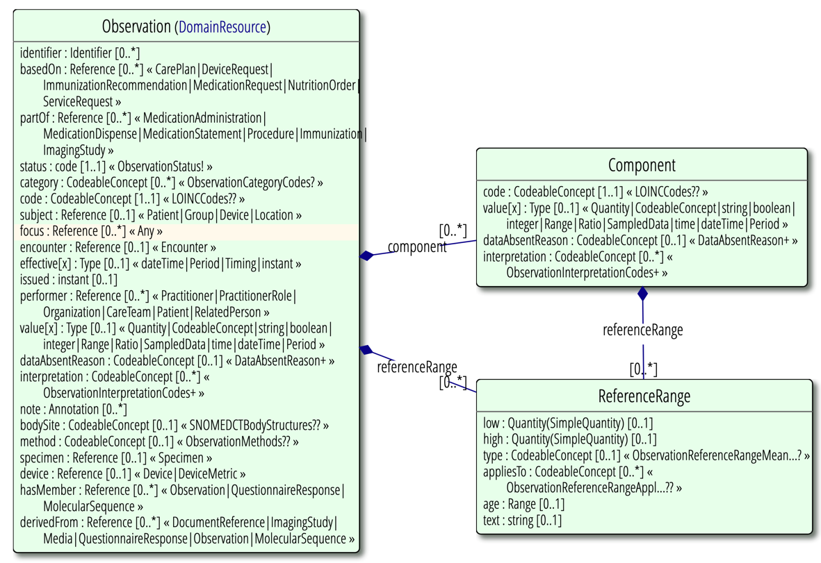
Example of a FHIR Observation Resource
Code
Value
Body Site
Method
Device

Slide 36
Standards Don’t Complete the Architecture
FHIR
FHIR relies upon the implementer to specify artifacts using other specifications
(e.g. CDS Hooks)
Procedural Knowledge
FHIRPath Invariants
Invariant expressions are used to describe resource structural constraints
Assertional Knowledge
Statement
Model
80% data requirements
FHIR resources do not attempt to address 100% of data requirements
Terminology Knowledge
FHIR relies upon the implementer to fill gaps in clinical terminology
HL7 terms
REST API, versioning, guidance
FHIR REST specification needs to be augmented by other specifications (SMART App Launch, FHIRCast)
Foundational
Architecture

Slide 37
Clinical Statements Can Vary Greatly
Code
Systolic blood pressure
Standing systolic blood pressure
Non-invasive systolic arterial pressure
Measurement of blood pressure using cuff method
End systolic blood pressure by US
Brachial artery - right Systolic blood pressure [8547-2]
Systolic blood pressure Brachial artery - right/Brachial artery [8577-9]
Body site
Brachial artery
Little finger arteries right
Brachial artery - right
Method
Invasive/Non invasive
Cuff size
Cuff blood pressure
Device
US…

Slide 38
Multiple Representations of a Value
Quantity: 130 mm Hg
Integer: 130 (assume units are in code field)
Range: [130,132] mm Hg
Codable concept:
Finding of increased blood pressure
Increased systolic arterial pressure
On examination - initial high blood pressure

Slide 39
Completing the Knowledge Architecture
VA requirements go beyond the scope of industry-defined standards to include cases that may be specific to veterans (i.e. traumatic brain injuries, audiology, prosthetics).
VA Architecture
Procedural Knowledge
+Reminders, Smart Alerts, Safety Events
Assertional Knowledge
+Quality Measures, Clinical Guidelines
Statement
Model
+TBI, Audiology, Prosthetics – FHIM to describe data requirements beyond USCDI
Terminology Knowledge
+Harmonized Terminology using Solor Extension – for additional data requirements
Foundational
Architecture
+Extend APIs, FHIR Terminology Server, Patient Identity Cross Reference

Slide 40
Current State of Clinical Statements
Clinical statements are often represented in unpredictable and denormalized forms, rendering decision support to be unreliable and unsafe
Lack of data quality in clinical statements remains the greatest obstacle to analysis and interoperability
It is difficult to aggregate clinical information managed by health information networks without a common format that provides semantic clarity and high quality
Clinical statements need to be represented in a manner that is understandable, reproducible, and useful
Back to Presentation Overview

Slide 41
Clinical Input Form
Back to Presentation Overview

Slide 42
Clinical Input Form (CIF)
Clinical Input Form
Can be based on a variety of statement models such as CEM, CIMI, CCDAs, etc.
May lead to variation in clinical statements
Represents EHR information entered by clinicians
Is not a literal “form” but instead refers to the manner in which information is represented by:
Constraining information to allow only certain values to be entered (i.e. drop-down list, radio button…)
Breaking up large chunks of related information into smaller parts like in medication orders
Condition
Medication
Vital Signs
Inconsistent
Statements

Slide 43
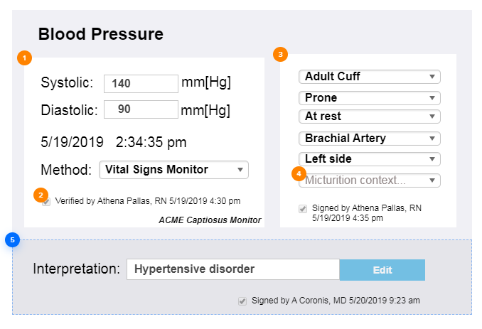
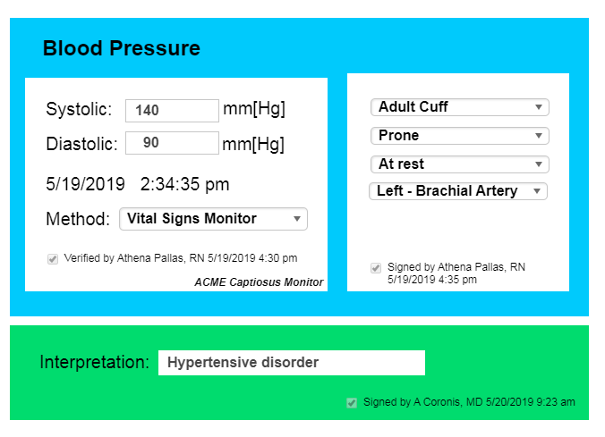
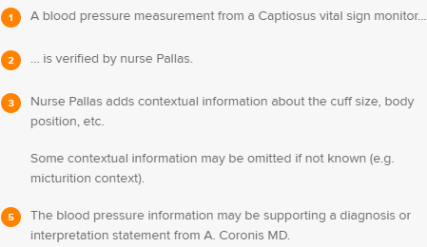
Example of Clinical Input Forms (CIF)
Blood pressure can be represented in multiple different ways in CIF
Inconsistent Statements
4
5
Back to Presentation Overview

Slide 44
Introduction to Analysis Normal Form (ANF)
Back to Presentation Overview

Slide 45
Analysis Normal Form (ANF)
Applies a clean separation between statement and terminology concerns
Helps structure clinical information so that it is consistently represented when exchanged among systems
Normalizes a variety of clinical statements to a common normal form
Condition
Medication
Vital Signs
ANF Statement

Slide 46
ANF HL7 Informative Ballot
The ANF HL7 Informative Ballot was successfully submitted on August 4th, 2019
The HL7 Ballot voting period is open until September 9th, 2019, all comments are welcome
HL7 link: www.hl7.org/documentcenter/public/ballots/2019SEP/downloads/HL7_CIMI_LM_ANF_R1_I1_2019SEP.pdf
Mirror link: http://solor.io/wp-content/uploads/2019/08/ANF_Ballot_20190819.pdf

Slide 47
ANF Design Principles
Simplicity: Simplicity of the entire system instead of just one area of the system
Consistency: Consistent representation of information that is commonly shared across models
Reusability: Architectural patterns should encourage class reusability where possible. Reusability may further refine encapsulation when composition is considered
Reducing Variability: Minimize arbitrary classification rules to eliminate ambiguities (i.e. False Dichotomies) to allow a single representation of clinical data
ANF’s Design Principles help standardize statement representation so that it is understandable, reproducible, and useful
Notes:
For instance, attribution and participation information should be captured consistently. Failure to do so forces implementers to develop heuristics to capture and normalize attribution information that is represented or extended differently in different classes (e.g., FHIR).

Slide 48
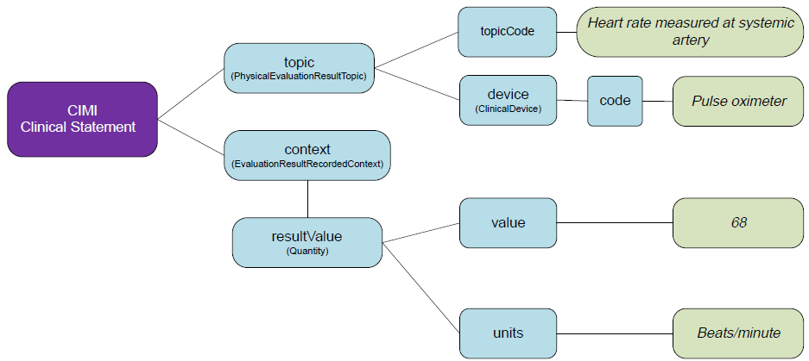
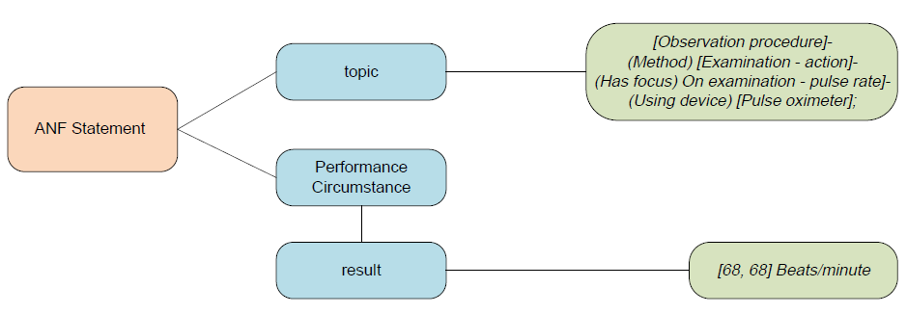
CIMI vs. ANF Representations
ANF reduces the complexity of statement representations common in other models such as CIMI.

Slide 49
CIF vs ANF
CIF: Data Entry and Display
The way information is presented to clinicians that is the most efficient for the clinicians to use (CIF)
Clinical data can be unstructured and difficult to query
ANF: Data Analysis and Mining
The way data is represented to data analysts that is the most efficient for querying data for analysis and research
Clinical data should be normalized before it can be stored in a clinical data repository

Slide 50
What ANF can be used for?
Clinical Decision Support
Provide a standards-based, normalized representation of clinical statements
Use an objective measure to help evaluate the result, presence, and magnitude of a specific finding, request or observation
Classify the topic of a statement using standard terminology expressions
Define data based on compositional layers according to Knowledge Architecture
Data Analytics / Mining
Create normalized data natively
Transform representations of clinical statements to normal form (e.g. transform C-CDA templates, FHIR profiles to ANF)
Back to Presentation Overview

Slide 51
ANF Model
Back to Presentation Overview

Slide 52
ANF Statement Types
Performance of action, may include
Passive observation of a phenomenon related to patients and their health status or family history, and
Active interventions, such as providing education or administering medications
Request for action, may include
Procedure orders
Consultation with other providers
Active interventions

Slide 53
Major Components of an ANF Statement
Topic
Defines the action (being performed or requested) or the result of that action
Needs to be able to exist on its own and still retain original intent and clarity of meaning
Each clinical statement may only have one topic (but the topic is a comprehensive expression)
Circumstance
HOW, WHY, WHEN, and with WHAT “result” a requested or performed action will be or was carried out
ANF promotes a normalized representation of observation or intervention results where all results are represented to a "measure"

Slide 54
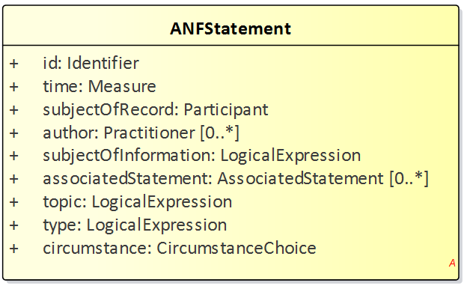
ANF Statement
Who
What
How

Slide 55
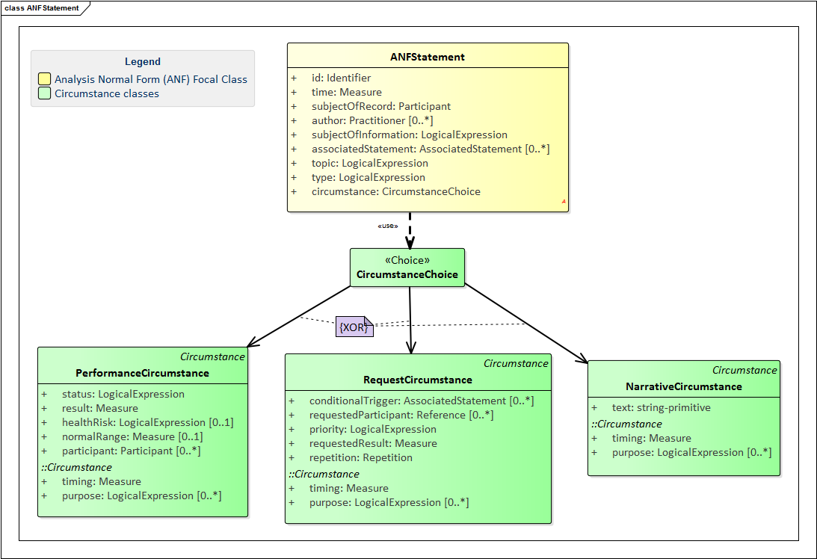
ANF Logical Structure (UML notation)
“circumstance” choice
Exclusive OR
Inherited attributes

Slide 56
ANF Examples Requests for Observations and Actions
Back to Presentation Overview

Slide 57
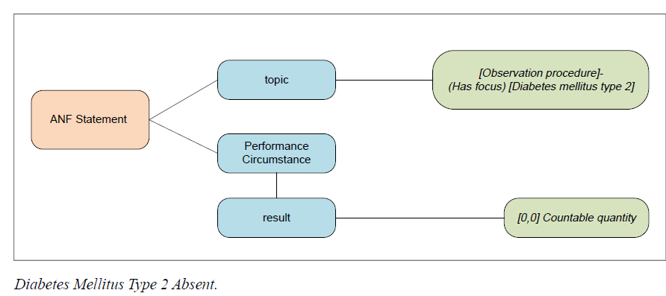
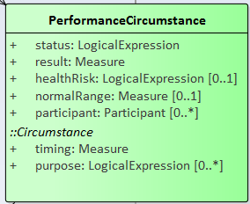
ANF Statement: Diabetes absent
Performed observation:
Diabetes Mellitus Type 2 is absent

Slide 58
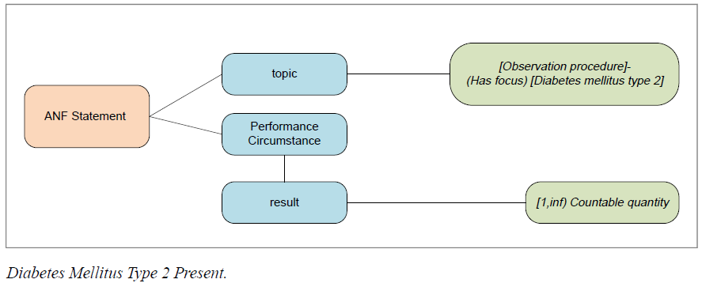
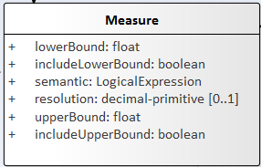
ANF Statement: Diabetes present
Performed observation:
Diabetes Mellitus Type 2 is present

Slide 59
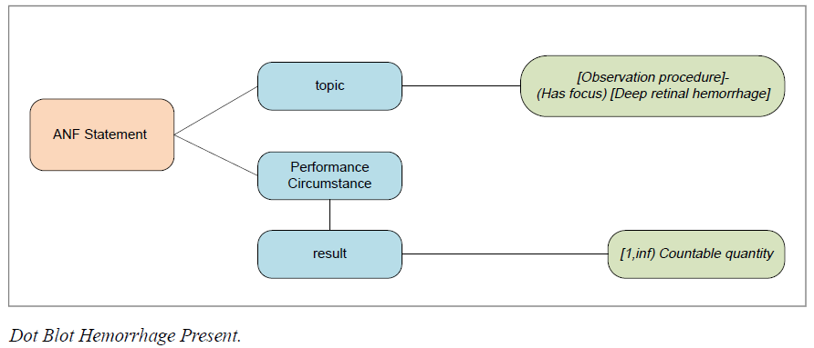
ANF Statement: Retinal Hemorrhages Present
Performed observation:
Dot blot hemorrhages are present (number undefined)

Slide 60
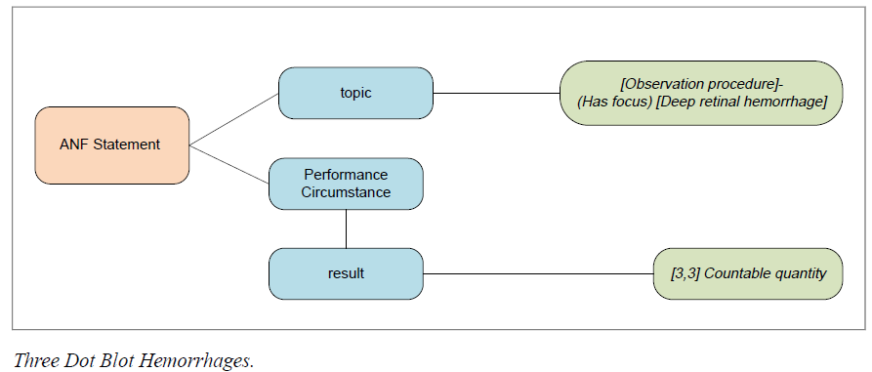
ANF Statement: Hemorrhages Counted
Performed observation:
Three dot blot hemorrhages

Slide 61
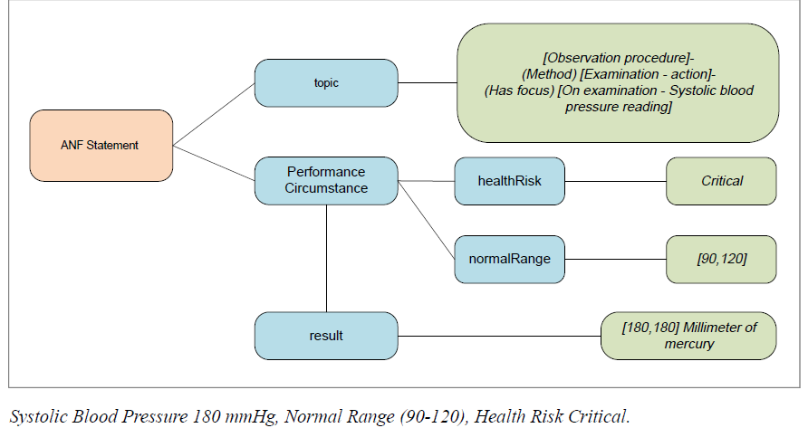
ANF Statement: Critical Blood Pressure
Performed observation:
Critical systolic blood pressure of 180 mmHg, normal range (90, 120)

Slide 62
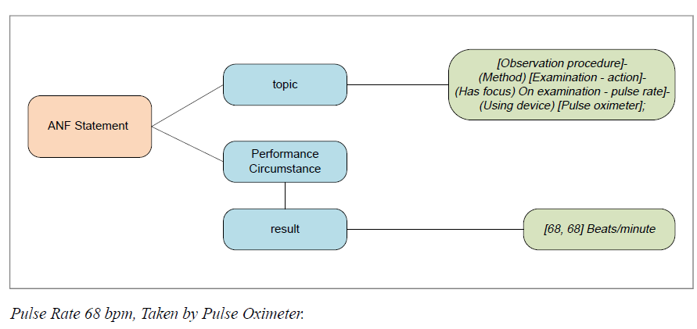
ANF Statement: Pulse Measured
Performed observation:
Pulse rate by pulse oximetry of 68 bpm

Slide 63
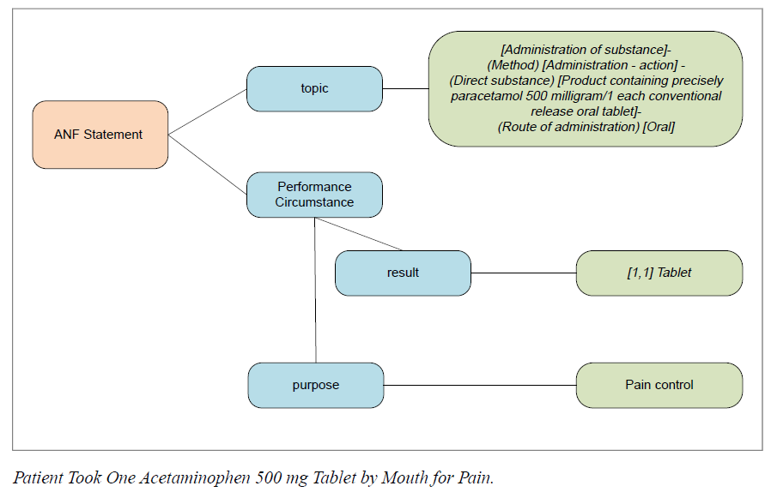
ANF Statement: Medication Administered
Performed Action:
Administered one 500 mg of acetaminophen oral tablet for pain control
acetaminophen

Slide 64
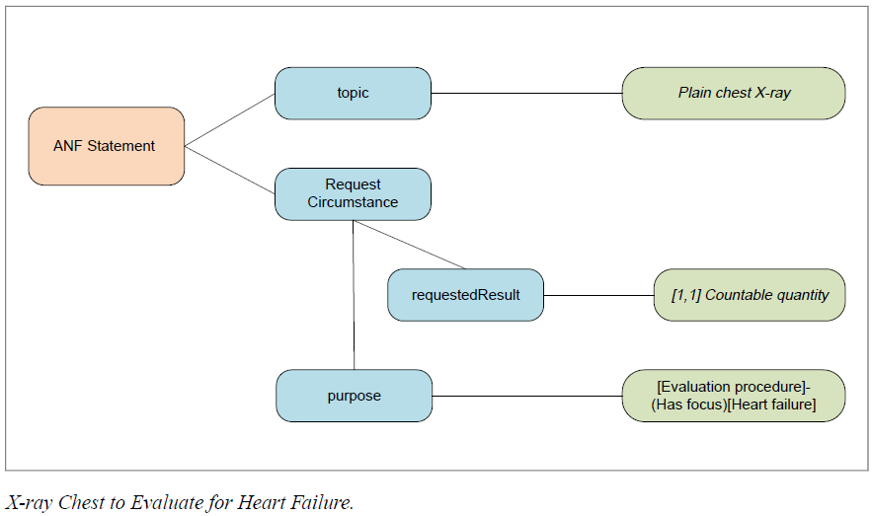
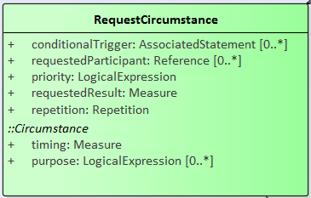
ANF Statement: Requested Diagnostic Procedure
Requested Action:
Order for chest X-ray to evaluate heart failure

Slide 65
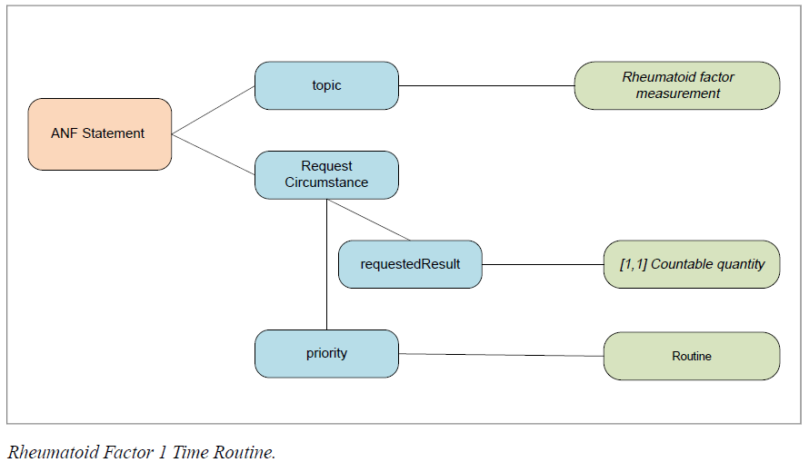
ANF Statement: Requested Laboratory Test
Requested:
Order for routine rheumatoid factor 1 blood test

Slide 66
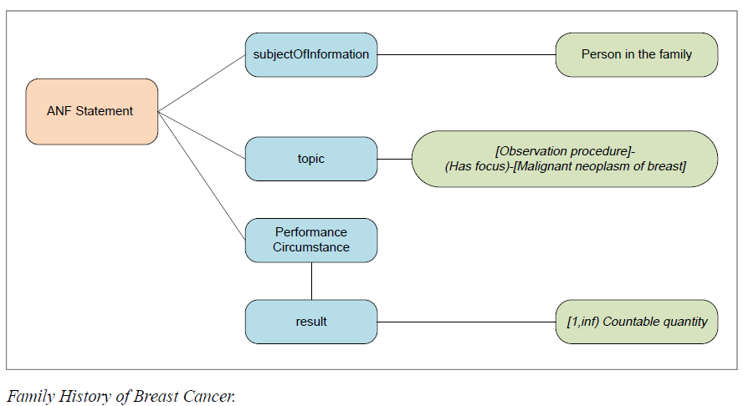
ANF Statement: Family History
Performed Observation:
Family history of breast cancer (grandmother)
Grandmother
Back to Presentation Overview

Slide 67
ANF - Next Steps
Back to Presentation Overview

Slide 68
Next Steps
Apply ANF to normalize clinical information for analysis
To make ANF accessible so that statements can be represented as new FHIR resource or extensions to existing resources for clinical decision support
To enable ANF-based data to trigger clinical reminders and smart alarm
Use ANF to derive new information from assessments and questionnaires using a common form
Use ANF for other data mining and analytics to improve patient safety and health outcomes

Slide 69
FHIR APIs Using ANF Across Clinical Systems
EHR 1
EHR 2
Clinical Input/
Display Format
P
P
A
A
S
S
T
T
F
F
Data Exchange
FHIR Resources / CDA Docs /
V2 Messages
Clinical Reminders and Smart Alerts
ANF Data
P
Aggregated Data
A
S
Analysis
Database
FHIR API
Clinical Decision Support
Normalized Data
T
F
Notes:
ANF FHIR API to aggregate clinical statements across EHRs

Slide 70
Discussion
Back to Presentation Overview

Slide 71
Appendix
Back to Presentation Overview

Slide 72
Solor Content Integration
Back to Presentation Overview

Slide 73
Solor Content Integration: LOINC
Solor integration with LOINC is a successful example of how easily Solor integrates into systems. Improvements reduce the risk of redundancy and omissions to increase patient safety and include:
Better integration through improved description logic
Compatibility with SNOMED’s stated future direction
Supports a variety of numeric values, set, and ranges
Improved hierarchy and taxonomy to identify all equivalent concepts necessary for decision support

Slide 74
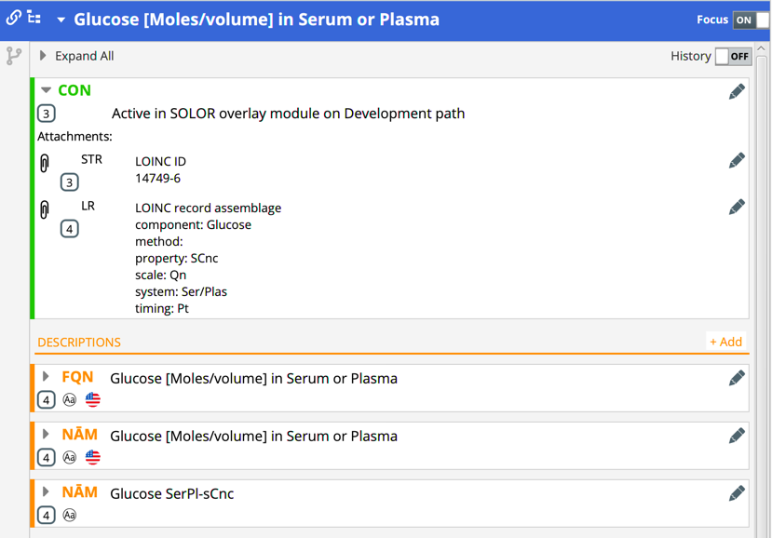
Example of Solor Content: LOINC
Using Solor to view the LOINC concept of Glucose [Moles/volume] in Serum or Plasma:
SOLOR CONCEPT

Slide 75
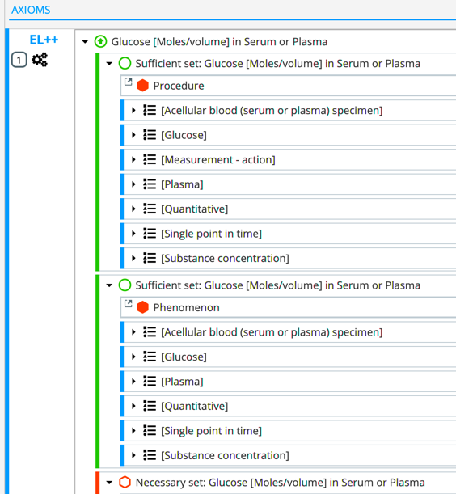
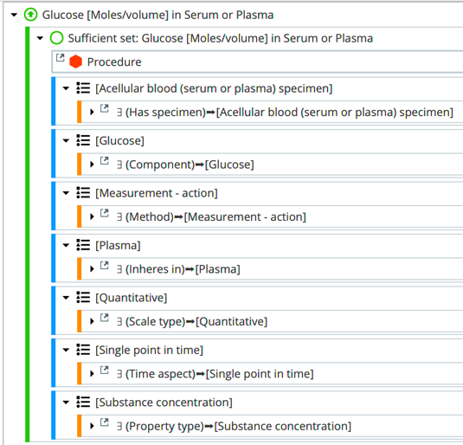
Understanding Solor’s Data Structure
Description of concepts within Solor follow LOINC & SNOMED OWL Axioms.
Solor Axioms for LOINC
Sufficient Set Detail

Slide 76
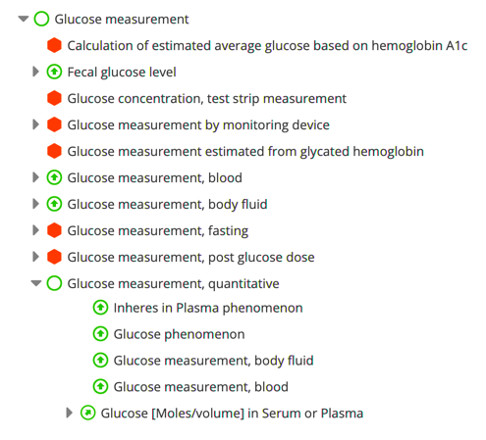
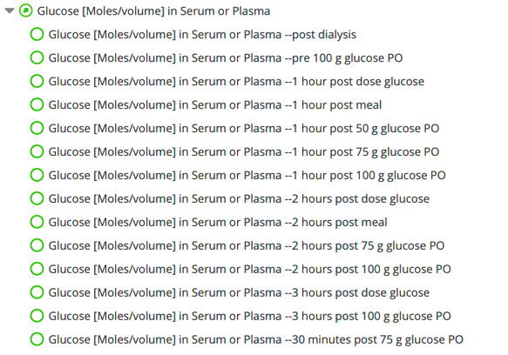
Solor Taxonomy
PARENT
CHILDREN

Slide 77
Solor Content Integration: LIVD
Solor integration with LIVD (LOINC to In Vendor Test Results) provides a central repository to manage distribution of IVD device manufacturer’s catalogs, version control to manage shifts over time, and modularity for distinct manufacturer catalogs. Improvements include:
Reduced time and cost to connect and update laboratory instruments
Elimination of custom implementations while allowing for local extensions to more easily author content
Standardized data and elimination of errors for lab tests, billing, and analysis purposes
Reduced risk of error & improved integrity of patient data through automated and seamless integration with LIS (Laboratory Information System)

Slide 78
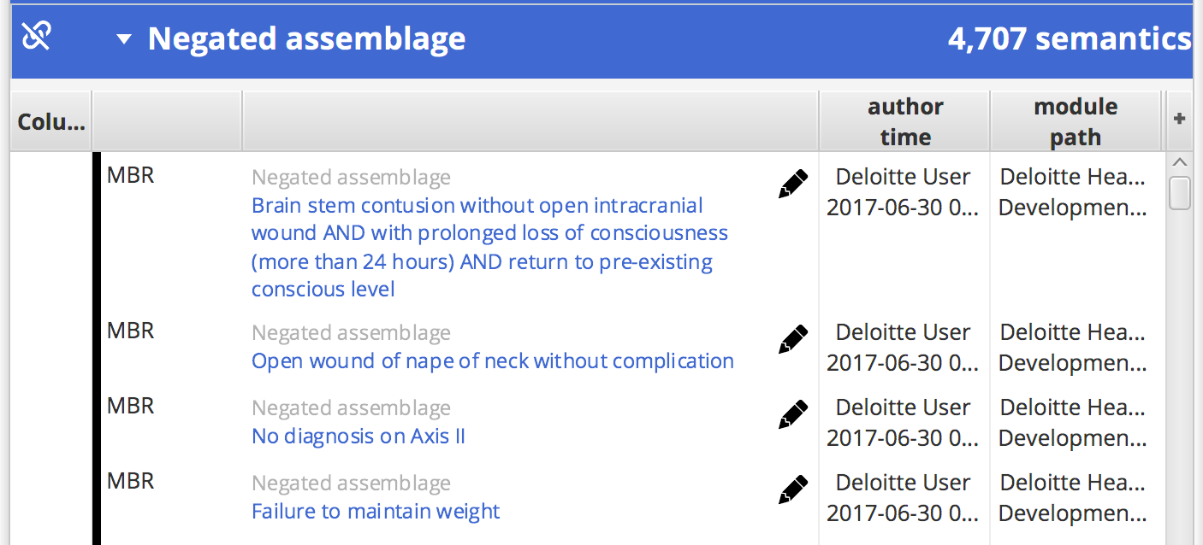
Solor Assemblage View
sample assemblage view
concept view of assemblage member
Concept is a member of these assemblages
Solor has the ability to improve standards in real-time.
Back to Presentation Overview

Slide 79
Solor Distribution
SNOMED RF2-compatible distribution format can be downloaded at:
https://healthservices.atlassian.net/wiki/spaces/SOLOR/pages/200114251/SOLOR+Extensions
SOLOR EXTENSIONS
Future release will include HL7 distribution standards for Solor artifacts

Slide 80
Solor Use Cases & Future Development
Back to Presentation Overview

Slide 81
Solor Use Cases
Genomics: Establish the standardization for genome data in an interoperable ecosystem.
FDA SHIELD/LIVD: Optimize workflow processes between manufacturers and laboratories in an integrated ecosystem.
FHIR: Import Solor content and artifacts into a standard FHIR Terminology Server for the purpose of representing VA FHIR APIs that go beyond USCDI/ARCH
recognition & awards
Solor awarded the FedHealthIT 2018 Innovation Award
June 2018
HSPC highlighted Solor as mission critical at HSPC 17th General Meeting
July 2018
Solor highlighted at the Federal Health Pavilion
Feb 2019
Solor featured as VA Seamless Care project at HIMSS
Feb 2019
Solor awarded the FedHealthIT 2019 Innovation Award
June 2019
Solor selected to present at 2019 OSHERA Summit
July 2019
81

Slide 82
Highlight: FDA SHIELD/LIVD Collaboration
SHIELD (Systemic Harmonization and Interoperability Enhancement for Lab Data) has agreed to collaborate with Solor to encode laboratory data in a common model to simplify the data sharing process between vendors and laboratorians.
Aligned Mission
As the FDA SHIELD group mandates standardization, Solor can best help SHIELD standardize its terminology for in vitro diagnostics, which are intended for use in diagnosis of disease or other conditions.
Method
Integrating disparate health standards into a common model to achieve semantic interoperability and thus help SHIELD standardize its lab data.

Slide 83
Future Development
development goals
2019
2020
2021
Conduct a strategy session with partners for consistent mindshare around Solor’s vision
Gain buy-in from potential customers and stakeholders
Operationalize Solor through use case development and widespread adoption
Become the foundation of HRO for Health Care Organizations
US Implementers required to adopt USCDI/ARCH and other specifications originating from the CURES Act for compliance
Provide and scale viable use cases across the Health IT community
Formalize Solor’s business model across the market

Slide 84
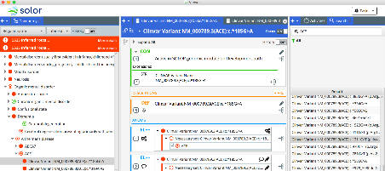
Collaborative Terminology Environment
We are currently developing a knowledge management environment that could potentially be used to integrate various specifications into a common ecosystem.
Back to Presentation Overview

Slide 85
Let’s Work Together!
We would love to work with you and your team!
Contact us!
Website
http://solor.io
Twitter
@Solor_HealthIT
Linkedin
http://solor.io/LinkedIn
Work with us!
Learn more about Solor Knowledge Architecture
Discuss how Solor can help improve semantic interoperability
Integrate and apply Solor to your workflow
Back to Presentation Overview

Slide 86
ANF Building Blocks
Back to Presentation Overview

Slide 87
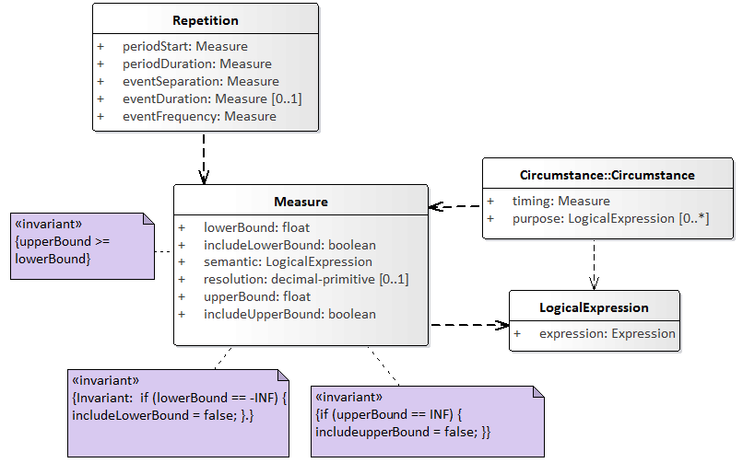
Building Blocks of ANF: Measure, Repetition, Logical Expression
ANF’s building blocks use primitive data types that can be implemented using existing data analysis tools and middleware
Invariant
Back to Presentation Overview
Notes:
Simplification of how data is represented
The effects of simplifying data types means this data can be processed much easily

