Slide 1
SOA and the New Orleans Project

Slide 2
SERVICE ORIENTED ARCHITECTURE (SOA)

Slide 3
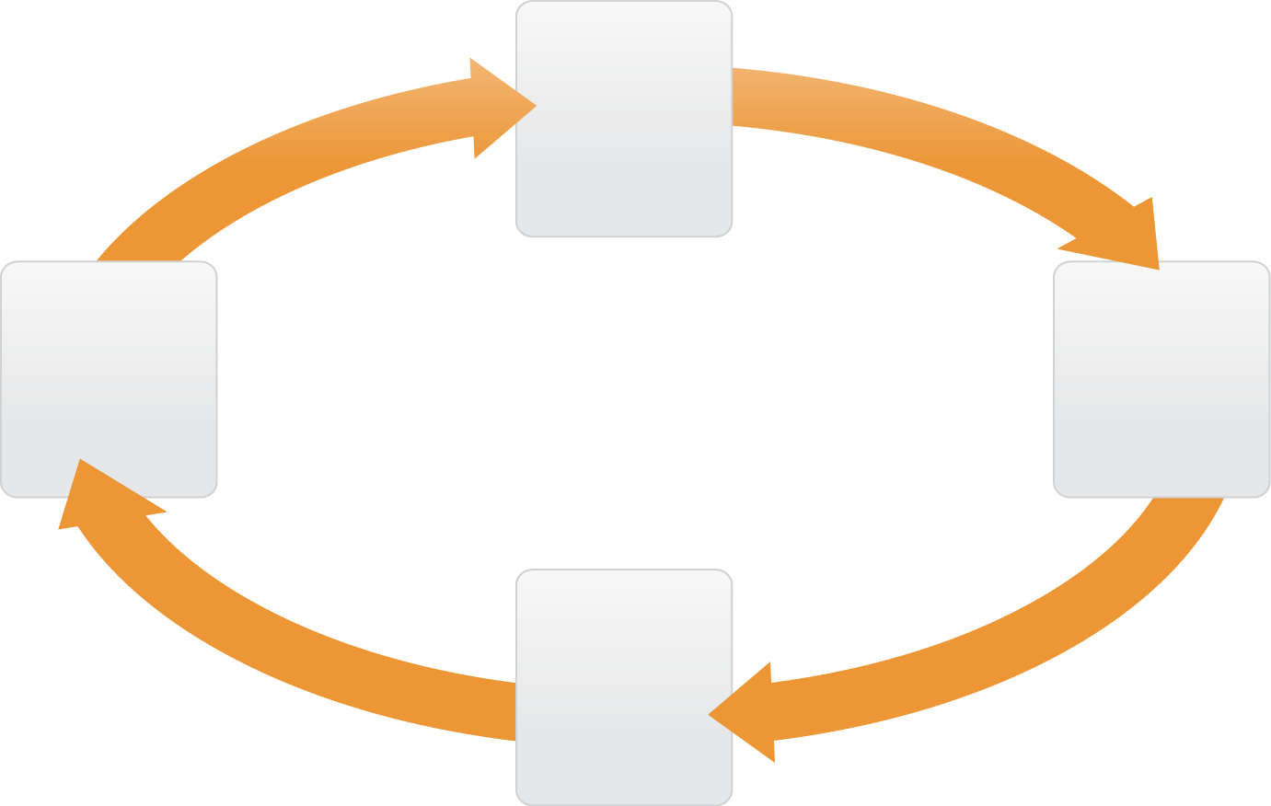
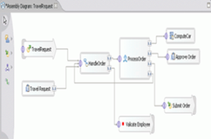
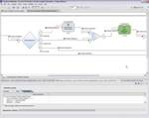
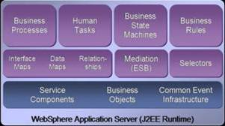
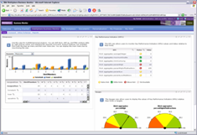
SOA AND CONTINOUS PROCESS IMPROVEMENT
SUPPORTING THE LEARNING HEALTH SYSTEM
Collaborative Development
Clean hand-off to IT with Business Models, Metrics
Integrated deployment of policies, rules, and services based on an SOA platform
Business Modeling and Simulation
Workflow and Choreography
Govern services throughout the SOA lifecycle, find and reuse for IT flexibility
Feedback for continuous improvement and optimization
Real time collaboration and management of business processes
Business Monitoring, Dashboards, Analytics

Slide 4
HARMONIQ ARCHITECTURE
EMRs
EHRs
CLINIQ
Health ALLY
SymphonIQ
Presentation
Layer
Common Presentation Layer-Angular JS Authoring Tools
Identity Management
Data Management
Clinical/Admin
Processes
CQL
Rule Engine
& Knowledge
Repository
Authorization
Vocabulary Server
Patient Consent
Application Service
Layer
Master Patient Index
Natural Language Server
Relationship Models
Business
Process
Modeling
Record Locator
Authentication
Decision Support
Enterprise Service Bus
Auditing and Logging
Master Data Management
HL7 v2/v3/FHIR
Workflow Knowledge Templates
Continuous Delivery
Context
Management
Consent/Access Management
HSPC Semantic Models
HSPC Models Services
Data Federation Layer
FHIR and Custom Healthcare Data Adapters
Data Access
Layer
CLI
ETL
CLI
ETL
CLI
ETL
CLI
ETL
Epic
ClinIQ
Siemens
ClinIQ
Cerner
ClinIQ
Greenway
ClinIQ
SymphonIQ
EDW
SymphonIQ
EDW
SymphonIQ
EDW
SymphonIQ
EDW

Slide 5
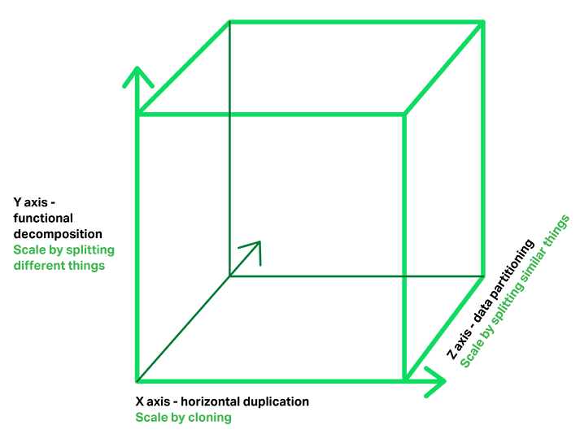
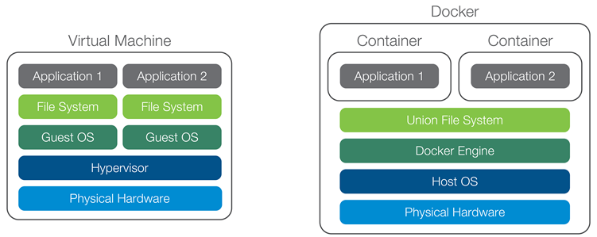
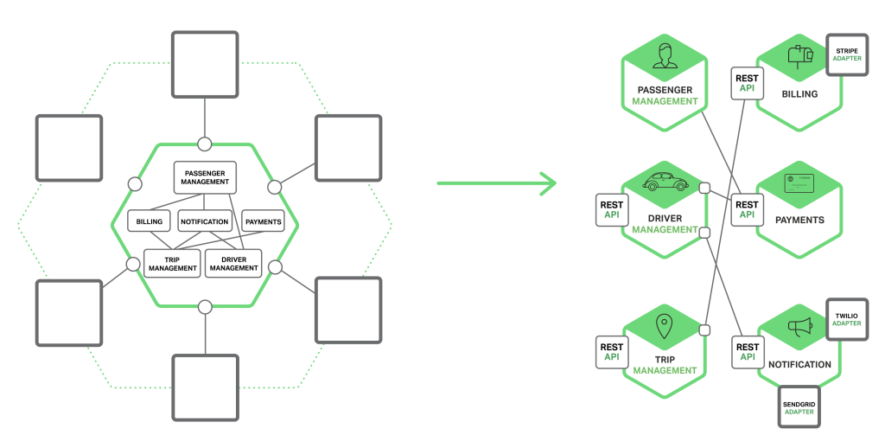
Platform
Merging multiple architectures into a cohesive, unified, standards based, advanced platform
Containers
Microservices
Continuous delivery
CONTINOUS DELIVERY
Employed by companies like Amazon, Netflix, eBay, Comcast, and Uber for over ten years
Drastic reduction in risk
Environment dependency risks reduced using lightweight virtual machines (Containers)
Environment hosting risks reduced using automated and immutable servers
Testing risk reduced using automated testing with Continuous Quality Improvement
Deployment risk reduced using incremental rollout and instantaneous rollback
Versioning risk reduced using microservices and volatility decomposition
CONTAINERS
MICROSERVICES
Evolution: Dynamic Link Libraries, Components, Services
The Art of Scalability: Martin L. Abbott, Michael T. Fisher
Axes of Scalability
Horizontal duplication (cloning resources) Functional/Volatility decomposition
- Advantages of Microservices (vs Monolithic)
Additional axis of scalability
Granular versioning
Individual scaling
Best-suited implementation
Guaranteed consistency
Quick instantiation
Lightweight resource
Management API

Slide 6
The Real World
EHR/EMRs need 30-40% enrichment of content in order to address clinical and administrative needs
EHR/EMR data is inherently dirty
Current state does support a data liquidity model
Stop making FHIR into an architecture
We need to find transition technologies that:
Support rapid schema discovery for existing systems
Deliver true federation of data (data on demand/real-time)
Embrace the full services models that other industries have migrated to

