Slide 1
http://hspconsortium.org

Slide 2
Learning Objectives
Understand HSPC Developers Program
Gain experience in setting up a SMART on FHIR sandbox in the cloud using HSPC sandbox platform*
Preview upcoming sandbox platform release with R4 support
Review HSPC developer resources
* Assume familiarity with of FHIR, SMART on FHIR, CDS Hooks
http://hspconsortium.org

Slide 3
The HSPC Developers Program
You build amazing health apps. We’ve got the tools to help.
http://developers.hspconsortium.org

Slide 4
HSPC Developers Portal
The resources needed to jump start any health app project: guides, tutorials, code samples, open source libraries, dev forums, etc.
HSPC Sandbox
A personal instance of a SMART on FHIR platform in the cloud, complete with tools and sample data to help developers build and test health apps
HSPC Gallery
HSPC's Gallery shows off some of the best SMART on FHIR applications. Browse or even take them for a spin with our live demo feature.
http://developers.hspconsortium.org

Slide 5
HSPC Developers Portfolio Features
SDK’s & Libraries
With HSPC and SMART's integration libraries, you can focus on building great apps and less on data transmission and security code.
Samples & Tutorials
Not sure how to get started? With our samples and tutorials library, you'll be up and running in no time.
Documentation
Need to dive deeper into FHIR, SMART on FHIR, or HSPC's SDKs? Our documentation library will help.
http://developers.hspconsortium.org

Slide 6
Sandbox
Fully functional FHIR server, data manager, app launcher
Vendor-neutral reference implementation environment
Support non-PHI data only (no HIPAA support)
Limited support, no SLA
http://hspconsortium.org

Slide 7
Platform Architecture
Your Apps
HSPC Sandbox Manager
EHR Simulator
Patient Viewer / Data Mgr
Scenario Builder
Persona Builder
Data Manager
Your Sandbox Instance A
https://sandbox.hspconsortium.org/<your_sandbox_name_A>
Your Sandbox Instance B
https://sandbox.hspconsortium.org/<your_sandbox_name_B>
Shared Services
Terminology Server
Sandbox Users
Launch Scenarios
FHIR Resource Server (DSTU2 or STU3)
Sandbox Users
Launch Scenarios
FHIR Resource Server (DSTU2 or STU3)
Auth Server
Personas
App Registry
FHIR Resource Datastore
Personas
App Registry
FHIR Resource Datastore
http://hspconsortium.org

Slide 8
Concept definitions
Sandbox User – an actor who has account on the HSPC platform and has access to sandbox environments
Persona - models EHR user who launches an application (practitioner or patient)
Launch Scenario – a repeatable app launch context that encapsulates a persona, patient(s) context, and a specific app
http://hspconsortium.org

Slide 9
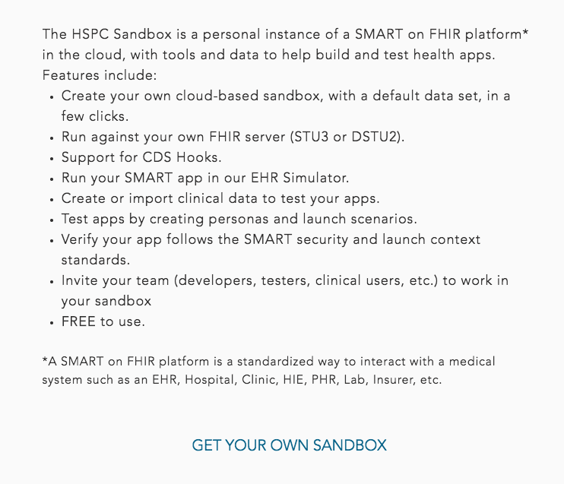
http://sandbox.hspconsortium.org

Slide 10
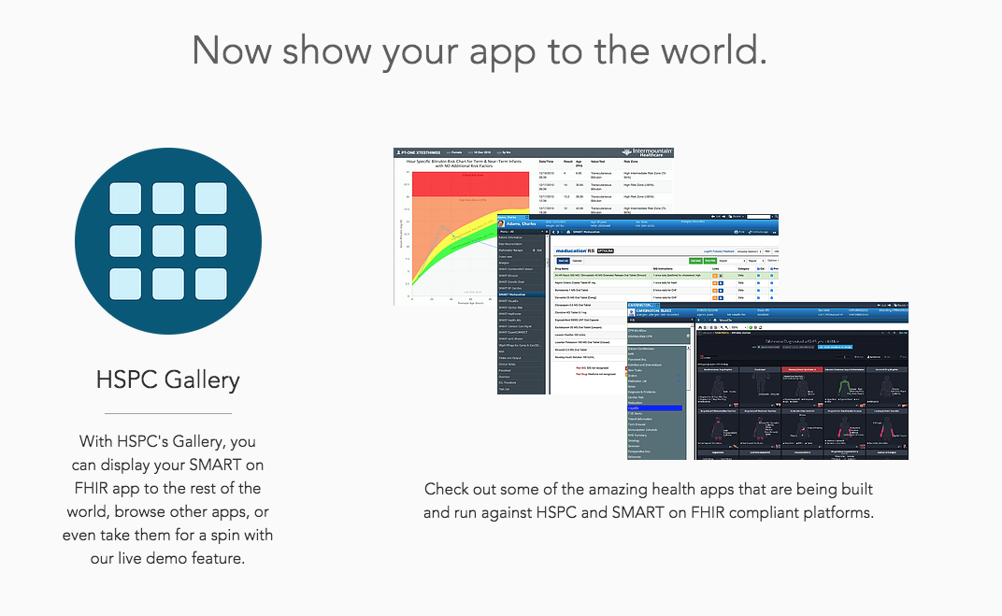
http://gallery.hspconsortium.org

Slide 11
1870
901
Sandbox Users
Unique Sandboxes
2x
298
HL7 FHIR Roundtable
Award Winner
New Users
Past 30 days

Slide 12
HSPC Internet Sites
Developer Website: developers.hspconsortium.org
Sandbox: sandbox.hspconsortium.org
Gallery: gallery.hspconsortium.org
Forum: bit.ly/hspc-developers-forum
http://hspconsortium.org

