Slide 1
A Brief Review of CIMI Progress, Plans, and Goals
CIMI/FHIR/HSPC Meeting
August 10, 2015
Stanley M Huff, MD
Chief Medical Informatics Officer

Slide 2
Introduction
Welcome to the Intermountain Healthcare Transformation Lab
Continental breakfast, afternoon snacks, lunch on your own
Purpose of these meetings:
Aug 10: Technical meeting: Laying out a course for CIMI to write HL7 FHIR profiles/clinical models
Aug 11: Clinical meeting: Creating broad consensus on HL7 FHIR profiles for true interoperability
Aug 12 -13 HSPC technical meetings
Powerpoint presentations for background, but the goal is to have discussions leading to decisions and actions
We can change the agenda as needed
All of the slides will be made available
Any suggested changes or additions to the agenda?

Slide 3
Laying out a course for CIMI to write HL7 FHIR profiles/clinical models

Slide 4
Context for this presentation
The Clinical Information Modeling Initiative (CIMI) is a community of interest that is producing detailed clinical information models to enable interoperability of health care information systems (see http://www.opencimi.org/ )
CIMI models are licensed free for use for all purposes, including commercialization and creation of derivative works
CIMI is becoming a work group within HL7

Slide 5
A diagram of a simple clinical model
Detailed Information Model for Systolic Blood Pressure
SystolicBPObs
SystolicBP
data
138 mmHg
LOINC
quals
BodyLocation
BodyLocation
data
Right Arm
PatientPosition
SNOMED CT
PatientPosition
data
Sitting

Slide 6
HL7 FHIR Resources and Profiles
FHIR Resource
Observation
Lab Obs
Patient Obs
Family Hx Obs
FHIR Profiles
Qn Lab Obs
Qual Lab Obs
Titer Lab Obs
Hematocrit
Serum Glucose
Urine Sodium
Invariant Profile Structure – CIMI Leaf Node Content

Slide 7
Background and Details on CIMI

Slide 8
CIMI Executive Committee
Stan Huff
Virginia Riehl
Nicholas Oughtibridge
Jamie Ferguson
Jane Millar
Tom Jones
Dennis Giokas

Slide 9
CIMI Modeling Taskforce
Linda Bird
Harold Solbrig
Thomas Beale
Gerard Freriks
Daniel Karlsson
Mark Shafarman
Jay Lyle
Michael van der Zel
Stan Huff
Sarah Ryan
Stephen Chu
Galen Mulroney
Heather Leslie
Rahil Siddiqui
Ian McNicoll
Michael Lincoln
Anneke Goossen
William Goossen
Josh Mandel
Grahame Grieve
Dipak Kalra
Cecil Lynch
David Moner
Peter Hendler

Slide 10
Intermountain’s Motivation for CIMI

Slide 11
The Ultimate Value Proposition of CIMI
Interoperable sharing of:
Data
Information
Applications
Decision logic
Reports
Knowledge

Slide 12
Patient

Slide 13
Core Assumptions
‘The complexity of modern medicine exceeds the inherent limitations of the unaided human mind.’
~ David M. Eddy, MD, Ph.D.
‘... man is not perfectible. There are limits to man’s capabilities as an information processor that assure the occurrence of random errors in his activities.’
~ Clement J. McDonald, MD

Slide 14
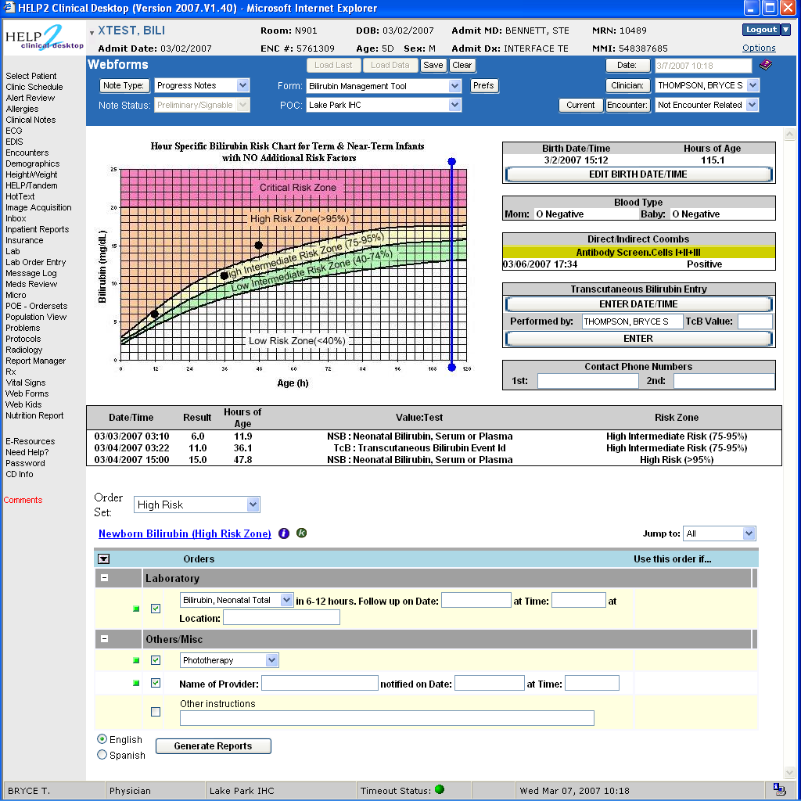

Slide 15
Newborns with hyperbilirubinemia

Slide 16
Clinical System Approach
Intermountain can only provide the highest quality, lowest cost health care with the use of advanced clinical decision support systems integrated into frontline clinical workflow

Slide 17
Decision Support Modules
Antibiotic Assistant
Ventilator weaning
ARDS protocols
Nosocomial infection monitoring
MRSA monitoring and control
Prevention of Deep Venous Thrombosis
Infectious disease reporting to public health
Diabetic care
Pre-op antibiotics
ICU glucose protocols
Ventilator disconnect
Infusion pump errors
Lab alerts
Blood ordering
Order sets
Patient worksheets
Post MI discharge meds

Slide 18
We can’t keep up!
We have ~150 decision support rules or modules
We have picked the low hanging fruit
There is a need to have 5,000 decision support rules or modules
There is no path from 150 to get to 5,000 unless we fundamentally change the ecosystem

Slide 19
Strategic Goal
Be able to share data, applications, reports, alerts, protocols, and decision support modules with anyone in the WORLD
Goal is “plug-n-play” interoperability

Slide 20
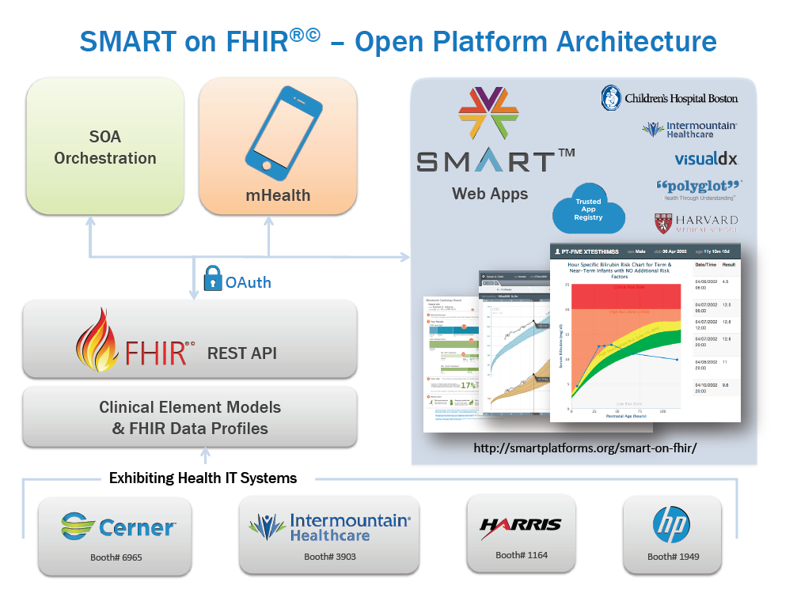
FHIR Profiles from CIMI Models
(using standard terminology)
Heterogeneous Systems
Commercial
EHR
Home Grown
System
System
Integrator
Others…

Slide 21
2015 HIMSS Demonstrations

Slide 22
CIMI Vision, Mission, and Goals

Slide 23
What Is Needed to Create a New Paradigm?
Standard set of detailed clinical data models coupled with…
Standard coded terminology
Standard API’s (Application Programmer Interfaces) for healthcare related services
Open sharing of models, coded terms, and API’s
Sharing of decision logic and applications

Slide 24
Clinical modeling activities
Netherlands/ISO Standard
ISO EN 13606
UK – NHS and LRA
Singapore
Sweden
Australia
openEHR Foundation
Canada
US Veterans Administration
US Department of Defense
Intermountain Healthcare
Mayo Clinic
MLHIM
Others….
SemanticHealthNet
HL7
Version 3 RIM, message templates
TermInfo
CDA plus Templates
Detailed Clinical Models
greenCDA
Tolven
NIH/NCI – Common Data Elements, CaBIG
CDISC SHARE
Korea - CCM
Brazil

Slide 25
Clinical Information Modeling Initiative
Mission
Improve the interoperability of healthcare systems through shared implementable clinical information models.
(A single curated collection.)

Slide 26
Clinical Information Modeling Initiative
Goals
Create a shared repository of detailed clinical information models
Using an approved formalism
Archetype Definition Language (ADL)
Archetype Modeling Language (AML)
Based on a common set of base data types
With formal bindings of the models to standard coded terminologies
Repository is open to everyone and models are licensed free for use at no cost

Slide 27
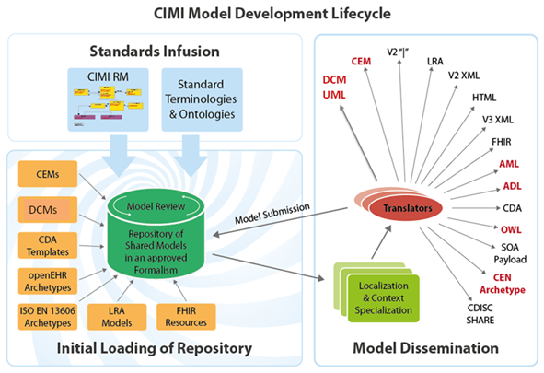

Slide 28
Access to the models
Browse and download models
CIMI models
http://www.clinicalelement.com/cimi-browser/#/
Intermountain models
http://www.opencem.org/#/

Slide 29
Goal: Models supporting multiple contexts
EHR data storage and retrieval using standard APIs
Message payload and service payload
Decision logic (queries of EHR data)
Clinical trials data (clinical research)
Quality measures
Normalization of data for secondary use
Creation of data entry screens (like SDC)
Capture of coding output from NLP

Slide 30
Selected CIMI Policies, Decisions, and Milestones

Slide 31
Terminology
SNOMED CT is the primary reference terminology
LOINC is also approved as a reference terminology
In the event of overlap, SNOMED CT will be the preferred source
(Propose that LOINC be used for lab observations - Stan)
CIMI will propose extensions to the reference terminologies when needed concepts do not exist
CIMI will have a place to keep needed concepts that are not a part of any standard terminology
CIMI has obtained a SNOMED extension identifier
CIMI will adhere to IHTSDO Affiliate’s Agreement for referencing SNOMED codes in models
Copyright notice in models, SNOMED license for all production implementations
CIMI will create a Terminology Authority to review and submit concepts to IHTSDO as appropriate

Slide 32
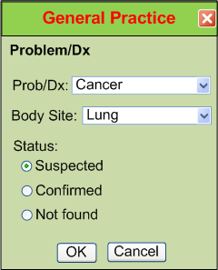
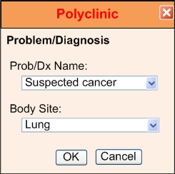
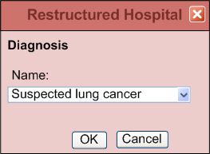
IsoSemantic Models – Example of Problem
(from Dr. Linda Bird)
e.g. “Suspected Lung Cancer”

Slide 33
Data Comes in Different Shapes and Colors
Finding – Suspected Lung Cancer
Finding – Suspected Cancer
Location – Lung
Finding – Cancer
Location – Lung
Certainty – Suspected
(Let’s say this is the preferred shape)

Slide 34
Data Standardized in the Service
Application
Application
and User
Data in preferred shape and color
Shape and color translation
Shape and color of data
in the local database

Slide 35
Partial Interoperability
Application
Application
and User
Standard Terms
(Non-standard Structure)
Term
Translators
Local databases,
CDA, HL7 V.2, etc.

Slide 36
Preferred Strategy – Full Interoperability
Application
Application
and User
Standard Structure
AND Standard Terms
(As defined by CIMI Models)
Requirements
Term and
Structure
Translators
Local databases,
CDA, HL7 V.2, etc.

Slide 37
Reasons to do it on the server side
Person writing the translation is most likely to understand the meaning of the data in their own database.
The person writing the translation only has to understand their own data and the preferred model.
They can optimize query execution for their own system
The query for the data is simpler. If the application has to write a query that will work for all shapes, the query will be inefficient to process by every system.

Slide 38
Some Principles
CIMI DOES care about implementation. There must be at least one way to implement the models in a popular technology stack that is in use today. The models should be as easy to implement as possible.
Only use will determine if we are producing anything of value
Approve “Good Enough” RM and DTs
Get practical use ASAP
Change RM and DTs based on use

Slide 39
Primary Near Term Goals
As soon as possible, make some high quality CIMI models available in a web accessible repository
ADL 1.5 (AOM framework) and/or UML (AML, XMI)
That use the CIMI reference model
That have complete terminology bindings
Get the models used in someone’s working system
Document our experience
Improve our processes and models
Repeat!

