Slide 1
Modeling Options
HSPC Meeting
June 17, 2015
Washington DC

Slide 2
General News
Joint CIMI FHIR meeting is being planned
Meetings will be in Salt Lake City, August 10-11, hosted by Intermountain Healthcare
Everyone is invited
Aug 10: Technical meeting: laying out a course for CIMI to write profiles/clinical models
Aug 11: Clinical meeting: creating broad consensus on profiles for true interoperability

Slide 3
CIMI and HSPC
Clinical Information Modeling Initiative (CIMI)
International organization for making “logical” models for interoperability
Healthcare Services Platform Consortium (HSPC)
Defining service APIs to support truly interoperable software
Use CIMI models to define “truly” interoperable services

Slide 4
Challenge
We are all using SMART and FHIR, but we may be using different profiles

Slide 5
Profile for “Blood pressure”
Observation = Blood Pressure
Subject.reference: Patient URL
Coding: LOINC 55284-4
Related:
type: has-component
target.reference:
Observation URL
type: has-component
target.reference:
Observation URL
Observation = Systolic BP
name: “Systolic”
coding: LOINC 8480-6
value.units: “mmHg”
Observation = Diastolic BP
name: “Diastolic”
coding: LOINC 8462-4
value.units: “mmHg”

Slide 6
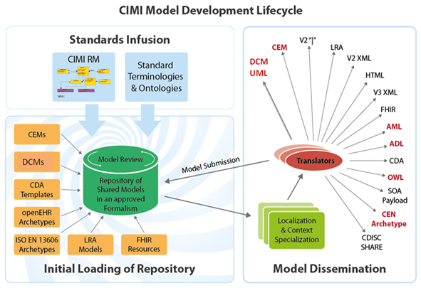

Slide 7
Possible Process
Standard
Terminologies
HL7 FHIR
Resources
Translator
(or manual)
HSPC approved
HL7 FHIR
Profiles
CIMI
Models
SOLOR
Intermountain
CEMs
openEHR
Archetypes
Isaac
(LEGOS)

Slide 8
HL7 FHIR Resources and Profiles
FHIR Resource
Observation
Lab Obs
Patient Obs
Family Hx Obs
FHIR Profiles
Qn Lab Obs
Qual Lab Obs
Titer Lab Obs
Hematocrit
Serum Glucose
Urine Sodium
Invariant Profile Structure – CIMI Leaf Node Content

Slide 9
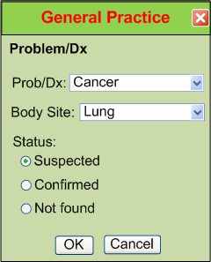
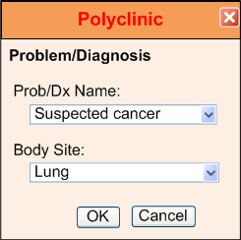
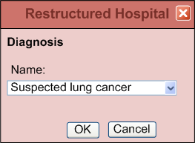
IsoSemantic Models – Example of Problem
(from Dr. Linda Bird)
e.g. “Suspected Lung Cancer”

Slide 10
Data Comes in Different Shapes and Colors
Finding – Suspected Lung Cancer
Finding – Suspected Cancer
Location – Lung
Finding – Cancer
Location – Lung
Certainty – Suspected
(Let’s say this is the preferred shape)

Slide 11
Data Standardized in the Service
Application
Application
and User
Data in preferred shape and color
Shape and color translation
Shape and color of data
in the local database

Slide 12
Partial Interoperability
Application
Application
and User
Standard Terms
(Non-standard Structure)
Term
Translators
Local databases,
CDA, HL7 V.2, etc.

Slide 13
Preferred Strategy – Full Interoperability
Application
Application
and User
Standard Structure
AND Standard Terms
(As defined by CIMI Models)
Requirements
Term and
Structure
Translators
Local databases,
CDA, HL7 V.2, etc.

Slide 14
Reasons to do it on the server side
Person writing the translation is most likely to understand the meaning of the data in their own database.
The person writing the translation only has to understand their own data and the preferred model.
They can optimize query execution for their own system
The query for the data is simpler. If the application has to write a query that will work for all shapes, the query will be inefficient to process by every system.

Slide 15
One Reason for Modeling
Models are defined so that when a programer needs to access patient data they know the precise logical structure of the data, and the exact codes that are allowed when a query is formulated. The semantics are explicit so the data can be returned in exactly the same structure even though the data is stored physically in many different ways.

Slide 16
Raw LOINC Codes
Code | Component | Prop |  | System | Scale | Method
2339-0 | Glucose | MCnc | Pt | Bld | Qn |  | mg/dL | Glucose [Mass/volume] in Blood
2341-6 | Glucose | MCnc | Pt | Bld | Qn | Test strip manual | mg/dL | Glucose [Mass/volume] in Blood by Test strip manual
2340-8 | Glucose | MCnc | Pt | Bld | Qn | Test strip automated | mg/dL | Glucose [Mass/volume] in Blood by Automated test strip

Slide 17
Options Considered

Slide 18
Options for Data Representation (Glucose in blood by manual test strip)
Option 1
PreCoordinatedGlucoseModel
name (focus): 2341-6 (Glucose [Mass/volume] in Blood by Test strip manual)
data.value: 120 mg/dL
method (qual): 1234 Test strip manual
data.value: 120 mg/dL
Sample query for quantative serum glucose by any method:
Select * from Observation where Observation.code in (2341-6, 2339-0, … [list of all MCnc LOINC codes with or without method in the code])
Sample query for quantative serum glucose by a specific method:
Select * from Observation where Observation.code == 2341-6
Comment:
To support the “any method query,” the list of codes in the query would need to be updated as new LOINC codes with methods were added.

Slide 19
Options (continued)
Option 2
PostCoordinatedGlucoseModel 1
name (focus): 2341-6 (Glucose [Mass/volume] in Blood by Test strip manual)
method (qual): 1234 Test strip manual
data.value: 120 mg/dL
Sample query for quantative serum glucose by any method:
Select * from Observation where Observation.code in (2341-6, 2339-0, … [list of all MCnc LOINC codes with or without method in the code])
Sample query for quantative serum glucose by a specific method:
Select * from Observation where Observation.code == 2341-6 OR
Select * from Observation where Observation.code == 2341-6 and method.code == 1234
Comment:
The list of codes in the query would need to be updated as new LOINC codes with methods were added. The method information is available in the method attribute, but it is redundant with the method information in the precoordinated code.

Slide 20
Options (continued)
Option 3 (The CIMI preferred model)
“Fully” PostCoordinatedGlucoseModel
name (focus): 2339-0 (Glucose [Mass/volume] in Blood)
method (qual): 1234 Test strip manual
data.value: 120 mg/dL
Sample query for quantative serum glucose by any method:
Select * from Observation where Observation.code = 2339-0
Sample query for quantative serum glucose by a specific method:
Select * from Observation where Observation.code == 2339-0 and method.code == 1234
Comment:
The list of codes in the query would not need to be maintained as new method codes were added. The method information is available only in the method attribute. There is only one way to query for each supported use case.

Slide 21
Options (continued)
Option 4
Permissive PostCoordinatedGlucoseModel
name (focus): (2341-6 OR 2339-0) --- Pre or post coordinated codes are allowed
method (qual): 1234 Test strip manual
data.value: 120 mg/dL
Sample query for quantative serum glucose by any method:
Select * from Observation where Observation.code in (2341-6, 2339-0, … [list of all MCnc LOINC codes with or without method in the code])
Sample query for quantative serum glucose by a specific method:
Select * from Observation where Observation.code == 2339-0 and method.code == 1234 OR
Select * from Observation where Observation.code == 2341-6 OR
Select * from Observation where Observation.code == 2341-6 and method.code == 1234
Comment:
The list of codes in the query would need to be updated as new LOINC codes with methods were added. Three ways to do the method specific query.

Slide 22
Options (continued)
Option 5
“Totally” PostCoordinatedGlucoseModel
name (focus): Glucose
method (qual): 1234 Test strip manual
component: Glucose
specimen: BLD
property: MCNC
scale: QN
data.value: 120 mg/dL
Sample query for quantative serum glucose by any method:
Select * from Observation where Observation.code == “Glucose” and specimen == “BLD” and property == “MCNC” and scale == “QN”
Sample query for quantative serum glucose by a specific method:
Select * from Observation where Observation.code == “Glucose” and specimen == “BLD” and property == “MCNC” and scale == “QN” and method == 1234 (Test strip manual)
Comment:
Long query statements, possible non-sense errors.

Slide 23
Implementation of the Preferred Option

Slide 24
QN Lab “Universal” - 1
Example 1 – Quantitative lab tests with method and challenge
Abstract Model
PostCoordinatedQuantLabUnivModel
name (focus): [value set of QN Lab LOINC items where method and challenge is not specified]
method (qual): [value set of all valid quantitative lab methods]
challenge (mod): [value set of all valid challenge concepts]
data.value.units: [value set of all quantitative lab units of measure]
Item to be represented: Glucose [Mass/volume] in Blood
Leaf level post coordinated QN lab model (no method) – CIMI preferred model
PostCoordinatedGlucoseModel
name (focus): LN 2339-0 (Glucose [Mass/volume] in Blood)
data.value.units: SCT 258797006 (mg/dL)

Slide 25
QN Lab “Universal” - 2
Example 1 – Quantitative lab tests with method
Abstract Model
PostCoordinatedQuantLabUnivModel
name (focus): [value set of QN Lab LOINC items where method and challenge is not specified]
method (qual): [value set of all valid quantitative lab methods]
challenge (mod): [value set of all valid challenge concepts]
data.value.units: [value set of all quantitative lab units of measure]
Item to be represented: Glucose [Mass/volume] in Blood by Test strip manual
Leaf level post coordinated QN lab model and method – CIMI preferred model
PostCoordinatedGlucoseModel – (model meaning binding, id code at the model level, should be the same for both the pre and post coordinated models)
name (focus): LN 2339-0 (Glucose [Mass/volume] in Blood)
method (qual): CIMISCT 1111 Test strip manual (117021008 Test strip method)
data.value.units: SCT 258797006 (mg/dL)
Leaf level pre coordinated QN lab model and method – CIMI iso-semantic model
PreCoordinatedGlucoseModel
name (focus): LN 2341-6 (Glucose [Mass/volume] in Blood by Test strip manual)
data.value.units: SCT 258797006 (mg/dL)

Slide 26
QN Lab “Universal” - 3
Example 1 – Quantitative lab tests with challenge
Abstract Model
PostCoordinatedQuantLabUnivModel
name (focus): [value set of QN Lab LOINC items where method and challenge is not specified]
method (qual): [value set of all valid quantitative lab methods]
challenge (qual): [value set of all valid challenge concepts]
data.value.units: [value set of all quantitative lab units of measure]
Item to be stored: Glucose [Mass/volume] in Serum or Plasma --1.5 hours post 0.5 g/kg glucose IV
Leaf level post coordinated QN lab model and challenge – CIMI preferred model
PostCoordinatedGlucoseChallengeModel
name (focus): 2345-7 (Glucose [Mass/​volume] in Serum or Plasma)
challenge (qual): CIMISCT 2222 (1.5H post 0.5 g/kg glucose IV)
data.value.units: SCT 258797006 (mg/dL)
Lead level pre coordinated QN lab model and challenge – CIMI iso-semantic model
PreCoordinatedGlucoseChallengeModel
name (focus): LN 1492-8 (Glucose [Mass/volume] in Serum or Plasma --1.5 hours post 0.5 g/kg glucose IV)
data.value.units: SCT 258797006 (mg/dL)

Slide 27
QN Lab “Universal” - 4
Example 1 – Quantitative lab tests with mehtod and challenge
Abstract Model
PostCoordinatedQuantLabUnivModel
name (focus): [value set of QN Lab LOINC items where method and challenge is not specified]
method (qual): [value set of all valid quantitative lab methods]
challenge (qual): [value set of all valid challenge concepts]
data.value.units: [value set of all quantitative lab units of measure]
Item to be stored: Glucose [Presence] in Urine by Test strip --1.5 hours post 75 g glucose PO
Leaf level post coordinated QN lab model method and challenge – CIMI preferred model
PostCoordinatedGlucoseChallengeAndMethodModel
name (focus): LN 2349-9 (Glucose [Presence] in Urine)
method (qual): CIMISCT 1111 Test strip manual (117021008 Test strip method)
challenge (qual): CIMISCT 3333 (1.5H post 75 g glucose PO)
data.value.code: [value set binding for Present/Absent]
Lead level pre coordinated QN lab model method and challenge – CIMI iso-semantic model
PreCoordinatedGlucoseChallengeAndMethodModel
name (focus): LN 6763-7 (Glucose [Presence] in Urine by Test strip --1.5 hours post 75 g glucose PO by Test Strip)
data.value.code: [value set binding for Present/Absent]

Slide 28
Request from CIMI to LOINC
Create “methodless” LOINC codes where they don’t exist for the top 2000 lab LOINC codes
This would be about 500 new LOINC codes

Slide 29
Rationale for Request
To support the CIMI preferred way of representing data we need “methodless” LOINC codes
These codes would sometimes be useful for ordering

Slide 30
Summary
Lab data is one of the simpler kinds of data
Use of models that are “partially” interoperable would have value in many use cases
Getting to “true” interoperability is hard
We want “true” interoperability in truly interoperable HSPC services
Many use cases would not need “true” interoperability

Slide 31
Next Steps
Continue making CIMI models with HSPC needs as a high priority
Generate FHIR profiles based on information in the CIMI models
Create tools to make it easy to browse and incorporate the FHIR profiles into applications and services

