Slide 1
The Consortium
Welcome to the 8th meeting
of the
The Healthcare Services Platform Consortium

Slide 2
Internet
Network: ACS_Public
PIN: Quality2012DC

Slide 3
Current Status
Provider led 501 (c) (3)
Focusing on a Healthcare Services Model similar to IOS or Android
270+ Interested parties
Led by Intermountain, LSU, VA and others
International participation with eHealth, Canada Health Infoway and NHS
Collaborating with other consortia
Open Source on internal assets and libraries
Collaboration with ACOG, ACS, C4MI, AHA, HL7, CIMI, Argonauts and others
HIMSS 2015
17 vendors participated throughout the floor on HSPC demo
Included Epic, Cerner, Athena and others
Major initiatives
FHIR profiles-data virtualization
Homogenizing vocabulary models
Healthcare SOA architecture
Identifying priority for use cases
VA Care Coordination and Clinical Pathways
Perioperative Use Case
Perinatal Use Case
…

Slide 4
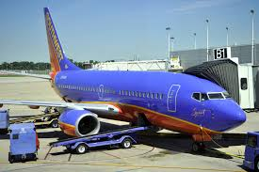
10.3 hours in the air
$67/minute
401/minute

Slide 5
Use Case Development
Identify what you want to do
Rank them by priority
Formalize the value proposition
Write a use case legal agreement with expectations, limitations
Implementation guide that packages context of the solution and delineates standards
Align incentives to use case to incentivize adoption and overcome hurdles of data sharing
Collaborate…collaborate…collaborate

