Slide 1
THE HEALTHCARE INNOVATION ECOSYSTEM
HiMSS 2015 & Development Sandboxes Update
by Rick Freeman
President & Founder
iSalus Consulting
June 19, 2015

Slide 2
@

Slide 3
Application Developers
Platforms Providers/Developers

Slide 4
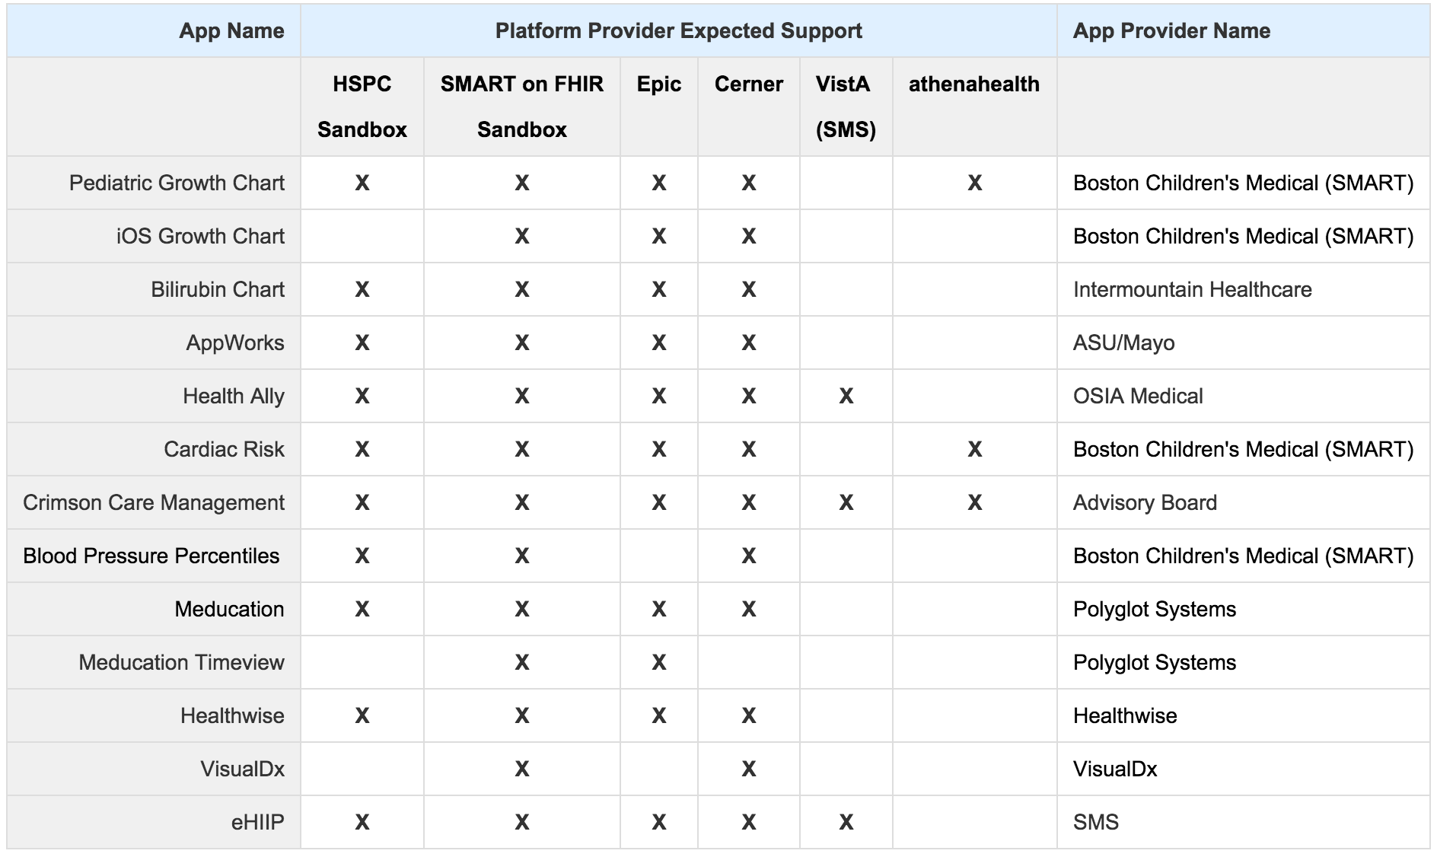
HiMSS 2015 Presence MOMENTUM IS BUILDING

Slide 5
The HSPC Development Resources & Sandbox
Access to features and data representative of a large scale hospital system.

Slide 6
What about these HSPC Sandboxes?
There are two different types of sandboxes
Application Development Sandbox
The purpose of these sandboxes is to provide a fully functional, EMR neutral implementation of the specification to enable rapid development of clinical apps.
Changes to the features of the platform will be infrequent, well communicated, and of only stable releases.
Will contain clinical data representative of real world medium to large-scale EMR implementations.
Platform Advancement Sandbox
The purpose of these sandboxes it to provide an environment where proposed or exploratory features can be developed and tested.
Provides a location for multiple organizations to collaborate on experimental platform features.
Platform features can be vetted before being officially proposed for specification inclusion.
Insulates Application developers from frequent platform changes.

Slide 7
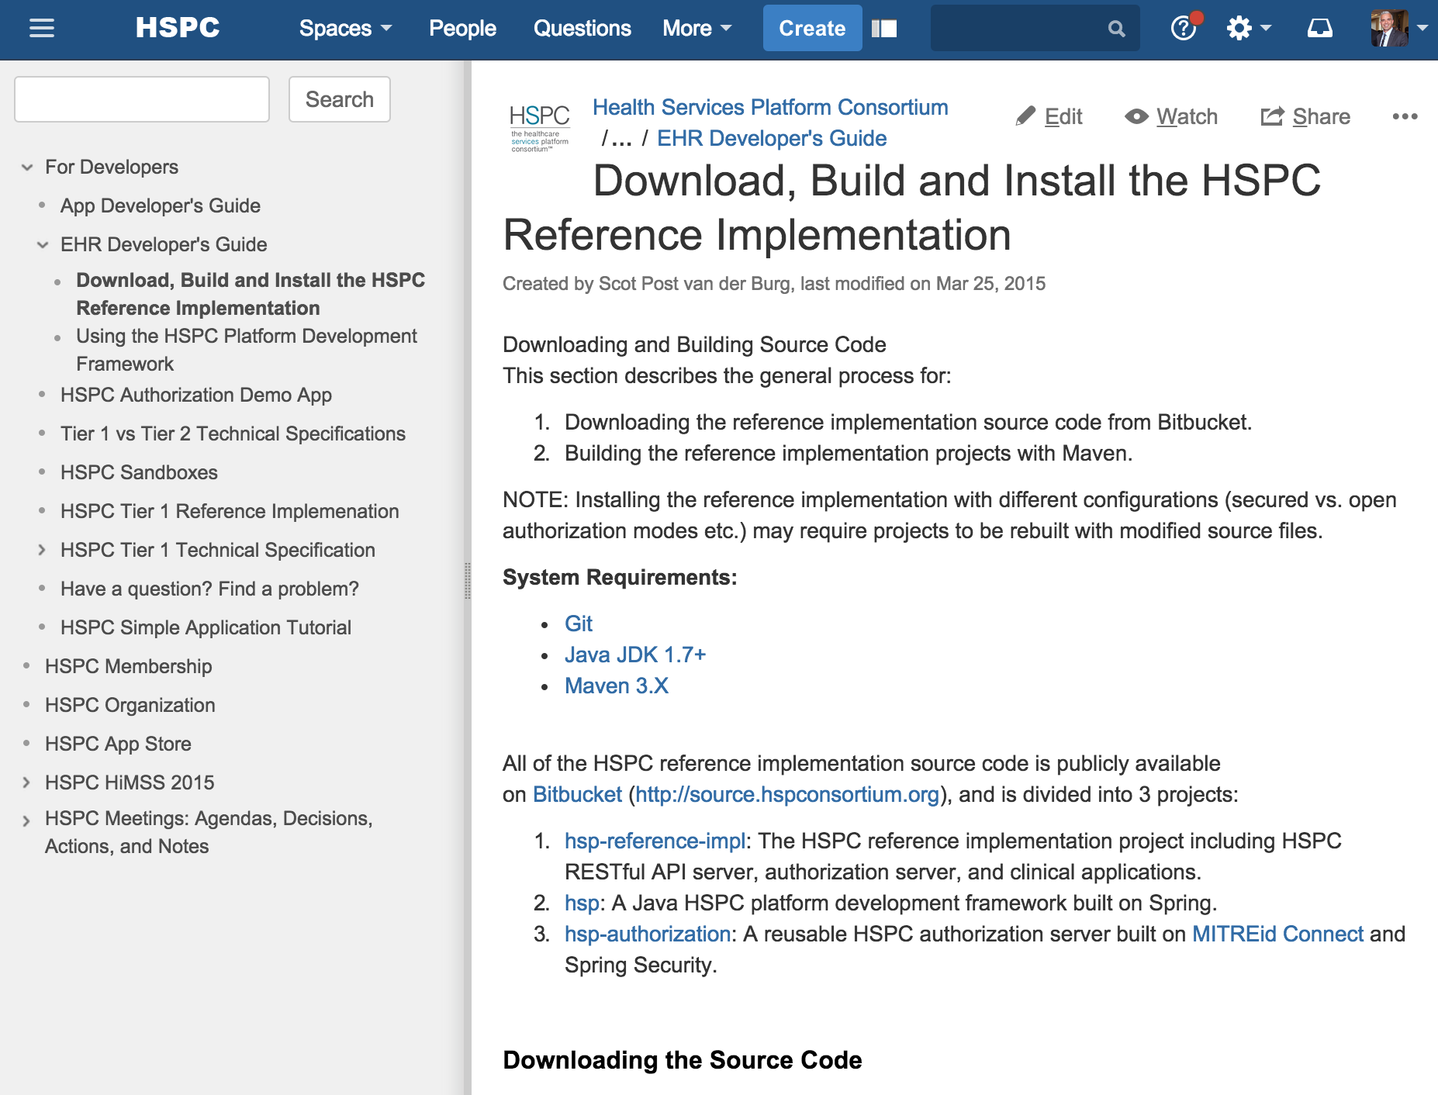
Status of the Developer Resources & Sandbox

Slide 8
Developer Resources & Sandboxes
Developer Resources
https://healthservices.atlassian.net/wiki/display/HSPC/For+Developers
DSTU1 Development Sandbox
https://hspc.isalusconsulting.com/demo
No new development planned for this sandbox.
The test data is very.
Not all FHIR resources are supported.
The HSPC FHIR Profiles are still being developed. See the Modeling and Terminology roadmap in JIRA.
DSTU2 Development Sandbox
https://hspc.isalusconsulting.com/dstu2/demo
FHIR Services Based on HAPI FHIR
Using Smart on FHIR Security Specification
Limited Sample Data
Only Bilirubin App Supported at the moment
The HSPC FHIR Profiles are still being developed. See the Modeling and Terminology roadmap in JIRA.

Slide 9
DSTU2 Sandbox URLs
Limited Patient Data – 67 Patients
Un-Secured: https://hspc.iSalusConsulting.com/dstu2/open-hsp-api/data
Secured: https://hspc.iSalusConsulting.com/dstu2/hsp-api/data
Authorization Server: https://hspc.iSalusConsulting.com/dstu2/hsp-auth
Example Query: https://hspc.isalusconsulting.com/dstu2/open-hsp-api/data/Patient?_format=json

Slide 10
Currently Being Developed
Java Client Library
Code Flow Client Authorization (User Facing)
Credentials Flow Client Authorization (Server to Server)
FHIR REST & JSON Template Libraries
More Apps converted to DSTU2 Sandbox
Improved Documentation
Update/Enhance DSTU2 Sandbox Documentation
Separate DSTU2 Sandbox from DSTU1 Sandbox Documentation

Slide 11
Up Next
Platform Enforcement of Scope Based Security
Implementation of HSPC FHIR Profiles
Simplified Installation of Reference Implementation (Vagrant)
Deployment of Platform Artifacts to Public Maven Repository
Server-to-Server Authorization (Support for apps that run outside the context of an EHR session).

Slide 12
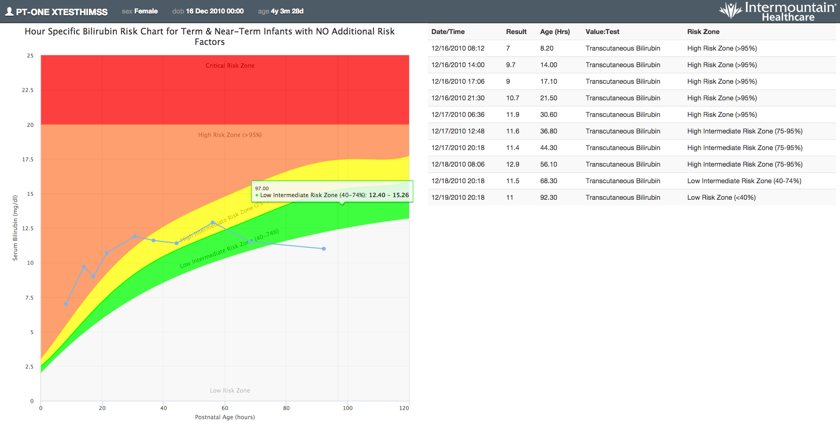
Demo HSPC Sandbox running Intermountain’s Bilirubin Risk Chart

Slide 13
Q & A

Slide 14
What about the HSPC App Store?
It’s central to the mission and vision of HSPC. Where is it?
Work has yet to begin… But, it’s next on the roadmap for 2015.
GOAL: HSPC App Store fully functional and open for business by SXSW Interactive 2016 and HiMSS 2016.
There is a lot to figure out.
Certification Testing (Will vendors require an extra certification?)
Hosting
Deployment
Payment model & commission.
Security
Customer support model
What’s next?
Need a committee and resources dedicated to building the app store and working through all the process and legal mumbo jumbo.

Slide 15
The HSPC Technical Specification
Taking a phased approach to enable the creation of meaningful applications.

Slide 16
Standards Based Spec Phase 1 (This is just the beginning)
REST
FHIR PROFILES
RxNorm

Slide 17
Phase 1 of the HSPC Spec
Semantically Interoperable Data Exchange using FHIR
Governed by HSPC FHIR Profiles (collaboration with Argonaut is a goal)
SMART on FHIR OAUTH2 Profiles for User Authorization
SMART on FHIR Application Launch Context
Support for applications that run outside of a specific user context
E.g. Apps triggered by events
Simple Eventing & Alerting
Integration into existing EHR workflows
Apps will launch inside an existing EHR workflow
User Notification & Messaging

Slide 18
Phase 2 of the HSPC Spec
GOAL: Enable innovation for use cases that involve multiple healthcare organizations or that move beyond the capabilities of existing EMRs and EHRs. Some Use Cases Phase 2 addresses include:
Use cases that span multiple EMR and EHRs
Care Coordination between independent platforms
Referrals & Scheduling
Workflows between separate healthcare organizations
Population Health Management and Analytics
Clinical Workflow modeling and orchestration of clinical services

Slide 19
Phase 1 vs. Phase 2
Phase 1 Goals
Phase 2 Goals
Semantically Interoperable Data Exchange
Data Access Authorization
Launch Context Sharing
EHR or EMR embedded application launching
Event based applications and applications that run outside of the EHR or EMR.
Simple Eventing & Alerting
User Notification & Messaging
Care Coordination between independent EHRs or EMRs
Clinical Workflow Modeling and Orchestration
Population Health Management

