Slide 1


Standards Activities and CIIC
January 12, 2018
Stanley M. Huff, MD

Slide 2
Agenda
Interoperability Activities
  NCVHS
  ONC
  HL7 Groups
    FHIR, CIMI, SMART (not HL7 yet!), CDS Hooks, Argonauts, Partners in Interoperability
  Sequoia
  IHE
  Commonwell
  Center for Medical Interoperability
  AMA IHMI
  SOLOR
  NLM Value Set Authority Center (VSAC)
  Common Data Elements
  Structured Data Capture
  RSNA – RadLex
  OSEHRA
  CARIN
  PCORINET
  Direct

Slide 3
HL7 Activities

Slide 4




FHIR
API specification for RESTful access to clinical resources
Applications portable against any vendor implementing FHIR services
Any application capable of making HTTPS calls can consume FHIR services

Slide 5
FHIR: Core Resources
AdverseReaction
Alert
AllergyIntolerance
CarePlan
Composition
ConceptMap
Condition
Conformance
Device
DeviceObservationReport
DiagnosticOrder
DiagnosticReport
DocumentReference
DocumentManifest
Encounter
FamilyHistory
Group
ImagingStudy
Immunization
ImmunizationRecommendation
List
Location
Media
Medication
MedicationAdministration
MedicationDispense
MedicationPrescription
MedicationStatement
MessageHeader
Observation
OperationOutcome
Order
OrderResponse
Organization
Other
Patient
Practitioner
Procedure
Profile
Provenance
Query
Questionnaire
RelatedPerson
SecurityEvent
Specimen
Substance
Supply
ValueSet

Slide 6
Observation Resource
Observation (DomainResource)
identifier : Identifier [0..*]status : code [1..1]« ObservationStatus! »
code : CodeableConcept [1..1] « LOINC ?? »
subject : Reference [0..1]« Patient|Group|Device|Location »
encounter : Reference [0..1] « Encounter »
effective[x] : Type [0..1]« dateTime|Period »
value[x] : Type [0..1]
« Quantity|CodeableConcept|string|Range|Ratio|SampledData|
Attachment|time|dateTime|Period »
interpretation : CodeableConcept [0..1] « Observation Interpretation+ »
method : CodeableConcept [0..1] « Observation Methods?? »
specimen : Reference [0..1] « Specimen »
device : Reference [0..1] « Device|DeviceMetric »
Observation
subject <patient identifier>
code (test code) from LOINC
value <the result of the test>
Observation
subject: Doe, John; #12345 code: 8480-6, Systolic BP
value: 120 mmHg

Slide 7
Example: Fetch a systolic blood pressure
GET https://open-api.fhir.me/Observation/8567?_format=json
{
"resourceType": "Observation",
"text": {
"status": "generated",
"div": "<div>1999-07-02: Systolic blood pressure = 109 mm[Hg]</div>"
},
"name": {
"coding": [
{
"system": "http://loinc.org",
"code": "8480-6",
"display": "Systolic blood pressure"
}
]
},
"valueQuantity": {
"value": 109.0,
"units": "mm[Hg]",
"code": "mm[Hg]"
},
"appliesDateTime": "1999-07-02",
"status": "final",
"subject": {
"reference": "Patient/1186747"
}
}
Resource (unique) ID
Resource Type
Semantics
Clinical Values
URL to Patient

Slide 8
Profile for “Blood pressure”
Observation = Blood Pressure
Subject.reference: Patient URL
Coding: LOINC 55284-4
Related:
type: has-component
target.reference:
Observation URL
type: has-component
target.reference:
Observation URL
Observation = Systolic BP
name: “Systolic”
coding: LOINC 8480-6
value.units: “mmHg”
Observation = Diastolic BP
name: “Diastolic”
coding: LOINC 8462-4
value.units: “mmHg”
19

Slide 9
People Use LOINC Codes Differently
Variations on use of methodless and method specific codes
Confusion on blood versus serum or plasma
Confusion on properties
Confusion on NAR vs NOM
Etc.
21

Slide 10
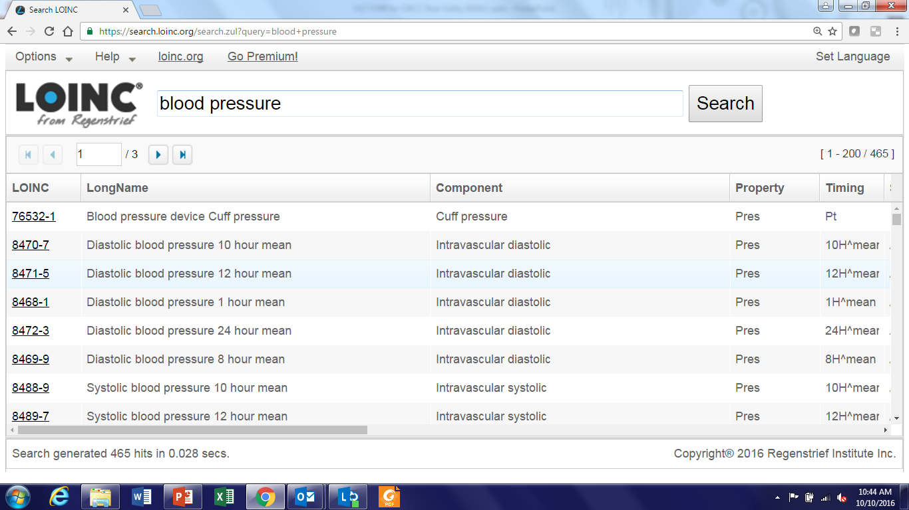
LOINC Codes for Blood Pressure

Slide 11
Terminology Entropy
No true interoperability because
  Provider organizations use different models/profiles
  Professional organizations use different models/profiles
  Vendors use different models/profiles
  Government agencies use different models/profiles
  Physicians vs Nurses vs Therapists vs …
  Clinical care vs Research
23

Slide 12

Clinical Information Modeling Initiative

Slide 13
CIMI
The Clinical Information Modeling Initiative (CIMI) is an HL7 Work Group that is producing detailed clinical information models to enable interoperability of health care information systems
CIMI was initiated during a “Fresh Look” session at an HL7 meeting in 2011
CIMI models are free for use for all purposes
See http://www.opencimi.org/ for more details
11

Slide 14
CIMI Mission
Improve the interoperability of healthcare systems through shared implementable clinical information models.

Slide 15
Make a shared repository of Detailed Clinical Models (aka logical models)
SystolicBPObs
SystolicBP
data
138 mmHg
LOINC
quals
BodyLocation
BodyLocation
data
Right Arm
PatientPosition
PatientPosition
SNOMED CT
data
Sitting
Notes:
Shows how parts of the model relate to each other
Shows the connections to standard coded terminologies
Issues of the boundary between models and terminology need to be considered at the same time to arrive at unambiguous meaning

Slide 16
CIMI creates “computable logical models.”
The models are algorithmically processable
Models show the structural relationship of the model elements (containment)
Models are expressed in a formal computable format
Coded elements have explicit binding to allowed coded values (attributes and values)
Models are independent of any specific programming language, implementation technology, or type of database
The models must support explicit, unambiguous query statements against data instances

Slide 17

SMART Platform –Open Specification for Apps
“Substitutable Medical Apps”
  Kohane/Mandl – NEJM (2009)
A SMART App is a Web App
  HTML5 + JavaScript
  Remote or embedded in EHR
  URL passes context & FHIR link
EHR Data Access via FHIR
OAuth2 / OIDC for security

Slide 18
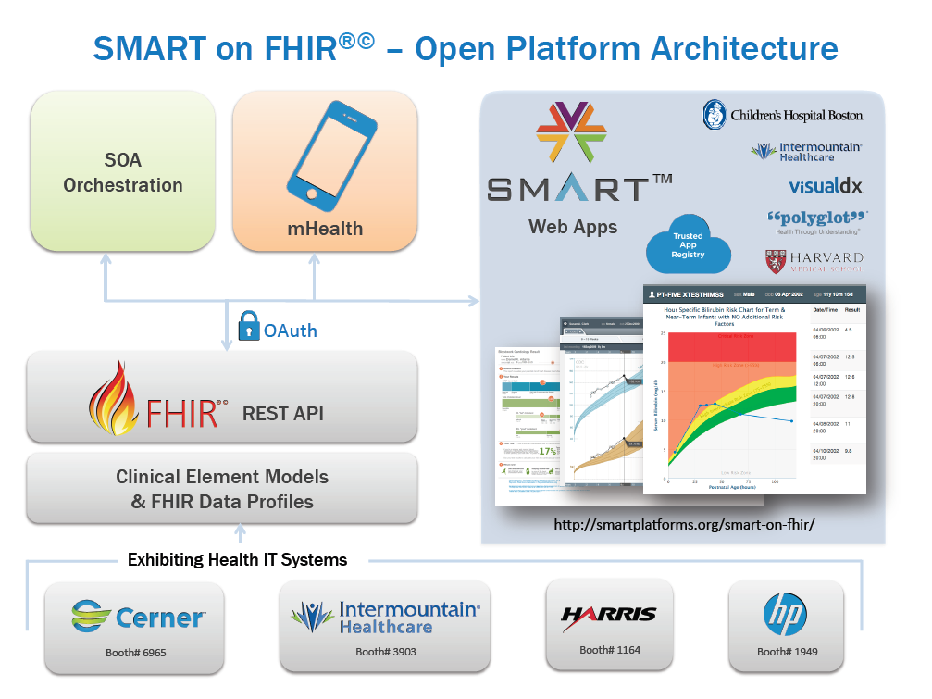


FHIR Profiles from
CIMI models
Heterogeneous Systems
Others…
18
Notes:
This slide focuses on EHR centric activity, but the scope of HSPC is all of healthcare!

Slide 19
CDS Hooks
Started in 2015 by Josh Mandel, creator of SMART (kickoff Oct 2015)
Open source (Apache Version 2.0)
Prototyped in PowerChart at Jan 2016 HL7 Connectathon
Evolving standard

Slide 20
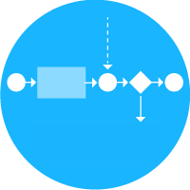

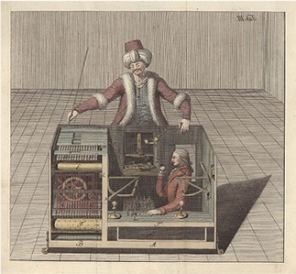

CDS Service
A service that is:
invoked by the EHR via a hook,
evaluates its own rules using FHIR data,
returns decision support via cards or decisions
Notes:
Doesn’t care about how the service is implemented

Slide 21
Hook Examples
patient-view
When a patient’s chart is opened
medication-prescribe
When a medication is selected for prescription
order-review
Viewing pending orders for signing

Slide 22
What is the Argonaut Project?
The Argonaut Project is an implementation community comprising leading technology vendors and provider organizations to accelerate the use of FHIR and OAuth in health care information exchange.
We are:
  Private sector initiated and funded
  Working collaboratively with other FHIR initiatives such as SMART-on-FHIR, the Health Systems Platform Consortium, and the FHIR Foundation
  Creating open industry Implementation Guides in high priority use cases of importance to patients, providers and the industry as a whole
We are NOT:
  A company
  A standards development organization
  A proprietary activity

Slide 23
Who’s Behind the Argonaut Project?
Technology Vendors | Provider Organizations
Accenture | Beth Israel Deaconess Medical Center
Athenahealth | Intermountain Health
Cerner | Mayo Clinic
Epic | Partners Healthcare
McKesson | SMART at Boston Children’s Hospital
MEDITECH
Surescripts
The Advisory Board Company
Staff (current and past)
  Prime contractor: HL7
  FHIR initiatives: Grahame Grieve, Josh Mandel, Brett Marquard, Eric Haas
  OAuth initiatives: Dixie Baker, Josh Mandel
  Project Management: Micky Tripathi, Jennifer Monahan

Slide 24
81 Organizations Registered in Argonaut Implementation Community

Slide 25
Argonaut Implementation Guides In a Nutshell
Query | Supported searches | Scope of response | Content of response
Patient | Identifier (e.g., MRN) OR (Full name + gender OR Full name + birthdate) | FHIR patient resources | Name Patient identifier Gender Birthdate Birth sex Race, ethnicity, language
Allergies | Patient OR Patient + Date | All allergies | Type of allergy Allergy status
Assessment and Plan of Treatment | Patient OR Patient + Category OR Patient + Status OR Patient + Specified date range | All Assessment and Plan of Treatment information | Care plan category (Argonaut extensions) Care plan status Narrative summary
Care Team | Patient OR Patient + Category OR Patient + Status | All current Care Team members | Care plan category (Argonaut extensions) Care plan status Care team members Care team provider roles
Goals | Patient OR Patient + Specified date range | All patient goals | Narrative description of goals Goals status
Immunizations | Patient | All immunizations | Immunization status (Argonaut valueset) Date of administration Type of vaccine Indicator of vaccine given or reported
Medications (statements) | Patient | All medications | Medication Medication status Date or date range
Medications (order) | Patient | All medication orders | Medication Order date Order status Prescriber

Slide 26
Argonaut Implementation Guides In a Nutshell (continued)
Query | Supported search operations | Scope of response | Content of response
Laboratory results (diagnostic reports) | Patient OR Patient + Diagnostic Report Code(s) OR Patient + Specified date range | All diagnostic reports | Laboratory code (LOINC) Result Status Time of measurement Time of report Source of report
Laboratory results (observations) | Patient OR Patient + Laboratory Code(s) OR Patient + Specified date range | All observations | Laboratory code (LOINC) Result value Status Time of measurement Reference range
Problems and Health Concerns | Patient | All problems and health concerns, current and historical | Problem or health concern code Problem or health concern category code (Argonaut extension) Problem or health concern status Verification status
Procedures | Patient OR Patient + Specified date range | All procedures, current and historical | Type of procedure Date performed Procedure status
Smoking status | Patient | Smoking status | Smoking observation status Result value code (LOINC) Date recorded Smoking status
Vital signs | Patient OR Patient + Specified date range | All vitals | Type of measurement (Argonaut value set) Time of measurement Result value (Argonaut value set) Observation status
Implantable devices | Patient | All UDIs for a patient’s implantable devices | Human readable form of barcode string Type of device

Slide 27
HL7 Partners in Interoperability
A regular meeting (twice a year) organized by HL7 to share information about interoperability
Three tracks
  Clinical
  Biopharma
  Payers

Slide 28
ONC
Office of the National Coordinator for Health Information Technologyf (ONC)
The position of National Coordinator was created in 2004, through an Executive Order by the 2nd President Bush, and legislatively mandated in the Health Information Technology for Economic and Clinical Health Act (HITECH Act) of 2009.
ONC is the principal federal entity charged with coordination of nationwide efforts to implement and use the most advanced health information technology and the electronic exchange of health information.

Slide 29

Healthcare Services Platform Consortium: Progress toward True Semantic Interoperability

Slide 30
Healthcare Services Platform Consortium
Mission
Improve health by creating a vibrant, open ecosystem of interoperable applications, content, and services
Vision
Be a provider-led organization accelerating the delivery of a platform that supports innovative healthcare applications for the improvement of health and healthcare.
Notes:
First meeting held Aug 5, 2013
Incorporated as a not-for-profit corporation on Aug 22, 2014
3 Benefactor members
Veterans Administration
Louisiana State University Health
Intermountain Healthcare
Key alliances
Center for Medical Interoperability (C4MI)
OSEHRA
3 Associate (organizational) members
Regenstrief
Motive
Allscripts
11 Individual members
Society Members: AMA, MHII and ACOG

Slide 31
HSPC Technical Strategies
Data virtualization
  HL7 FHIR (initial strategy)
  HL7 CIMI information models
    Automated or semi-automated creation of FHIR profiles
EHR/EMR integration
  SMART (initial strategy)
  Federated Real-Time Restful Services
SOA
  Orchestration, work flow, knowledge sharing
  SOA, BPM, Drools, etc.

Slide 32
Sequoia
In 2012, The Sequoia Project was chartered as a non-profit 501(c)(3) to advance the implementation of secure, interoperable nationwide health information exchange. Grew out of ONC’s NHIN project.
  The vision is to make the right health information accessible at the right place and time to improve the health and welfare of all Americans.
    Currently exchanging primarily CDA documents
    Very interested in exchange of discreet data using FHIR
eHealth Exchange – a network of exchange partners who securely share clinical information over the Internet across the US, using a standardized approach.
Carequality- a network of networks
RSNA Image Share – network for image sharing
http://sequoiaproject.org/

Slide 33
Integrating the Healthcare Enterprise (IHE)
A group sponsored by HIMSS
Creates profiles and implementation guides on existing standards
Some of the profiles have also become standards themselves
HIMSS/IHE folks attended the first CIIC meeting

Slide 34
Commonwell Health Alliance
Creating and executing a vendor-neutral platform that breaks down the technological and process barriers that currently inhibit effective health data exchange
The scope is semantic interoperability, but…
Inititial focus has been primarily on patient identity and administrative transactions
http://www.commonwellalliance.org/

Slide 35
Center for Medical Interoperability
A centralized, vendor-neutral approach to performing technical work that enables person-centered care, testing and certifying devices and systems, and promoting the adoption of scalable solutions
Scope of activity is healthcare interoperability, but initial focus has been on medical grade Wi-Fi and device interoperability
They have declined membership in HSPC
Representatives attended the first CIIC meeting
http://medicalinteroperability.org/

Slide 36
Target Architecture
Electronic Health
Records
Clinical
Applications
Research, Innovation
& Analytics
Enterprise
Application Layer
Specific Application(s)
3
Platform - Application
Interfaces
Plug-and-Play Interoperability Platform
PnP IOP
Platform Layer
Multi-Enterprise Router
1
Enterprise/Departmental Data Broker
Device - Platform
Interfaces
Gateways and IT Systems
Bedside/PoC Broker
Device
Layer
Device
Interfaces
2
Medical Devices
Standards-based
Proprietary
Notes:
[

Slide 37
AMA Integrated Health Model Initiative

Slide 38

A Common Data Model Solution (from Kristina Finney)
Created for and available to all stakeholders at no cost, sustained by paid resources, and incorporates expert input
A medical information model and master coding system that:
  Integrates existing code sets;
  Adds function, state, patient goals, descriptors and other critical data elements;
  Organizes data in a shared context;
  Supports expression of wellness and population health;
  Enables semantically interoperable technical solutions and care models; and
  Evolves based on real world use and feedback.

Slide 39
AMA Integrated Health Model Initiative
Intermountain has been visiting with the AMA since December 2016
Still learning about what IHMI is
3 Layers – terminology, models (context), knowledge
Model review process is managed by AMA

Slide 40
Others
  SOLOR
  NLM Value Set Authority Center (VSAC)
  Common Data Elements
  Structured Data Capture
  RSNA – RadLex (now joined with LOINC)
  OSEHRA

Slide 41
Questions?

