Slide 1
Development and Implementation of Reference Models
Roberto A. Rocha, MD, PhD, FACMI
Managing Director Semedy, Inc.
Assistant Professor of Medicine Division of General Internal Medicine and Primary Care Brigham and Women’s Hospital, Harvard Medical School

Slide 2
Overview
Background
Reference models
Clinical documentation
Efforts, challenges, lessons learned
Knowledge management
Assets, lifecycle, tools
Conclusions

Slide 3
Background

Slide 4
Reference models
Detailed clinical models that guide the implementation of robust and consistent clinical documentation templates within Electronic Health Record (EHR) systems
Promote standardization of structured clinical data captured at the point-of-care – e.g. forms, flowsheets
Compatible with different EHR tools, clinical settings, and clinical professionals

Slide 5
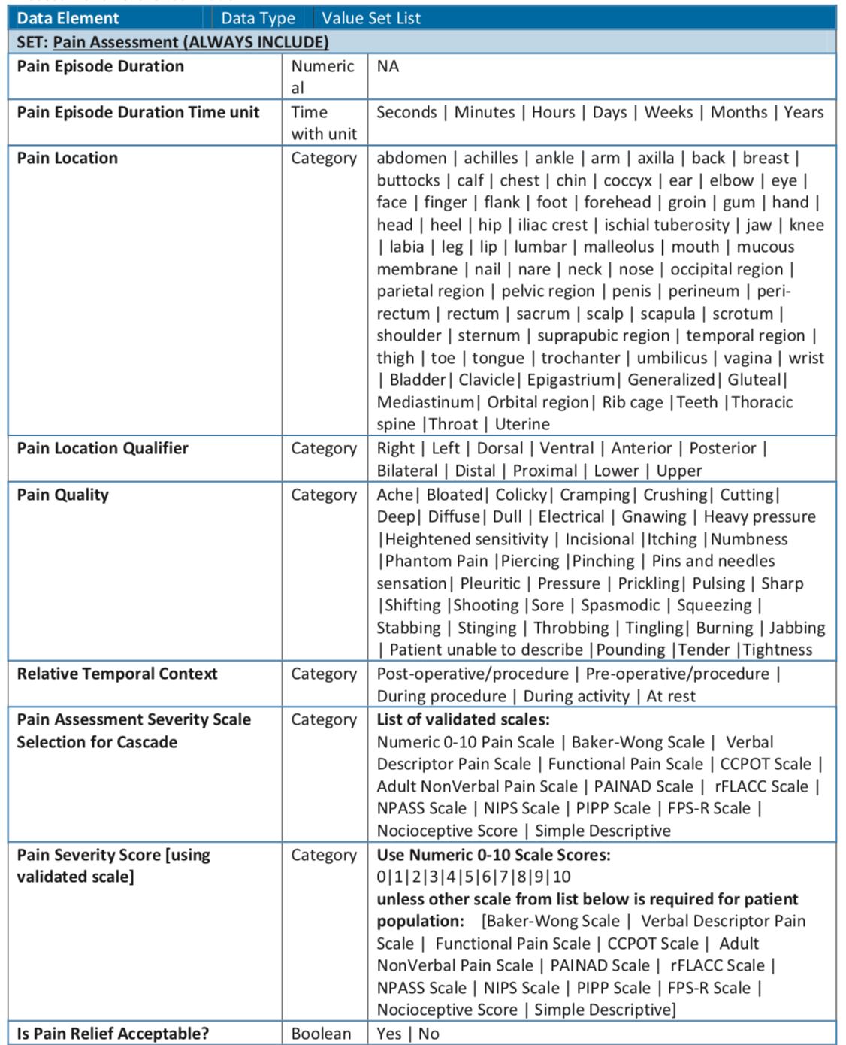
Collins SA, Bavuso K, Swenson M, Suchecki C, Mar P, Rocha RA. Evolution of an Implementation-Ready Interprofessional Pain Assessment Reference Model. AMIA Annu Symp Proc. 2017:605-14.

Slide 6
Clinical Documentation

Slide 7
Acute Care Documentation (1/3)
Publication:
Collins SA, Bavuso K, Zuccotti G, Rocha RA. Lessons learned for collaborative clinical content development. Appl Clin Inform. 2013 Jun 26;4(2):304-16
Context:
Large strategic initiative back in 2007 to develop standardized acute care documentation across two major academic medical centers: Brigham and Women’s Hospital and Massachusetts General Hospital

Slide 8
Acute Care Documentation (2/3)
Goals:
Highly structured documentation to fulfill clinical needs, regulatory reporting, and data reuse
All clinical disciplines (e.g. nursing, medicine, social work, physical therapy, nutrition, occupational therapy)
Proactive data standardization in an effort to avoid ambiguity and duplication – e.g. naming convention for data elements, reuse of value sets, etc.
Results:
Over 11,000 data elements defined, used in over 1,000 documentation templates – e.g. initial patient assessments, progress notes, procedure and perioperative notes, event notes, transfer notes, discharge notes, assessment scales, flowsheets, etc.
Bedside documentation system was not implemented

Slide 9
Acute Care Documentation (3/3)
Challenges:
Clinical requirements well understood by stakeholder groups - easily gained traction when cited as a rationale for content development requirements
Knowledge management and informatics requirements not well understood – formal processes to garner support and adherence
Limited resources, expertise, and competing priorities
Lessons learned:
Assess knowledge needs and set expectations at the start of the project
Define an accountable decision-making process
Increase team meeting moderation skills
Ensure adequate resources and competency training with online collaborative tools
Develop goal-oriented teams and consultative service-based teams

Slide 10
Large-scale EHR implementation (1/4)
Publications:
Collins SA, Gesner E, Morgan S, Mar P, Maviglia S, Colburn D, Tierney D, Rocha R. A Practical Approach to Governance and Optimization of Structured Data Elements. Stud Health Technol Inform. 2015;216:7-11
Gesner E, Collins SA, Rocha R. Pain Documentation: Validation of a Reference Model. Stud Health Technol Inform. 2015;216:805-9
Collins SA, Gesner E, Mar PL, Colburn DM, Rocha RA. Prioritization and Refinement of Clinical Data Elements within EHR Systems. AMIA Annu Symp Proc. 2016:421-430
Bavuso KM, Mar PL, Rocha RA, Collins SA. Gap Analysis and Refinement Recommendations of Skin Alteration and Pressure Ulcer Enterprise Reference Models against Nursing Flowsheet Data Elements. AMIA Annu Symp Proc. 2017:421-9
Collins SA, Bavuso K, Swenson M, Suchecki C, Mar P, Rocha RA. Evolution of an Implementation-Ready Interprofessional Pain Assessment Reference Model. AMIA Annu Symp Proc. 2017:605-14
Zhou L, Collins S, Morgan SJ, Zafar N, Gesner EJ, Fehrenbach M, Rocha RA. A Decade of Experience in Creating and Maintaining Data Elements for Structured Clinical Documentation in EHRs. AMIA Annu Symp Proc.2016:1293-1302

Slide 11
Large-scale EHR implementation (2/4)
Context:
System-wide vendor EHR implementation (2012-2017) – replace existing clinical systems
Goals:
Minimize (resolve) inconsistent data definitions across EHR applications and clinical settings, enabling and promoting data reuse and interoperability
Practical (pragmatic) approach to governance and implementation of structured data elements and reference models
Factors: resource allocation, implementation timeline, content refactoring, vendor best-practices, EHR limitations, etc.

Slide 12
Large-scale EHR implementation (3/4)
Process:
Identify clinical topics – align with strategic goals of the organization
Create draft reference model(s) – find/consolidate/reuse models
Quantify downstream data needs – reporting, regulatory requirements, clinical decision support, accurate billing, etc.
Prioritize clinical topics – focus on high-value topics
Validate reference model(s) – clinically accurate and complete
Quantify gap with EHR content – prioritize revision/refactoring
Disseminate validated model(s) – guide new content or revisions
Request revisions to EHR content – change management process
Assess reference model utilization – implementation and compliance
Monitor for new evidence - revisions to reference model (evergreen)

Slide 13
Large-scale EHR implementation (4/4)
Results:
Data elements: +15,000 (forms) and +45,000 (flowsheets)
Dedicated workgroup: +5 reference models (discontinued)
Pain Assessment: 47 data elements organized into 9 data groups
EHR system successfully implemented at all sites
Challenges:
Implementation timeline incompatible with the development of detailed reference models
EHR processes and tools not designed to promote detailed, consistent, and reusable data definitions across applications and modules
EHR content & data refactoring is an iterative process that requires expertise and motivated individuals

Slide 14
Knowledge Management

Slide 15
Clinical Knowledge Management (CKM)
Systematic and sustainable acquisition, adaptation (localization), and management of knowledge assets
Assets → data capture, clinical decision support (CDS), population management, analytics, etc.
Includes the adaptation of reference knowledge sources to reflect local requirements, resources, and priorities
Follows a well-defined lifecycle, including specific stages for documentation, testing, and monitoring – supported by skilled resources and integrated tools
Rocha RA, Maviglia SM, Sordo M, Rocha BH. Clinical knowledge management program. In: Greenes RA, editor. Clinical Decision Support - The Road to Broad Adoption (Second Edition). Burlington: Academic Press; 2014. p. 773-817

Slide 16
Scope of CKM activities
alerts, reminders, medication warnings, duplication warnings, therapeutic alternatives, infobuttons, etc.
CDS
Data Templates
Terminology & Ontology Management
Software Infrastructure
Data Definitions
forms, flowsheets, documentation templates, data fields, calculators, etc.
value sets and classification rules for problems, medications, procedures, etc.
master files, dictionaries, translation tables, and reference ontologies (e.g. SNOMED CT, ICD-10-CM, LOINC)
editors, portals, repositories, virtual collaboration tools, knowledge retrieval services, rule execution engines

Slide 17
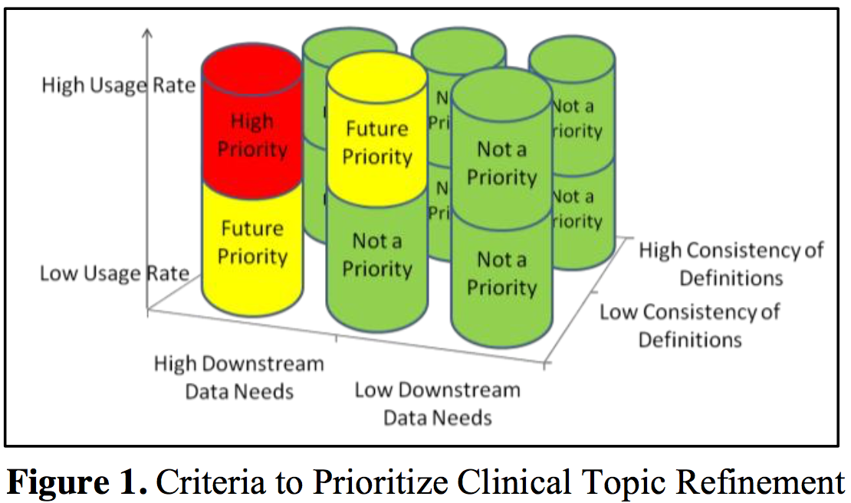
Focus on relevant clinical topics
Collins SA, Gesner E, Mar PL, Colburn DM, Rocha RA. Prioritization and Refinement of Clinical Data Elements within EHR Systems. AMIA Annu Symp Proc. 2016:421-430

Slide 18
KM lifecycle → Reference Models
Request (new or update)
Design
Implement
Test & Deploy
Monitor
Evaluate
Authorize & Prioritize

Slide 19
Conclusions

Slide 20
Conclusions: implementation
Early engagement of clinical leaders to set expectations of technical process, dependencies, and requirements
Provision of formal training about informatics standards and governance processes
Establish a KM (Informatics) team with proper authority and robust toolset – guide implementation and ensure compliance with processes and standards

Slide 21
Conclusions: models & assets
Establish governance for essential asset types
Define and optimize curation processes (lifecycle)
Implement software platform integrated with knowledge sources and consumers
Monitor & evaluate processes and interventions
Seek alignment with standards, maximizing interoperability and external collaborations
Collaborate with other institutions to help amortize operational costs and promote innovation

Slide 22
Thank you!
Roberto A. Rocha, MD, PhD
r.rocha@computer.org
http://scholar.harvard.edu/rarocha
This work by Roberto A. Rocha is licensed under a Creative Commons Attribution-NonCommercial-ShareAlike 4.0 International License

