Slide 1
Project and Process Identification
Facilitators:
Susan Matney
Julia Skapik
Jimmy Tcheng

Slide 2
Target Outcome
Develop principles and criteria for identifying and executing CIIC’s first projects→ partner initiatives
Identify up to three new or existing [projects] that can partner with CIIC soon after this meeting→ including success criteria and evaluate these projects based on criteria
Develop a plan for engagement, process, and action--> extend existing process to depict an initial view of how to accomplish the work and a picture of what the larger support system needed for the initiatives and the overall governance

Slide 3
Proposed Principles
Two-pronged approach to model creation: Hybrid: Convenience and Strategic
Shared high priority concepts as collaborative projects – demographics, standard labs, meds, procedures, UDI, problems, common assessments, anatomic path, microbiology – “Core / general data elements”
Domain-specific concepts developed by stakeholder communities – “Domain-specific data elements”
Principles that should guide CIIC interactions with other groups: See consensus principles
Only advance projects where: team is committed, has resources to build, and plans to implement
Build on existing work, not despite it
Plan wisely - introduction of models, implementation into workflow, and interoperability testing

Slide 4
Proposed (initial) Criteria for Project Selection
Project characteristics
Ongoing project, expected tangible results in 1 year or less
Representative / committed clinical, sponsor and stakeholder communities
Primary perspective is clinical care (clinicians and patients)
Need / commitment to implement data standards
Participation requirements
Agreement to represent perspectives of all interested stakeholders, including participation in governance
Agreement to use shared process / technical approach / tooling
Agreement to implement work product as standards / open source content (with allowable license with IP disclosure)
Informatics resourcing
Resources commensurate to clearly defined tasks
Broad representation of perspectives and expertise on the project team
Reuse existing models whenever possible; alternative modeling requires clear justification with different use case

Slide 5
commitment to Principles
Commitment to feedback/external participation/shared representation and perspectives
Commitment to open source (with allowable IP)
Commitment to reuse existing content if appropriate to use case
Agreement to utilize shared process/tooling
Agreement to shared technical (standards-based) approach

Slide 6
Success criteria
Criticality/ high value /linked to a strategic imperative
Economic
Regulatory
Execution of patient care
Improved outcomes
Safety
Interoperability
Multidisciplinary
Patient-centered

Slide 7
Success criteria
Amenable to improvement (higher improvement=more value)
Adequate resources (time, financial, data)
Adequate expertise
Clearly defined scope
Clearly defined lifecycle with participation of stakeholders throughout

Slide 8
Success criteria*
Has multi-stakeholder involvement (OK if multilayered-– ie differential participation)
Clinical
Technical/informatics/terminology
Process
Implementer
System (Developer, HIE, Registry and otherwise depending on use case but the broader the better)
Patient
* Opportunities for further engagement (patient advocacy groups, drug organizations)

Slide 9
Success criteria
Potential for reuse
Reducing provider burden
Testing and validation plan
Implementation plan
Maintenance plan/stewardship
Primary perspective is clinical care
Initial phase to last 6-12 months for a tangible deliverable, OK to have multi-phased approach

Slide 10
Criteria | Registries on FHIR CDEs | MDEpinet/RAPID | Pain Assessment | Cancer Core Data Set
Success | Significant number of registries are using the CDEs to pull data from EHRs and write to registries. Pilot has been completed by NCDR Cath PVI, SVS-VQI | Implementation in domain specific data elements in registries and clinical documentation. | Pain tracked across settings using standards in two or more institutions. | Used for decision support and quality measurement for cancer treatment.
Scope | HIT 15 CDEs with patient identification | 100 CDEs?? |  | Cancer staging - 200 data elements
Implementator(s) | NCDR Cath PVI, SVS-VQI | Epic, Medstreaming | UofMinn, Brigham and Women’s | PenRad, ACS,
Resources (funding) | PCPI in kind, DCRI in-kind, Pew charitable trust, Intermountain in-kind | MDEpinet, Intermountain in-kind | Intermountain in-kind | PenRad in-kind
 |  |  | Nursing Big Data Group | Mitre in-kind ACS VA
Commitment to CIIC requirements | High | High | ?? | High
Date first phase completed | Fall 2018 | Fall 2017 | Fall 2018 | ??
Date of implementation | Fall 2019 | Fall 2018 |  | ??

Slide 11
Additional projects
5) SHIELD: Mike Waters, FDA, EHR developers, device/lab vendors, clinicians
Scope: Laboratory In Vitro Diagnostics, CLIA
Implementation use cases: real-time epidemiology for ID tracking and opioid treatment
Success:
Resources/support: Currently funded by industry and FDA resources
High value: Critical to clinical care, multistakeholder, high reuse potential
Opportunity: Moderate— currently not ready for on boarding, high potential value/alignment
Next step: outreach to SHIELD group re: technical approach and CIIC

Slide 12
Additional projects
6) Women’s Health CRN: Farrah Darbouze, Lisa Lang, Terrie Reed, Behnaz Minaei
Scope: Common Data Elements for Women’s Health Coordinated Registry Network (reproductive health, preventive health, primary care)
Implementation use cases: Deployed women’s health registries
Success:
Resources/support: PCOR funding, in kind support from ONC, FDA, NLM
High value: Interoperability use case, health disparities, multidisciplinary effort

Slide 13
Additional projects
7) IHMI/ Modeling information around SDOH: AMA/Christina Finney, SIREN
Scope: Social Determinants of Health
Next step: discussion of alignment/evaluation of principles
8) IHMI/ Interoperable device data PGHD: AMA/Christina Finney, MDEpinet?
Scope: Device data
9) AHRQ Outcomes Measure Framework: AHRQ, outcome SME teams
Scope: 5 domain areas: depression, lumbar spondyloithesis, afib, asthma, lung cancer

Slide 14
Additional projects
10) Newborn Screening Translational Research Network: (Rebecca Goodwin)
Scope: Tracking newborn outcomes
11) Radiology Standards Harmonization with Enhanced Laboratory Modeling: Sarah Mauldin/VA
Scope: tracking lifetime dosing of radiation
12) Imaging Information Interoperability Initiative (I4): ACR, PenRad, Intermountain, RSNA
Scope: radiology imaging documentation and decision-making
IFOR, RadLex, etc.

Slide 15
Additional projects
13) Am College of Obstetrics & Gynecology (ACOG – Steve Hasley)
Office of Population Affairs
14) University of Utah (Claude Nanjo) – data elements to support
Opioid calculator, bilirubin calculator
Patient dashboards
15) Intermountain – (Grant Wood)
Clinical genetics, pharmacogenomics
Whole genome sequencing

Slide 16
Plan for Engagement: (Turf to Marketing)
Engagement
Project owners / sponsors
Informatics resources
Process
Providing consultation / education / guidance
Defining expected content
CIIC development process
Actions
Monitoring progress
Feedback loop

Slide 17
Project Description
Project summary
Sponsors and collaborators
Informatics resources
Informatics work products / scope
Timeline / milestones
Work plan
Testing and implementation plan

Slide 18
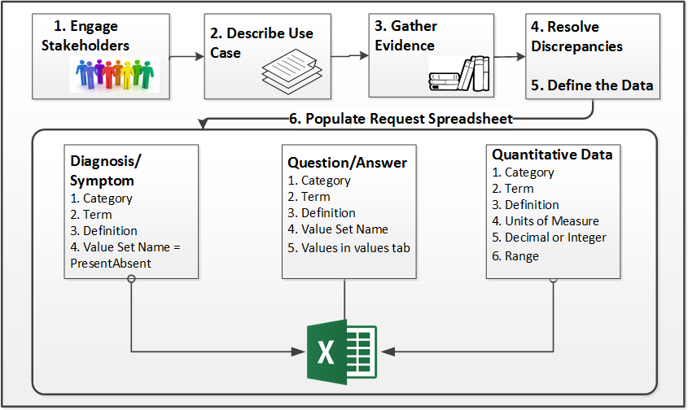
Content Analysis/Request Process: ONC Supported

Slide 19
Additional process steps : integrate into Process above
Define project scope
Scan for existing model content in composed models
Scan existing registration for similar/related content
Build around CIMI model approach— categorize by datatype and utilize terminology model to segment the content
Add new content into registration tool/location
Gather existing sample data
Define use cases and personas for dataset

Slide 20
Additional process steps: integrate into Process above
Engage existing content owners
Guidance for terminology use
Better acronym ☺
Intellectual property
Partnership agreement
Identify resources

Slide 21
Additional process steps : integrate into Process above
Review list of tags and metadata for content
Identify relevant tags for the use cases
Ownership rules
Validation steps
Feedback process
Endorsement

Slide 22
Additional process steps : integrate into Process above
Maintenance requirements
Formal publication requirements
Use tagging
Integration testing
Mapping guidance

Slide 23
Next steps
Complete initiative gathering and evaluation process
Complete success criteria
Enumerate the commitments of partners
Extend the existing process with additional steps and document extended process
Review all above content with stakeholders

