Slide 1
Terminology and Modeling Decisions
February 4, 2015
Stanley M. Huff, MD
Chief Medical Informatics officer
Intermountain Healthcare

Slide 2
Server Side Normalization of Data

Slide 3
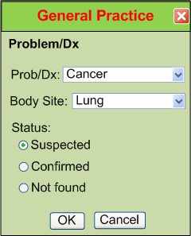
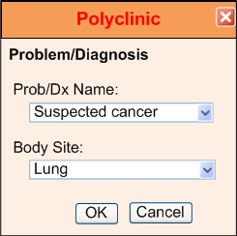
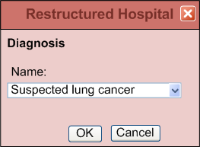
IsoSemantic Models – Example of Problem
(from Dr. Linda Bird)
e.g. “Suspected Lung Cancer”

Slide 4
Data Comes in Different Shapes and Colors
Finding – Suspected Lung Cancer
Finding – Suspected Cancer
Location – Lung
Finding – Cancer
Location – Lung
Certainty – Suspected
(Let’s say this is the preferred shape)

Slide 5
Data Standardized in the Service
Application
Application
and User
Data in preferred shape
Shape and code translation
Shape and color of data
in the local database

Slide 6
Partial Interoperability
Application
Application
and User
Standard Terms
(Non-standard Structure)
Term
Translators
Local databases,
CDA, HL7 V.2, etc.

Slide 7
Preferred Strategy – Full Interoperability
Application
Application
and User
Standard Structure
AND Standard Terms
(As defined by CIMI Models)
Requirements
Term and
Structure
Translators
Local databases,
CDA, HL7 V.2, etc.

Slide 8
Reasons to do it on the server side
Person writing the translation is most likely to understand the meaning of the data in their own database.
The person writing the translation only has to understand their own data and the preferred model.
They can optimize query execution for their own system
The query for the data is simpler. If the application has to write a query that will work for all shapes, the query will be inefficient to process by every system.

Slide 9
Decisions
We will pursue server side normalization of data
We will create detailed “leaf level” models as the basis for true interoperability
There is a need to establish an authoritative set of HL7 FHIR profiles for interoperability
We will promote HL7 as the place to convene a group to establish the set of authoritative set of HL7 FHIR profiles for interoperability

Slide 10
Questions and Discussion

