Slide 1
Tier-2 Functionality and Development Sandbox Initiatives

Slide 2
Some driving use cases For tier 2
Three main categories of need appear to be arising in our HCOs:
Care coordination/workflow optimization across venues of care
Enterprise systems, ACOs, HIEs
Connected care – integrating patient-facing and provider processes
Biosensors, wearables, apps
Applying big data analytics – e.g., population management, patients-like-mine-based CDS
Many of the use cases need to:
Integrate multiple data sources, not just single EHR
Use business process management, CDS, and other services
Do write-backs into EHRs/data repositories

Slide 3
Challenges to aN App developer
What platforms?
What standards?
What data sources and data flows?
What services?
Assembling all the resources to develop and test
How to validate and certify
What can be leveraged vs. created de novo?
Production, deployment, distribution paths
How to launch a business
➔ Can we create a more synergistic eco-system?

Slide 4
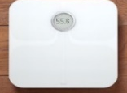
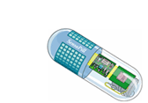
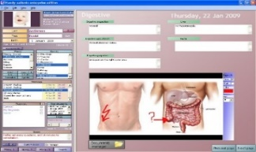
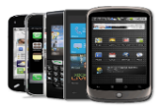
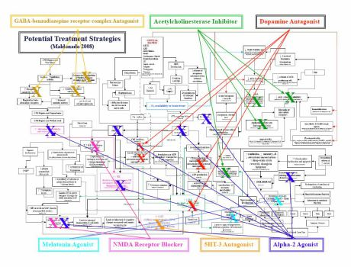
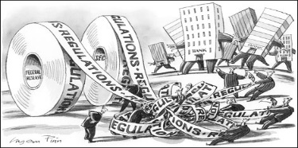
Building the ECOSystem: The Role of SANDBOX/Testbed Resources

Slide 5
Data sources and Data Flows
Device data
Proprietary clouds
PHR/app data
Proprietary clouds
PHR data integrators
EHR data
Standards-based interfaces (and virtual repositories)
Knowledge bases
Environment, PH data
Other data
Data analytics repositories

Slide 6
Role of A Developer Sandbox
Recognizing the state of flux of this dynamic environment
Goal to facilitate app development & deployment pathway
Provide access to a reference implementation of standards as they evolve
Develop and test new middleware services
Build apps against middleware (current and/or next-gen)
Create a community of participants to build on and contribute to this emerging ecosystem
Researchers – faculty/students
Health care organization and university partners
Entrepreneurs - individuals, and vendors – small and large

Slide 7
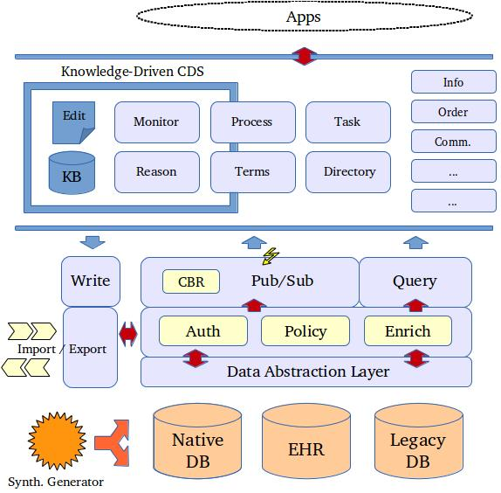
Abstract Architecture

Slide 8
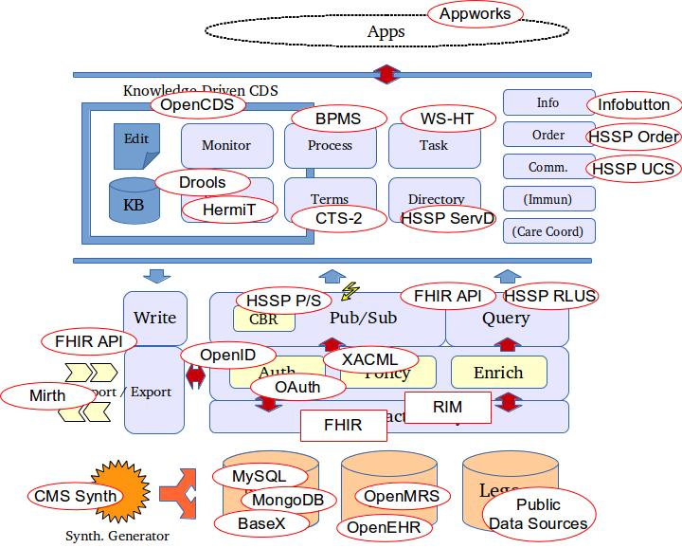
Architecture with candidate services

Slide 9
Potential services
Current and near-term
Access to multiple resources
Middleware services, SDKs, app libraries
Data sources – EHRs, other clinical data stores, PHRs, device data repositories, aggregate DBs, knowledge repositories
Test data – synthetic datasets, pseudo-identified real datasets
Developer support
Design services, usability testing, technical services
Collaboration workspaces
Common and private group spaces
Deployment pathway support
Reliability, security, scale optimization
Possible in future
Testing and validation
Provide access to stakeholders and pilot environments
Certification/validation of standards compatibility
Business development
Incubator services
Business plan development
Tech transfer services, patents, licensing
Market resources
App store
Cloud hosting / PaaS partnerships

Slide 10
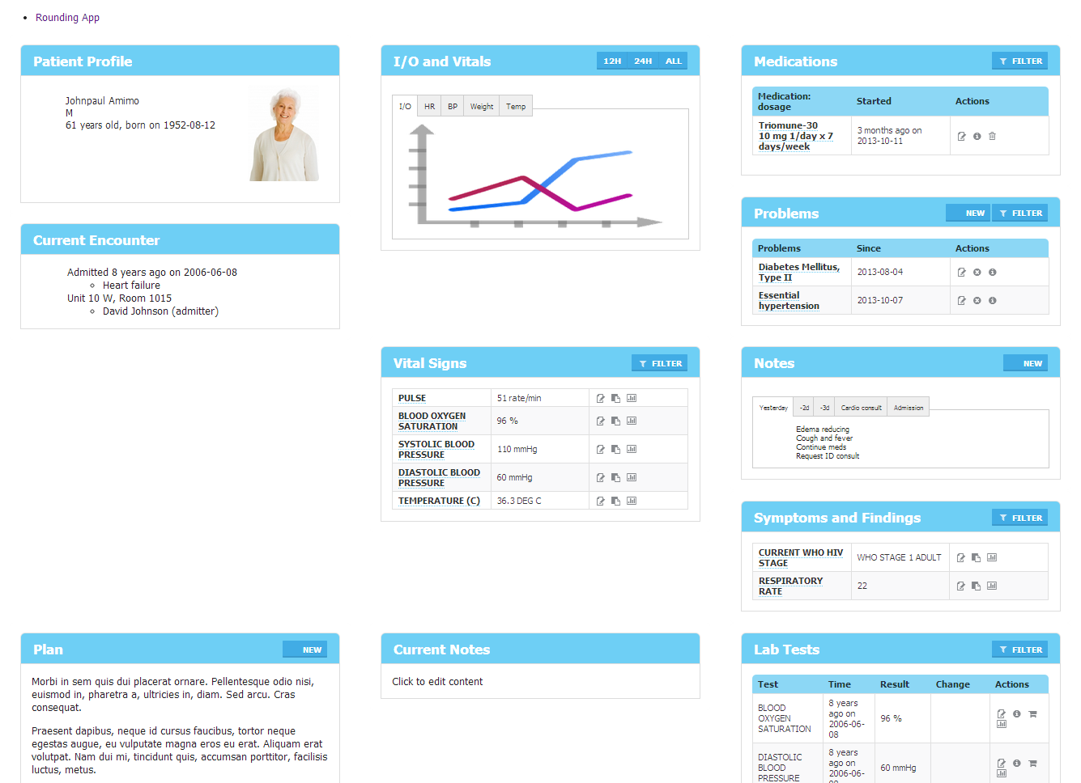
An app example developed using AppWorks composable “widgets”
Notes:
Early functioning prototype showing a rounding app. Each widget serves a specific purpose (view and edit medications) and interacts with other widgets in the app.

Slide 11
TIER-2 BPM/CDS services
Current area of focus of subgroup – for care coordination / care pathway use cases
Focus on services to:
Identify possible care pathway(s) for a patient
Evaluate status of a patient with respect to a care pathway
Determine next steps/actions or need to change to another pathway
Orchestrate subsequent actions
Record data for tracking pathway status
Analytics for dashboards, outcomes reports, etc.

