Slide 1
Knowledge Authoring: Examples Using Tools from the OMG
Adapting Business Process Modeling Tools to Medicine
Peter Haug, MD
Intermountain Healthcare

Slide 2
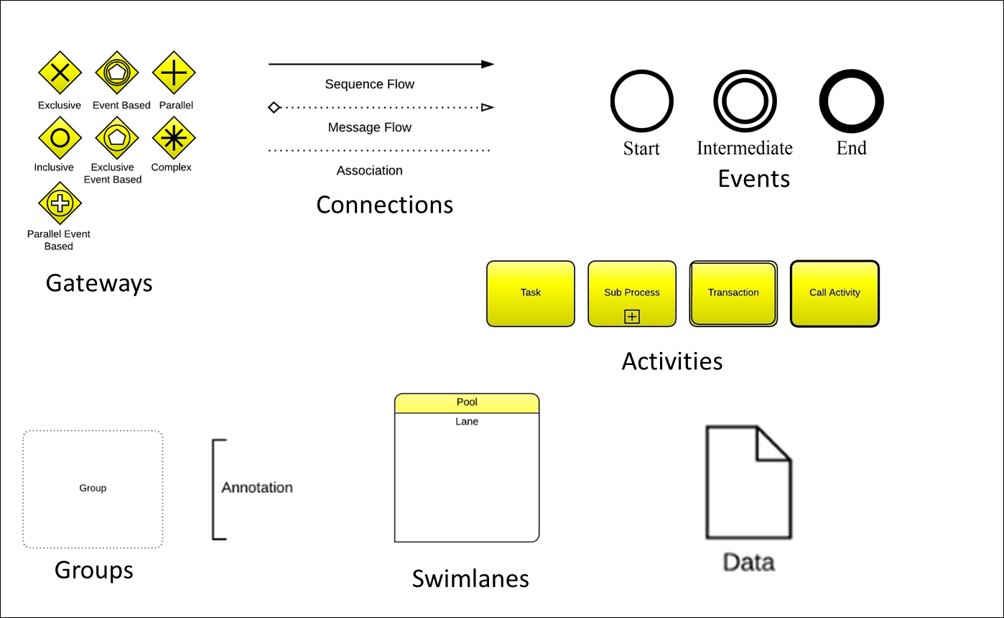
Business Process Management Languages
Developed by the Object Management Group (OMG)
Describe Processes rather than Decisions
Graphical Authoring Tools
Executable Code/Multiple Commercial Engines

Slide 3
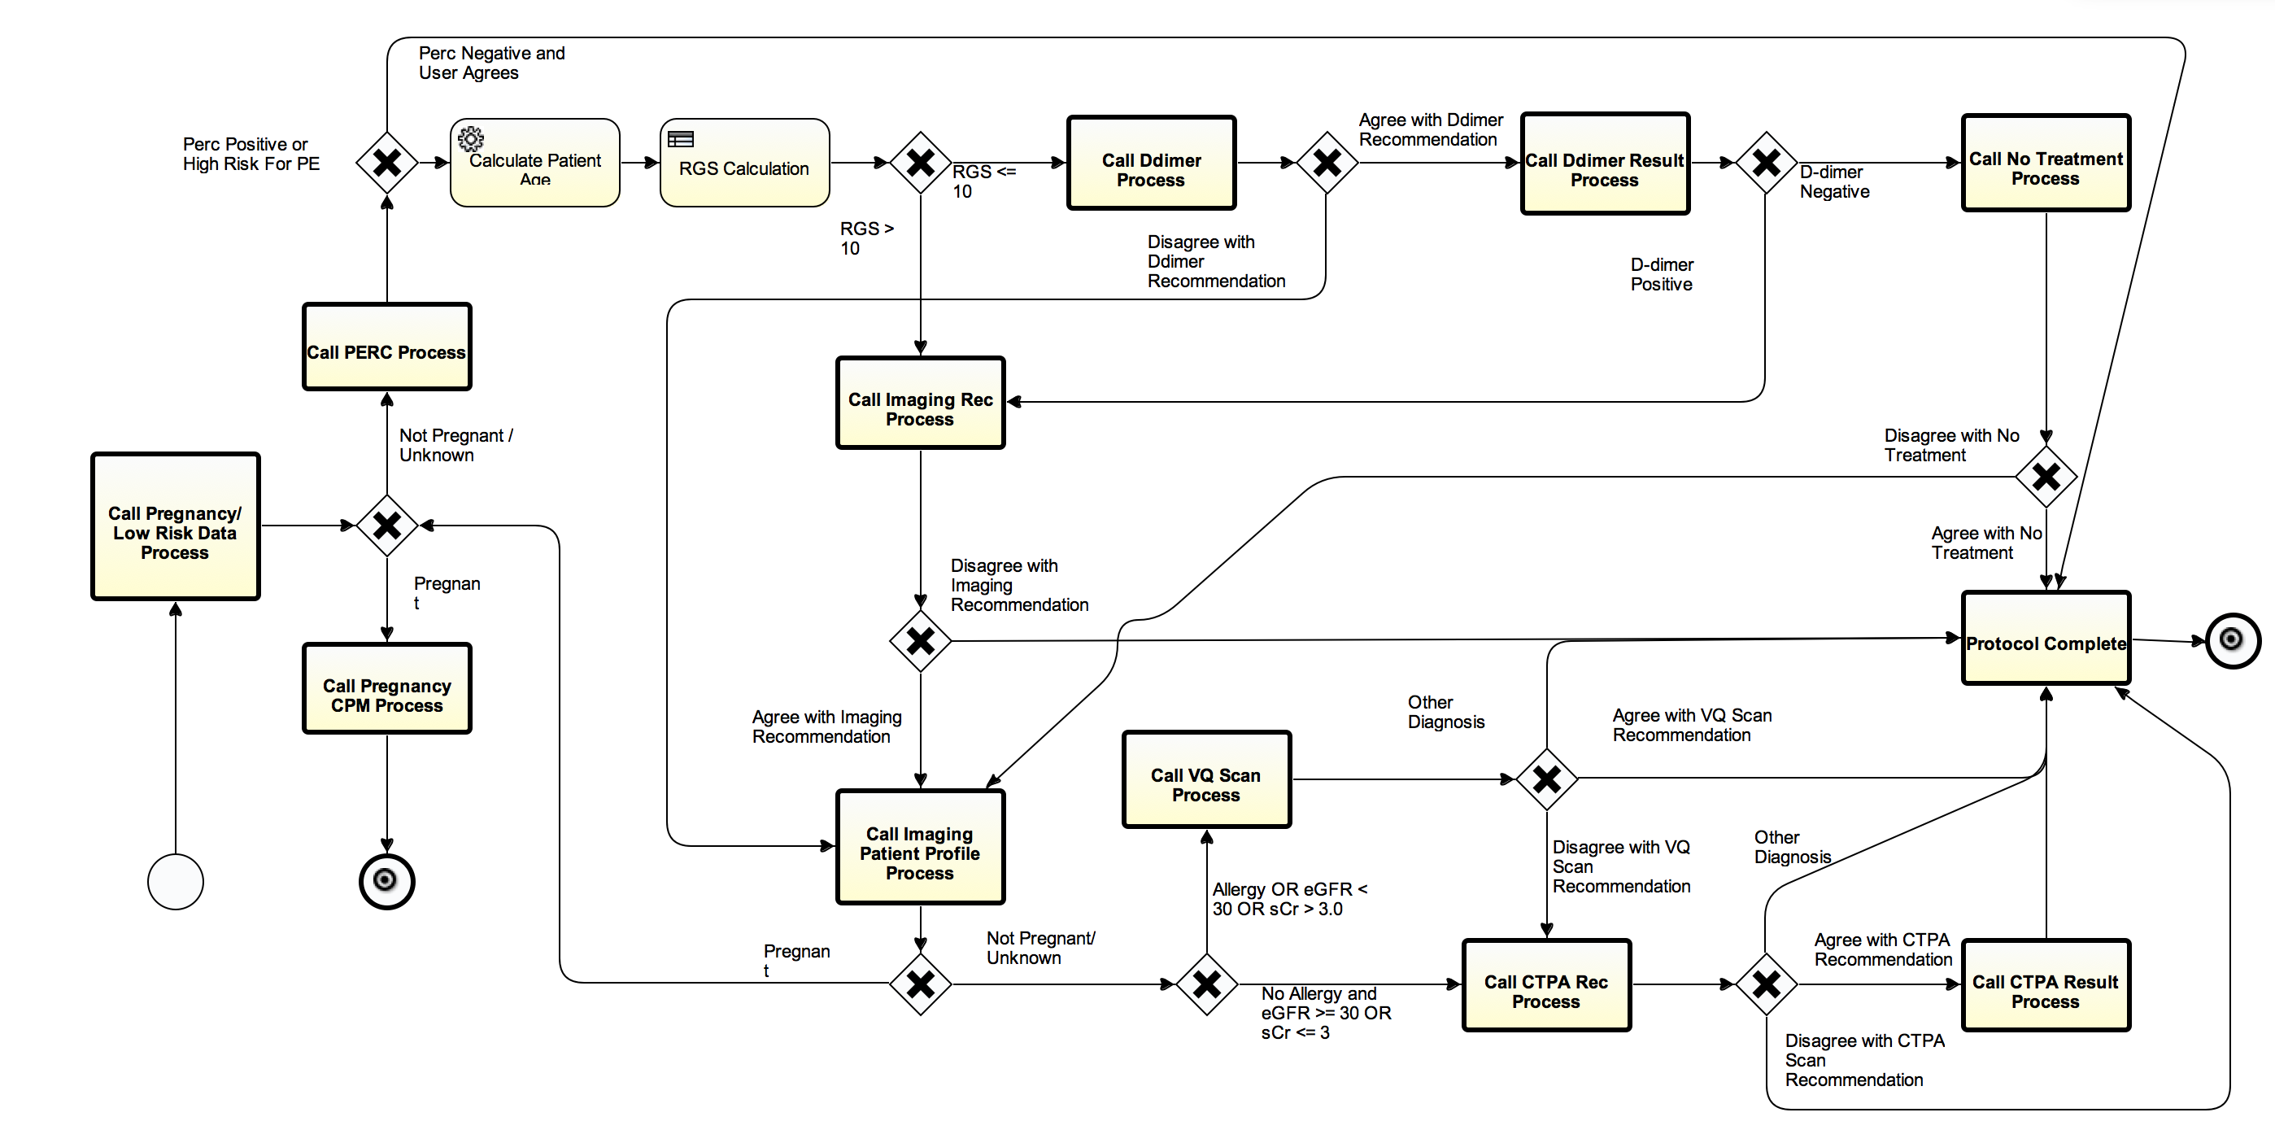
Three Process Management Tools
Business process modeling notation 2.0
  Tools for modeling workflows
Decision modeling notation 1.1
  Authoring and executing decision
  logic
Case management modeling notation 1.1
  Flexible support for processes
  managed by knowledge workers
Diagnosing Pulmonary Embolism

Slide 4
An Authoring Environment for Electronic Protocols
Business Process (Knowledge) Management Tools
  Business Process Modeling and Notation 2.0
  Decision Modeling Notation 1.1
  Case Management and Notation 1.1
Configuration Tools for Services from EHR (FHIR)
Configuration Tools for Special Services
    To Manage Data Models
    To Provide Added Inferencing Capability
      Physiologic Models
      Predictive Models (Bayesian Networks)
      NLP Services
      Custom Java-Based Tools
Configuration Site Specific Information

Slide 5
Business Process Management Notation (BPMN)
Orchestrating workflows
  Part of the work is done by computers
  Part of work done by people
Authoring environment produces executable output
  Workflow execution engines will run the process specification
Diagnosing Pulmonary Embolism

Slide 6
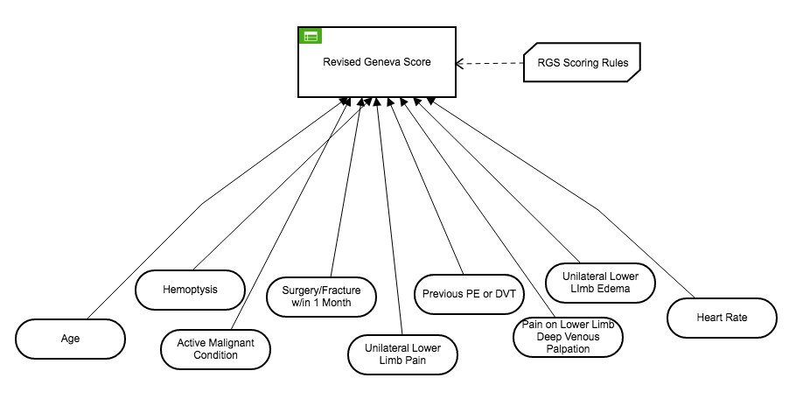
Decision Modeling Notation (DMN)
Documents the Logic of Decisions
  Enumerates Necessary Data Elements
  Captures Compositional Logic
Authoring System uses Graphics and Decision Tables
Produces Executable Output

Slide 7
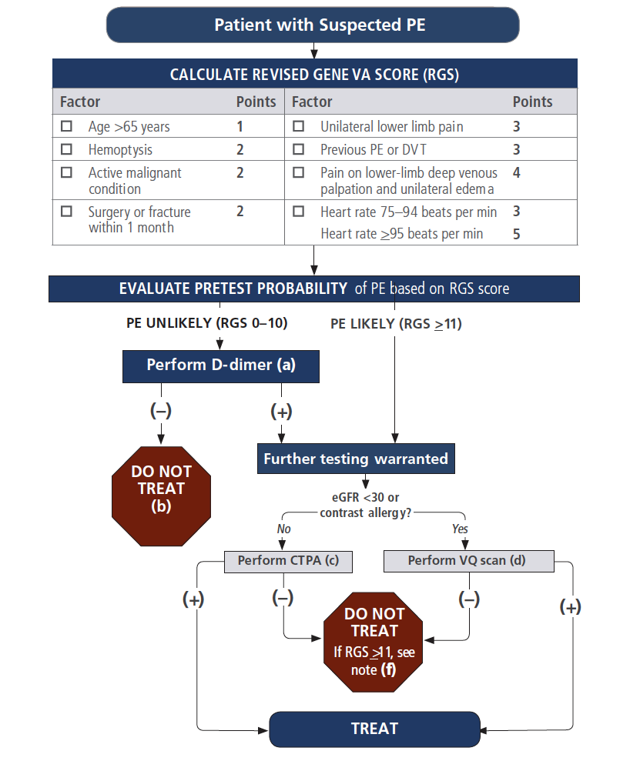
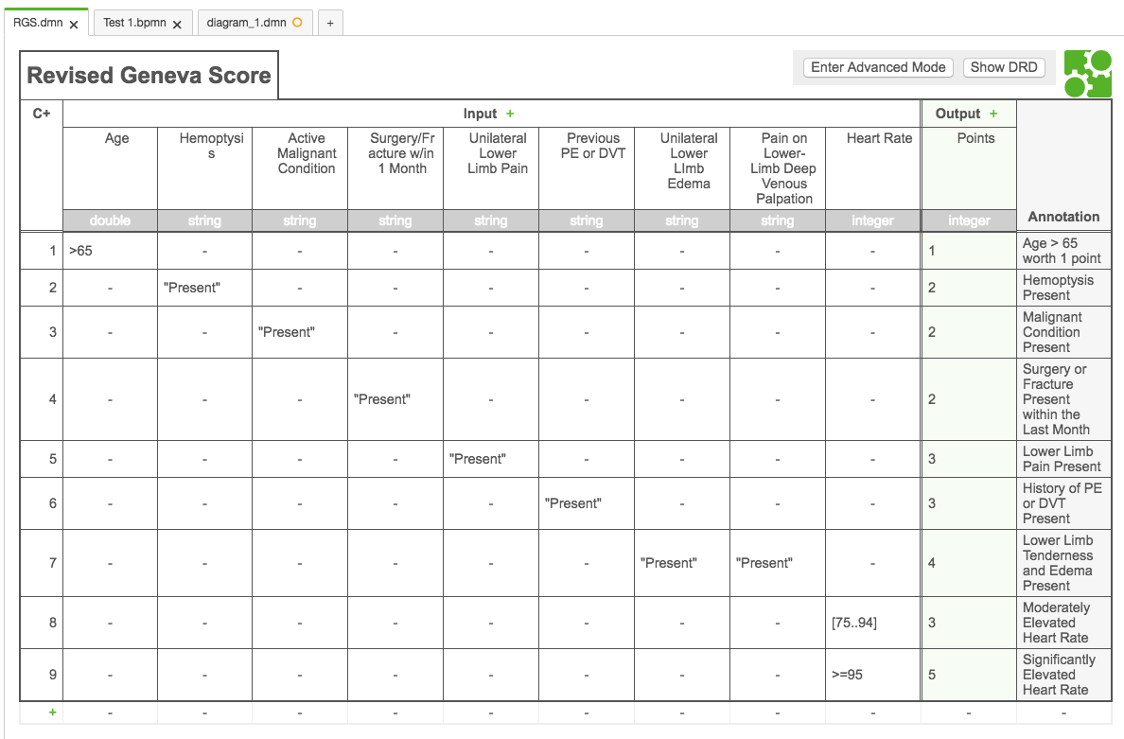
Decision Modeling Notation: Decision Tables
Specific Logic Described in Decision Tables
  Simplifies Designing, Critiquing, Maintaining Logic
Can be Supplemented (or Replaced) by Expressions
  Several Expression Languages available
Notes:
Multiple, Flexible Table Designs
Friendly Enough Expression Language (FEEL)

Slide 8
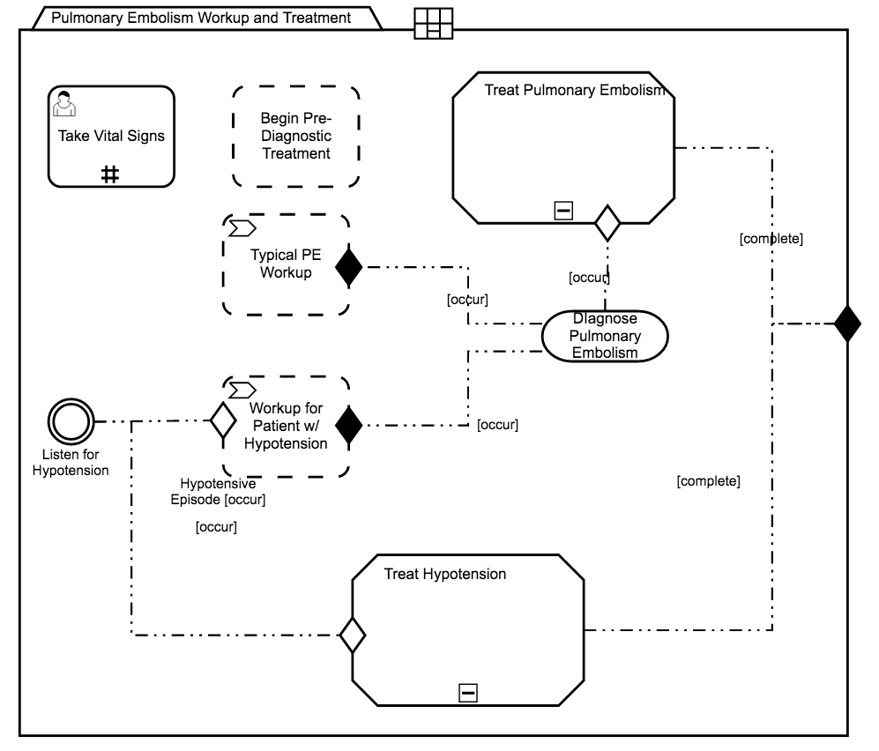
Case Management Model Notation (CMMN)
For Experts to choose relevant approach
  Activated for a specific context (symptoms suggest pulmonary embolism)
Allows flexibility
  When patient state is ambiguous
  When choice of approach requires Expert judgement
The newest of the standards-relatively untested

Slide 9
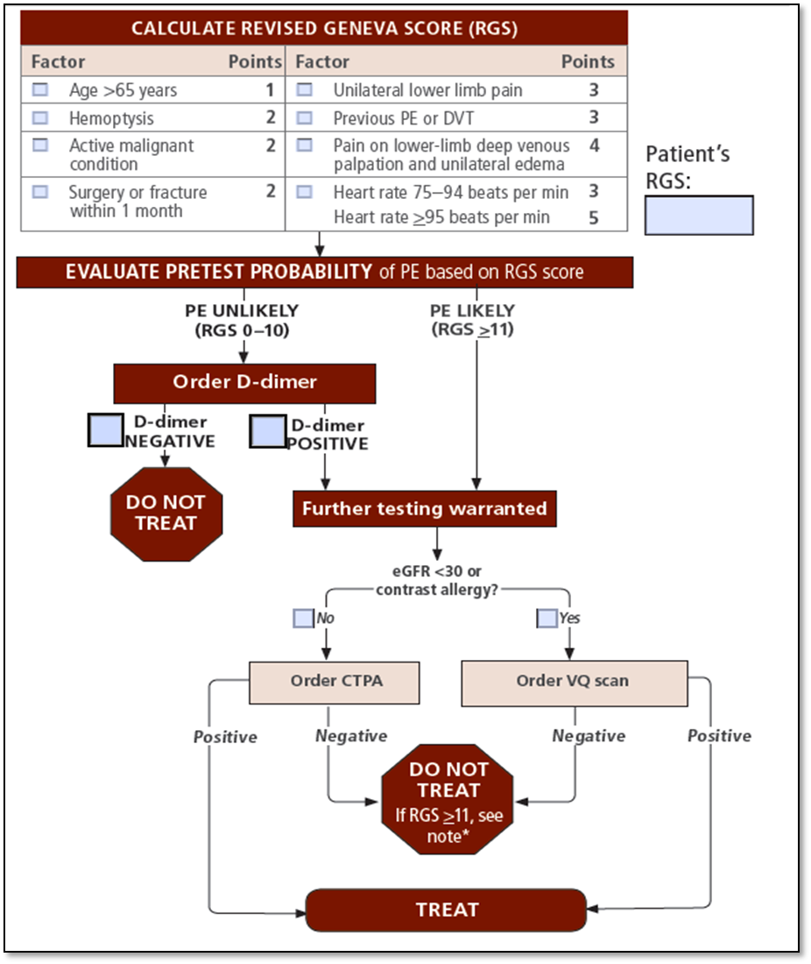
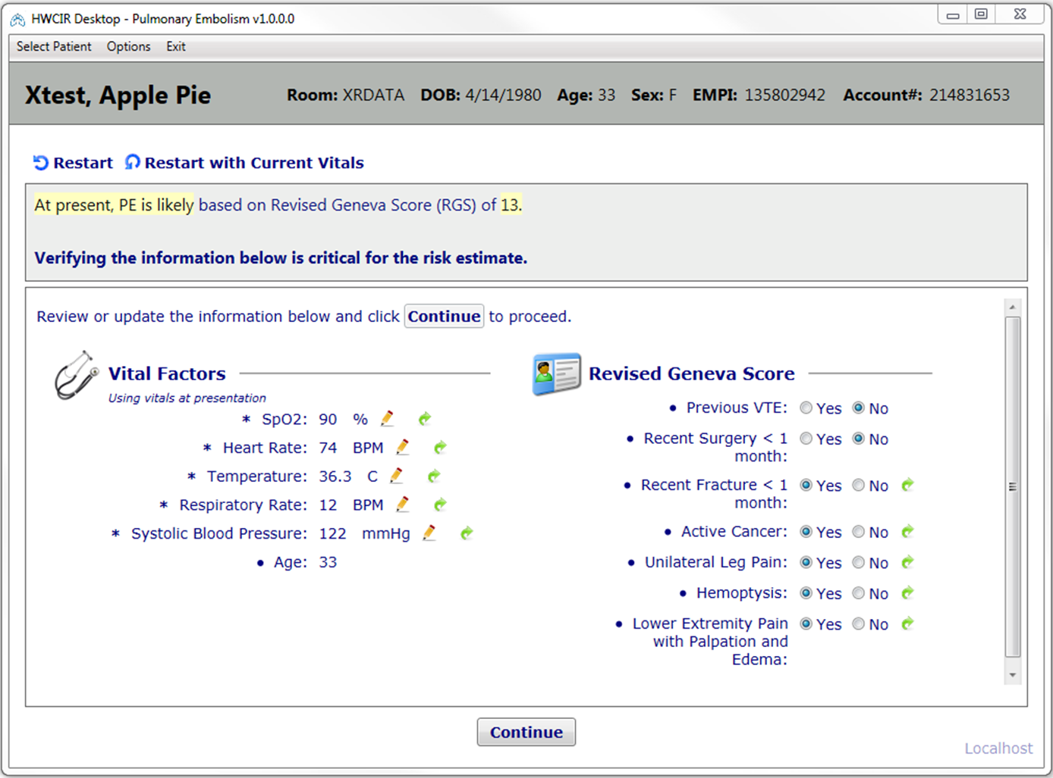
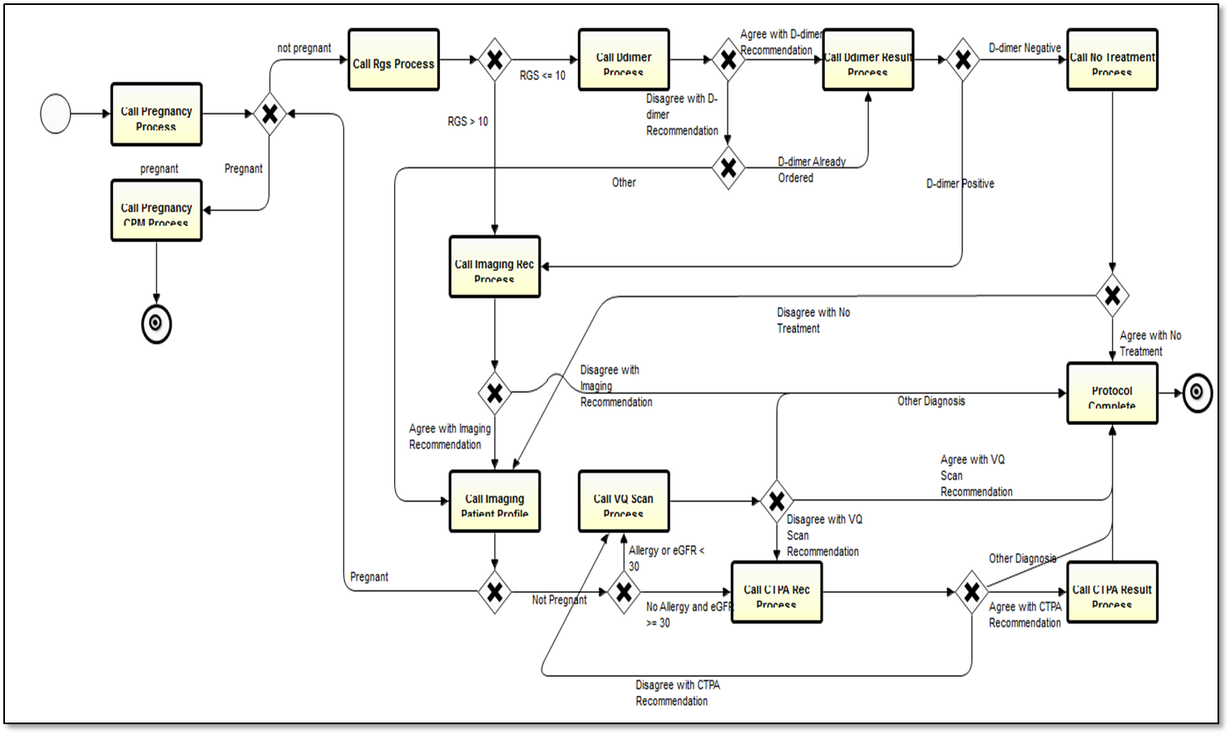
Tools for Delivering Medical Workflows
Runtime
Environment
BPMN Authoring
Medical Knowledge
Algorithm for Pulmonary Embolism Workup
Workflow execution using a BPMN engine.
Pulmonary embolism workflow designed in a BPMN authoring tool.

Slide 10
OMG-Sponsored Projects
Field Guide to Sharable Clinical Pathways
  BPMN, CMMN & DMN in Healthcare
  Medical Adaptation of BPM Models and Model Reuse
Motivating Use Cases
  Care in Pregnancy
    Start with Simple Model: Workflow Model of a Normal Pregnancy
  Depression in Veterans
    Model Response to Depression and Suicide

Slide 11
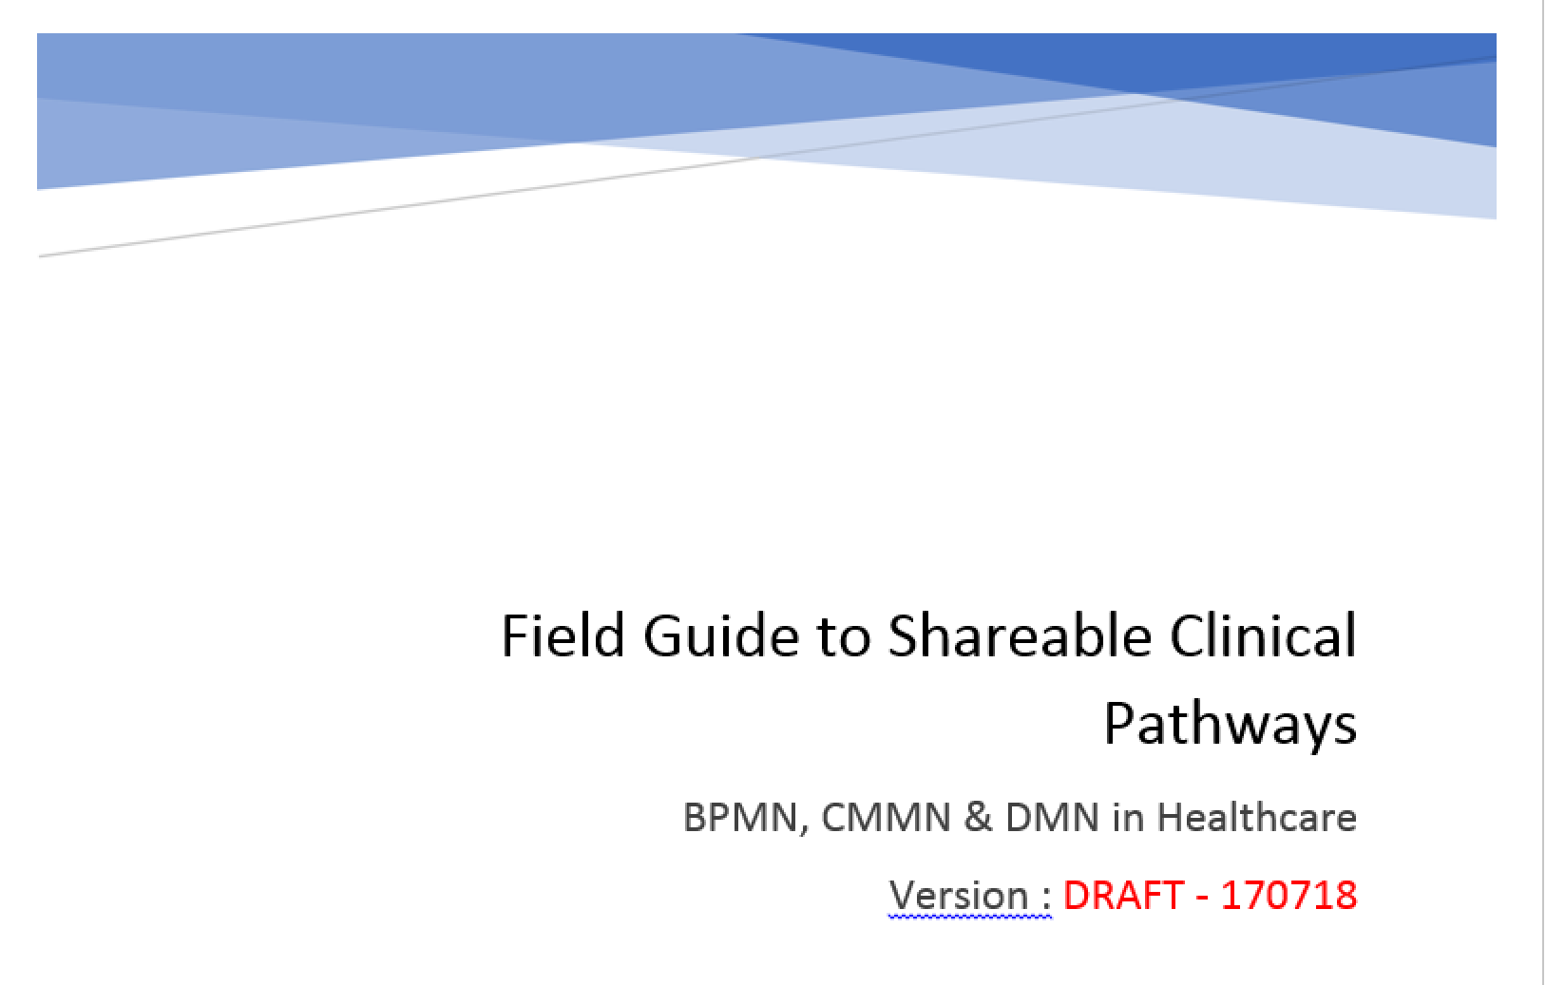
Contents
Introduction
Scope
Reference Examples and Patterns
Producing Models
Consuming Models
Sustainment and Governance
Appendices

Slide 12
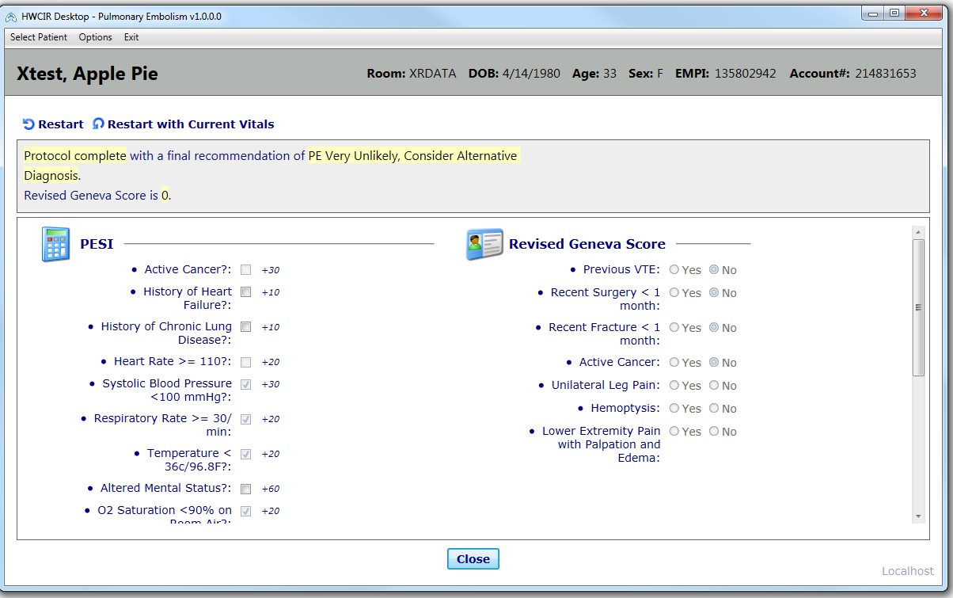
An Initial Experience with BPMN
A Pulmonary Embolism (PE) Workflow
Reduces use of Imaging Studies
  Improves capture of relevant data
  Documented pre-testing PE Probability
  Improved test utilization
  Reduced costs of testing for PE
Notes:
PE incidence (CTPA +/ total CTPA) was 9% at baseline and was 14% with use of ePE. Intermountain’s CTPA rate (proportion of ED visits with a CTPA performed) was 3.8% prior to the integration of ePE and in 2014, the direct costs of these CTPA’s at Intermountain was $312,239. In 2015, when ePE was first implemented and utilization was relatively high, the direct costs for CTPA were $75,964, representing cost savings of $236,275.

Slide 13
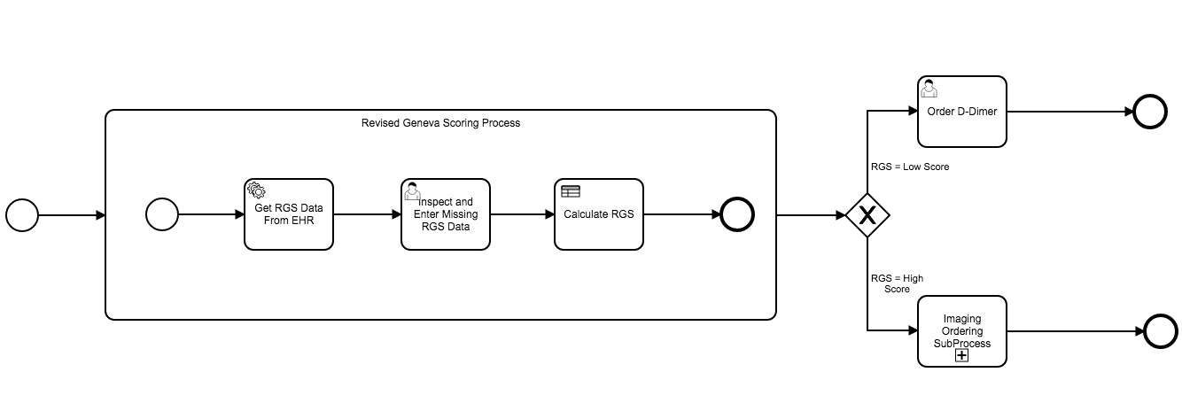
Example: Testing for Pulmonary Embolism
Decision logic requires 8 data elements
Each is weighted according to diagnostic importance
Testing decisions are based on the total of weights
Imaging Study

Slide 14
Authoring at Different Granularities
Coarse Grained Models
  Captures the Fundamental Workflow
  Supports Training/Design of Non-Automated Tools
  Non-Automated Implementation
Fine Grained Models
  For Automated and Non-Automated Settings
  For Full Automation Requires Services
    EHR Supplied Services
    Services Supplied in an Application Environment

Slide 15
Non-Automated Process Model
For Business Process Models can be inspected and implemented without computerization.
Data collection needs are modest and can be handled manually.
Involve computations that can be done by humans without computer assistance.
Workflow handoffs can use non-automated communication channels.
Documentation will be non-automated.
Assembly of tools needed for intervention (medications, surgical kits, etc.) non-automated.
Identification and response to key tasks non-automated
  Passage of time
  Availability of new data

Slide 16
Tools for Non-Automated Process Models
Activation rules (documented in paper forms and integrated into workflow through training of select workflow participants).
Paper-based workflow tracking systems.
Paper-based, structured decision-support forms (including checklists, calculation forms, etc.).
Paper-based documentation forms.
Inbox/outbox locations to help manage handoffs.
Tube systems (for internal communications) and mail (for external communications).
Ancillary services (using non-automated workflows) to provide the necessary tools needed for clinical interventions required by the workflow.
Well-developed training and review systems to guarantee consistency with the prescribed workflow.

Slide 17
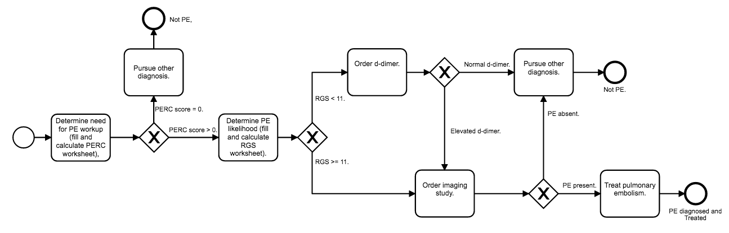
Non-Automated (High Level) Pumonary Embolism Model
How do we automated this?
Notes:
Figure 1: A simple workflow model for initial workup of possible pulmonary embolism. This workflow is presented in a way amenable to non-automated implementation. Paper forms are used to calculate the PRC and the RGS, and the caregivers are taught that an elevated RGS leads to imaging studies while a low RGS should be followed up with the d-dimer test.

Slide 18
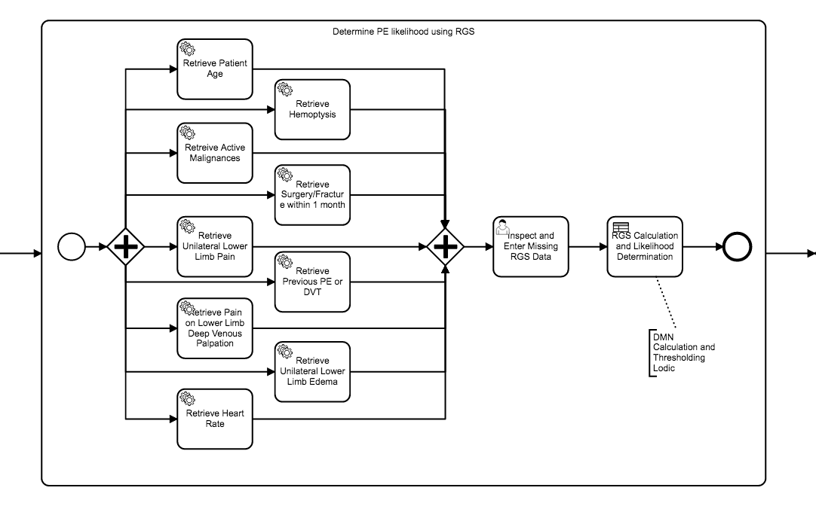
Automated Process Model-
Service to Retrieve Data
User Inspects and Corrects Data
DMN to Calculate RGS
Notes:
Figure 2: Expansion of the “Determine PE likelihood (fill and calculate RGS worksheet)” activity shown in figure X. This elaboration on the simple activity node includes detail needed for computer execution.

Slide 19
Growing and Extending a Detailed BPMN Model

Slide 20
Initial PE Workup Description
Workup of suspected pulmonary embolism.
Initial testing decision is based on a the Revised Geneva Score
Totals under 10 lead to a blood test (the D-dimer)
Totals of 11 or greater lead to the computed tomography-pulmonary angiogram (CTPA).
VQ Scan is substituted if CTPA is contraindicated

Slide 21
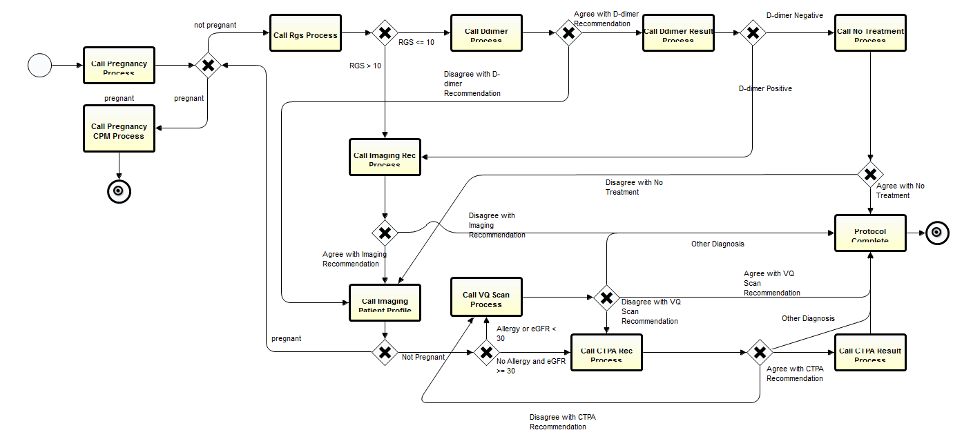
Initial BPMN Model

Slide 22
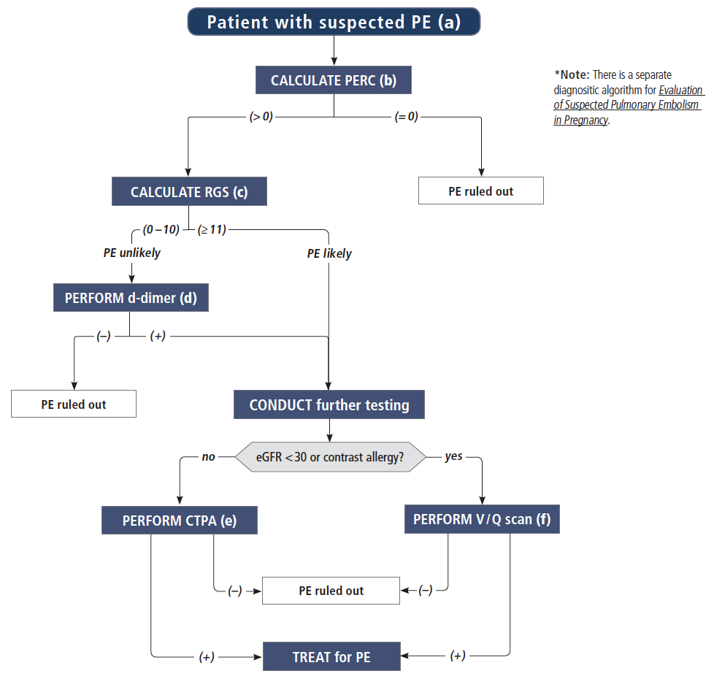
Amended PE Diagnostic Process
“Pulmonary Embolism Rule-out Criteria”
PERC is predicated on a low risk of PE, based on clinician gestalt
Each PERC factor is scored 1 point
If the total PERC Score is greater than zero, PERC is said to be “positive” and PE is not ruled out
If the total PERC Score is
equal to zero PERC is
said to be “negative”
and PE can be ruled
out
PERC Factors
Age >= 50
Heart Rate >= 100 bpm
SPO2 < 95%
Prior History of Venous Thromboembolism
Surgery in last 4 weeks
Hemoptysis
Exogenous Estrogen
Unilateral Leg Swelling

Slide 23
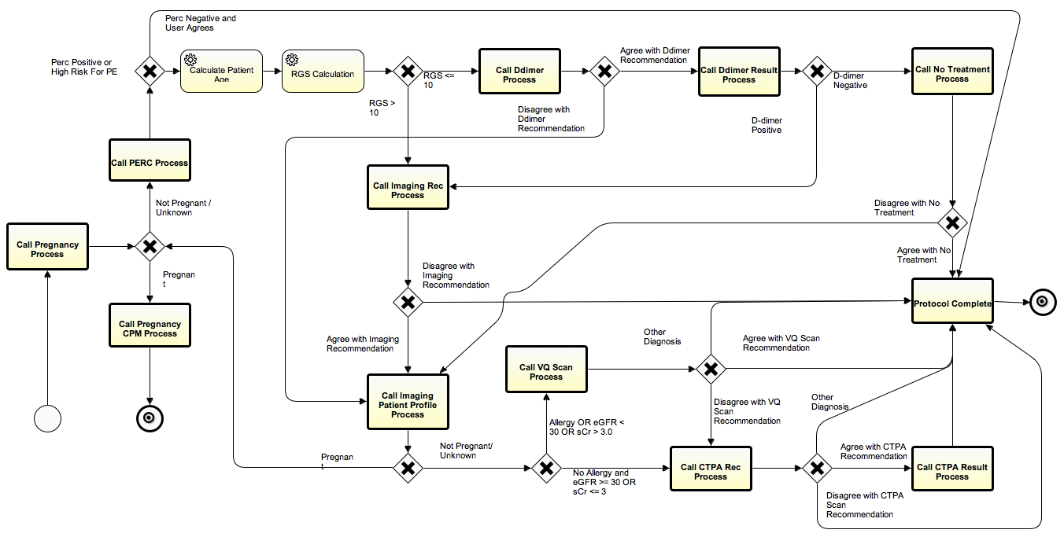
Revised Pulmonary Embolism Diagnostic Model

Slide 24
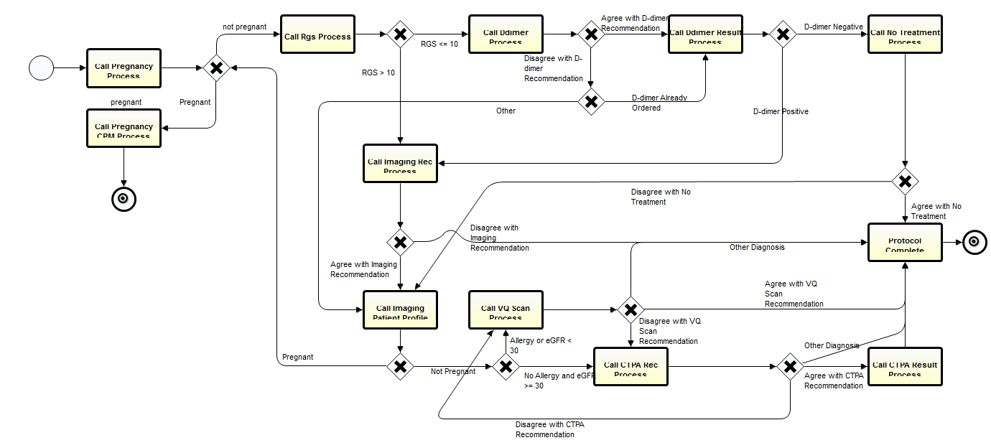
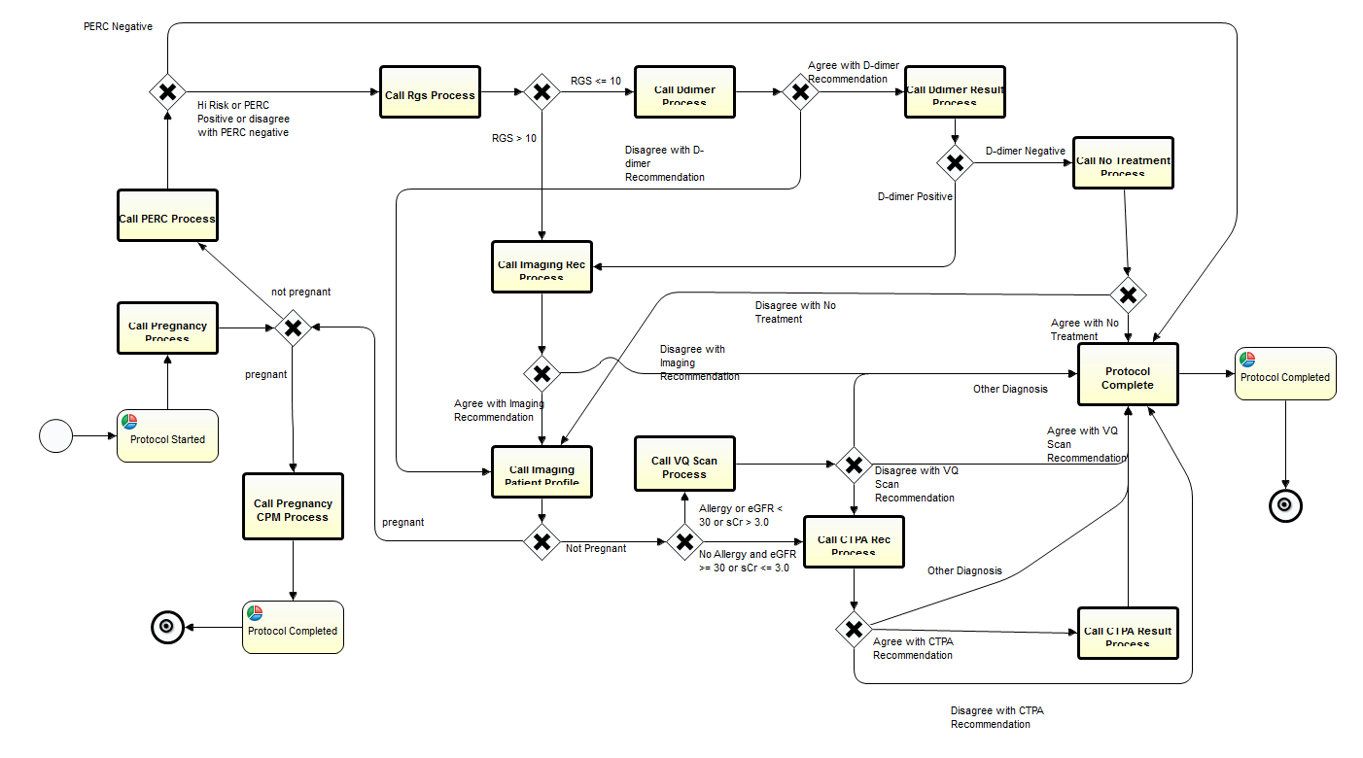
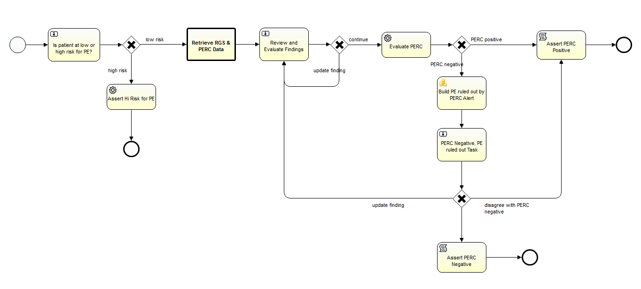
Maintenance: Modifying the Workflow
Modified Main Logic
(adding an additional screening process - PERC)
Notes:
Should we ask about PE risk before pregnancy?

Slide 25
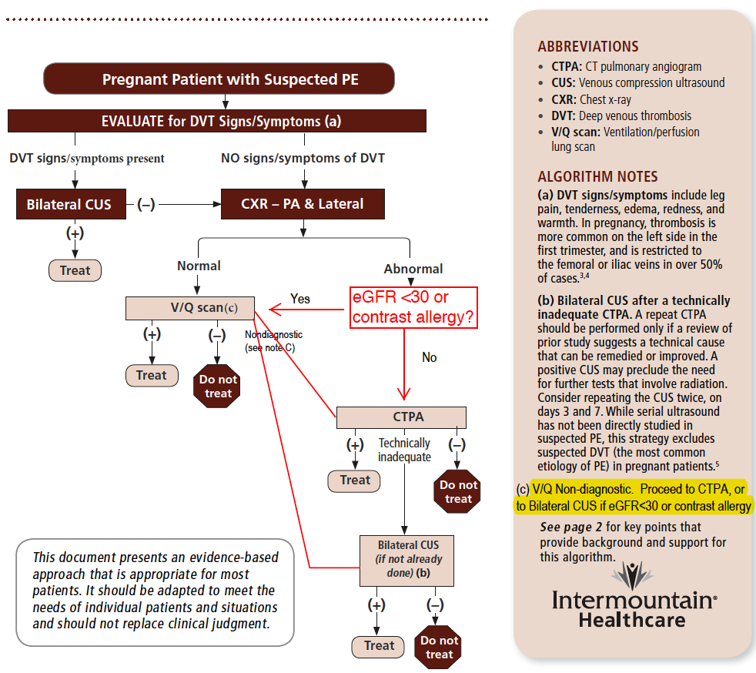
PE Diagnosis in Pregnancy
Goal in Pregnancy is to minimize radiation Exposure
  CTPA yields most radiation
  VQ Scan yields less radiation
  CUS yields no radiation

Slide 26
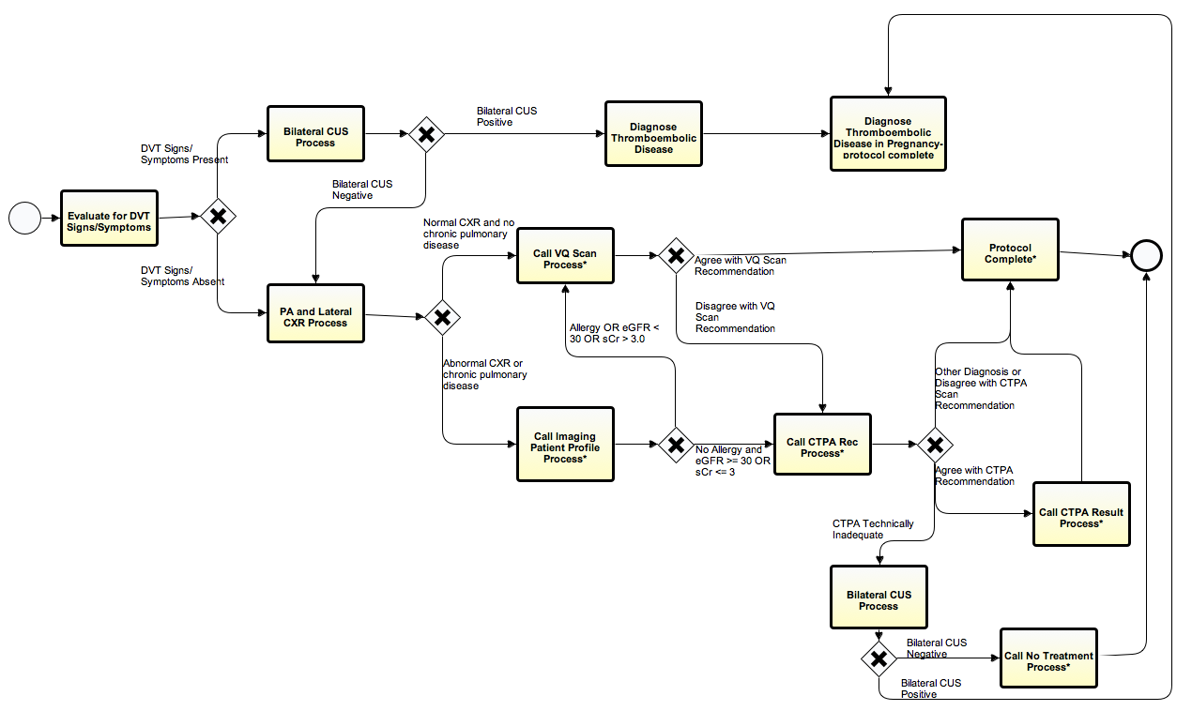
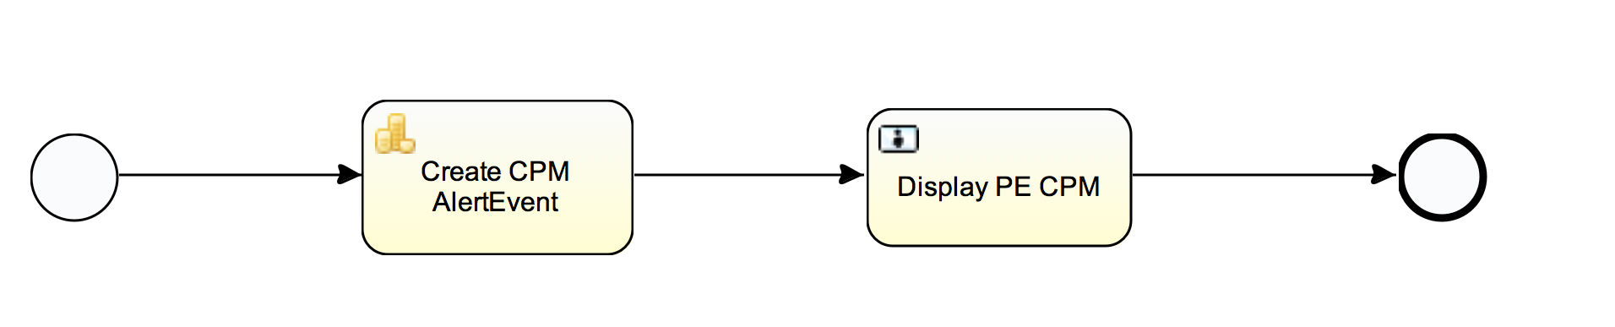
Pulmonary Embolism in Pregnancy

Slide 27
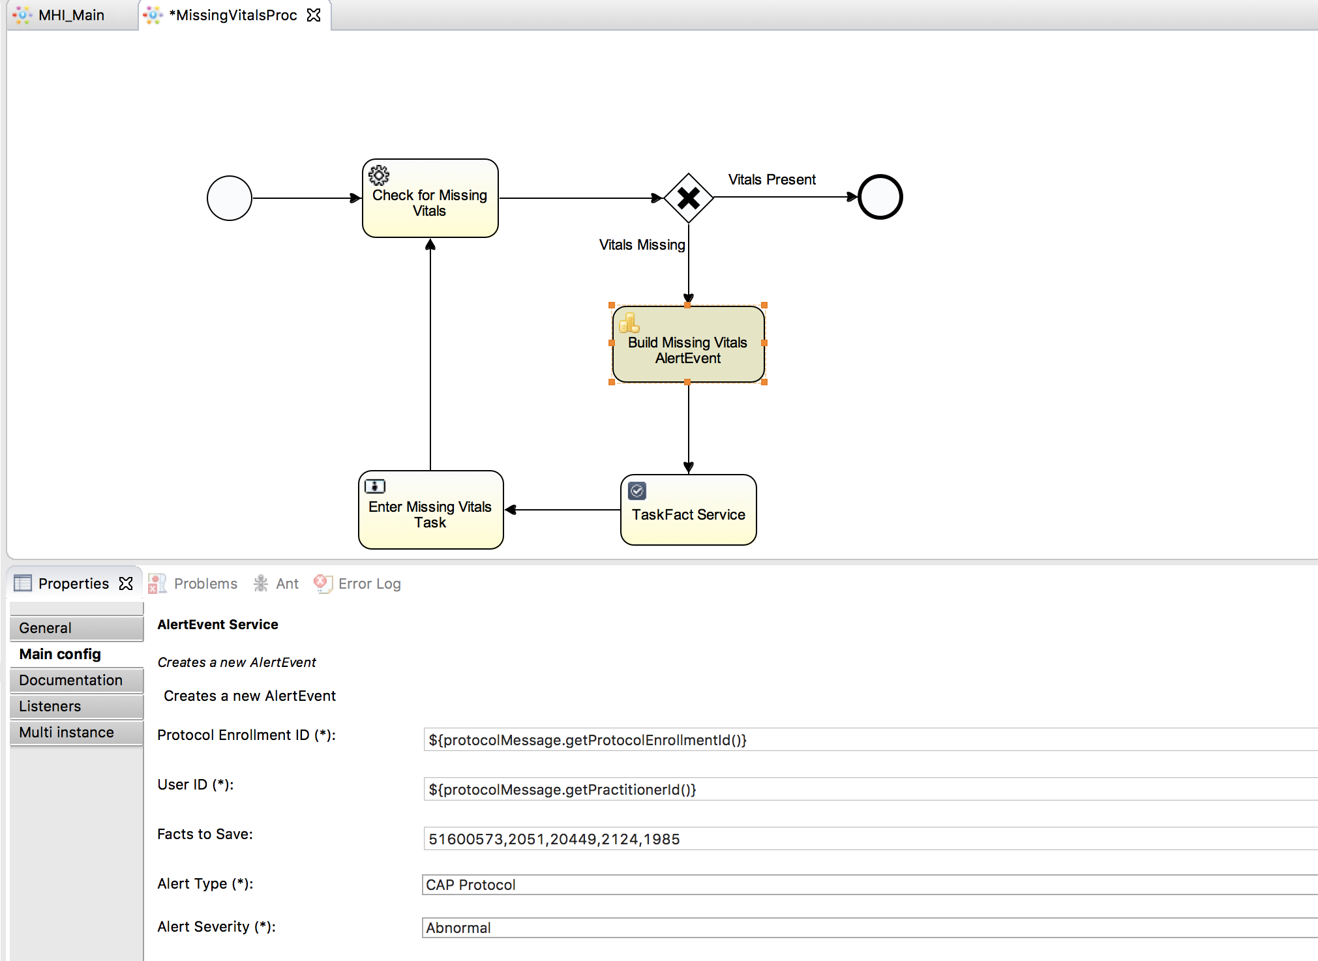
Configuring Alert Event Services

Slide 28
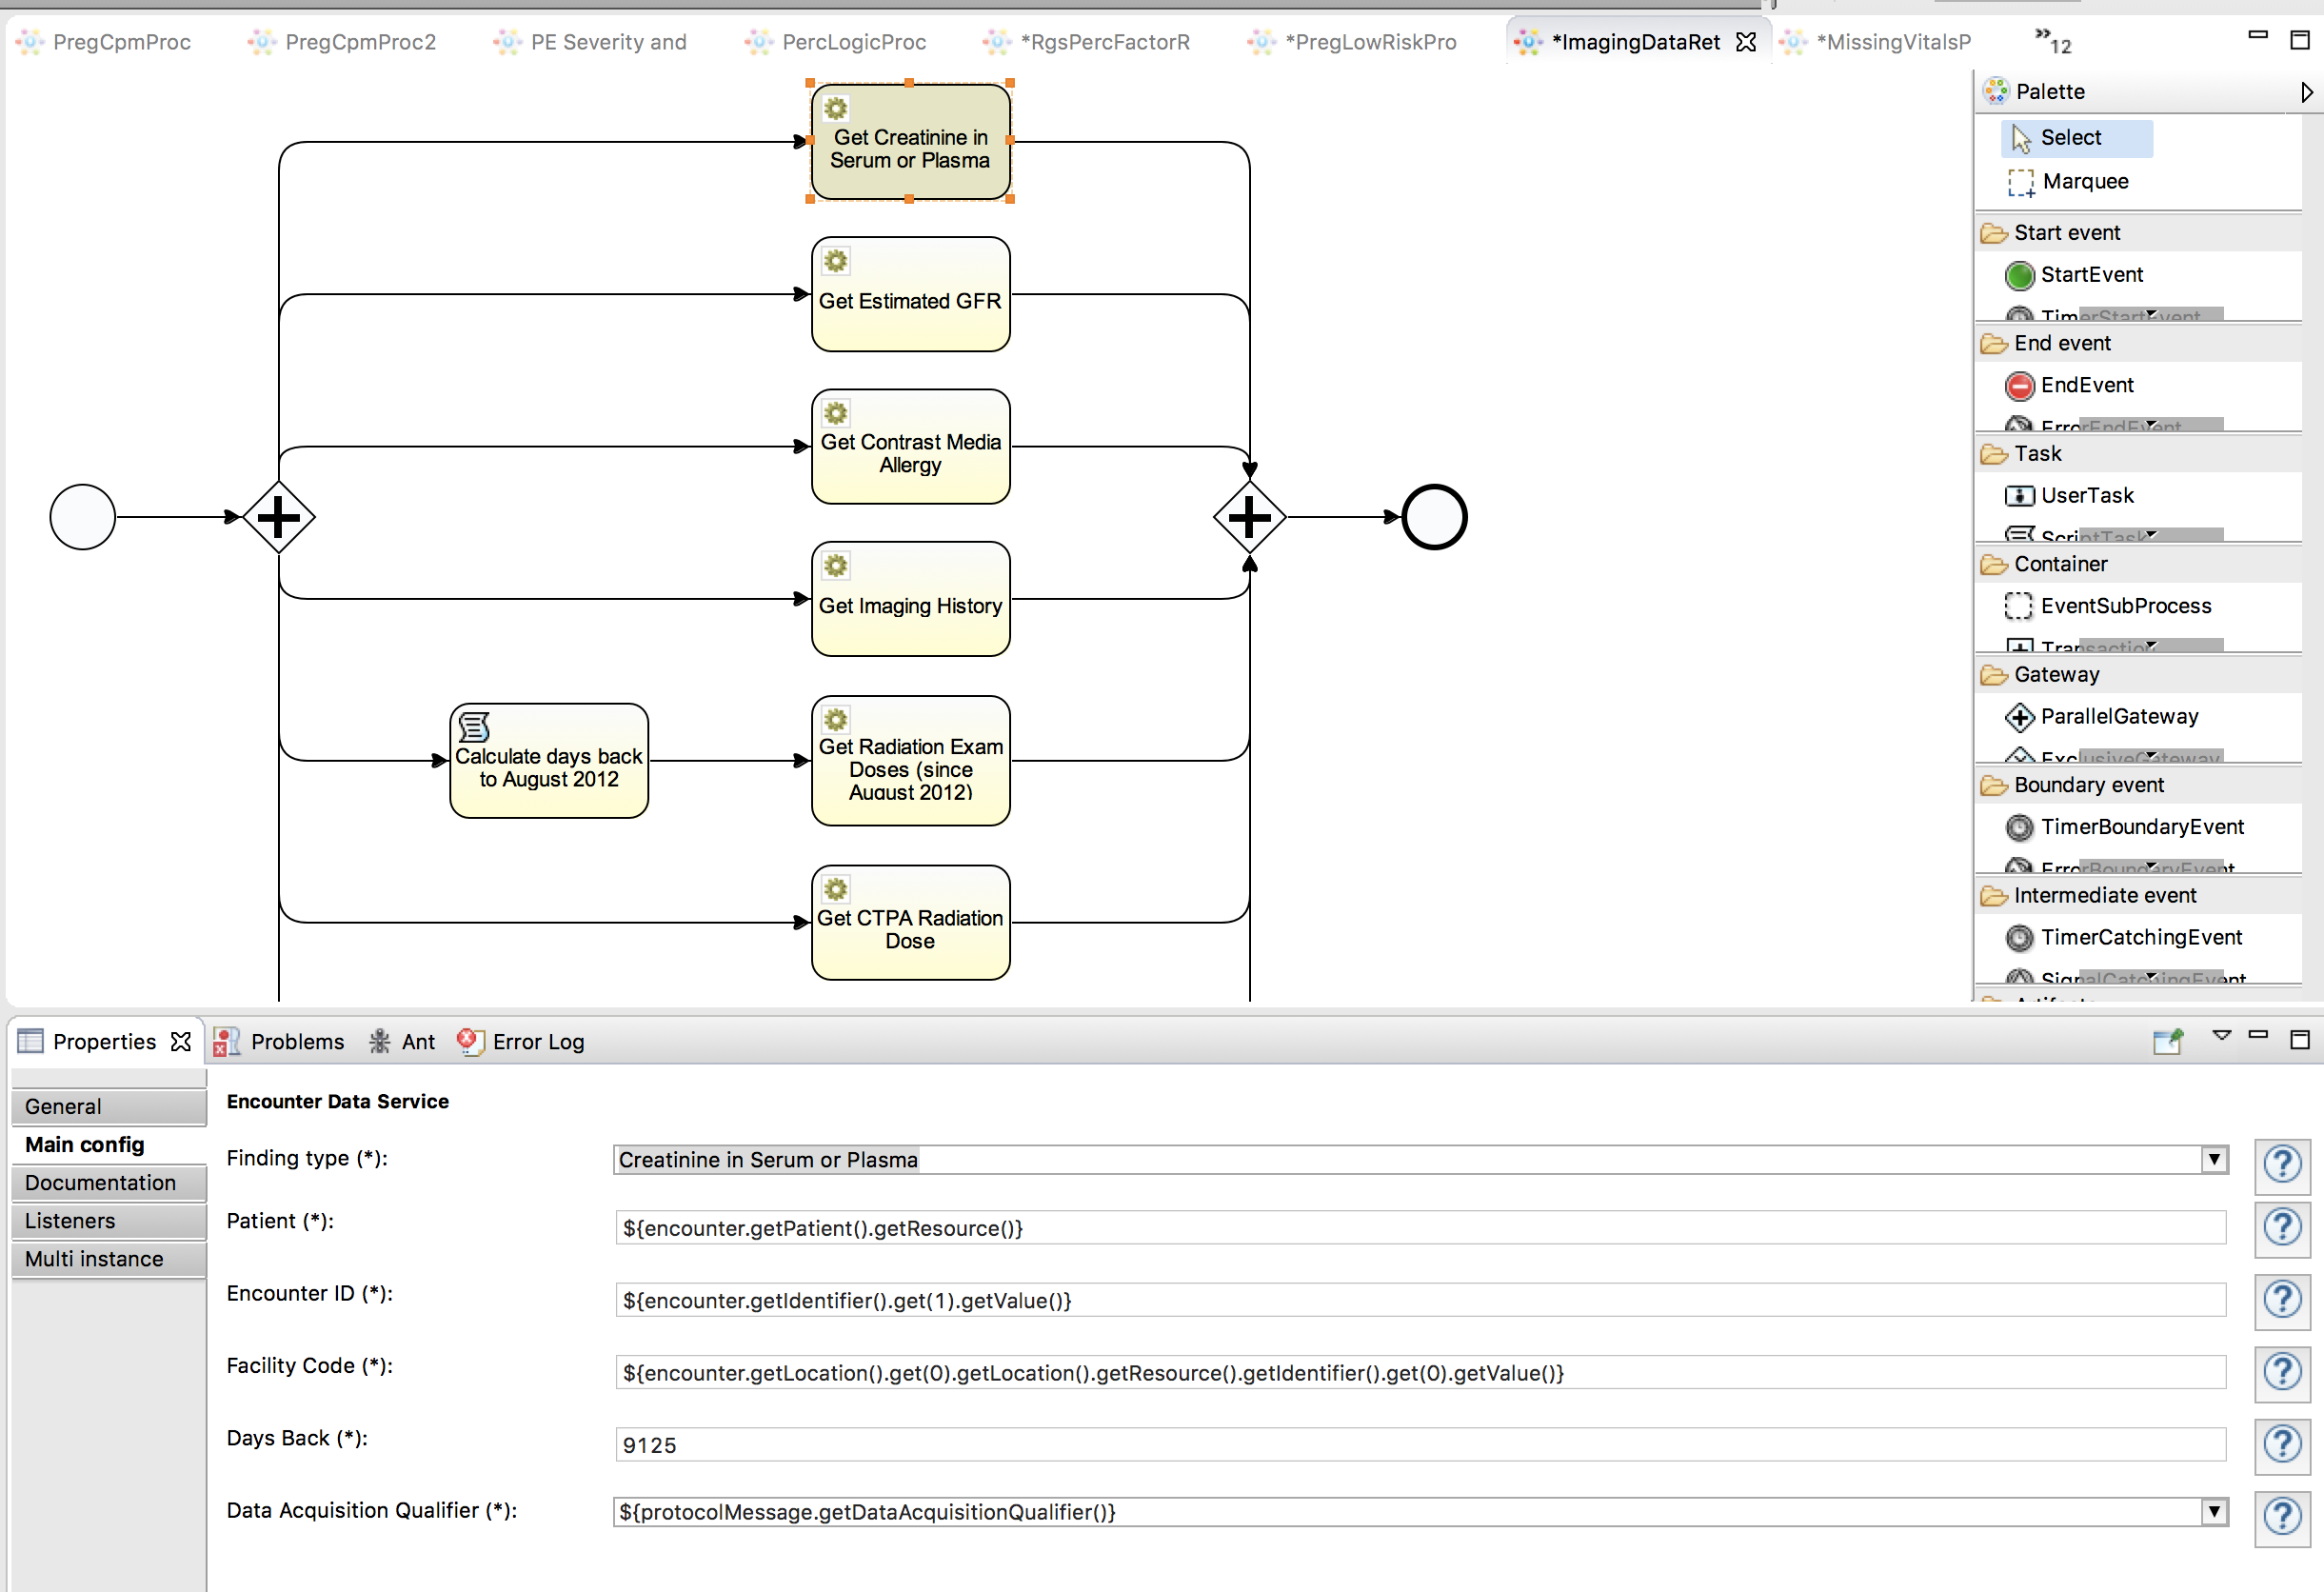
Configuring Data Access Services

Slide 29
Components Necessary to Make BPM Computable
Two types: EHR supplied and part of External Platform
EHR Supplied
  Focus on Standards-Based Services
  Use HL7 FHIR Definitions
Platform-based
  Standards-Based as far as Possible
  Business Process Management Standards-OMG
  FHIR Standards/CDS Standards-HL7
  Terminology Standards
  Etc.

Slide 30
Component | Description
EHR Supplied Services
Data Read Services | These allow an application, running external to and EHR, to access data through EHR-based service calls. Preferably, they conform to the HL7 FHIR service definitions.
Data Write Services | Simple data write services allow typical clinical data collected in external applications to be written back into and stored in the hosting EHR. While simple, these services should still appropriately trigger internal CDS and other data-driven EHR actions.
Publish and Subscribe Services | The EHR should provide publish services to enable publish and subscribe activities in the web application server environment. (Since other applications may also publish there, the EHR should be able to subscribe to events of interest found here.)
Ordering Services | Ordering services are more difficult. These should allow external applications to order all orderable items. The services should provide all of the functionality needed. As an example, medication orders require more processing than simply storing in and EHR’s data repository. A medication ordering service should provide components sub-services including allergy and drug interaction checking, routing to pharmacy, adding to medication administration system, etc.
User Interface Integration Services | The EHR will need to provide a mechanism for an externally hosted application to display a user interface in an appropriate place in the workflow. The SMART on FHIR and CDS-Hooks technologies are examples.
EHR Supplied Services

Slide 31
Component | Description
Hosting Platform Supplied Services
Subscribe Services | To support subscription to the events published by the EHR.
Terminology Services | A well designed data dictionary will make identifying and accessing necessary data much easier. A good deal of medical knowledge is also embedded here.
Business Process Management (BPM) Services | This category refers to Business Process Modeling and Notation 2.0, Decision Modeling and Notation 1.1, and Case Management Modeling and Notation 1.1. They provide two important functions: 1) Each provides a graphical authoring environment that is used to design and maintain the application. 2) Each specifies an executable form of the application that can be executed at runtime in an appropriate execution engine.
Communication Services | Services to support interactions with users. They can include pager services, faxing services, etc. The BPMN 2.0 standard suggests the WS-Human Task standard as the specification for managing interactions with users.
Data Storage Services | A service to store relevant information external to the hosting EHR. This may include log files, process data, and some clinical data for which there is not a good storage model in the EHR.
Role Management Services | Since the BPM services will be management processes involving care teams, it is necessary to manage and provide access to the roles necessary for the care models.
Inferencing Services | The BPM and DMN environments are ideal for deploying a variety of inferencing tools including mathematical models, classification and prediction systems, Physiologic models, etc.
Custom Services | Special purpose services (such as natural language processing tools) can be accessed as a part of the care delivery workflow.
Platform Supplied Services

Slide 32
Designing a CDSS for Complex Electronic Protocols
Human Task Client Framework
Protocol Execution Environment
BPMN2 Engine
DMN Engine
HumanTask Processor
Terminology/ Ontology Services
Business Process Management Tools
Standard User Communication Model(WS-Human Task)
Appropriate Services from EHR (FHIR, HSP?)
Special Services
  To Manage Data Models
  To Provide Added Inferencing Capability
    Physiologic Models
    Predictive Models (Bayesian Networks)
    NLP Services
    Custom Java-Based Tools
Client (UI) Tightly Integrated with Hosting EHR
Antibx
Penicillins
Amoxicillin
Dicloxic..
Aminogly..
Gentimyc..
MetaData
Custom Service Tasks
CMMN Engine
User Interface Generator
Data Transformation Services
NLP Services
Extended Inferencing Services
Etc…
Case
Human Tasks
Data Services
Etc.
FHIR Order-Com Services
FHIR Patient ID Services
FHIR Data Write Services
FHIR Data Read Services
FHIR Publish/
Subscribe Services
(Data Drive)
Hosting
EHR
EHR-Based Resources

Slide 33
Comments and Questions
Questions???

