Slide 1
BPM Standards and Healthcare
November 14, 2017
Stephen A. White, Ph.D.

Slide 2
Agenda
Introduction
The Significance of Standards
Overview of BPM Standards
Example Definition of a Clinical Pathway – Antenatal Care
Summary

Slide 3
Introduction
I am a contractor for VHA with 30 years of process modeling experience, ranging from modeling pilot workload to commercial business processes.
I have worked with many business domains, such as telco, finance, insurance, and now healthcare.
I have been involved with BPM standards development. In particular, I was the lead editor of the BPMN specification and was a contributor to the CMMN specification.

Slide 4
Agenda
Introduction
The Significance of Standards
Overview of BPM Standards
Example Definition of a Clinical Pathway – Antenatal Care
Summary

Slide 5
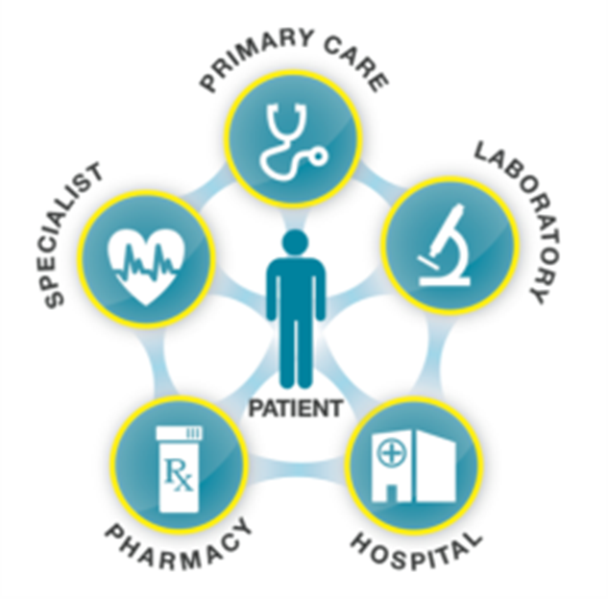
BPM Standards. Why Do They Matter?
The significance of standards
“VHA is committed to realizing an effective, standards-based care coordination strategy, leveraging available industry standards and building upon that work to address any identified gaps adversely impacting the effective and seamless care coordination and care plan management our Veterans require.”
Standards provide a common language and expectations supporting process flow among clinician, hospital, pharmacy, lab, and patient.
Standards provide the guidelines that govern the exchange of information, both in content and in transport protocol.
BPM Standards are supported by a large array of tools, documentation, and training (including university courses).

Slide 6
What are the BPM Standards?
The significance of standards
In the context of this presentation, these are the Object Management Group (OMG) BPM Standards:
Business Process Model and Notation (BPMN)
Case Management Model and Notation (CMMN)
Decision Model and Notation (DMN)

Slide 7
Do These BPM Standards Apply to Healthcare?
The significance of standards
“A Process is a Process is a Process…”
BPM standards, such as BPMN, are designed to be business domain agnostic.
BPMN, with its formal execution semantics, is rich enough to handle processes across all business domains.
Business domains will usually have their own terminology, adornments, and patterns, but the basic process behavior constructs remain the same.
CMMN expands BPMN process capabilities to add very unstructured and planning behaviors.
DMN represents the logic of decision making and is, thus, complimentary to BPMN and CMMN.

Slide 8
Agenda
Introduction
The Significance of Standards
Overview of BPM Standards
Example Definition of a Clinical Pathway – Antenatal Care
Summary

Slide 9
BPMN Overview
Overview of bpm standards
BPMN is about processing…
It is a relatively mature standard. Development began in 2001.
It is also an ISO Standard (ISO/IEC 19510:2013)
It is supported by 80+ modeling tools and execution engines.
There is significant literature, training, and university courses.
It has a metamodel and notation for process modeling as well as formal execution semantics.

Slide 10
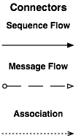
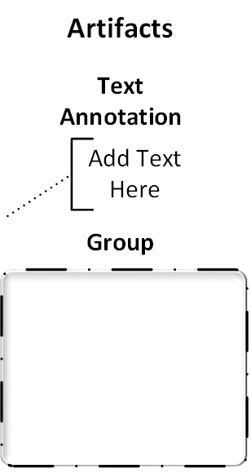
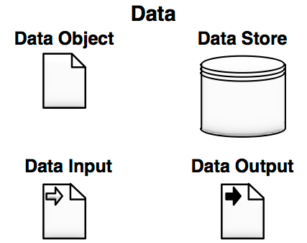
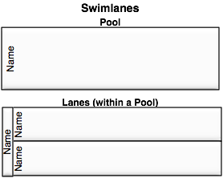
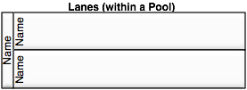
BPMN Elements
Overview of bpm standards

Slide 11
CMMN Overview
Overview of bpm standards
CMMN is about managing…
It is a relatively new standard. Development beginning in about 2010.
Supporting resources are still growing.
It has a metamodel, notation, and execution semantics for modeling a case.
CMMN 1.0 was released in May 2014 and 1.1 beta was released in March 2016.

Slide 12
CMMN Elements
Overview of bpm standards
Case File Item
Case Plan Model
Task
Stage
Criterion
Connector

Slide 13
DMN Overview
Overview of bpm standards
DMN is about deciding…
It is a relatively new standard. Development beginning in about 2012.
Supporting resources are still growing.
It has a metamodel and notation for modeling repeatable business decisions.
It can define the logic of the decision in multiple ways – e.g., expressions, decision tables.
DMN 1.1 released in Jun 2016

Slide 14
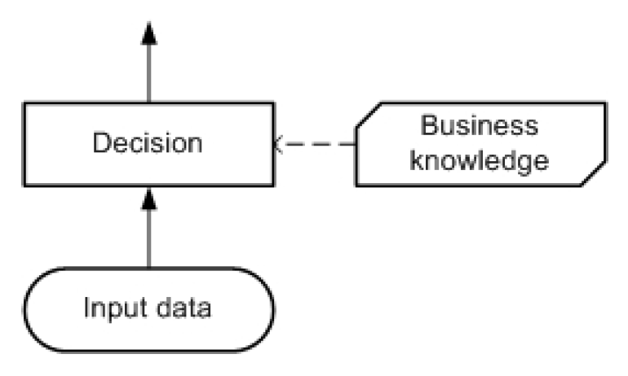
DMN Elements
Overview of bpm standards

Slide 15
Agenda
Introduction
The Significance of Standards
Overview of BPM Standards
Example Definition of a Clinical Pathway – Antenatal Care
Summary

Slide 16
Background
Example Definition of a Clinical Pathway – Antenatal Care
The OMG has been hosting a BPM Healthcare Project, which started in Dec, 2016.
Major healthcare organizations are participating.
The main output of the project is the development of a “Field Guide” for healthcare organizations to development comprehensive and sharable models of Clinical Pathways using OMG BPM standards.
To support and inform this work, an example Clinical Pathway is being developed in parallel.
The chosen Clinical Pathway is antenatal care.
Validate if BPMN, CMMN, and DMN are fit for purpose.

Slide 17
Antenatal Care
Example Definition of a Clinical Pathway – Antenatal Care
This example has a well defined start and end
From the first appointment after the start of pregnancy to delivery
Delivery and Postnatal care is not included
This is a complicated example, so the focus is on the “happy path” and a few exceptions.
Many of the potential complications are not defined (yet).

Slide 18
Scope of the Antenatal Clinical Pathway
Example Definition of a Clinical Pathway – Antenatal Care
This Clinical Pathway is complex:
There are 22 process models
There are 9 case models
There are 17 Decision models
The models are connected; combining to create a comprehensive model of the behaviors and decisions of the Clinical Pathway.

Slide 19
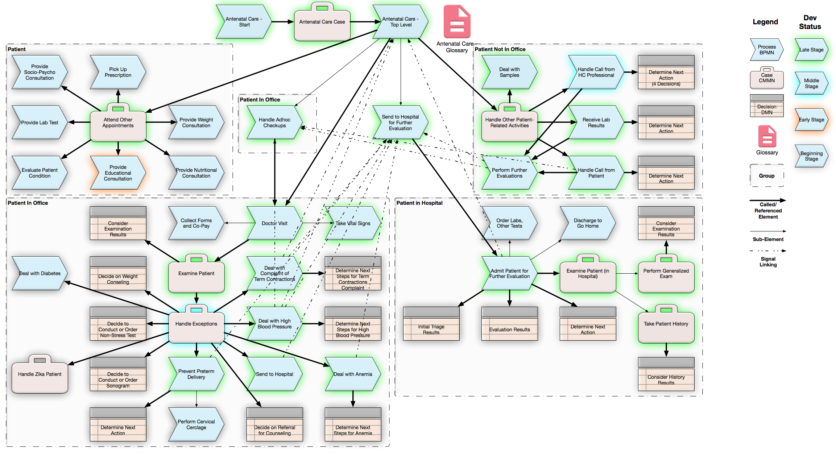
Scope of the Antenatal Clinical Pathway
Example Definition of a Clinical Pathway – Antenatal Care

Slide 20
Methodology
Example Definition of a Clinical Pathway – Antenatal Care
Develop the High Level Model and Relationships
Create Process (BPMN) and Case (CMMN) Models from the High Level Model
Create Decision (DMN) models as needed
Iterate on the generated models

Slide 21
Develop the High Level Model and Relationships
Example Definition of a Clinical Pathway – Antenatal Care
Include these elements:
Activities, Actors, Artifacts, Events, Goals, Knowledge, Systems
How, Who, What, When, Why, Where
Identify the relationships between these elements.
Take this as far as you can before starting the diagramming.
This will also serve as the the glossary of the project.

Slide 22
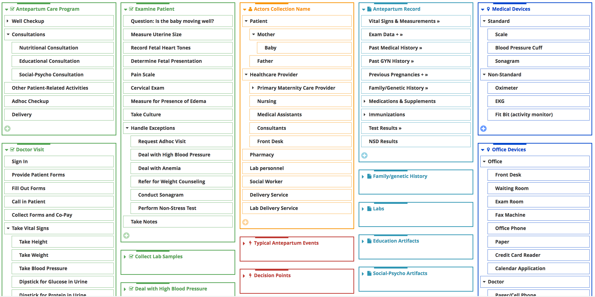
Develop the High Level Model and Relationships
Example Definition of a Clinical Pathway – Antenatal Care

Slide 23
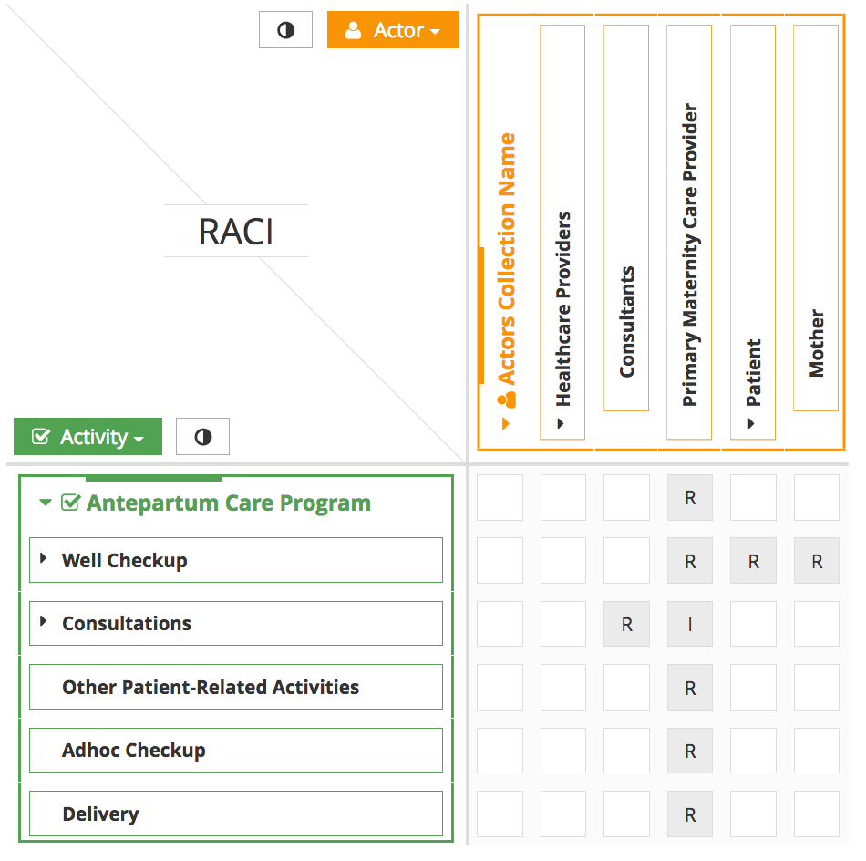
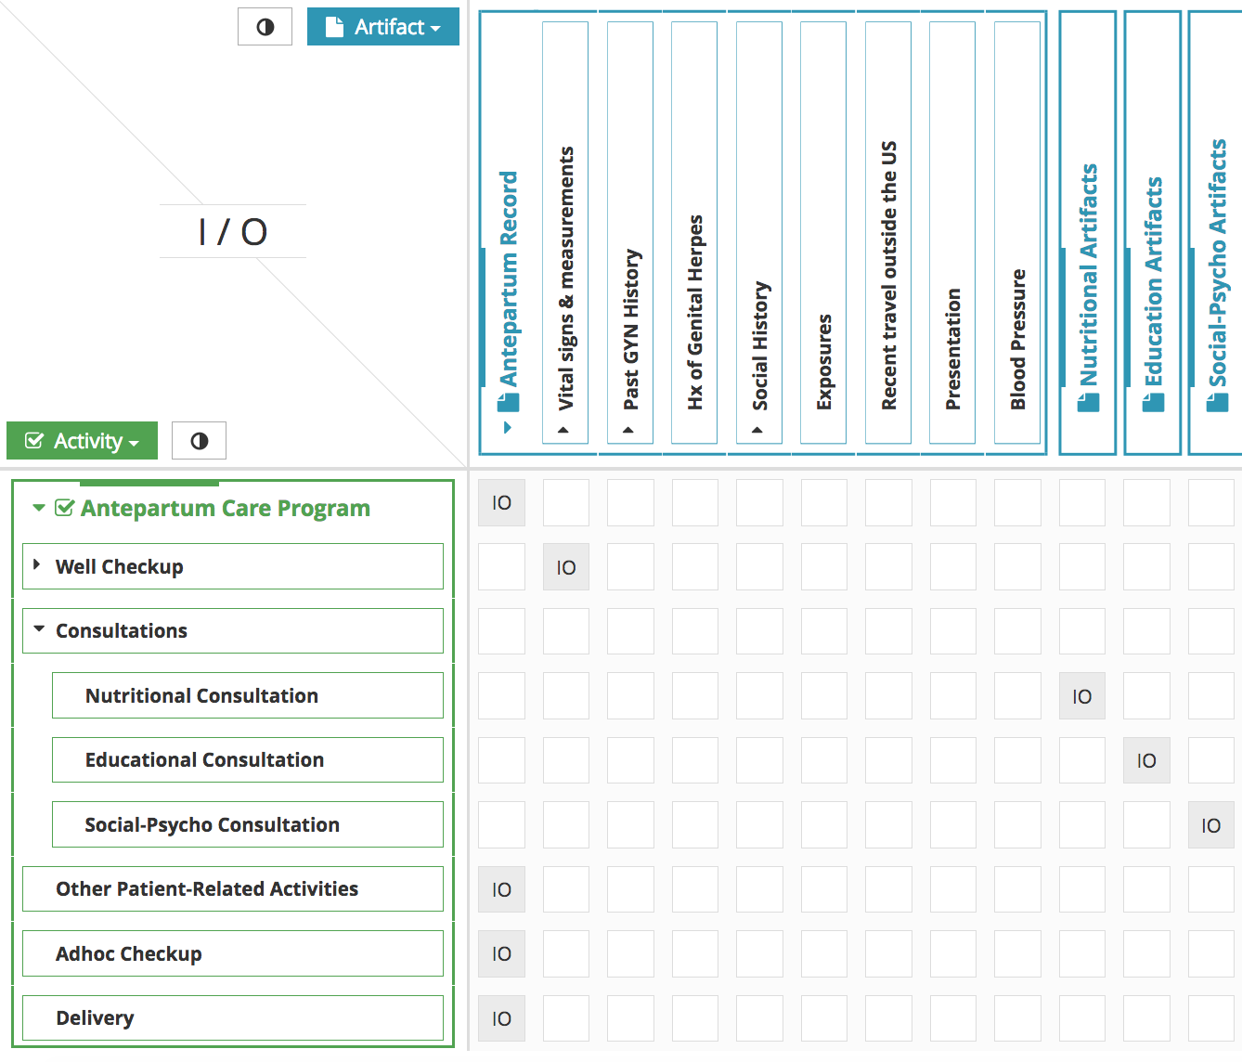
Define the Relationships
Example Definition of a Clinical Pathway – Antenatal Care

Slide 24
Create Behavioral Models from Identified Activities
Example Definition of a Clinical Pathway – Antenatal Care
Choose between BPMN and CMMN to start the modeling – per identified activity group.
In general, use BPMN for more structured processes – e.g., a sequential flow of activities
Use CMMN for more unstructured processes – e.g., a check list of activities
Some adjustments may be needed as modeling develops

Slide 25
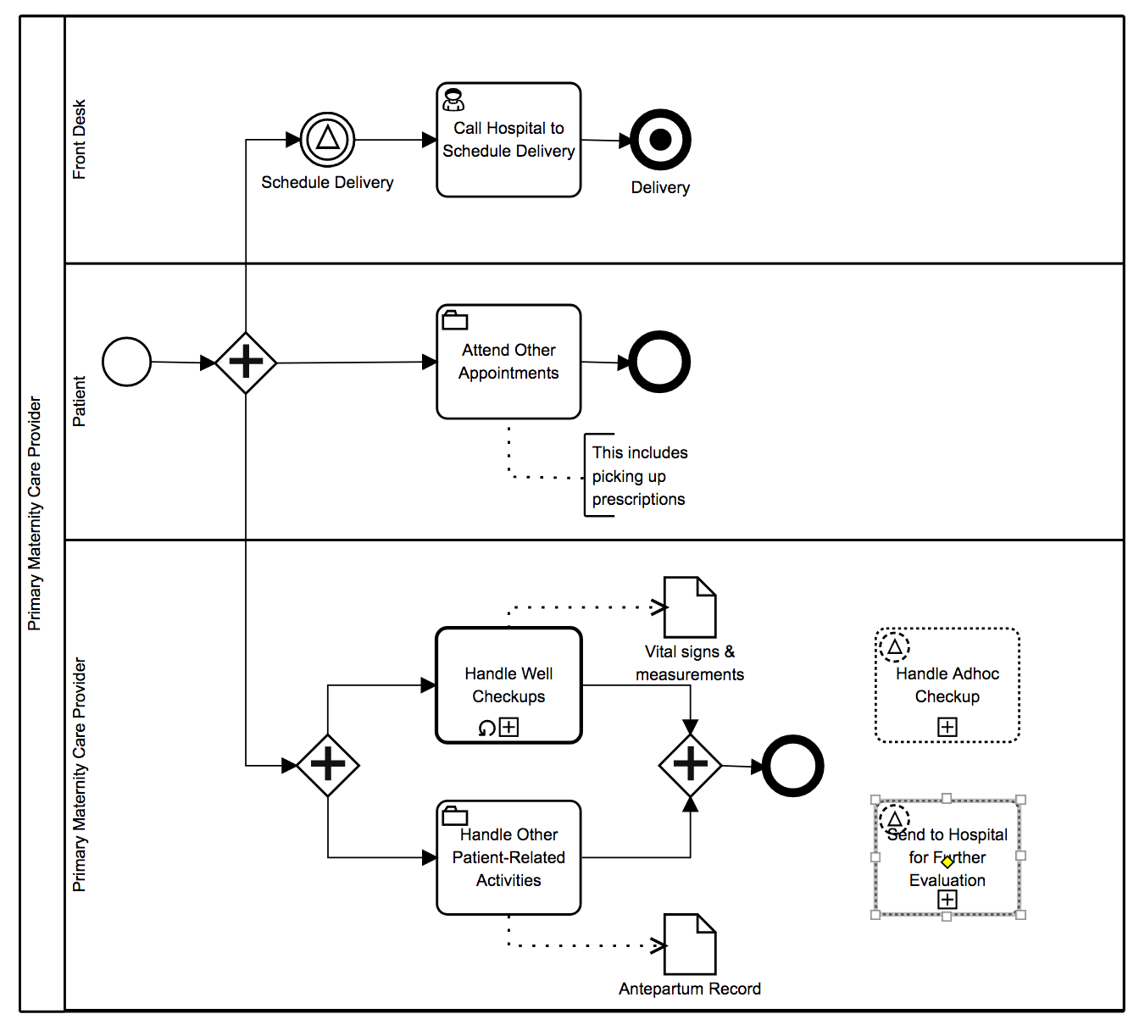
Create Process Based on the High Level Models
Example Definition of a Clinical Pathway – Antenatal Care

Slide 26
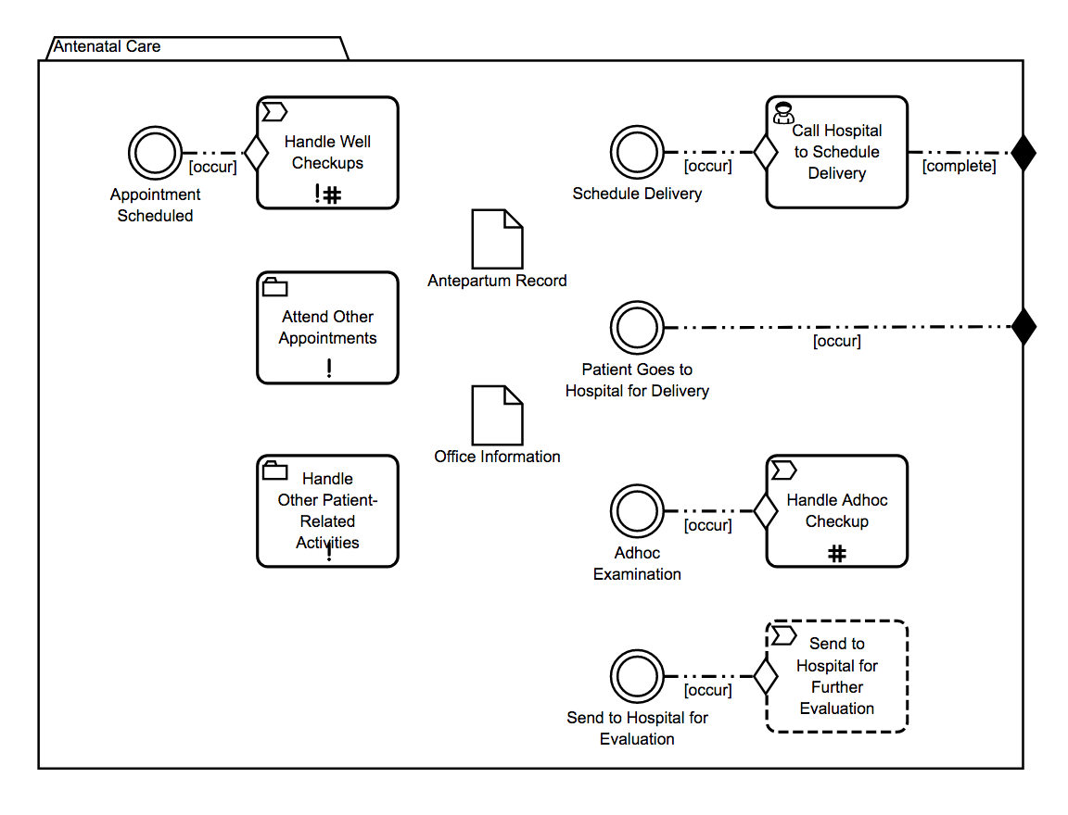
Create Case Models Based on the High Level Models
Example Definition of a Clinical Pathway – Antenatal Care

Slide 27
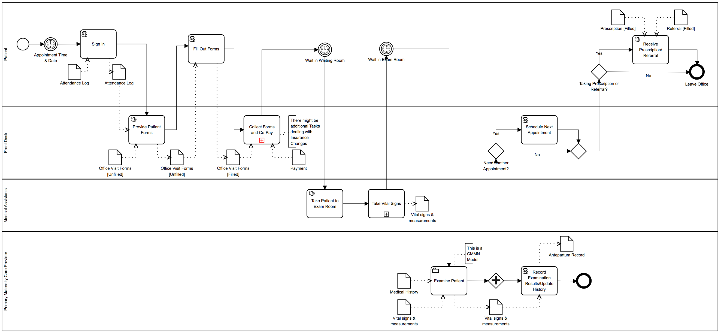
Iterate and Develop Detailed Models
Example Definition of a Clinical Pathway – Antenatal Care

Slide 28
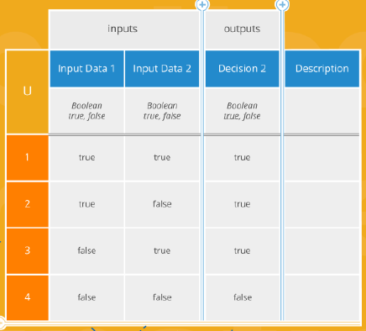
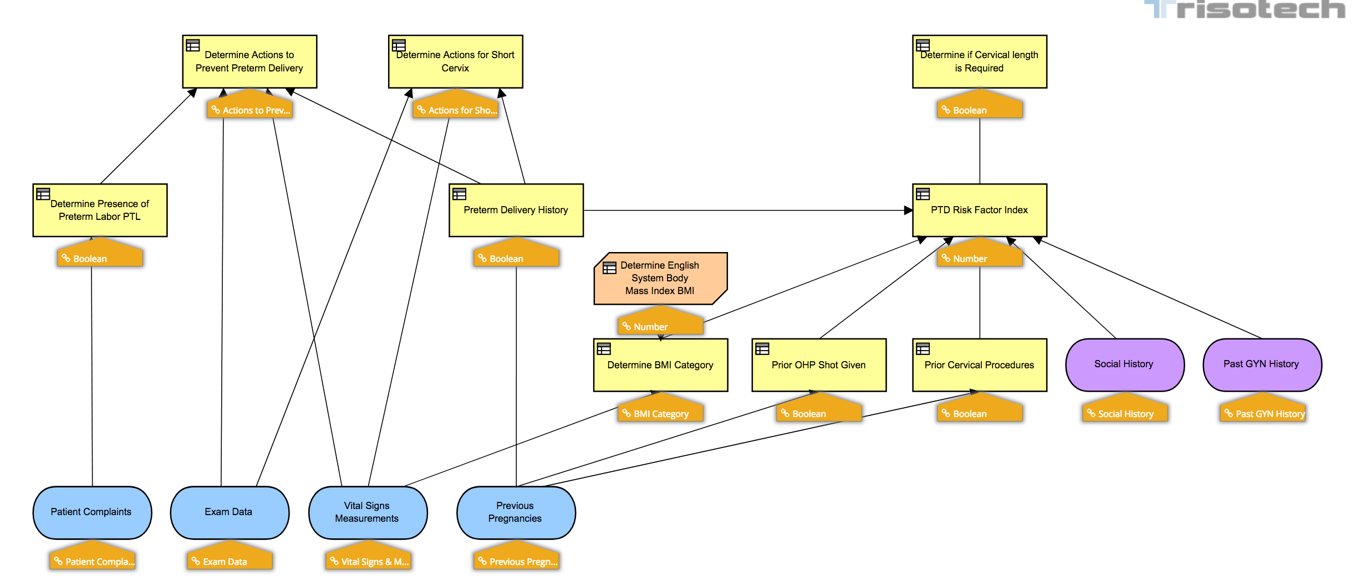
Develop DMN Models as Needed
Example Definition of a Clinical Pathway – Antenatal Care

Slide 29
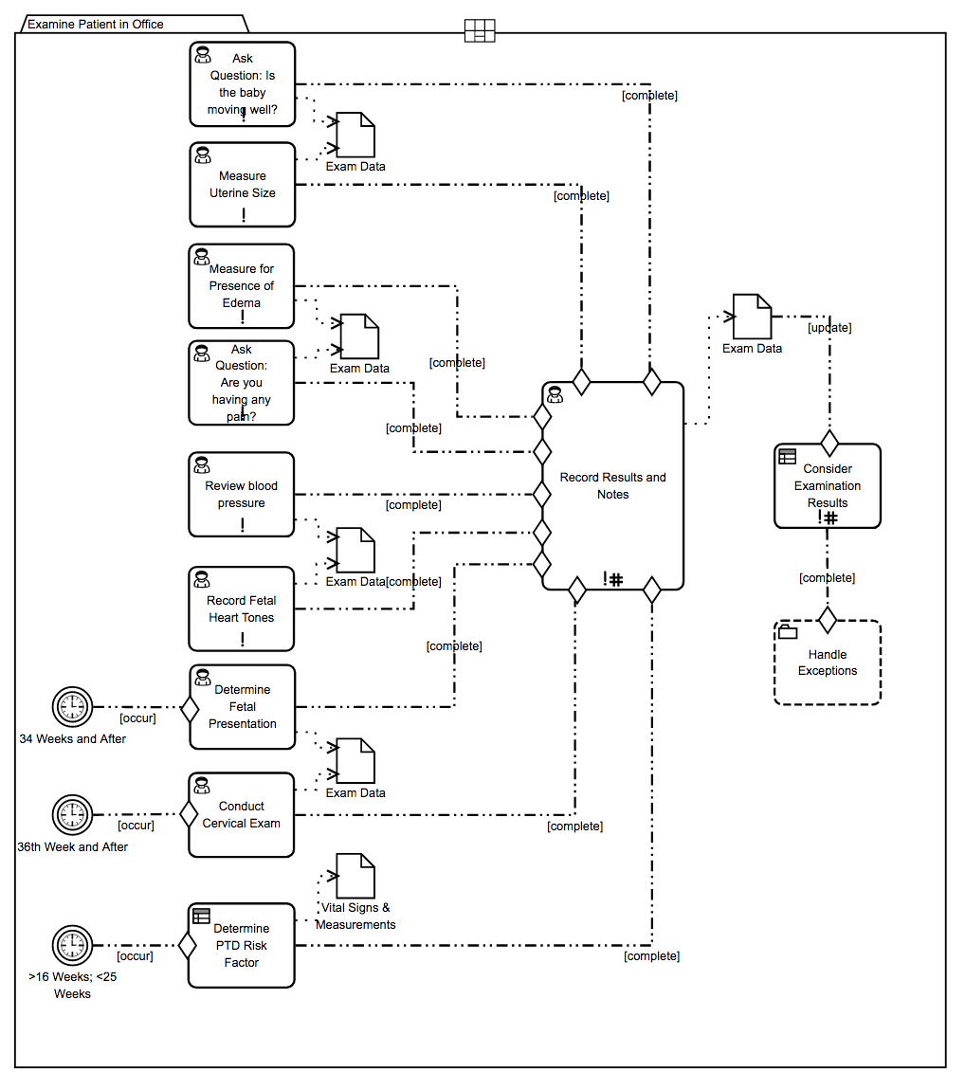
Relationship between a Process and a Case
Example Definition of a Clinical Pathway – Antenatal Care

Slide 30
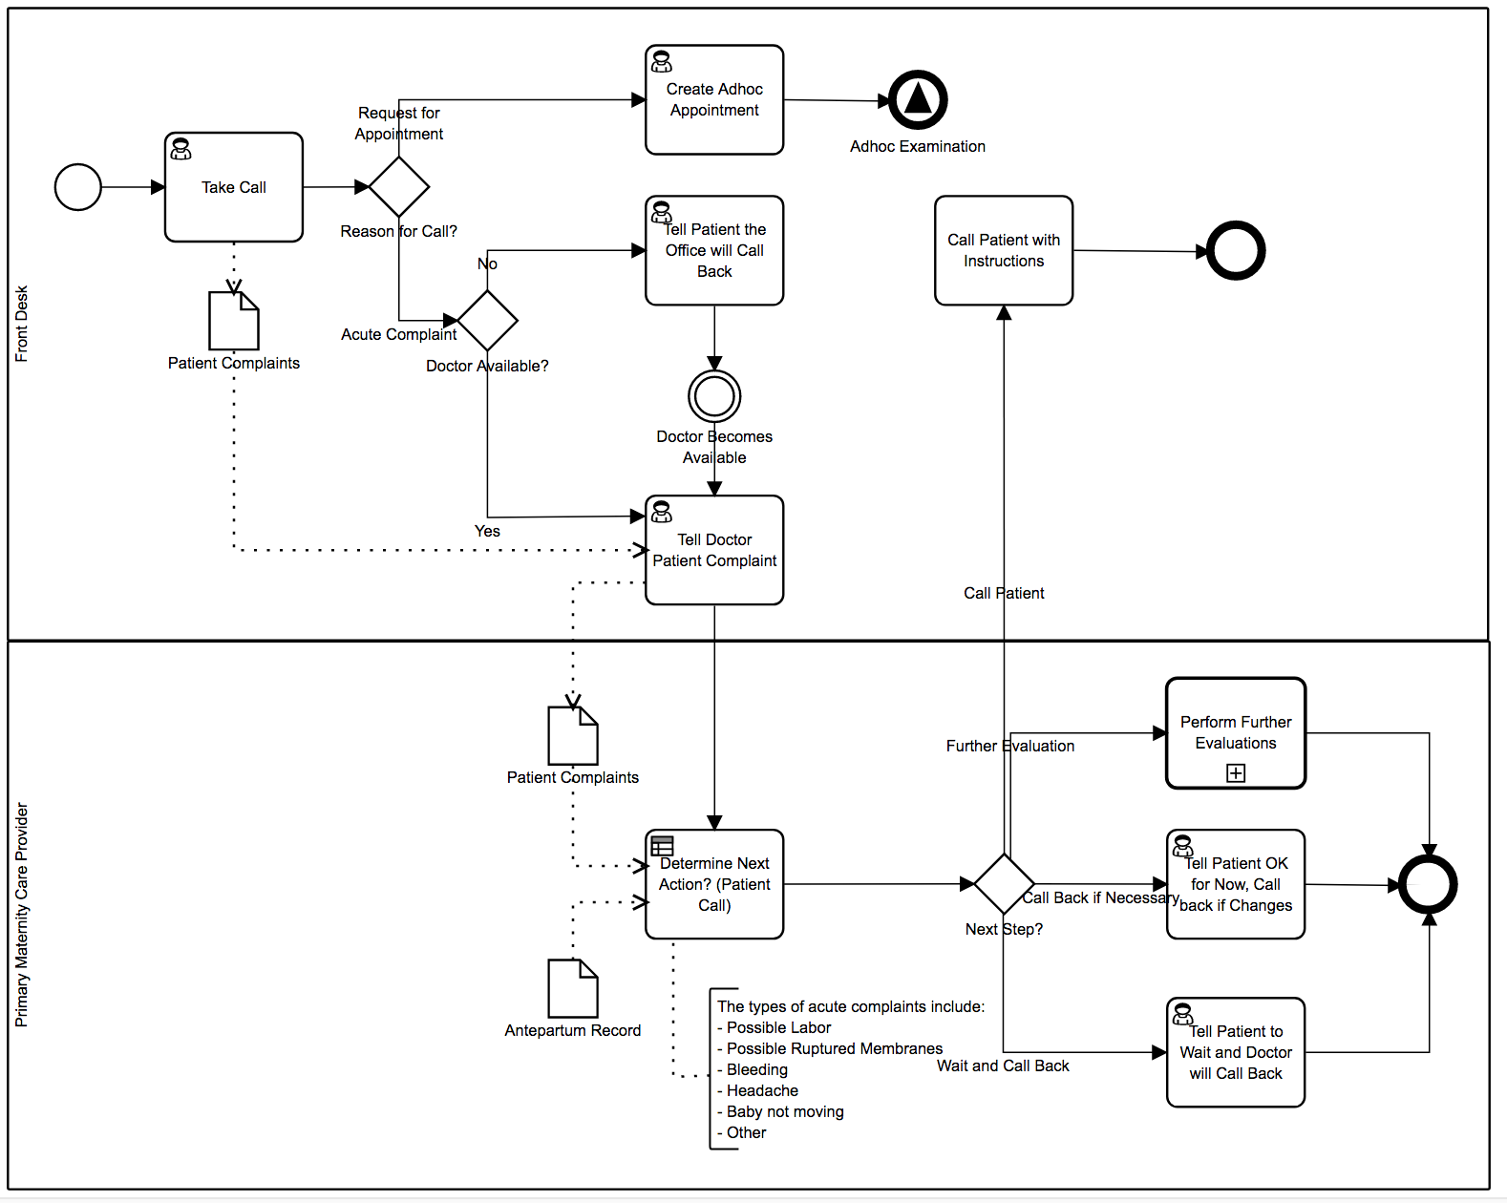
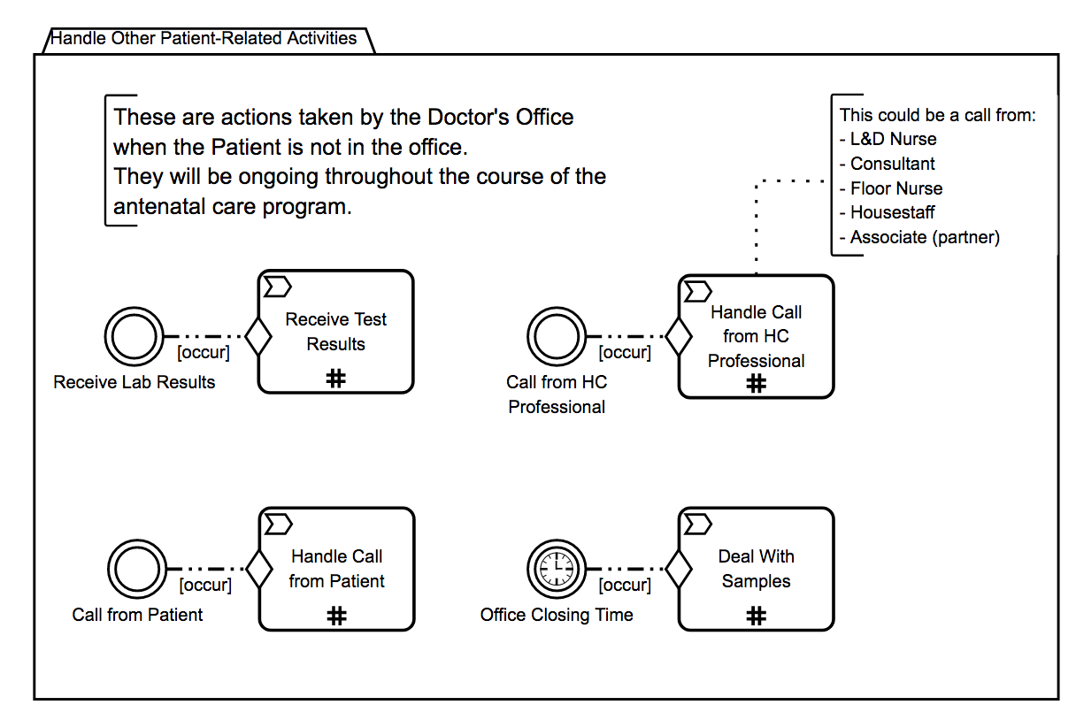
Relationship between a Case and a Process
Example Definition of a Clinical Pathway – Antenatal Care

Slide 31
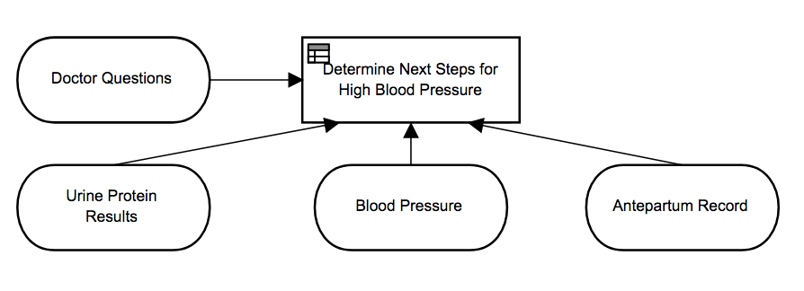
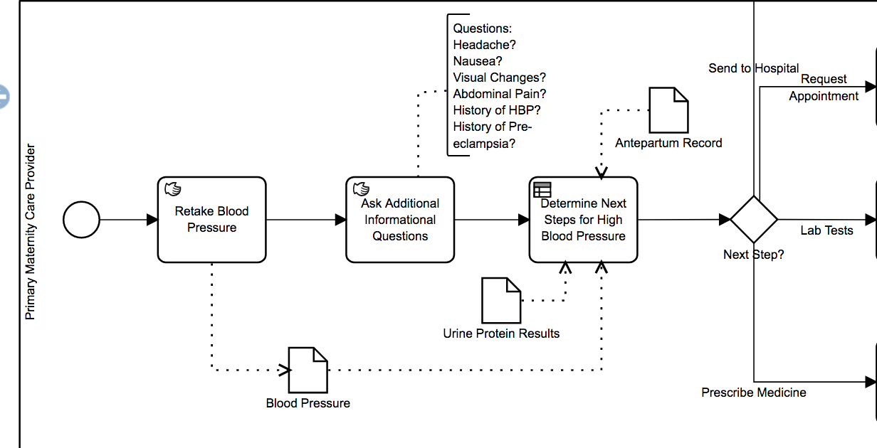
Relationship between DMN and BPMN
Example Definition of a Clinical Pathway – Antenatal Care
The relationship is basically the same between DMN and CMMN.

Slide 32
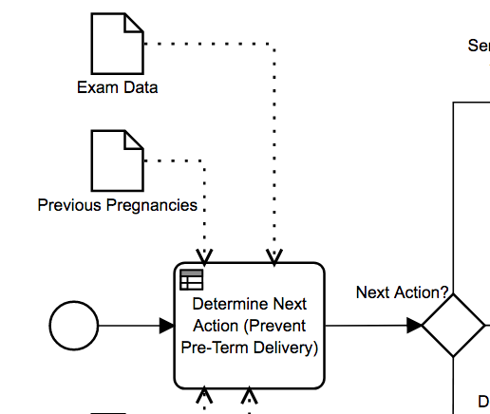
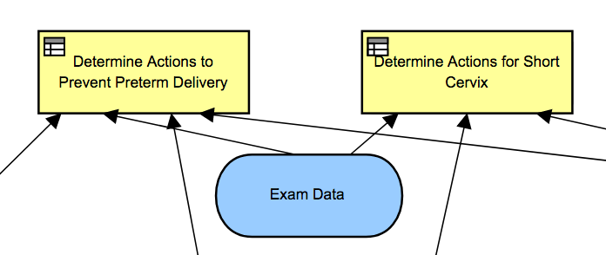
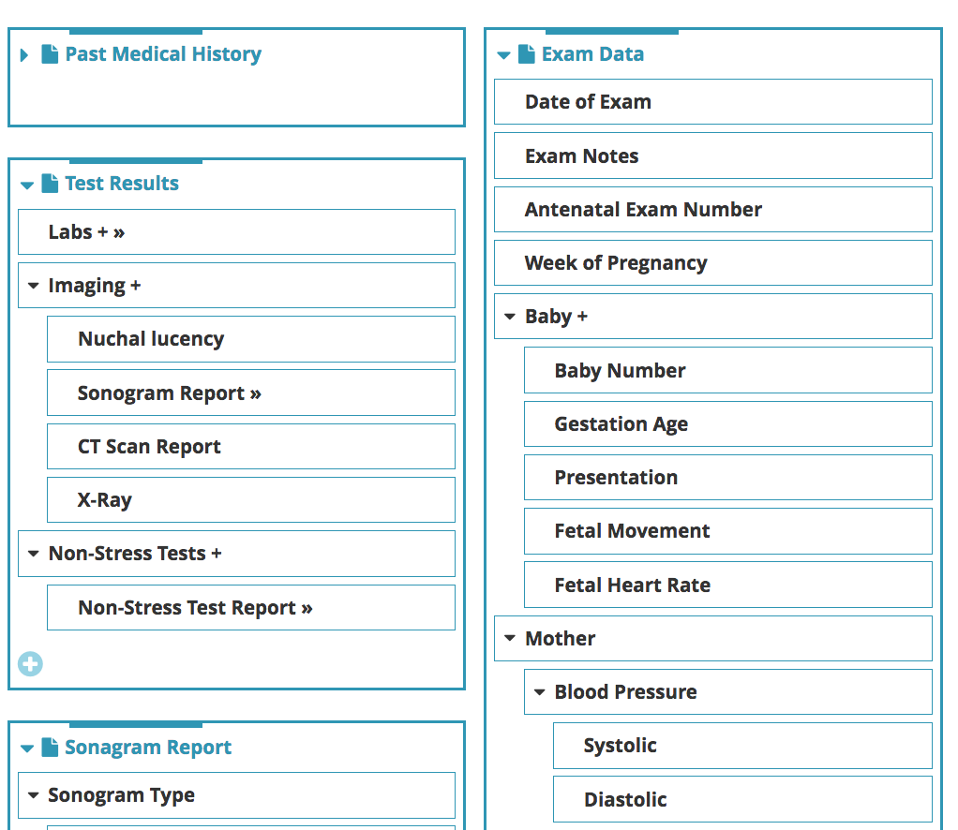
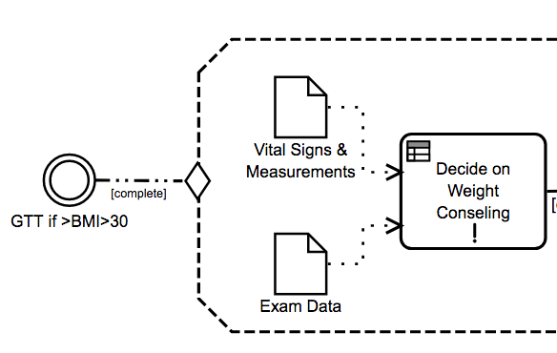
Best Practices
Example Definition of a Clinical Pathway – Antenatal Care
Example: There should be a separate Artifact Item in the Glossary for each Process Data Object, Case File Item, and Decision Input.
These Artifacts will often have a complex structure.
You don’t want too many separate items, but not too little, either.

Slide 33
Agenda
Introduction
The Significance of Standards
Overview of BPM Standards
Example Definition of a Clinical Pathway – Antenatal Care
Summary

Slide 34
Summary
The Antenatal Care use case was started to test the modeling capabilities of BPMN, CMMN, and DMN in describing a Clinical Pathway.
I.e., do they work for the purpose?
The test has been considered a success. That is, the standards can do the job.
Any gaps or requirement requests will be submitted to the appropriate teams within the OMG

Slide 35
Questions
???????

Slide 36
Background Slides

