Slide 1
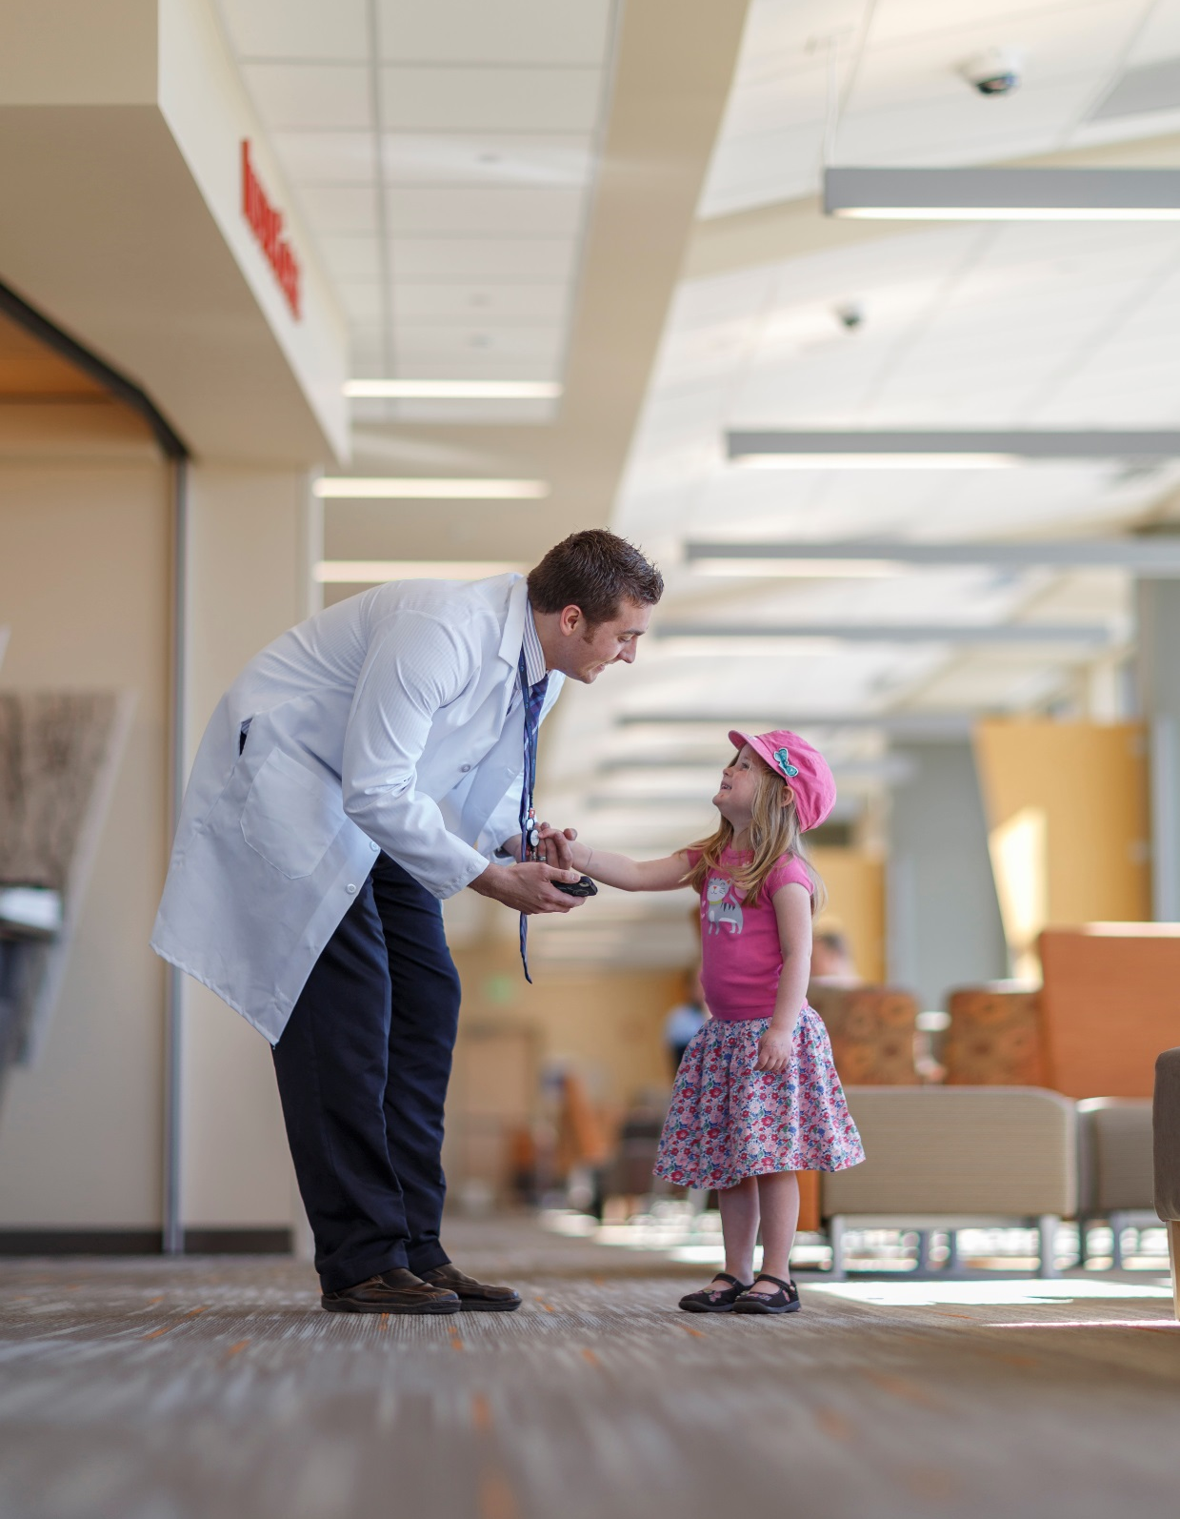
i4 Summit
Breakout Questions

Slide 2
DAY 1

Slide 3
What benefits would come with movement to structured reporting model and increasing interoperability of discrete data in radiology?
Could help automate the registries/ quality improvement –
increase efficiencies
more reliable data.
Improve workflow (viewer talks to reporting system talks to workflow system system)
Need to look at specific workflows… screening vs diagnostic? Some are more easily structured (i.e. Screening)
Use it for scenarios that could adopt and deloy widely – such as an ACR registry.
Could lead to more uniform, evidence based way to integrate best practice.
Could structure report per exam/view by the finding or the abnormality.... More flexibility in tailored reporting per context-

Slide 4
What major barriers impede widespread transformation of radiology data from text/image documents to actionable discrete data?
For each barrier, what recommended actions could we advance to make progress?
Determining the boundaries between the structured report/discrete data and the free text (NLP)
Is there a fused model between the structured reporting and the free text? What does it look like?
Action towards progress: look for areas of minimal translation between clinical data entry and the use of the data (in registries, standardized reporting systems, and things like Lung CAD and Breast CAD)
Lack of Adoption
Too many mouse clicks makes systems unusable. Don’t interrupt or impede the thought process of the clinical task at hand (interpreting the film)
The systems need to be very usable. - Could get poor data due to over use of defaults. We know natural tendency is to take the “easy way”
Does the structure and discrete data become a detriment to NLP?
We need to think about the computers for tomorrow – not just the computers of today.
Need the models to support the differential and the diagnosis – to highlight the key findings and surface into CDSS appropriately to improve patient outcomes.
Lack of more “killer” use cases that would motivate people to solve these issues. ”if you supply X, you will get Y”. The added value to the clinician or the patient for the additional effort/data. Such as encoding the follow up recommendation –
The accessibility of the knowledge created in multiple venues/arenas – that are then sold for profit. This needs to be more transparant.
The fine line between “profit” and the “greater good”.
Difference between academic radiologist and community radiologist (willingness to change) – Need to demonstrate more time off, less stress, address payment model issues.

Slide 5
What major barriers impede widespread transformation of radiology data from text/image documents to actionable discrete data?
For each barrier, what recommended actions could we advance to make progress?
Determining the boundaries between the structured report/discrete data and the free text (NLP)
Is there a fused model between the structured reporting and the free text? What does it look like?
Action towards progress: look for areas of minimal translation between clinical data entry and the use of the data (in registries, standardized reporting systems, and things like Lung CAD and Breast CAD)
Lack of Adoption
Too many mouse clicks makes systems unusable. Don’t interrupt or impede the thought process of the clinical task at hand (interpreting the film)
The systems need to be very usable. - Could get poor data due to over use of defaults. We know natural tendency is to take the “easy way”
Does the structure and discrete data become a detriment to NLP?

Slide 6
What major barriers impede widespread transformation of radiology data from text/image documents to actionable discrete data? (Cont.)
For each barrier, what recommended actions could we advance to make progress?
We need to think about the computers for tomorrow – not just the computers of today.
Need the models to support the differential and the diagnosis – to highlight the key findings and surface into CDSS appropriately to improve patient outcomes.
Lack of more “killer” use cases that would motivate people to solve these issues. ”if you supply X, you will get Y”. The added value to the clinician or the patient for the additional effort/data. Such as encoding the follow up recommendation –
The accessibility of the knowledge created in multiple venues/arenas – that are then sold for profit. This needs to be more transparant.
The fine line between “profit” and the “greater good”.
Difference between academic radiologist and community radiologist (willingness to change) – Need to demonstrate more time off, less stress, address payment model issues.

Slide 7
DAY 2

Slide 8
Should we formally organize i4 to create a framework for collaboration and standardization for radiology content?
If yes… Yes -
Should/could we organize under CIIC or some other national organization?
ACR/RSNA Contribute a radiology voice to the CIIC efforts
What role should ACR and RSNA take in this organizational effort?
Collaborate to bring the radiology voice together to the CIIC community.
How can we provide broad opportunity for participation and keep the process non-commercial and non-political?
Evaluate carefully the transparency requirements – how to “keep it open” and transparent, but still allow for profitability.
Having the data model and services “open” but keeping the workflow, presentation/UI of the different apps proprietary could work.
** Want to address this on a project by project basis. The plan sounds reasonable – but as said – can not be committed to yet. Need to continue discussing with individual “home” communities.

Slide 9
How can we encourage content development from many sources while avoiding chaos and fragmentation?
Build consensus to a common ground – but don’t impede the progress of any teams work towards their end goal. This may end up in mapping from the individual content to the consensus model.

Slide 10
What specific projects can we work on now?
Lung Nodule follow up –
lung nodule screening – Lung Rad
size of nodule,
content of nodule
Needs:
rad report data (category assignment, fup interval)
referring MD directory
Alerting the Patient
Incidental finding (Fleishner criteria)
Needs: EMR data, patient information, MD information, insurance information – create 3 letters – one for clinician, patient letter, one insurance company letter. Making sure there is a follow up order as well.
Idea: The radiology community creates a document (IG, Profiles, RFI/RFP) stating we need a solution that follows these standards and guidelines.

Slide 11
- What should we target to do at RSNA 2017, and in the 6 months following?
How should suppliers be included?
Not sure anything can be done before RSNA this year – already very busy for that
At the most – arrange a 2nd meeting of this team to work soon after RSNA on developing the next 12 year plan.
Investigate an asynchronous method of communication for this group to continue work.
We need a project manager to facilitate the asynchronous work.
Need to have tools in place to manage asynchronous work.

Slide 12
How can we bring greater coherence to the content created from a variety of sources so that content blends into a unified language?
Carefully consider where coherence needs to occur – not all things need to be incorporated into each others…
Need to have adequate IT support to the clinical work.

Slide 13
Anything else we should consider?
The content creation process – what is IH doing?
At IH – monthly meetings- webex style – with different breakout groups/sections doing interim work. With IT and PM support to maintain momentum and coordination.
The help needs to be more then scheduling – need business analyst support as well to get more work done between the meetings with the subject matter experts.

