Slide 1
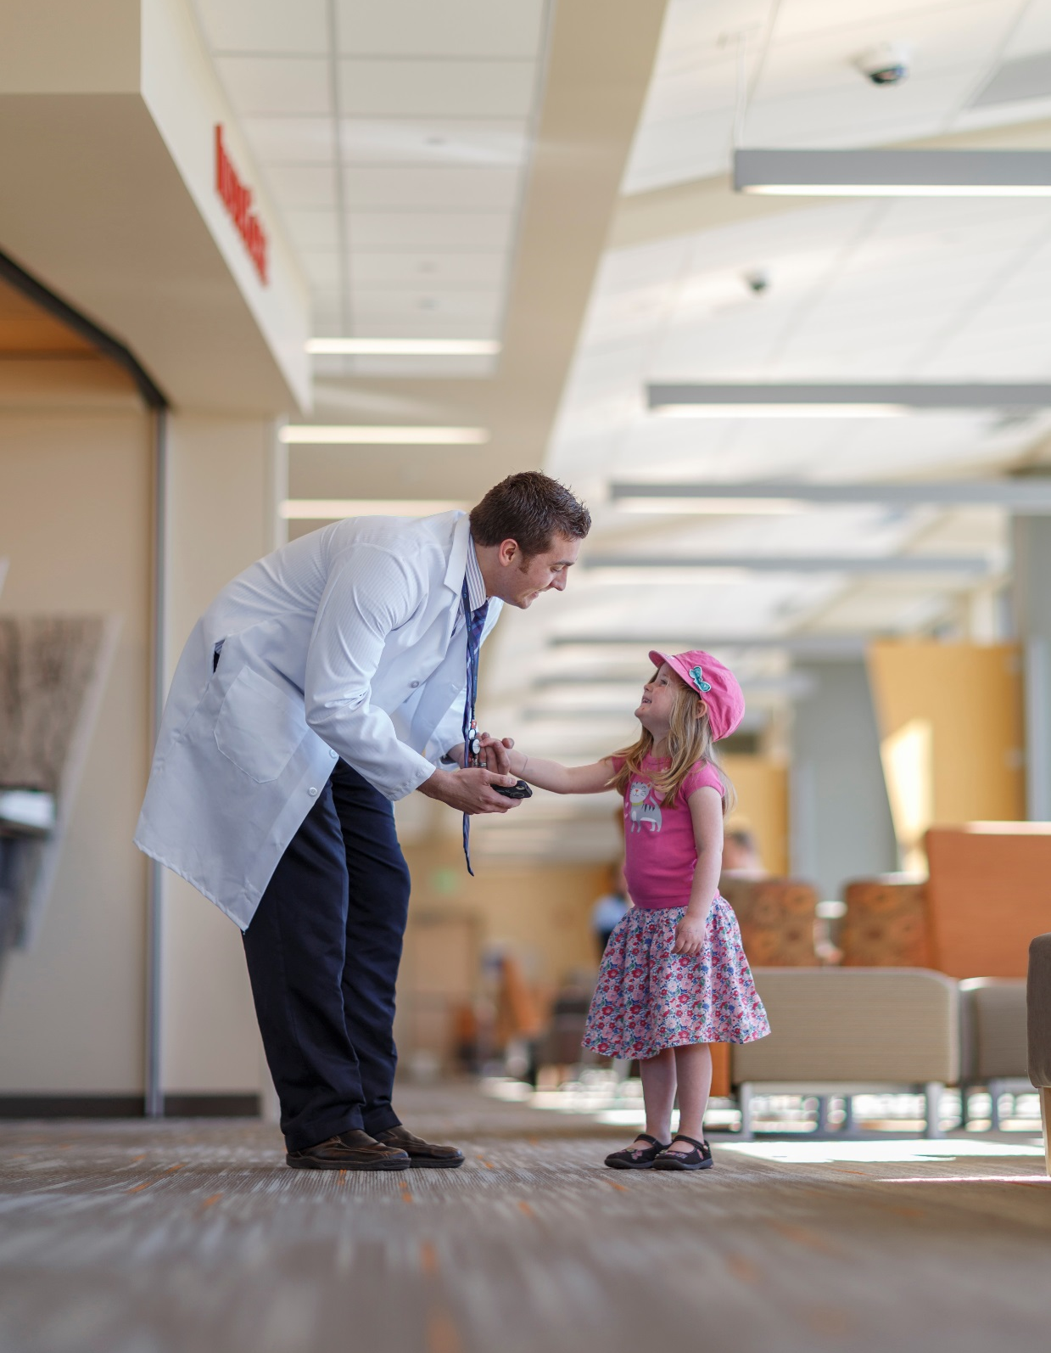
i4 Summit
Breakout Questions
Group Report Out

Slide 2
What benefits would come with movement to structured reporting model and increasing interoperability of discrete data in radiology?
Registry submissions in a standardized way
Actionable information can drive quality to leverage evidence based practices driven into decision support
Data to support costing structure to see if the radiology procedures produce actionable outcomes
As less experienced staff play a greater role in care, there is a greater need for evidence based guidance
Ability to do quantitative peer review
Foundation for AI and machine learning practices
Radiologist satisfaction increase because the tools fetch and input quantitative data
Less need for the radiologist to go back and add data to reports
Data is usable across the enterprise
Facilitates moving data across patient care settings, e.g., pediatrics movement to adult care
Can provide high level of care in resource strapped environments
Currently cannot answer some of the most basic data questions, e.g., how many ankle fractures, types of fractures. Currently takes significant manual resources. Can support operations management and improvement.
Note: Need implementations to develop the evidence to show that these benefits are realized

Slide 3
Barrier | Action
No single agreed on semantic architecture for defining the models | Develop coalitions to develop common data models
Current radiology report practice is narrative and does not rely on a semantic models. Perceived as efficient. | Demonstrate that structured data is more efficient, e.g., generating bi-rads. Develop tools to support guided dictation so that each section within the dictation captures data that can be coded. Demonstrate the added value of structured data
Lack of regulatory framework or incentive to improve the quality of reports and the use of structured data | Reimburse for radiology reports with discrete data
Lack of evidence that discrete data is delivering real value | Conduct pilots to demonstrate the value
Need to change the culture | RSNA and ACR continue to promote structured coding. Models will enable automation that will make it easier Convey that the radiologist is part of the care team Next generation of radiologist will be more oriented to electronic documentation

Slide 4
Should we formally organize i4 to create a framework for collaboration and standardization for radiology content?
Options – for the next six months
Standalone – for the next two meetings. Coordinate meeting dates with HSPC or CIIC
Could move faster, but may lack coordination
Will need relationships with other organizations
Need resources for organizational management
Meet before or after another group for one day
Attach to another organization
May be slower, but would have better coordination
Possible organizations
CIIC – a logical home, but still under early development
HSPC
IHE – maybe after the standards are defined. Could support implementation guides and test plans
HL7 – can support standards balloting. Do initial work and bring to HL7

Slide 5
Organizational Approach
What role should ACR and RSNA take in this organizational effort?
Could assist in providing support for convening meetings and communication channels
Should consider including radiology sub-specialties and other “ologies”. RSNA can help with outreach
RSNA and ACR need to be engaged because they are both engaged in addressing this issue

Slide 6
Organizational Approach
How can we provide broad opportunity for participation and keep the process non-commercial and non-political?
Address these issues openly
Have IP policies that balance the need for open source and retain commercial IT value as appropriate
Open participation
Broad call for participation
Transparency – public proceedings, meeting processes
Clear and simple rules of engagement – strong commitment to purpose over individual organizational interests
Governance model

Slide 7
How can we encourage content development from many sources while avoiding chaos and fragmentation?
Establish strong linkages with existing efforts
Have a simple commonly understood formalism for expressing work
Make choices that will create momentum
Need to have the clinical models and the schema
Tooling to enable collaboration authoring, viewing, reviewing, managing
Must have a clinician friendly view

Slide 8
What specific projects can we work on now?
All work should include the appropriate clinical expertise including the sub-specialty societies
Define how the work will be delivered
What artifacts will be produced
Defining an architecture
Vendors would benefit from a defined architecture
Opportunity to guide the vendors and suppliers in what is needed
CMS quality reporting requirements – sets up a cause or purpose for the work = 9 projects
Cancer Interoperability and cancer registries

Slide 9
What should we target to do at RSNA 2017, and in the 6 months following?
Go back and vet ideas with participant organizations and meet to share feedback and refine focus to define the next six months
2 hour meeting
Select time to maximize attendance
Make presentation at MITA meeting (NEMA medical imaging group – DICOM)
Key actions for next six months – reconvene this group at least once or more
RSNA Meeting
Develop a method for moving work forward
Work groups
Steering group
Select initial projects and begin work

Slide 10
How can we bring greater coherence to the content created from a variety of sources so that content blends into a unified language?
Considerations
Existing standards -- DICOM, HL7, IHE have standards based solutions.
Biggest challenge is in the deep semantic level
Need to take into account the installed base and existing standards
Process
Do an environmental scan on what exists today and strengths and weaknesses
Develop consensus on gaps, what has high value to build on
As noted above develop a general/common modeling approach

Slide 11
Anything else we should consider?
Having models and demonstrations that are persuasive about the clinical benefits and are visible to the medical imaging community will drive adoption
Look for small manageable targets of opportunity to achieve high value rapidly
Communications from this group outward is critical to drawing in additional stakeholders – academics, vendors

