Slide 1

Informatics and Interoperability Initiatives

Slide 2
Overview
RadLex
RadElement
RSNA Reporting Initiative
IHE
RSNA Image Share Network
RSNA Machine Learning Initiatives

Slide 3
RadLex
To provide a comprehensive resource for radiology terminology.
To serve as a repository for standard terms developed by others.
To incorporate these terms into a semantic framework.
To facilitate interoperability and semantic applications.

Slide 4
RadLex
Scope:
Anatomy
Pathology
Imaging techniques (e.g. modalities, agents)
Imaging findings (e.g. Fleischner, BI-RADS)

Slide 5
RadLex
Scope (continued):
Synonyms
Reporting terms (e.g. uncertainty)
Radiology workflow terms
Other languages
Radiology procedure codes

Slide 6
RadLex

Slide 7
RadLex
Approximately 46,000 concepts
Approximately 76,000 terms (i.e. including synonyms)
Interactive browsing
  Radlex.org
  Bioportal
Web service access via Bioportal API

Slide 8
RadLex Playbook
Objective: Interoperability of imaging exams
Structured names and codes for radiology procedures
Built using RadLex terms

Slide 9
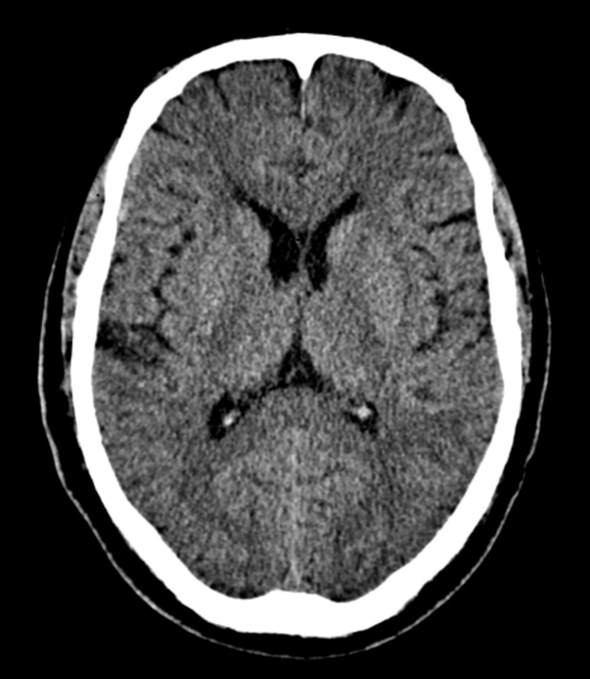
RadLex Playbook
Head^HEAD_WO (Adult)
Head^RoutineHead (Adult)
BRAIN WO CT
BRAIN NO IV CT
HEAD OR BRAIN W/O C CT
BRAIN WO CT HEAD WITHOUT CNTRST

Slide 10
RadLex Playbook
RPID | SHORT_NAME | MODALITY | BODY_REGION | PHARMACEUTICAL
RPID22 | CT Head wo | CT (RID 10321) | HEAD (RID 9080) | WITHOUT IV CONTRAST (RID 28768)

Slide 11
RadLex Playbook
  - Head^HEAD_WO (Adult)
  - Head^RoutineHead (Adult)
  - BRAIN WO CT
  - BRAIN NO IV CT
  - BRAIN WO CT
  - HEAD OR BRAIN W/O C CY
  - BRAIN WO CT HEAD WITHOUT CNTRST
  - Head^HEAD_WO (Adult)
  - Head^RoutineHead (Adult)
  - BRAIN WO CT
  - BRAIN NO IV CT
  - BRAIN WO CT
  - HEAD OR BRAIN W/O C CY
  - BRAIN WO CT HEAD WITHOUT CNTRST
  - Head^HEAD_WO (Adult)
  - Head^RoutineHead (Adult)
  - BRAIN WO CT
  - BRAIN NO IV CT
  - BRAIN WO CT
  - HEAD OR BRAIN W/O C CY
  - BRAIN WO CT HEAD WITHOUT CNTRST
  - Head^HEAD_WO (Adult)
  - Head^RoutineHead (Adult)
  - BRAIN WO CT
  - BRAIN NO IV CT
  - BRAIN WO CT
  - HEAD OR BRAIN W/O C CY
  - Head^HEAD_WO (Adult)
  - Head^RoutineHead (Adult)
  - BRAIN WO CT
  - BRAIN NO IV CT
  - BRAIN WO CT
  - HEAD OR BRAIN W/O C CY
  - BRAIN WO CT HEAD WITHOUT CNTRST
  - Head^HEAD_WO (Adult)
  - Head^RoutineHead (Adult)
  - BRAIN WO CT
  - BRAIN NO IV CT
  - BRAIN WO CT
  - HEAD OR BRAIN W/O C CY
  - BRAIN WO CT HEAD WITHOUT CNTRST
  - Head^HEAD_WO (Adult)
  - Head^RoutineHead (Adult)
  - BRAIN WO CT
  - BRAIN NO IV CT
  - BRAIN WO CT
  - HEAD OR BRAIN W/O C CY
  - BRAIN WO CT HEAD WITHOUT CNTRST
  - Head^HEAD_WO (Adult)
  - Head^RoutineHead (Adult)
  - BRAIN WO CT
  - BRAIN NO IV CT
  - BRAIN WO CT
  - HEAD OR BRAIN W/O C CY
  - Head^HEAD_WO (Adult)
  - Head^RoutineHead (Adult)
  - BRAIN WO CT
  - BRAIN NO IV CT
  - BRAIN WO CT
  - HEAD OR BRAIN W/O C CY
  - BRAIN WO CT HEAD WITHOUT CNTRST
  - Head^HEAD_WO (Adult)
  - Head^RoutineHead (Adult)
  - BRAIN WO CT
  - BRAIN NO IV CT
  - BRAIN WO CT
  - HEAD OR BRAIN W/O C CY
  - BRAIN WO CT HEAD WITHOUT CNTRST
  - Head^HEAD_WO (Adult)
  - Head^RoutineHead (Adult)
  - BRAIN WO CT
  - BRAIN NO IV CT
  - BRAIN WO CT
  - HEAD OR BRAIN W/O C CY
  - BRAIN WO CT HEAD WITHOUT CNTRST
  - Head^HEAD_WO (Adult)
  - Head^RoutineHead (Adult)
  - BRAIN WO CT
  - BRAIN NO IV CT
  - BRAIN WO CT
  - HEAD OR BRAIN W/O C CY
  - Head^HEAD_WO (Adult)
  - Head^RoutineHead (Adult)
  - BRAIN WO CT
  - BRAIN NO IV CT
  - BRAIN WO CT
  - HEAD OR BRAIN W/O C CY
  - BRAIN WO CT HEAD WITHOUT CNTRST
  - Head^HEAD_WO (Adult)
  - Head^RoutineHead (Adult)
  - BRAIN WO CT
  - BRAIN NO IV CT
  - BRAIN WO CT
  - HEAD OR BRAIN W/O C CY
  - BRAIN WO CT HEAD WITHOUT CNTRST
  - Head^HEAD_WO (Adult)
  - Head^RoutineHead (Adult)
  - BRAIN WO CT
  - BRAIN NO IV CT
  - BRAIN WO CT
  - HEAD OR BRAIN W/O C CY
  - BRAIN WO CT HEAD WITHOUT CNTRST
  - Head^HEAD_WO (Adult)
  - Head^RoutineHead (Adult)
  - BRAIN WO CT
  - BRAIN NO IV CT
  - BRAIN WO CT
  - HEAD OR BRAIN W/O C CY
  - Head^HEAD_WO (Adult)
  - Head^RoutineHead (Adult)
  - BRAIN WO CT
  - BRAIN NO IV CT
  - BRAIN WO CT
  - HEAD OR BRAIN W/O C CY
  - BRAIN WO CT HEAD WITHOUT CNTRST
  - Head^HEAD_WO (Adult)
  - Head^RoutineHead (Adult)
  - BRAIN WO CT
  - BRAIN NO IV CT
  - BRAIN WO CT
  - HEAD OR BRAIN W/O C CY
  - BRAIN WO CT HEAD WITHOUT CNTRST
  - Head^HEAD_WO (Adult)
  - Head^RoutineHead (Adult)
  - BRAIN WO CT
  - BRAIN NO IV CT
  - BRAIN WO CT
  - HEAD OR BRAIN W/O C CY
  - BRAIN WO CT HEAD WITHOUT CNTRST
  - Head^HEAD_WO (Adult)
  - Head^RoutineHead (Adult)
  - BRAIN WO CT
  - BRAIN NO IV CT
  - BRAIN WO CT
  - HEAD OR BRAIN W/O C CY
  - Head^HEAD_WO (Adult)
  - Head^RoutineHead (Adult)
  - BRAIN WO CT
  - BRAIN NO IV CT
  - BRAIN WO CT
  - HEAD OR BRAIN W/O C CY
  - BRAIN WO CT HEAD WITHOUT CNTRST
  - Head^HEAD_WO (Adult)
  - Head^RoutineHead (Adult)
  - BRAIN WO CT
  - BRAIN NO IV CT
  - BRAIN WO CT
  - HEAD OR BRAIN W/O C CY
  - BRAIN WO CT HEAD WITHOUT CNTRST
  - Head^HEAD_WO (Adult)
  - Head^RoutineHead (Adult)
  - BRAIN WO CT
  - BRAIN NO IV CT
  - BRAIN WO CT
  - HEAD OR BRAIN W/O C CY
  - BRAIN WO CT HEAD WITHOUT CNTRST
  - Head^HEAD_WO (Adult)
  - Head^RoutineHead (Adult)
  - BRAIN WO CT
  - BRAIN NO IV CT
  - BRAIN WO CT
  - HEAD OR BRAIN W/O C CY
Notes:
Highlight connection of RPIDs to RIDs

Slide 12
RadLex Playbook
  - Head^HEAD_WO (Adult)
  - Head^RoutineHead (Adult)
  - BRAIN WO CT
  - BRAIN NO IV CT
  - BRAIN WO CT
  - HEAD OR BRAIN W/O C CY
  - BRAIN WO CT HEAD WITHOUT CNTRST
  - Head^HEAD_WO (Adult)
  - Head^RoutineHead (Adult)
  - BRAIN WO CT
  - BRAIN NO IV CT
  - BRAIN WO CT
  - HEAD OR BRAIN W/O C CY
  - BRAIN WO CT HEAD WITHOUT CNTRST
  - Head^HEAD_WO (Adult)
  - Head^RoutineHead (Adult)
  - BRAIN WO CT
  - BRAIN NO IV CT
  - BRAIN WO CT
  - HEAD OR BRAIN W/O C CY
  - BRAIN WO CT HEAD WITHOUT CNTRST
  - Head^HEAD_WO (Adult)
  - Head^RoutineHead (Adult)
  - BRAIN WO CT
  - BRAIN NO IV CT
  - BRAIN WO CT
  - HEAD OR BRAIN W/O C CY
  - Head^HEAD_WO (Adult)
  - Head^RoutineHead (Adult)
  - BRAIN WO CT
  - BRAIN NO IV CT
  - BRAIN WO CT
  - HEAD OR BRAIN W/O C CY
  - BRAIN WO CT HEAD WITHOUT CNTRST
  - Head^HEAD_WO (Adult)
  - Head^RoutineHead (Adult)
  - BRAIN WO CT
  - BRAIN NO IV CT
  - BRAIN WO CT
  - HEAD OR BRAIN W/O C CY
  - BRAIN WO CT HEAD WITHOUT CNTRST
  - Head^HEAD_WO (Adult)
  - Head^RoutineHead (Adult)
  - BRAIN WO CT
  - BRAIN NO IV CT
  - BRAIN WO CT
  - HEAD OR BRAIN W/O C CY
  - BRAIN WO CT HEAD WITHOUT CNTRST
  - Head^HEAD_WO (Adult)
  - Head^RoutineHead (Adult)
  - BRAIN WO CT
  - BRAIN NO IV CT
  - BRAIN WO CT
  - HEAD OR BRAIN W/O C CY
  - Head^HEAD_WO (Adult)
  - Head^RoutineHead (Adult)
  - BRAIN WO CT
  - BRAIN NO IV CT
  - BRAIN WO CT
  - HEAD OR BRAIN W/O C CY
  - BRAIN WO CT HEAD WITHOUT CNTRST
  - Head^HEAD_WO (Adult)
  - Head^RoutineHead (Adult)
  - BRAIN WO CT
  - BRAIN NO IV CT
  - BRAIN WO CT
  - HEAD OR BRAIN W/O C CY
  - BRAIN WO CT HEAD WITHOUT CNTRST
  - Head^HEAD_WO (Adult)
  - Head^RoutineHead (Adult)
  - BRAIN WO CT
  - BRAIN NO IV CT
  - BRAIN WO CT
  - HEAD OR BRAIN W/O C CY
  - BRAIN WO CT HEAD WITHOUT CNTRST
  - Head^HEAD_WO (Adult)
  - Head^RoutineHead (Adult)
  - BRAIN WO CT
  - BRAIN NO IV CT
  - BRAIN WO CT
  - HEAD OR BRAIN W/O C CY
  - Head^HEAD_WO (Adult)
  - Head^RoutineHead (Adult)
  - BRAIN WO CT
  - BRAIN NO IV CT
  - BRAIN WO CT
  - HEAD OR BRAIN W/O C CY
  - BRAIN WO CT HEAD WITHOUT CNTRST
  - Head^HEAD_WO (Adult)
  - Head^RoutineHead (Adult)
  - BRAIN WO CT
  - BRAIN NO IV CT
  - BRAIN WO CT
  - HEAD OR BRAIN W/O C CY
  - BRAIN WO CT HEAD WITHOUT CNTRST
  - Head^HEAD_WO (Adult)
  - Head^RoutineHead (Adult)
  - BRAIN WO CT
  - BRAIN NO IV CT
  - BRAIN WO CT
  - HEAD OR BRAIN W/O C CY
  - BRAIN WO CT HEAD WITHOUT CNTRST
  - Head^HEAD_WO (Adult)
  - Head^RoutineHead (Adult)
  - BRAIN WO CT
  - BRAIN NO IV CT
  - BRAIN WO CT
  - HEAD OR BRAIN W/O C CY
  - Head^HEAD_WO (Adult)
  - Head^RoutineHead (Adult)
  - BRAIN WO CT
  - BRAIN NO IV CT
  - BRAIN WO CT
  - HEAD OR BRAIN W/O C CY
  - BRAIN WO CT HEAD WITHOUT CNTRST
  - Head^HEAD_WO (Adult)
  - Head^RoutineHead (Adult)
  - BRAIN WO CT
  - BRAIN NO IV CT
  - BRAIN WO CT
  - HEAD OR BRAIN W/O C CY
  - BRAIN WO CT HEAD WITHOUT CNTRST
  - Head^HEAD_WO (Adult)
  - Head^RoutineHead (Adult)
  - BRAIN WO CT
  - BRAIN NO IV CT
  - BRAIN WO CT
  - HEAD OR BRAIN W/O C CY
  - BRAIN WO CT HEAD WITHOUT CNTRST
  - Head^HEAD_WO (Adult)
  - Head^RoutineHead (Adult)
  - BRAIN WO CT
  - BRAIN NO IV CT
  - BRAIN WO CT
  - HEAD OR BRAIN W/O C CY
  - Head^HEAD_WO (Adult)
  - Head^RoutineHead (Adult)
  - BRAIN WO CT
  - BRAIN NO IV CT
  - BRAIN WO CT
  - HEAD OR BRAIN W/O C CY
  - BRAIN WO CT HEAD WITHOUT CNTRST
  - Head^HEAD_WO (Adult)
  - Head^RoutineHead (Adult)
  - BRAIN WO CT
  - BRAIN NO IV CT
  - BRAIN WO CT
  - HEAD OR BRAIN W/O C CY
  - BRAIN WO CT HEAD WITHOUT CNTRST
  - Head^HEAD_WO (Adult)
  - Head^RoutineHead (Adult)
  - BRAIN WO CT
  - BRAIN NO IV CT
  - BRAIN WO CT
  - HEAD OR BRAIN W/O C CY
  - BRAIN WO CT HEAD WITHOUT CNTRST
  - Head^HEAD_WO (Adult)
  - Head^RoutineHead (Adult)
  - BRAIN WO CT
  - BRAIN NO IV CT
  - BRAIN WO CT
  - HEAD OR BRAIN W/O C CY
RPID22
Notes:
Highlight connection of RPIDs to RIDs

Slide 13
LOINC/RSNA
4-year NIBIB project now reaching completion
Harmonized imaging procedure model
Joint governance committee now forming

Slide 14
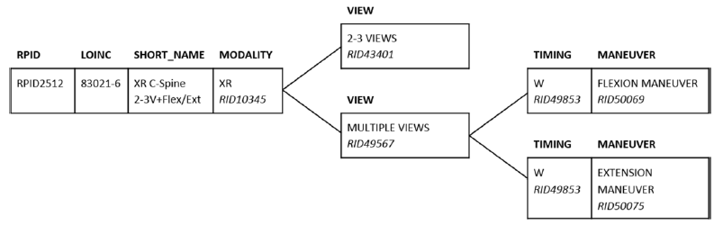
LOINC/RSNA
RadioGraphics 2017, 37: 1099-1110

Slide 15
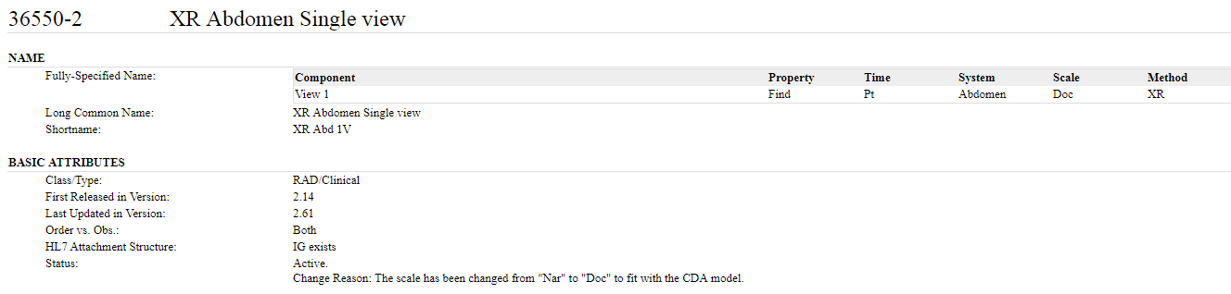
LOINC/RSNA
RPID | MAP_TO | TARGET_SYSTEM
RPID2590 | 36550-2 | 2.16.840.1.113883.6.1

Slide 16
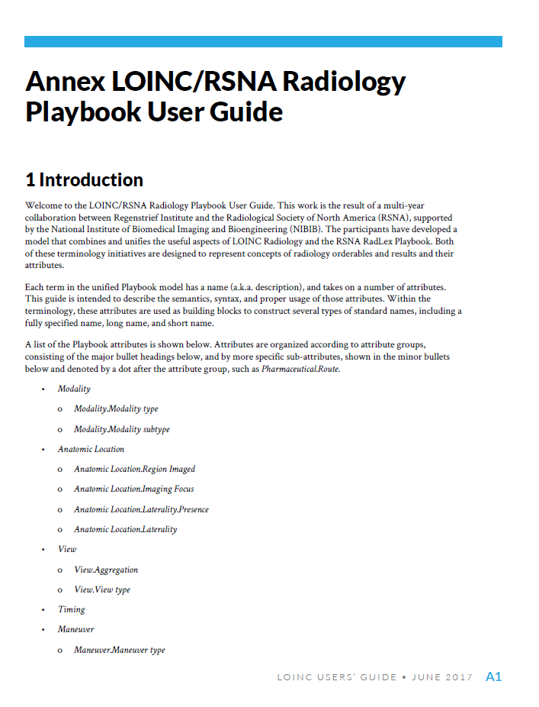
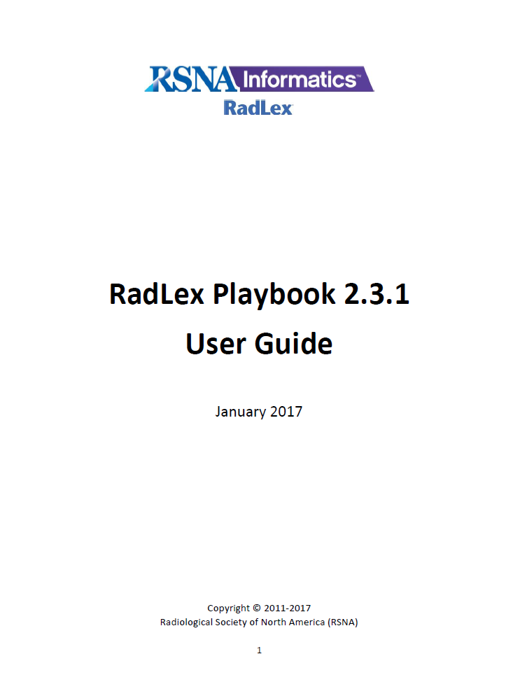
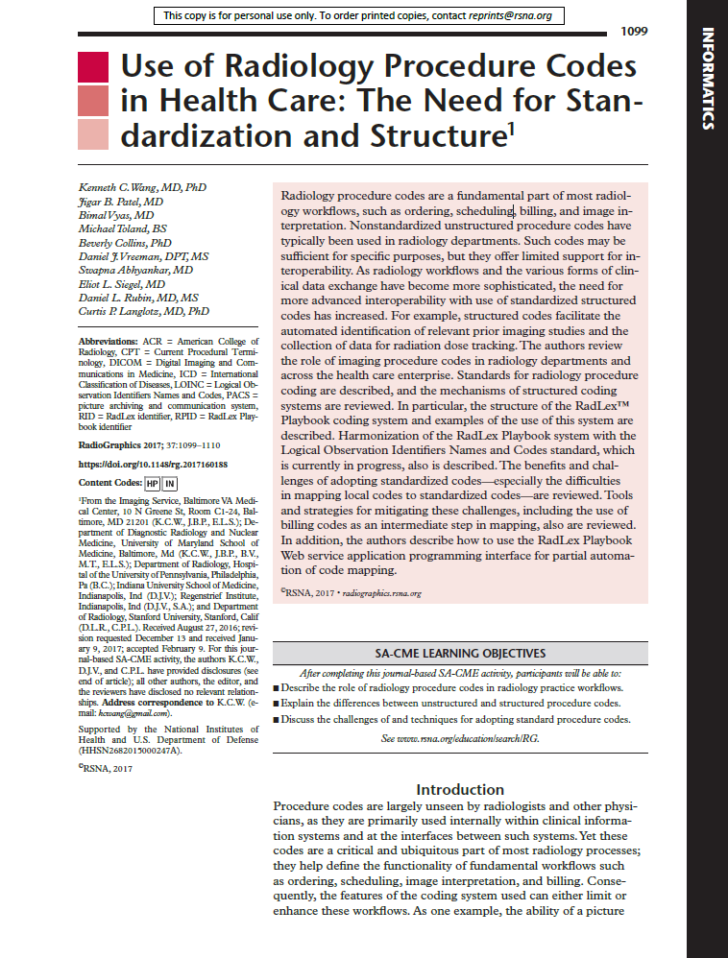
LOINC/RSNA

Slide 17
RadElement
Common Data Elements (CDEs)
Joint ACR-RSNA Initiative
Goal: Develop core set of radiology-focused CDEs for use in reporting, decision support and related applications
RadElement.org
  Library of Radiology CDEs
  Organized into Projects
  Expressed in JSON with RESTful Services API
  Includes fully linked description of coded values incorporated

Slide 18
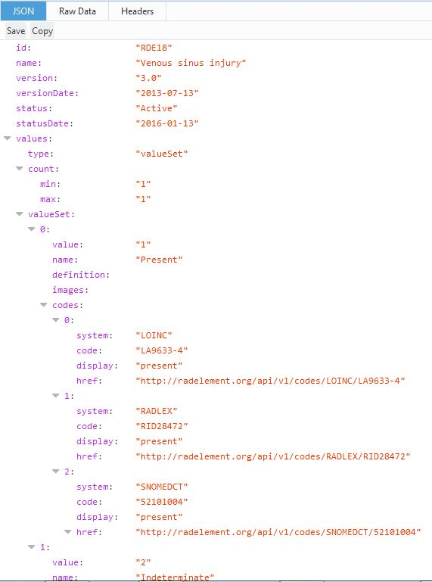
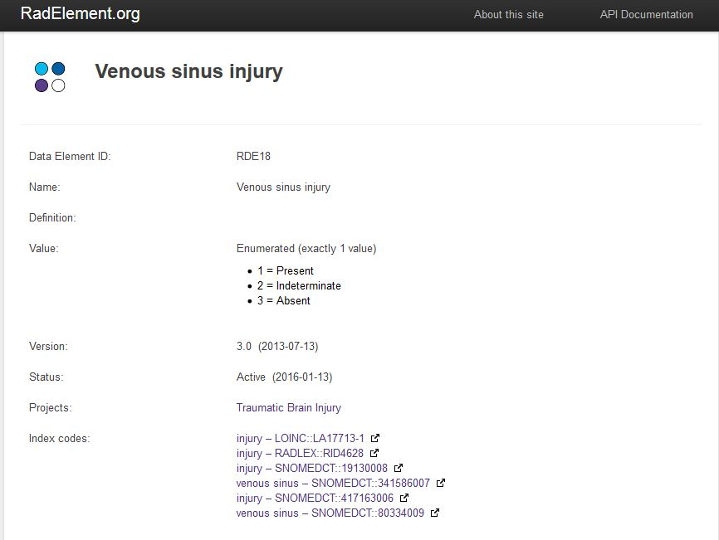
RadElement.org

Slide 19
RadElement
Committee Governance
ACR-RSNA Steering Committee
  Coordinates and publishes all submissions
Radiology Subspecialty Subcommittees
  Prioritize and develop elements relevant to their domains
  Convened with subspecialty societies and in coordination with relevant ACR x-RADS groups
  ASNR Neuroradiology group pilot underway
  Process similar to that used to develop RadLex

Slide 20
RSNA Reporting Initiative
Facilitate radiologists to generate comprehensive, uniform reports that adhere to best practices, yet flexible enough to adapt to local practice patterns.
RSNA maintains a library of radiology reporting templates developed by expert panels.
More than 200 templates published in the new IHE MRRT (Management of Radiology Report Templates) format.

Slide 21
www.radreport.org

Slide 23

MRRT Profile: Management of Radiology Report Templates
  Defines the format of reporting templates (using HTML5) and the service architecture for interaction with a template repository (like radreport.org)
Specifies the desirable and common template features that reporting applications may support.
Specifies a data model for templates that will serve as a format for how templates can be transmitted between systems.

Slide 24
Sample format MRRT Report
The MRRT report has a metadata section with various concept mappings for form elements, and a second body section with the actual reporting details presented as HTML5
<!DOCTYPE html>
<html>
<head>
<meta charset="UTF-8"/>
<meta content="CT Chest Pulmonary Embolism" name="dcterms.title"/>
<meta content="CT Chest Pulmonary Embolism template :: Authored by Heilbrun ME" name="dcterms.description"/>
<meta content="http://www.radreport.org/template/0000116" name="dcterms.identifier"/>
<meta content="en" name="dcterms.language"/>
<meta content="IMAGE_REPORT_TEMPLATE" name="dcterms.type"/>
<meta content="Radiological Society of North America (RSNA)" name="dcterms.publisher"/>
<meta content="May be used gratis, subject to license agreement" name="dcterms.rights"/>
<meta content="http://www.radreport.org/license.pdf" name="dcterms.license"/>
<meta content="2012-03-28" name="dcterms.date"/>
<meta content="Heilbrun ME" name="dcterms.creator"/>
<meta content="Kahn CE Jr [editor]" name="dcterms.contributor"/>
<link rel="stylesheet" type="text/css" href="IHE_Template_Style.css"/>
<!-- The absolute link to the CSS file is http://www.radreport.org/html/IHE_Template_Style.css -->
<script type="text/xml">
<!--
<template_attributes>
<top-level-flag>true</top-level-flag>
<status>ACTIVE</status>
>
<coding_schemes>
<coding_scheme name="RadLex" designator="2.16.840.1.113883.6.256" />
<coding_scheme name="SNOMEDCT" designator="2.16.840.1.113883.6.96" />
<coding_scheme name="LOINC" designator="2.16.840.1.113883.6.1" />
</coding_schemes>
<term>
<code meaning="computed tomography" value="RID10321" scheme="RadLex">
</term>
<term>
<code meaning="pulmonary embolism" value="RID4834" scheme="RadLex">
</term>

Slide 25
www.open.radreport.org
Open source site for sharing templates
Templates may be uploaded by members of RSNA & ESR

Slide 28
Template Library Advisory Panel
TLAP members have reviewed all English language MRRT Templates on radreport.org & open.radreport.org
  76/233 of MRRT templates meet peer-review criteria for continued display as “select” templates
  300+ updated and disease specific templates are pending review

Slide 29
Limitations/Opportunities
Disincentive to build structured content if structure is lost between EHR components
Remaining skepticism that the patient/population benefit of structured data has been demonstrated
  Restrictions of physician autonomy
  Time constraints

Slide 30
IHE - Integrating the Healthcare Enterprise
Develops implementation guides (IHE Profiles) that show how to use standards (DICOM, HL7, W3C, etc.) to improve workflow and communications in healthcare
Provides testing and implementation support to help vendors and purchasers of health information technology adopt IHE profiles and achieve interoperability

Slide 31
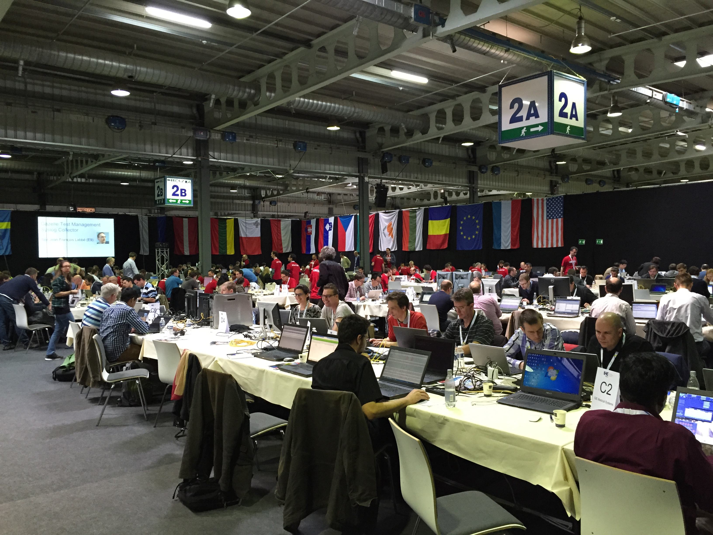
IHE
Activity initiated in 1997
RSNA and HIMSS founding sponsors
IHE International established in 2009
IHE USA created to oversee testing and implementation
IHE deployment committees now in 17 countries worldwide

Slide 32













IHE Domains
Radiology
since 1998
Pharmacy
Since 2009
Cardiology
since 2004
Pathology
since 2006
Laboratory
since 2004
Eye Care
since 2006
(Healthcare)
IT Infrastructure
since 2003
Quality
Research & Public Health
since 2006
Radiation Oncology
since 2004
Patient Care Coordination
since 2004
Patient Care Devices
since 2005
Notes:
32

Slide 33
IHE Adoption
Key Radiology Profiles implemented:
  Workflow (Radiology Scheduled Workflow – SWF.b)
  Health Information Exchange (Cross-enterprise Document Sharing – XDS.b)
  Radiology Reporting (Management of Radiology Report Templates – MRRT)
  Radiation Dose Information (Radiation Exposure Management – REM)
IHE Profiles referenced by ONC MU requirements and European Commission acquisition guidelines

Slide 34
RSNA Image Share Network
NIBIB-funded demonstration project to enable patient control of imaging information
  Image-enabled Personal Health Records
Establishes network using IHE profiles (XDS.b-I)
  Enables site-to-site exchange
  Same architecture used for exchange of other health information

Slide 35
Image Share Network Usage
10 radiology centers currently enrolling patients in the network
Vendors are implementing the RSNA Image Share Edge application into their image management appliances (several hundred potential customer sites)
7 vendor (lifeIMAGE) customer sites currently testing their implementations
June 10, 2017:
  Patients – 33,086
  8,060 of those patients have created personal health record accounts and accessed their images
  Exams – 121,4260
  Images – 25,000,000+ (avg. 220 images/exam)

Slide 36
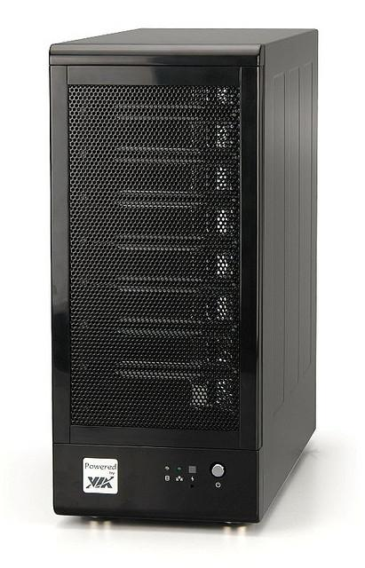
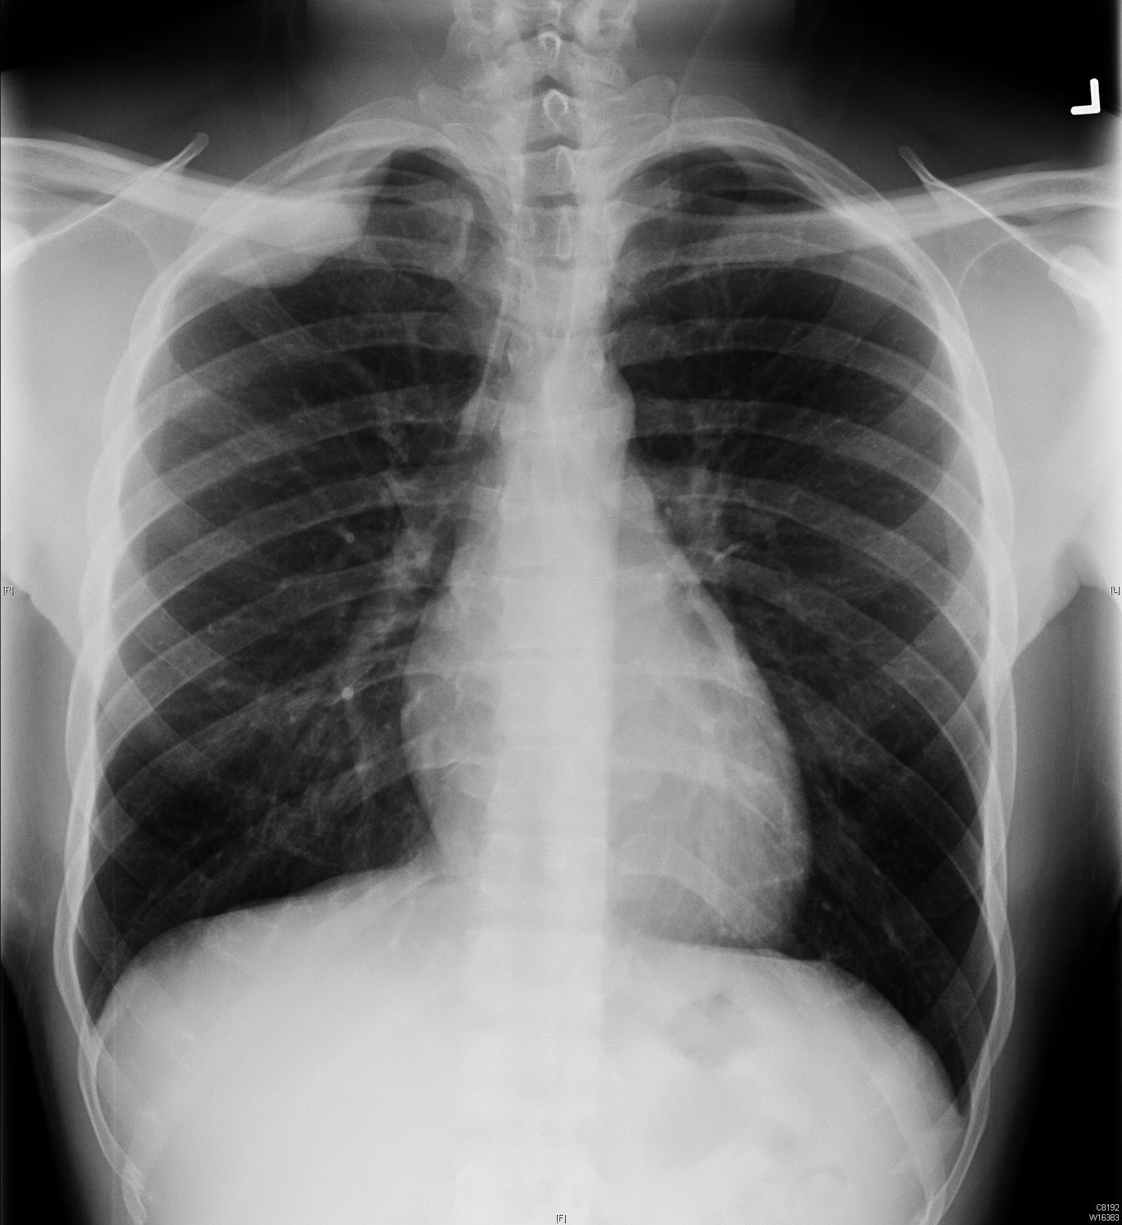
Hospital/
Imaging Center
PHR
Clearinghouse
Edge
Server
Persistent
Image and
Report Storage
-
PIX Manager
Patient Identity Feed [ITI-8]
Pid=Secure ID + PIN
Patient ID
Source
Document
Registry
Registry Stored Query [ITI-18]
Pid=Secure ID + PIN
RIS
RSNA ID Map
HL7 Feed
Pid=Local
Register Document Set [ITI-42] Pid=RSNA ID + PIN
Delete Document Set
Note: Requires new transaction to be defined
Report dB
Retrieve Document [ITI-43]
Note: Returns KOS and Reports
Document
Consumer
Provide Reports
Document/
Imaging Document
Repository
Imaging
Document
Consumer
Document
Source
Provide Images
Provide & Register Document Set [ITI-41]
Pid=RSNA ID + PIN
Note: Document set includes (in the following order) CDA-formatted report, KOS manifest and individual DICOM objects in part 10 format.
Retrieve Imaging Document Set [RAD-69]
Imaging Document
Source
DICOM C-MOVE
Pid=Local
Temporary
Image Storage
PACS
Patient Conveys SECURE ID + PIN
Edge Device Sends to Registry/Repository → PHR Retrieves

Slide 37
Survey - Patient and Provider Satisfaction
n=213
Obtaining access to my medical images proceeded without difficulty
Notes:
Elderly well represented among early adopters of Image Share Network (ISN)
Ease of access to medical images was rated higher with ISN
Demonstrated feasibility of patient-directed, Internet based, interoperable system to exchange medical images
Meets patient expectations regarding access, timeliness and privacy

Slide 38
Image Share and Sync for Science
S4S: collaboration among researchers, EHR vendors and the US federal health agencies (ONC,NIH).
Designed to provide a convenient pathway for patients to contribute their health information for research.
RSNA received contract extension to demonstrate how medical imaging can be connected to S4S

Slide 39
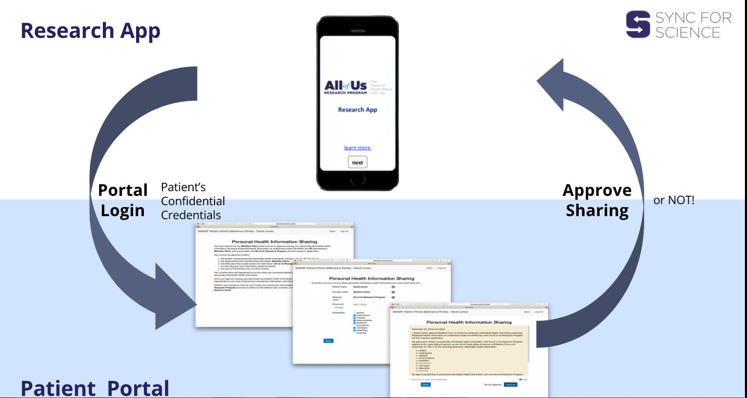
S4S

Slide 40
Image Share – S4S Connector
ASSUME
C-Find --SYNC
C-Move - ASYNC
+ QIDO/WADO RS (RESTful services)
GET /ImagingStudy
FHIR
Broker
RS Broker
( EDGE V.5
+ Mods )
Generally
Useful
AUTH
PACS
GET/ Metadata
Get DICOM data
GET/ DocumentReference
EDGE
Service
RIS via HL7 V2
Token
Introspection
Broker
Web
Service
Calls
JWT Claims Based
Cerner
Reference Stack
FHIR API Based
Reference
Epic

Slide 41
Image Share - S4S
Goal is to deliver working reference model for adoption by vendors
Collaborative development between Image Share and S4S teams is underway
Project period of performance ends March 30, 2018

Slide 42
RSNA Machine Learning Initiatives
Bone Age ML Challenge
Deep Learning Classroom
Machine Learning Exhibit Pavilion
Machine Learning Data Standards Committee

Slide 43
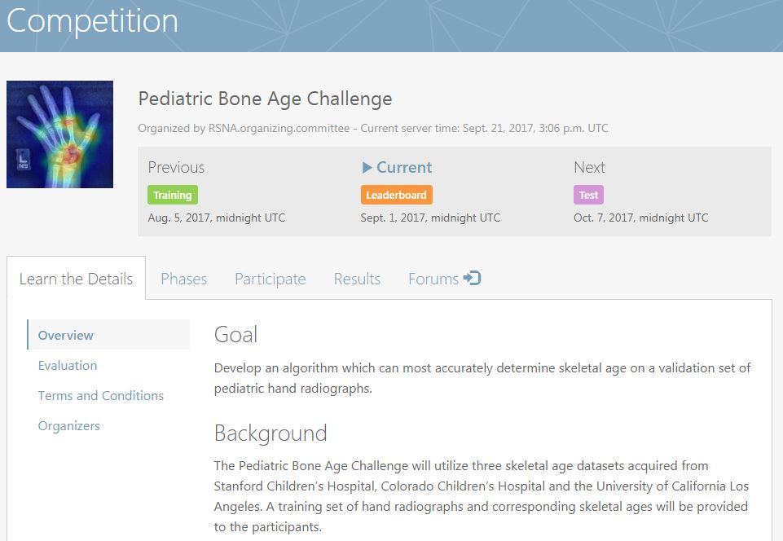
ML Bone Age Challenge

Slide 44
Questions?
For more information, informatics@rsna.org

