Slide 1
Registries and Interoperability
Seth Blumenthal, MBA
Clinical Information Interoperability Council
November 14, 2017

Slide 2
2015 Registry Landscape Survey
Published @ AcademyHealth eGEMS
Conducted by PCPI staff
Surveyed 152 societies and associations about registry programs: governance, # of registries, purpose, data collection, expenses, funding and interoperability
52% response rate. Registries are generally self-funded with smaller budgets. 39% <$1mil/yr.
Most registries collected demographics, treatments, practitioner information and comorbidities; 53% captured PROs
88% used manual data entry; 18% linked to external secondary data sources
Cost, interoperability were barriers to continued registry development
https://egems.academyhealth.org/articles/abstract/10.5334/egems.248/

Slide 3
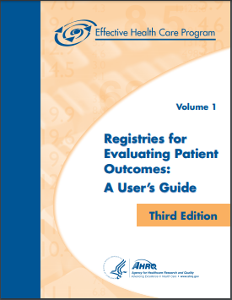
Interest in Registry Networks Growing
AHRQ Registries Handbook 4th edition will include a chapter on registry networks
Seth Blumenthal, MBA (Lead)
PCPI
Kathleen Blake, MD, MPH
American Medical Association
Christina Mack, PhD, MSPH
IQVIA
Danica Marinac-Dabic, MD, PhD
FDA
Caleb Stowell, MD
Providence Health & Services
PCPI’s NQRN program
What does it do and how to participate
Work to date and current focus

Slide 4
Why Interoperability Matters
Value-based payment driving measurement that crosses boundaries
Current lack of interoperability of health care data impairs ability to realize better value for populations & patients
Clinicians and patients need pertinent data from all sources to make decisions
Technical interoperability allows access to data; semantic interoperability preserves the meaning of the information in the data so it can reliably be used in decision-making
Improved semantic interoperability is expected to result in significantly reduced data acquisition costs as well as better data quality

Slide 5
Opportunity for Registries and Registry Networks
Industry has mostly focused on technical interoperability
Semantics, or how information or meaning is represented in data, vary widely between specialties, institutions and industry
Registries collectively capture much important clinical data with validity & specificity that allow for national measurement & analytics
Opportunity in registries to standardize definitions of common data elements, reducing need for abstraction & data mapping
Registry networks well-suited to drive consensus on these kinds of standards and demonstrate the hypothesis that the work is value-added.

Slide 6
What do we need to do in informatics?
Because registries:
Capture structured, specific clinical data for most clinical specialties
Are relatively small in number and coordinated through registry networks
They are a good platform for data standards & interoperability work
Need to standardize semantics in a way that represents a voluntary, clinician-driven consensus. If clinical stakeholders across the specialties and professions can agree on standardizing common clinical data…
Theory: this work will lower data acquisition cost to a greater extent than the cost of making the changes in systems. It might also improve data quality.
…burdens and barriers to adoption will be lowered.

Slide 7
What is PCPI doing to help registries improve interoperability?
NQRN program identified interoperability as a priority in 2016
Interoperability WG convened and “Registries on FHIR” project launched convened bringing registries, vendors and informaticists together
Completed information-gathering campaign and submitted paper to AMIA 2018 Informatics Summit
Initial aim – to demonstrate value of common data elements in lowering registry data acquisition cost and/or improving data quality
Collaborating with ACC/NCDR, SVS/VQI, HL7 and FDA/MDEpiNet
Beginning to develop minimum dataset; planning working meeting March 19, 2018 at the PCPI Spring Conference in Arlington, VA.

Slide 8
Getting it done: three projects
MDEpiNet Project RAPID: developing a set of common clinical data elements, beginning with the ONC Common Clinical Data Set and FHIR resources
Registries on FHIR: implement these CDEs in two registries: NCDR/CathPVI and SVS VQI. Measure impact in data acquisition cost/data quality
HL7 Common Clinical Registry Framework work group: Update CCRF Domain Analysis Model (DAM) to incorporate these CDEs, then work to create a general registry FHIR profile that incorporates those CDEs. Collaborate with NQRN to push for adoption in registries.

Slide 10
Medical Device Epidemiology Network (MDEpiNet) and PCPI Work to Develop and Implement Data Standards for Common Clinical Concepts Title
James E. Tcheng, MD, FACC, FSCAI, FESC
Professor of Medicine
Professor of Community and Family Medicine (Informatics)
Duke University Health System

Slide 11
Randomized Controlled Trials (RCT)
Powerful tools used to:
Evaluate the effectiveness of new (or established) therapies
Account for the effects of unmeasured confounders and selection bias by indication
Issues:
Limited questions that can be addressed
Highly complex and constrained
Expensive
Limited generalizability to ‘real-world’ populations

Slide 12
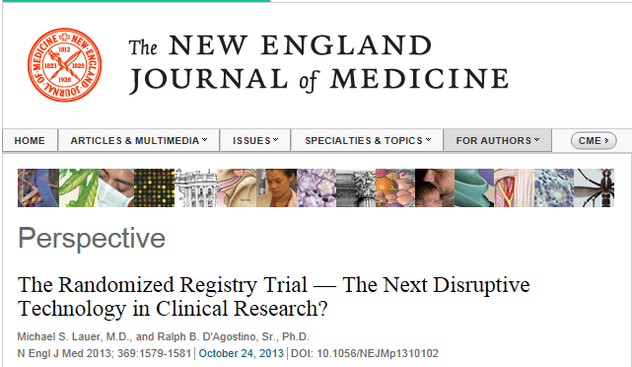
Randomized Registry Trials
“…the use of observational registries in conducting clinical trials could, in fact, be a game changer, especially in the current fiscal climate.” Lauer MS and D’Agostino RB, The Randomized Registry Trial – The next Disruptive Technology in Clinical Research. N. Engl J. Med 2013; 369: 1579-1581. DOI 10.1056/NEJMp1310102

Slide 13
Peripheral Arterial Disease
Registry Assessment of Peripheral Interventional Devices (RAPID)
Launched June 5, 2015
Goal
Enable the use of peripheral vascular disease registries to accelerate the pre- and post-market assessment of peripheral arterial interventional devices
Enable the use of peripheral vascular disease registries for discovery science in PVD

Slide 14
Basic Principles for Success
Developing uniform, harmonized definitions specific to a particular area
Defining relevant questions
Establishing quality by design principles to ensure data quality and ability of registry to withstand audit
Successfully addressing any relevant informed consent issues
Developing incentives for sustainability of the registry

Slide 15
RAPID Partners
3 Major U.S. Societies and Registries
American College of Cardiology (ACC) - NCDR
Society of Interventional Radiology (SIR) - NIRQR
Society for Vascular Surgery (SVS) - VQI
5 International Partners
US, Japan PMDA, GMDN, Australia, Germany
7 U.S. Agencies
FDA, AHRQ, CMS, DOD, ONC, NHLBI / NIH, NLM
6 EHI Companies
Epic, Medstreaming, M2S, HealthJump, Novella / Quintiles, Boston Biomedical
12 Device Manufacturers

Slide 16
Why RAPID?
Current Challenge = Heterogeneity
Devices (balloons, DCBs, stents, atherectomy, others)
Patient and disease characteristics (severity, location, extent)
Provider specialties (cardiology, vascular surgery, IR)
Treatment options (permutations TNTC)

Slide 17
RAPID Project Plan
Phase I: Identify minimal set of core data elements for registry assessment of lower extremity arterial devices
Obtain data elements from existing registries and industry case report forms used for pivotal device approvals.
Develop structured comparison report of all relevant data elements to allow selection based on clinical expertise.
Select core data elements, develop technical specifications for each element and a method to integrate Unique Device Identifier (UDI) data for precise device specification.
Duke Clinical Research Center (DCRI)
Informatics Team: Anne Heath, Mary Williams

Slide 18
RAPID Project Plan
Phase II: Develop data extraction interoperability across peripheral registries and hospital EHRs that provide patient-level data for core data elements
The ACC, SIR and SVS peripheral intervention registries would incorporate the core data elements.
EHR manufacturers would be encouraged to develop smart data elements for the core data set.
Core data set would be provided to other national registries, such as the International Consortium of Vascular Registries (ICVR).

Slide 19
RAPID Project Plan
Phase III: Use a coordinated registries network (CRN) for studies supporting a regulatory decision.
Projects would extract minimal core data from different registries or other data sources, such as centers using the same EHR system
Individual projects might need supplementary data
Prospective clinical trial, pre-market study
Post-market study, surveillance
Objective performance criteria creation
Goal: Total Product Life Cycle evaluation of devices in real world practice.

Slide 20
RAPID Progress
DCRI Informatics Team
Received and anonymized data elements from—
6 Society-based registry data forms
3 Major US Registries: ACC NCDR, SIR NIRQR, SVS VQI
3 International Registries: Australia, Germany, Japan
7 Device manufacturer case report forms
Bard, Boston Scientific, CSI, Cook, Gore, Medtronic, Terumo
Analyzed 3,904 data elements
Selected and organized 2,021 variables that were specific to peripheral arterial disease (PAD) device evaluation
Culled to a minimum core clinical dataset of 100 terms
Notes:
EHR vendors participation incentivized by ONC involvement
UDI and NLM used GMDN definitions.

Slide 21
FDA Coordinated Registry Networks
Orthopedics (joint replacement) - ICOR
Vascular intervention – VISION (RAPID)
Prostate ablation – SPARED
Robotics
Women’s Health
Hernia repair
Cardiovascular disease – CDCRN (TAVR, etc.)
Neurology (stroke intervention) – DAISI
Breast implants – NBIR
GI (bariatric devices) – CATNIP
TMJ
Venous infusion catheters – VANGUARD
CIEDs – EP PASSION

Slide 22
World of Opportunities
Common data models (generic data aggregation)
SENTINEL, PCORNet, i2b2, OHDSI
Data transfer, representation
HL7 v2+, FHIR
Clinical care ↔ Registries ↔ Research ↔ Reporting
Common, cross-registry / EHI data elements
Minimum core (domain-specific) data elements
Quality and outcome measures
UDI: reference data in GUDID, AUDI databases
Analytics
(Traditional) data aggregation and analysis
Distributed analysis

Slide 23
A Few Quotes – MDEpiNet Annual Meeting (10/2017)
R. Califf – call to solve the data sharing problem …
R. Platt – an “enormous lift” to understand the meaning of data at an individual site, and to keep data coordinated (in reference to SENTINEL CDM)
M. Matheny – translation of data between data models is not particularly difficult (in reference to SENTINEL, PCORNet, i2b2, OHDSI) – problem is CDM implementation and its continued coordination

Slide 24
World of Opportunities
Common data models (generic data aggregation)
SENTINEL, PCORNet, i2b2, OHDSI
Data transfer, representation
HL7 v2+, FHIR
Clinical care ↔ Registries ↔ Research ↔ Reporting
Common, cross-registry / EHI data elements
Minimum core (domain-specific) data elements
Quality and outcome measures (typically summative)
UDI: reference data in GUDID, AUDI databases
Analytics
(Traditional) data aggregation and analysis
Distributed analysis

Slide 25
THE Foundational Issue
Tower of Babel
Pieter Bruegel the Elder and Pieter Bruegel the Younger, 1563

Slide 26
The Foundational Solution
Native, Interoperable Data Standardization
Electronic health information
Electronic Health Records
Procedure reporting systems
Registries, CRNs
Clinical contexts

Slide 27
Data Challenge: Multiple Masters
Clinical care
Health system
Payers
Patients
Federal, state programs
FDA
Registries
Research
Oh yes … clinicians
Recipients
Producers
(aka Customer #1)

Slide 28
Customer #2: Database Developer
So you want to build a database …
Database field label (i.e., what do you call the data element, aka the “address” of the data in the database)
Data type / format (e.g., text string, integer, date, constrained list, …)
Business rules (e.g., range limits, consistency checks, …)

Slide 29
Key CDE Metadata
Question or prompt
May have associated controlled terminology
Value, result or answer
May have associated controlled terminology
HCV status:
Clinical concept label (e.g., human prompt for CRF, data entry screen)
Db field label (all caps, no spaces, underscores only, limited chars …)
Clinical definition of the concept, synonyms thereof
Data type / format (e.g., free text, constrained list, integer, …)
Allowed values (aka permissible values = value set; VSAC?)
Allowed values definitions
Business rules (e.g., range / edit checks, consistency, validation)
SDO binding(s)
Published reference(s)

Slide 30
Common Clinical Data Elements
Clinical concepts shared across clinical, research, and regulatory contexts NOT unique to the discipline and that already have bindings to standardized terminologies:
Demographics, administrative data (ONC)
Vital signs, tobacco use history (ONC)
Procedure codes (CPT)
Laboratory data (LOINC)
Medications (RxNorm)
UDI and reference device data (GUDID)

Slide 31
FHIR CDE Specification
…
Identifier
Based on
Status
Category
Code
Subject
Context
Effective period
Issued
Performer
Value Codable Concept
Data Absent Reason
Interpretation
Comment
Body Site
Method
Specimen
Device
Reference Range
Reference Range ID
Reference Range Extension
…

Slide 32
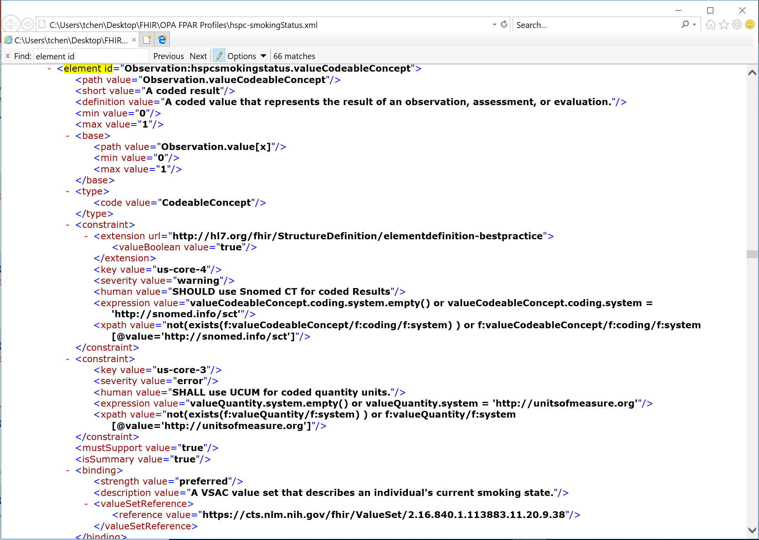

Slide 33
From Concepts to Action
Creating the ecosystem …
MDEpiNet Projects (RAPID, BUILD, CATNIP, EP PASSION, etc.) – identify domain-specific CDEs
Clinical concept label, db label, etc.
Re-populate GUDID, create AUDI
NQRN – identify common clinical CDEs
Leverage FHIR for vetted content
Create simplified technical representation to accelerate implementation across NQRN registries
Informatics – model representations
CIIC process, CIMI repository

