Slide 1
Clinical Information Interoperability Council
Webinar
Sept 25, 2017
Stanley M. Huff, MD

Slide 2
CIIC 2017
Meeting Overview
July 13, 2017
Notes:
Option One

Slide 3
Agenda
The big picture
What we want to do
Why?
How?
What we want to accomplish in this meeting
(Opportunity for questions during the 11:00 am session)

Slide 4
What we want to do

Slide 5
Make a shared repository of Detailed Clinical Models (aka a logical models)
SystolicBPObs
SystolicBP
data
138 mmHg
LOINC or
SNOMED Observable
quals
BodyLocation
BodyLocation
data
Right Arm
PatientPosition
PatientPosition
SNOMED CT
data
Sitting
Notes:
Shows how parts of the model relate to each other
Shows the connections to standard coded terminologies
Issues of the boundary between models and terminology need to be considered at the same time to arrive at unambiguous meaning

Slide 6
What
The models are used during software development, which makes the process much faster and more efficient, and it insures that the references to data in the software adhere to the agreed standards.

Slide 7
What
We want to create ubiquitous sharing of standardized data across the breadth of medicine for:
Direct patient care
Research and learning
Public health
Clinical trials
Data from devices
Post market surveillance
Quality and disease specific registries
Billing and health administration
Any where that we share health related data and information …..

Slide 8
Logical Model Development Lifecycle
Standards Infusion
Core Reference Model
SNOMED CT
LOINC
RxNorm
SystolicBPObs
SystolicBP
HL7 FHIR
data
138 mmHg
LOINC or
SNOMED Observable
CDISC
quals
CEMs
HL7 CDA
BodyLocation
BodyLocation
DCMs
data
Right Arm
Translators
Model Review
X12
Repository of
Shared Models
in an approved
Formalism
PatientPosition
SNOMED CT
CDA
Templates
PatientPosition
NCPDP
data
Sitting
openEHR
Archetypes
HL7 V2
ISO EN 13606
Archetypes
FHIM
Models
FHIR
Resources
Initial Loading of Repository
Model Dissemination
Notes:
Create an open shared repository of “logical models” in an agreed format
Import existing content whenever possible
Select one approved logical model for a given kind of data in a given context (data entry, data retrieval and analysis)
Create “approved” mappings to standard implementations
Caveats
This is the first meeting of a “campaign” or a “crusade”
This is a huge project – it will take many years
This is an essential first step to semantic interoperability. We also need
Security
Legal basis for sharing data
Aligned incentives for sharing data

Slide 9
The Interoperable App Development Process
Domain Analysis
Create Logical Models (CIMI)
Approve Models
Model Repository
Create Physical Artifacts (FHIR Profiles)
Project Needs
Pediatric Growth Chart
Neonatal Bilirubin
Comm Acq Pneumonia
OPA Data Collection
MQIP
ACC registries
Terminology
Server
(SOLOR)
Conformance Testing
Create Software (Apps, Services, CDS)
Artifact Repository (FHIR Profiles)

Slide 10
The ultimate value of detailed information models
Software is developed much faster
Clinical knowledge is contained in the models
Much easier for software engineers
The data used in the applications is completely conformant to standards, leading to semantic interoperability
If you follow the SMART on FHIR development strategy, your software can be shared with any system that supports the approved standards

Slide 11
Three related but very different questions
What data should be collected? (part of domain analysis)
It will be different for different situations
How should the data be modelled?
Two fields or one (the degree of pre and post coordination)
What does the data mean?
How do we make computable definitions for diabetes mellitus, myocardial infarction, heart failure, chronic renal failure, etc.

Slide 12
Why?

Slide 13
Why?
“To help people live the healthiest lives possible.”

Slide 14
Patient

Slide 15
Core Assumptions
‘The complexity of modern medicine exceeds the inherent limitations of the unaided human mind.’
~ David M. Eddy, MD, Ph.D.
‘... man is not perfectible. There are limits to man’s capabilities as an information processor that assure the occurrence of random errors in his activities.’
~ Clement J. McDonald, MD

Slide 16
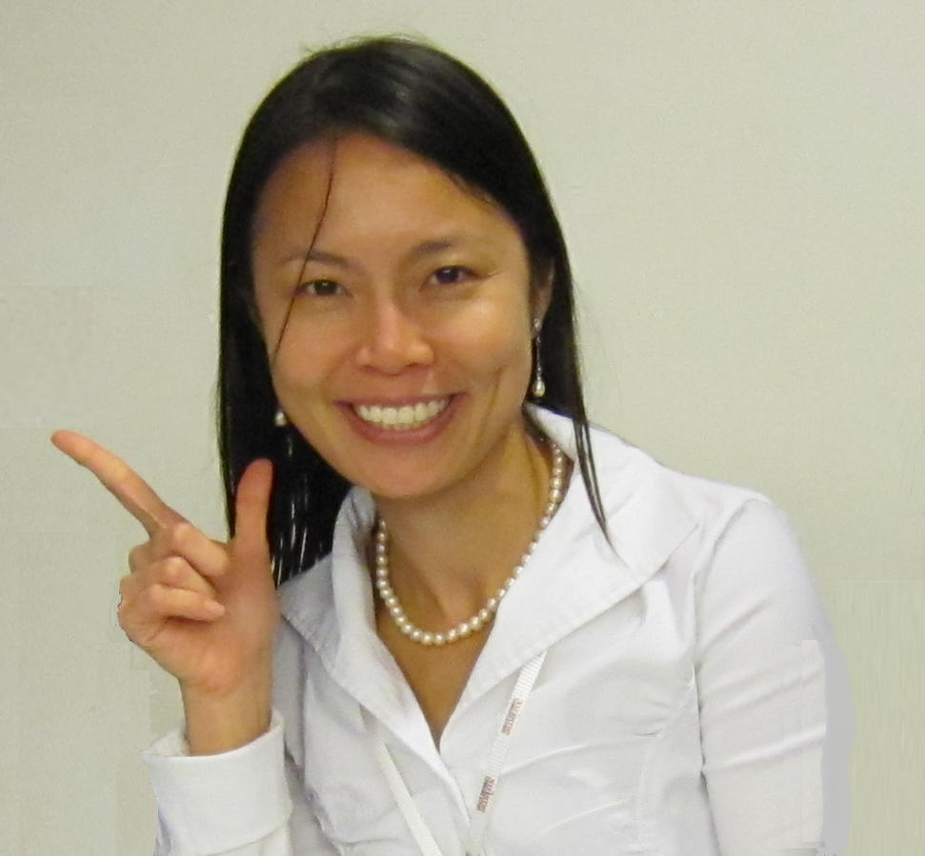
Eileen
Notes:
HL7 meeting in San Antonio January 2012
30 something, newly married, planning for a family
Expert informaticist
Ran a half marathon 2 weeks before the HL7 meeting
Fever, nausea and vomiting, collapsed, taken to a community hospital
Unrecognized sepsis, died of untreated septic shock
The clinicians involved were not “bad” people. They were just busy and did not apply all the knowledge that they had.
If you are a practicing clinician, you are very lucky if you haven’t been involved in a similar bad outcome. I was, as a first year Internal Medicine resident. (Acute abdomen in a really tough cowboy. I frail old woman vomiting blood.)

Slide 17
Why?
We need to
Provide better care
By sharing executable clinical decision support modules
Decrease cost
Make clinicians and patients happier
Provide accurate computable data as the foundation of a learning health system
Notes:
$1.2 billion to install an EHR system
We do the right thing about 50% of the time
250,000 deaths per year due to medical errors - NPR
http://www.npr.org/sections/health-shots/2016/05/03/476636183/death-certificates-undercount-toll-of-medical-errors
440,000 deaths per year due to medical errors – Northwestern
https://news.northwestern.edu/stories/2016/11/how-to-prevent-440000-yearly-deaths-due-to-medical-errors/
~35,000 deaths per year from automobile accidents, estimated 40,000 in 2016
When did it become socially acceptable to have a quarter of a million people die each year from medical errors?
It is like trying to do thermodynamics before there were reliable thermometers
Each EHR vendor uses a proprietary database schema, proprietary models and unique terminology to represent clinical data
Some standardization of codes is now occurring, but
Data is not consistent vendor to vendor, or even organization to organization within the same vendor
This means that:
Sharing data is difficult
Sharing executable software across vendors is impossible
Each useful application is created or re-created on each different platform (and we pay for it!)
There are unmet needs for health care applications and decision support
Software costs are higher than they need to be

Slide 18
How?

Slide 19
How
Have practicing front-line clinicians direct the work
All stakeholders agree to work together
Agree to use a common format for representing the models
Use and share common tools to create the models
Approve one preferred model for a given kind of data in a given situation
Do the work in existing projects whenever possible
Use existing models whenever possible
Notes:
Registries
Quality
Disease specific
MDEpiNet
openEHR
HL7 CIMI
Quality metrics
NIH Common Data Elements
LOINC, SNOMED CT, RxNorm

Slide 20
Summary of the July 13th meeting in Bethesda
Keynote speaker – Don Rucker, MD (National Coordinator for HIT)
About 120 attendees
Representing – AAN, AAO, ACOG, ACS, ACC, ACP, APTA, ANA, FDA, CDC, NCI, AHRQ, NIAID, DoD, VA, PCPI, AMIA, SPM, HIMSS and many other organizations
Meeting outcomes
CIIC should continue
Create mission, vision, a plan for initial governance
Develop a mailing list and a discussion forum
Projects
ACOG – OPA – FPAR, Cancer DTR, MDEpiNet RAPID, Wound Assessment, PCPI registry interoperability project, Quality measures
Next meeting – December 5-7 in New Orleans with HL7 Partners in Interoperability

Slide 21
The END (or maybe the beginning?)
Contact Information:
Stan.Huff@imail.org

