Slide 1
OSEHRA Overview
Seong K. Mun, PhD
President and CEO
Professor: Virginia Tech
Arlington, Virginia, USA
June 28, 2017
Notes:
The slides included in this deck shows the precise formatting to use for the Title Slide at slide one of this template.
Side Title: Veranda 38 point
Middle Information: Veranda 18 Point
Date/Time: Veranda 20 Point

Slide 2
A Bit About Myself
MRI Development in the 80’s
PACS/MDIS Efforts - Filmless
ACR/NEMA to DICOM
GOV – Can we help you?
Long time resistance from the Industry
Conformance
DOD Requirement
PACS: FDA Regulated Product. How?
Teleradiology – Telemedicine
Global Disease Survailance

Slide 3
Open Source Business Models
H
The
_{Strong}
_{Copyleft}
Foundation
_{Linux Kernel}
_{Weak}
_{Copyleft}
_{Openstack}
_{Firefox}
_{License}
_{The Apache Foundation}
_{Non-}
_{Copyleft}
_{GENIVI}
_{Eclipse}
_{OSEHRA}
_{Permissive}
_{Android}
_{Ad Hoc}
_{Opinion}
_{Leaders}
_{Single}
_{Moderator}
_{Committee-}
_{Based}
_{Commercial}
_{Support}
_{Members}
_{Only}
_{Closed}
Governance Model (how contributions are managed and accepted)
WHO DECIDES?
- Courtesy of MARK RADCLIFF
Notes:
Linux: The free software kernel for the GNU/Linux operating system
The Linux Foundation: non-profit consortium dedicated to fostering the growth of Linux, and promoting standardization and technical collaboration of Open Source
Open Stack: the leading open source Cloud management platform
Firefox: the leading open source browser – part of the Mozilla project
The Apache Foundation: provides support for the Apache community of over 100 open-source software projects, covering code, licensing, governance
Genivi: non-profit industry alliance committed to driving the broad adoption of an In-Vehicle Infotainment (IVI) open-source development platform
Eclipse: IDE environment, platform and framework
OSEHRA: supports an open, collaborative community of users, developers, and companies engaged in advancing electronic health record software and health information technology.
Android: mobile applications platform
VANITY Foundations

Slide 4
OSEHRA at a Glance
Established in 2011 Under VA Sponsorship
501(c)(6) Membership-Based Non-Profit
Independent Corporation
Mission: “Build and support an open source community ……… engaged in advancing electronic health record software and related health IT.”
Current Membership:
30 Corporate Members
20 General Members
1,000+ Associate Members
Supported by VA $4M / Year
OSEHRA does not compete for GOV Contracts
4
4

Slide 5
Current Organizational Members
Industry
AbleVets
Amida Technology Solutions
Apex Data Solutions
Book Zurman, Inc.
BITS, Inc.
CGI Technologies and Solutions, Inc.
Document Storage Systems, Inc.
Eastern Informatics, Inc.
Electronic Health Solutions
FIS GT.M Group
HIRS
HSPC
Kitware, Inc.
Liberty IT Solutions, LLC
Management Support Technology, Inc.
MedicaSoft, LLC
Microsoft
PatchAdvisor
RedHat*
Soosang ST
The Software Revolution, Inc. (TSRI)
Zato Health
Non-Profit
Dream Hospital
MITRE Corporation*
Oroville Hospital
Pusan National University Hospital
Regenstrief Institute
UPMC Technology Development Center
* Denotes final co-signed agreement is pending.

Slide 6
VistA Evolution
Superior Core Technology- VistA
Enterprise Health Management Platform
Modernization Strategy
Adoption of Open Source Methodology
Community Involvements
6

Slide 7
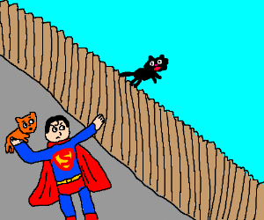
Over the Fence Open Source

Slide 8
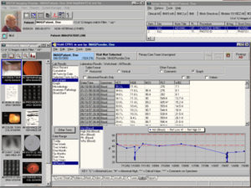
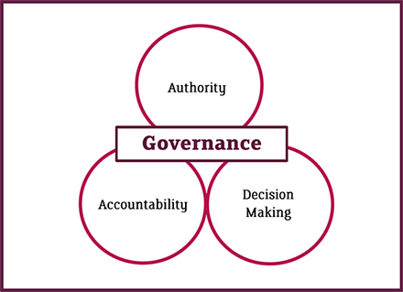
OSEHRA Ops Ecosystem
GOVERNANCE
SOFTWARE
Rules of Engagement
Business Model
Software
And
Product
Management
COMMUNITY
Community Development and Management
8

Slide 9
OSEHRA Groups
Group Name | Type
Architecture | Work Group
Certification | Work Group
Code Convergence | Work Group
Community Vision / Strategy | Work Group
Development Tools | Discussion Group
Immunization | Open Source Project Group
Meaningful Use | Open Source Project Group
OSP Candidates for VA VistA Intake | Discussion Group
Pharmacy TWG | Work Group (VA)
popHealth Developer | Work Group
popHealth Steering | Work Group
popHealth User | Work Group
Reminders VA | Work Group
VistA / eHMP in the Cloud | Open Source Project Group (Org. Member Only)
VistA js | Work Group
VistA Security TWG | Work Group (VA, Private)
Visualization | Open Source Project Group

Slide 10
OS (as is) vs. COTS (Contract)
COTS
Open Source
Organization
Self Service Org

Slide 11
Open Source Defined
Open Source Software (OSS) is computer software for which the source code is made available under a license in which the copyright holder provides (depending upon the specific license) various rights to study, change, and distribute the software.
Without a license, software is not open source.
The copyright holder provides the rights.

Slide 12
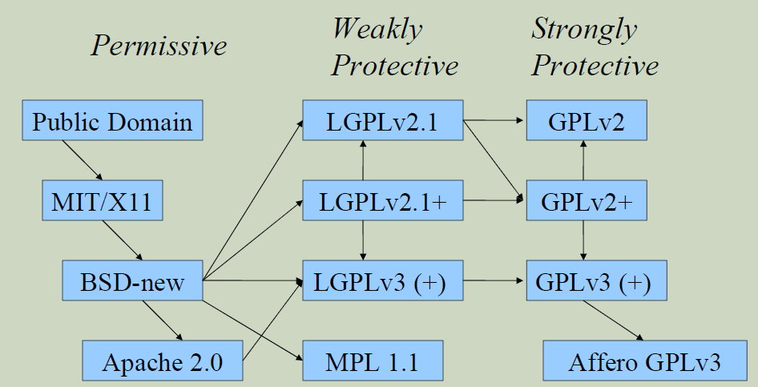
IP and Licensing
Apache License Version 2.0
General Trend for Permissive License
Restrictive Licenses Hamper Long Term Growth and Collaboration
Beware the viral license!
David Wheeler

Slide 13
Procurement & IP
Contractor-produced code is copyrighted unless special contract terms and condition exist to convey copyright
Open Source licensing is an assertion of copyright

Slide 14
OS usability Certification
OSEHRA is an ANSI-accredited Standards Development Organization (SDO)
Develop national consensus based standards
An open source software quality standard will be essential to establish usability of code prior to intake:
Proper Licensing
Adequate Documentation
Basic Error Checking
Unit Test Coverage
14

Slide 15
Open Source Life Cycle – Fileman Example
VA FOIA Code Release
Medsphere Product Deployment and Improvement
Additional Improvements from open source community
Contributors License Result as Apache 2.0 for the Community
VA Analyzes / Accepts the Improved Code
VA Enterprise Deployment
VA Code Intake Process
Pre-OSEHRA

Slide 16
Open Development
VA Identifies OS Immunization Product
It Lacked Some Features
OSEHRA Forms Open Workgroup
SME from VA, IHS and Community
OS Vender Made Changes in the OS Product
VA Issued Competitive Integration Contract
Most Suitable Product
Improve Product for Other Users
Save Money and Time
New Business Model

Slide 17
OS Adoption Candidates
Candidate | Priority | Status | Origin
Complex Orders “Then” Conjunction** | 1 | Working with Maintenance team to create path for intake. Certified to OSEHRA Level 2TM. | DSS, Inc.
Maternity Tracker* | 2 | Has NSR, Salt Lake City in pilot phase. Rejected by EPIP, needs funding possibly from women’s health group. Rhodes to send TRB. OSEHRA Certification in progress. | VACI
XU Digital Signature** | 3 | Holt confirmed it was passed along to Kernel team. | OSEHRA Staff
RAPTOR* | 4 | 11th on funding queue. OSEHRA Certification in process, namespace issue needs response from OI&T. | VACI
Enhanced Problem List | 5 | C. Short to follow up with Health Information Management Service (HIMS) to see if desired. Possible demo with business owners. | DSS, Inc.
Appointment Postcard Notification v4.0** | 6 | NSR submitted, not a qualifier for EPIP due to size and complexity. Needs alternate funding. | VHA Class 3
Veteran Appointment Notification System (VANS) | 7 | Waiting for response from business owner to see if it is desired. | VACI
On-the-Fly Alerts | 8 | More information to be obtained, possible demo with business owners. | DSS, Inc.
*In Certification Process **Already Certified

Slide 18
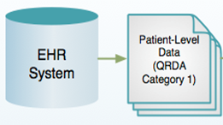
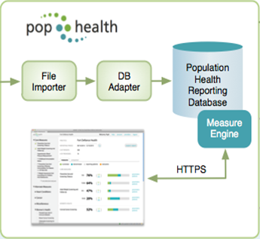
Reference Implementation (RI)
PopHealth Product Management
Healthcare Providers
Multi-tenant Organization
●
●
●

Slide 19
Community based Product Management Code Converging
Road Map
Frozen by ONC OSEHRA Transition
Sep 2014
Version 4.0
Dec 2015
Version 2.1
Feb 2013
Version 3 May 2014
OSEHRA
Trunk
MITRE Trunk
May 2013
MU-2 cert.
~ Dec 2013
Nmedw branch
Jul 2014
Northwestern
Branch (nmedw)
Merge completed
Sep 2015
Aug 2013
eHCT v2 branch
Aug 2014
eHealthConnecticut
Branch (V2)
Wyoming
Medicaid Branch
Modified for WY QCCP Program –
candidate for future merge
June 2013

Slide 20
Open V5.0 Enhancements
2015 Edition Health IT module for CQM reporting Certification
Criteria 170.315 (c)(2,3,4); (d)(1-3, 5); (g)(4,5) (CHPL Certification ID: IG-3684-17-0010).
Patient and Provider Filters
Filters patient data and CQM results by patient demographics and provider information - implementation of (c)4 criterion. The filtering is implemented at the per measure level. Measure Calculation
Export QRDA Cat I
Improved Audit Logging
Captures additional events, i.e., export patient data and cqm results, delete patients record, user role updates, etc.
eCQM Benchmark
Allows providers and practices to compare their current quality measure progress against a configurable list of static baselines/goals
2017 eCQM reporting
Loads the 2016 measure bundle by default

Slide 21
VistA/eHMP Cloud Project
Microsoft Azure Initiative
To Test
Deployment
Scalability
Security
OSEHRA Organizational Members Only
DSS, Medicasoft, Liberty IT, RedHat
PatchAdvisor, CGI, Growing………

Slide 22
Korea Team Organizing
4 Organizational Members
1 Individual Faculty Member
Completed Initial Training Session
Launched Official OS Study Group
Workshop in Korea

Slide 23
Technical Lessons Learned
Open Source is more than a code thrown over the fence
OS process must be integrated fully
Software should be designed with OS in mind
Organizational work process must evolve
Functioning community is essential
Balancing the art of Discipline and Innovation

Slide 24
Activity – Coming Year
OS Standard Certification – National Consensus
In Support of Transition – Community Engagements
eHMP
Digital Health Management Platform
OS Products
Unfulfilled Requirements
Others such Cloud
Electronic Clinical Quality Measures (eCQM)
Other Fed and State Agencies
International Activities

Slide 25
Thank you.
munsk@osehra.org
900 N. Glebe Road
Arlington, Virginia

Slide 26
OS Value Proposition
USER
No Vendor Lock In
Transparency
Best Fit Lower Costs
Developers
Learn from Others*
Show off Innovation* Peer Review*
Peer Recognition*
Vendor
Lower Dev Cost
Fast to Market
Flexibility
Best Talent
Sustainability

Slide 27
OSEHRA’s Capabilities
Community Development and Management
Code/Product Management
Code Certification – Reuse of Codes
Governance for Public and Private Partnership
Open Dev/Testing Lab
Facilitation of OS Development
Ready-made open consultation via community engagement

