Slide 1
Healthcare Services Platform Consortium: Progress toward True Semantic Interoperability

Slide 2
Historical Perspective
(slides from July 2014)

Slide 3
HSPC History
Initiated by Intermountain and Harris
Meetings
May 2013 Salt Lake City
August 2013 in Phoenix
January 2014 Salt Lake City
May 2014 in Phoenix
July 2014 Salt Lake
(August 2014, Washington DC, hosted by IBM)
Currently working on bylaws and membership agreements to form a business entity
For more information: Craig Parker, Oscar Diaz, Stan Huff

Slide 4
Strategic Goal
Be able to share data, applications, reports, alerts, protocols, and decision support modules with anyone
Goal is “plug-n-play” interoperability

Slide 5
Essential Functions of the Consortium
Select the standards for interoperable services
Standards for models, terminology, security, authorization, context sharing, transport protocols, etc.
Modeling: SNOMED, LOINC, RxNorm – FHIR Profiles – do it together
Publish the models, and development instructions openly, licensed free-for-use
Provide testing, conformance evaluation, and certification of software
Gold Standard Reference Architecture and its Implementation
We will work with an established company to provide this service
Fees that off set the cost of certification will be charged to those who certify their software
Commitment from vendors to support the standard services against their database and infrastructure
Everyone does not have to do every service
There must be a core set of services that establish useful applications

Slide 6
Other Functions of the Consortium
Participation in “other” functions is optional for a given member
Enable development “sandboxes”
Could be provided by companies or universities
Could be open source or for-profit
Set up an actual “App Store”
Many companies already have their own app stores
Vendor certification that a given application can be safely used in their system
Accommodate small contributors that won’t have their own app store
Create a business framework to support collaborative development
Pre-agree on IP, ownership, co-investment, allocation of revenue
Try to avoid unique contracts for each development project
Provide a way for people to invest (Venture capital)

Slide 7
Principles
Not-for-profit entity
There could be an associated for-profit entity
Simple majority of providers on the Board of Directors
All organizations will have equal influence and opportunity
Intermountain and Harris will not be “special”
Start small, be effective, and then grow
We want to allow everyone that is interested to participate
Allow diverse strategies and participants
Open source and for-profit
One person business up to multi-national corporations
Healthcare providers and healthcare software developers
Students and professional software engineers
Initially, focus on the minimum set of standards and technology
Increase options as we gain experience and success
HSPC is not producing software (mostly)
HSPC members or groups of members produce software
HSPC may need to provide a reference implementation for purposes of certification
No “central planning” by HSPC of app development
Participants decide what they want to build and invest their own resources
We DO need to agree about the minimum set of services that will enable a marketplace

Slide 8
Relevant Core Assumptions
We use existing standards whenever possible
We need comprehensive and unambiguous models of clinical data (hematocrit, white count, temperature, blood pressure, adverse reactions, health issues (problems), prescriptions, substance administration, etc.)
The models are the basis for querying and retrieving data for storing data through services
We need a single set of consistent models for HSPC based interoperability
It would be even better if there was one common set of FHIR profiles industry wide
We want to create needed FHIR profiles from existing content

Slide 9
Now

Slide 10
Healthcare Services Platform Consortium
Mission
Improve health by creating a vibrant, open ecosystem of interoperable applications, content, and services
Vision
Be a provider-led organization accelerating the delivery of a platform that supports innovative healthcare applications for the improvement of health and healthcare.
Notes:
First meeting held Aug 5, 2013
Incorporated as a not-for-profit corporation on Aug 22, 2014
3 Benefactor members
Veterans Administration
Louisiana State University Health
Intermountain Healthcare
Key alliances
Center for Medical Interoperability (C4MI)
OSEHRA
3 Associate (organizational) members
Regenstrief
Motive
Allscripts
11 Individual members
Society Members: AMA, MHII and ACOG

Slide 11
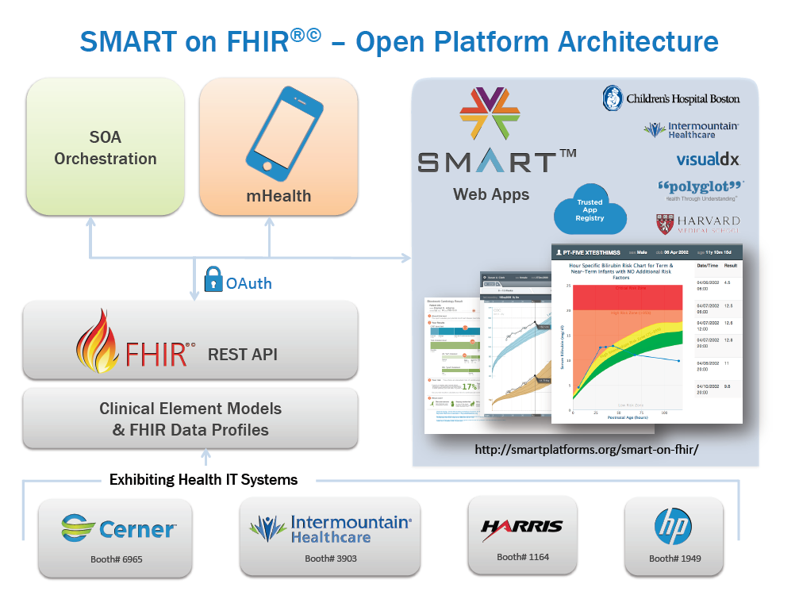
FHIR Profiles from
CIMI models
Heterogeneous Systems
Others…
11
Notes:
This slide focuses on EHR centric activity, but the scope of HSPC is all of healthcare!

Slide 12
Why?
“To help people live the healthiest lives possible.”

Slide 13
The Healthcare Services Platform Consortium (HSPC) is a provider-driven 501(c)3 international initiative with 270+ participants of leading healthcare organizations dedicated to unlocking the power of entrepreneurial innovation and highly interoperable/plug and play solutions that improve healthcare outcomes.
HSPC’s open marketplace and services platform seeks to foster a new level of provider-vendor collaboration and innovation to meet one of the industries’ greatest needs -- accelerating the creation, sharing and delivery of promising software applications and knowledge for healthcare.

Slide 14
Key Functions of the Consortium
Support reliable sharing of a variety of knowledge content to support clinical decisions and processes
Provide a Healthcare Community Cloud and Vendor Neutral Marketplace
Create standards based models and terminology that support semantic interoperability
Support conformance and certification testing to ensure true semantic interoperability
Create and support collaboration between providers, vendors, and standards development organizations to reach true semantic interoperability and a plug and play application development environment.

Slide 15
HSPC Technical Strategies
Data virtualization
HL7 FHIR (initial strategy)
HL7 CIMI/CEM information models
Automated or semi-automated creation of FHIR profiles
EHR/EMR integration
SMART (initial strategy)
Federated Real-Time Restful Services
SOA
Orchestration, work flow, knowledge sharing
SOA, BPM, Drools, etc.

Slide 16
HSPC Platform Thoughts
Centricity
Shared
Services
Stack
Knowledge Services
Security
Auditing
Data Drive,
Time Drive
Pub - Sub
Notification, Etc.
Core
Shared
Services
BPMN2
Engine
Terminology/Ontology
DROOLS
More…
CE ICU
(EFS)
Enterprise Service Bus
EHR
SMART on FHIR
App
Finance
SMART
Payers
RIS/PACS
Etc.
FHIR
Other
Enterprise
Apps and
Services
Core EHR

Slide 17
Key Technical Activities
Application development site
Development of information models
HL7 Clinical Information Modeling Initiative
FHIR Profiles
Strategy for conformance testing
Definition of reference SOA platform architecture
Creation of reference implementation
Development of a healthcare community cloud and vendor neutral ecosystem

Slide 18
Purpose and Goals for this Summit

Slide 19
Helpful Definitions
Conformance = developer does self-testing to see if what is being created is compliant with approved specifications
Certification = an independent 3rd party tests the product to determine if it is compliant with approved specifications

Slide 20
Conformance and Testing Vision
Create an HSPC “brand” around certification similar to the Underwriter’s Laboratory or the Good Housekeeping Seal of Approval
The HSPC Certification Seal holds value for both producers and purchasers.
It increases the market value for certified apps and services because it insures a high degree of out-of-the-box interoperability

Slide 21
The Compliance Pyramid
HSPC Compliance
1 Preferred structure, extensions, explicit LOINC and SNOMED, units, magnitude, …
Argonaut Compliance
Structure(s), extensions and some specific LOINC and SNOMED
HL7 FHIR Compliance
Structure(s), Generic LOINC
HL7 Version 2 Compliance
Structure, No terminology Constraints

Slide 22
Specific Goals for this Meeting
Approve a set of principles that guide HSPC’s strategy for certification testing
Approve a broad definition (requirements) of what it means to be an HSPC certified application or service
Make a high level plan of how we will pursue creation of HSPC conformance and certification capabilities

Slide 23
Agenda Review

Slide 24
Questions?

