Slide 1
Powerful Results. Delivered.
HSPC
Conformance and Certification Testing
(Redacted)
Speaker: Mario Hyland
Senior Vice President, AEGIS.net, Inc.
June 29, 2017
Intermountain
Salt Lake City, UT

Slide 2
Assuring Interoperability
… in order to Live the Healthiest Life Possible

Slide 3
@Interopguy
July 2016 – Voted #6 - #HIT100
Why so Serious @Interopguy (Batman)?
Interopguy: Because Interoperability is a Serious Issue, and one which the industry needs to address on a Continuous Basis.
Avoid the One-and-Done approach.

Slide 4
What would happen if airlines practiced “One and Done” Testing? How Important is Patient Safety?
AEGIS.net, Inc. - Powerful Results. Delivered.SM
4

Slide 5
Overview
Consider for a moment:
If implementing Industry based Standards like FHIR® is viewed as a path towards Interoperability, why then are Organizations developing unique testing approaches?
There is a National ROI many organizations are realizing through the use of Shared Services
such as Testing as a Services (TaaS)
in a Cloud based ecosystem

Slide 6
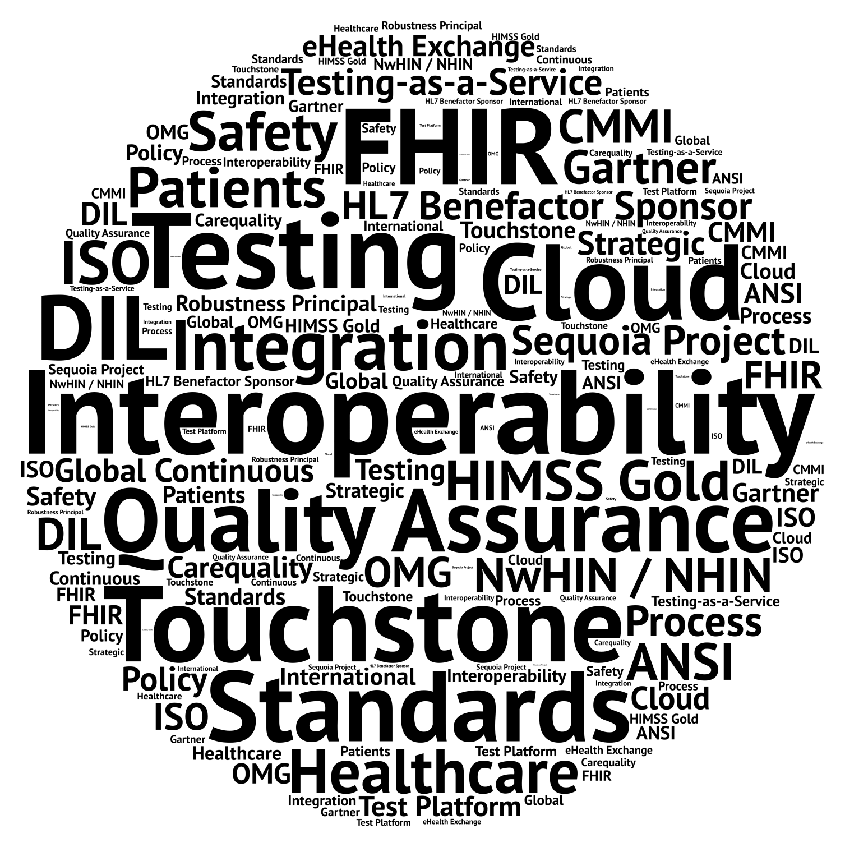
Who is AEGIS?

Slide 7
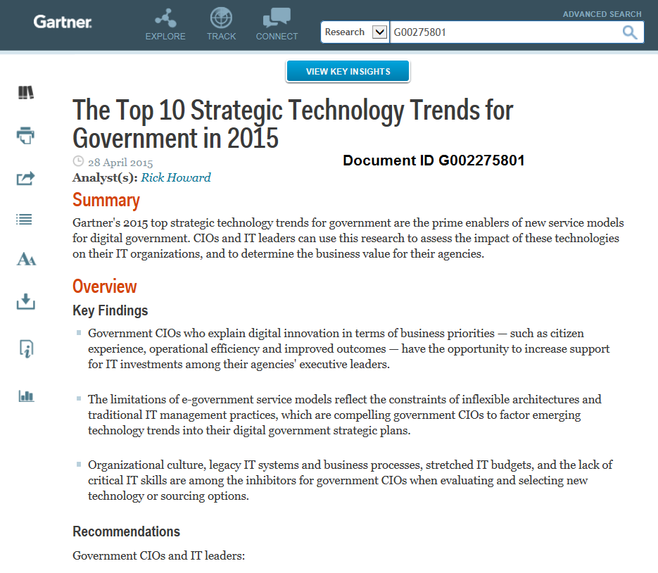
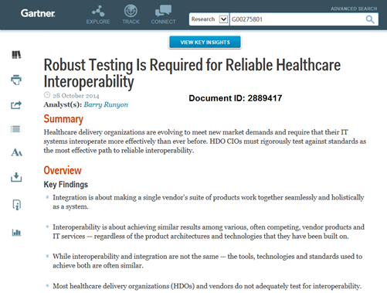
Industry Research
AEGIS.net, Inc. - Powerful Results. Delivered.SM
7

Slide 8
Industry Awards
2016 Federal Health IT Innovation Awards Finalists (Overall Innovation : Interoperability)
Overall Winner is the Health and Human Services – Family Planning Profile (FPP) Cloud based Conformance Harness Platform, supported by AEGIS
AEGIS.net, Inc. - Powerful Results. Delivered.SM

Slide 9
Interoperability
REALITY
It is a “Point in Time”
OBJECTIVE
to achieve “Continuous
Interoperability”
AEGIS.net, Inc. - Powerful Results. Delivered.SM
9

Slide 10
Elements of a Testing Program
The following tasks/steps are products associated with supporting a Testing Program
Standards / Specification
Use Cases / Test Scenario
Written Test Case / Test Package
Test Data to support the testing
Reference Implementation (walk-the-walk)
Automate the Test Cases (support TDD)
Test Guide and Training documents (YouTube)
Test results provide a wealth of knowledge

Slide 11
Testing Programs
The following Testing Programs have are/been supported by AEGIS
ONC NHIN Initial rollout (Interop Lab)
Sequoia Project (formerly Healtheway) (DIL)
HHS/OPA IHE Profile FPP (QRPH) (DIL)
HL7 Conformance Immunization v2 (DIL)
NIST IHE PIX/PDQ (ITB)
HL7 FHIR (Touchstone)

Slide 12
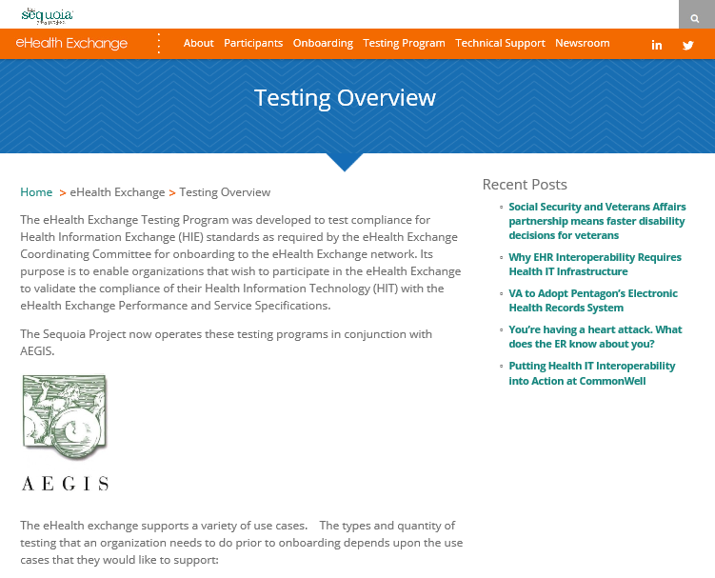
Sequoia Project
eHEX (eHealth Exchange (formerly NHIN)

Slide 13
eHEX Testing Program
Schedule of major milestones & events
RFP June 2012 (eHEX – 500 tests, NYeC – 200)
Response CCHIT and AEGIS Team
September negotiations
October Program begins
November CCHIT / Healtheway / NYeC Sign
Nov – Feb build written Test Case Packages
Nov – Feb prep DIL to host eHEX Test Cases
Feb – Apr load 1,350 Test Cases

Slide 14
eHEX Testing Program
April 2013 – direction from the eHEX CC and Sequoia – Pilot the eHEX Testing Program
Invited 12 Organizations to participate
Two (2) week exercise
Objective: test-the-test (2010/2011 – 1,350 Test Case
Sequoia / CCHIT / AEGIS administer the Pilot
Approach : have Organizations test each test case.
Success / Pass : when three (3) organizations pass a test case (it is a candidate for the formal test program).

Slide 15
eHEX Testing Program
After two (2) weeks
Done – NO
Participants drop from twelve (12) to five (5)
After twelve (12) weeks (end June 2013)
Published Test Cases for 2010 / 2011 (1,350)
During the Pilot – 305 Test Cases were attempted by at least ONE (1) Organization
During the Pilot – 127 Test Cases pass by at least ONE (1) Organization
During the Pilot – 56 Test Cases pass by three (3) or more Organizations

Slide 16
eHEX Testing Program (DIL)
Official Program Launch September 2013
To Date – 134 eHEX Participants have tested in the DIL as part of Onboarding to the eHEX
Nearly 10 Million Test Execution
More than 50 Million conformance rules executed
Over 500 Registered Organizations/Test Systems
Supported by one person

Slide 17
eHEX Testing Program (CTB)
The Financial picture of the Testing Program
RFP offered revenue sharing (target 200 Organizations to participate in the eHEX onboarding)
No up front revenue (cost to be bore by the CTB)
Program original target to be operational by Nov 2012
CCHIT Team – 3 FTE
AEGIS Test Team – 30 FTE (between Nov – Mar)
Advanced the Test Cases
Automated the DIL
Built Connect Reference Implementation
Test Data loading
Support the Q&A for Pilot

Slide 18
eHEX Testing Program
The Financial picture of the Testing Program
CCHIT suspends operation Nov 2013
AEGIS made significant capital investment to launch the eHEX Testing Program
Sequoia (HealtheWay) and AEGIS strike a new agreement Nov 2013
AEGIS receives first payment from the Sequoia Testing Program – 4/24/2014

Slide 19
eHEX Lessons Learned
500 Test Cases become 1,350
2010 and 2011 version of the specifications
Additional Test Cases required to support data (pre-test)
The Bar was too high
100% Conformance is something to aim for not to be held to
One-and-Done testing
No Surveillance
No new test cases added in four years
A few re-validation (< 5%)

Slide 20
HHS/OPA IHE Profile FPP (QRPH)
Aug 2014 OPA FPP was published final by IHE (after nearly 18 months effort)
IHE notified OPA not to plan for FPP to be tested at the Feb 2015 IHE Connectathon –
No tests would be available
Implementers typically need two (2) or more years to implement new profiles
OPA Let a Contract via GSA Schedule IT-70
AEGIS awarded a one year contract

Slide 21
HHS/OPA IHE Profile FPP (QRPH)
Contract mission
Enable OPA FPP to test at the IHE Connectathon
Support OPA FPP go final at the IHE, requires three (3) active participates to pass all IHE testing.
Support OPA FFP present Use Case at the HIMSS Interoperability Showcase
Public support testing platform OPA FPP (DIL)

Slide 22
HHS/OPA IHE Profile FPP (QRPH)
Project Schedule (8 weeks)
Decompose the IHE Profile and create Test Cases
Work with IHE Connectathon Management to acceptance of the proposed Test Cases
Target industry participants (EHR)
Register AEGIS DIL, and three (3) IHE OPA FPP Participants (place holders)
Load the test cases into the AEGIS DIL (24 tests)
Build an RI to support Form Manager, Form Receiver, and reference Form Filler
Prep the EHR vendors for the IHE Connectathon

Slide 23
HHS/OPA IHE Profile FPP (QRPH)
Outcome Analysis
Feb 2015 IHE Connectathon – OPA FPP was represented (Didi – QRPH)
Three Organizations participated
Finished testing by day two (2)
During the IHE Connectathon
Introduce AEGIS DIL and TDD to several new EHR Vendors
Engage with three (3) new participants (GE, etc)
IHE Connectathon Results
OPA FPP successfully completed the IHE requirement for three (3) (actually six passed)
OPA FPP selected by HIMSS to showcase in the Interoperability Showcase.

Slide 24
HL7 v2 Immunization
HL7 v2 Conformance Testing Pilot (12 weeks)
CDC Immunization IG Version 1.6
HL7 partnered with AEGIS as a Conformance Testing partner (HL7 Conformance Testing)
HL7 Contracted with Jean DeTeau (DDI, Inc)
Decomposed IG to create Test Cases
Loaded the Test Cases into AEGIS DIL
Present HL7 Conformance Testing at HIMSS 2015 (9 Organizations participated)

Slide 25
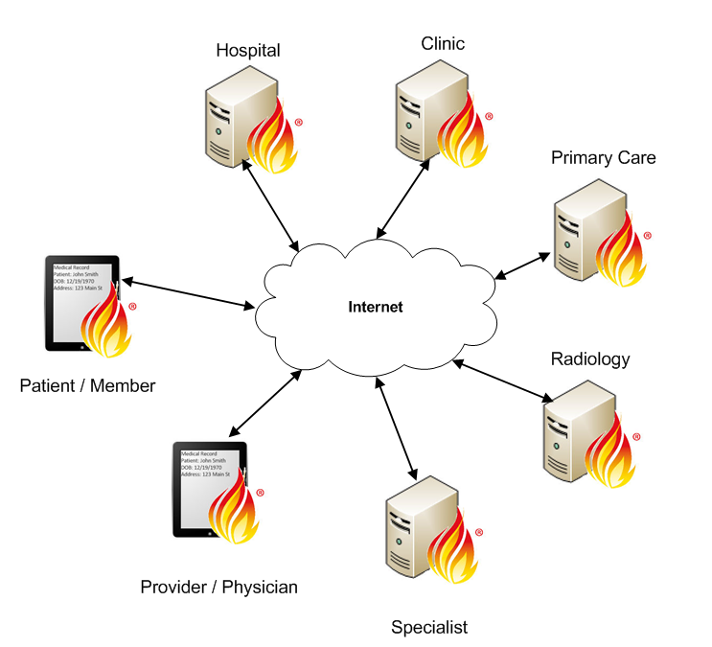
FHIR – Integrated Ecosystem

Slide 26
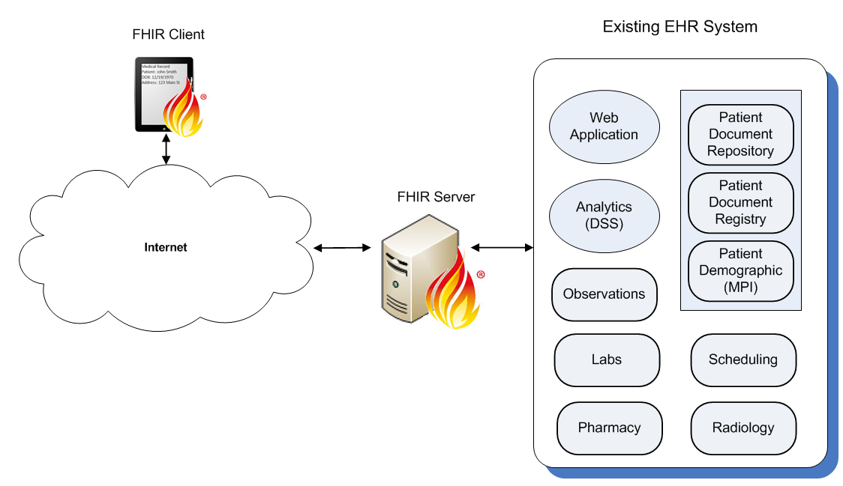
FHIR –EHR Integration

Slide 27
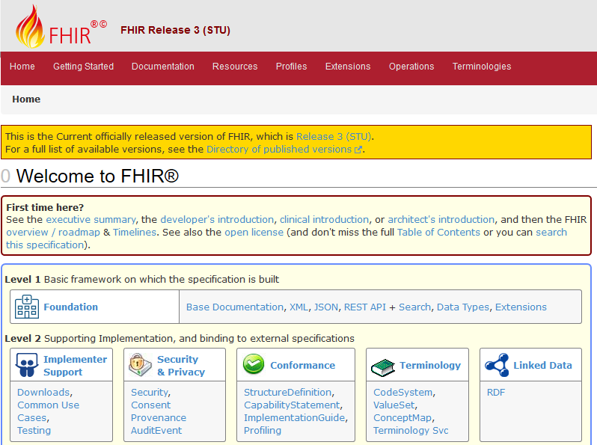
FHIR Specification

Slide 28
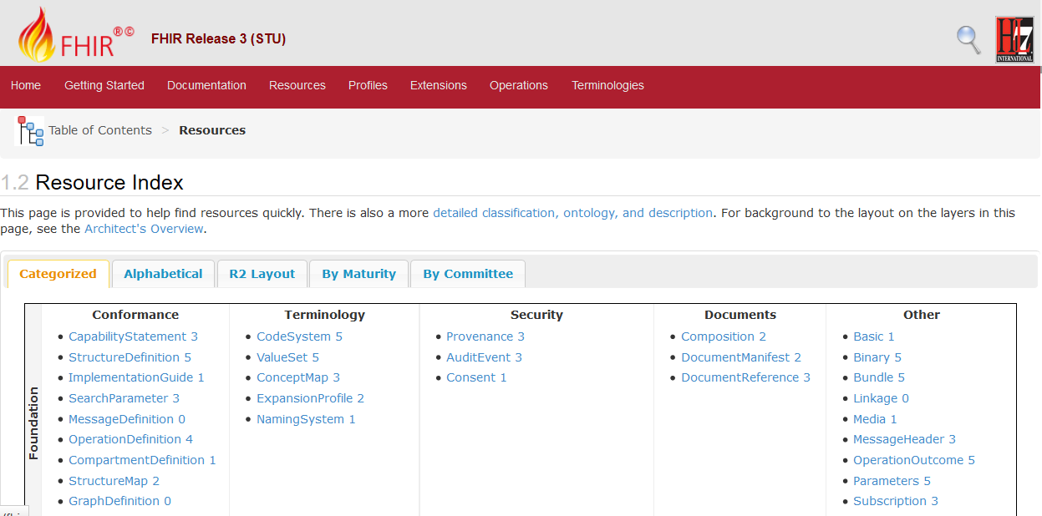
FHIR Resources (FMM)

Slide 29
Why Interoperability is Challenging
Systems Interoperability Challenges
Organizational/Patient directed exchange of information
Interpretation thru Implementation
Common Testing Approach (Happy Path)
Limited Exception Negative Testing (due to dependence on Peer-to-Peer testing)
Multiple versions of standards to support (yes, there will be change), future proofing
Standards will be put under new intense pressure.
AEGIS.net, Inc. - Powerful Results. Delivered.SM
29

Slide 30
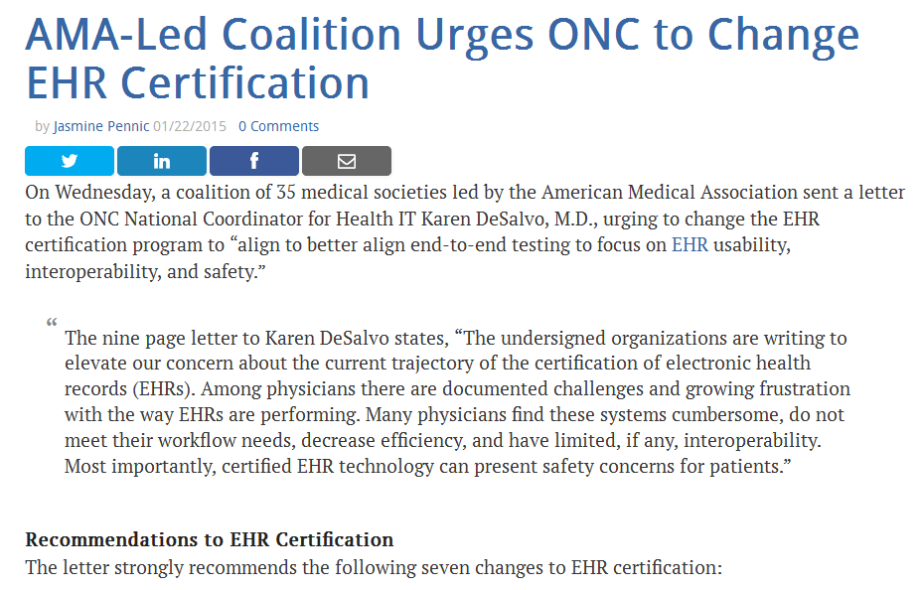
EHR Certification Testing

Slide 31
How to Mitigate Interoperability Risk
A way to Mitigate Interoperability Risk
Because – we do face Interoperability Issues
Interoperability Strategies
Standards-based Testing (SDO feedback loop)
Test Early and Test Often
Infuse Interoperability into the Development Cycles thru TDD (Test Driven Development)
Embrace the goal of “Continuous Interoperability” through process
AEGIS.net, Inc. - Powerful Results. Delivered.SM
31

Slide 32
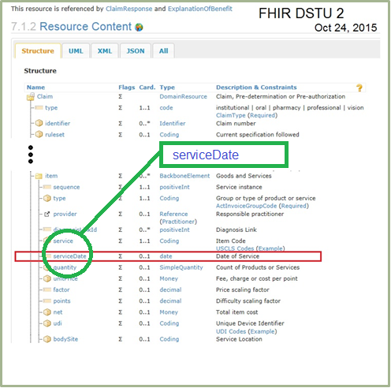
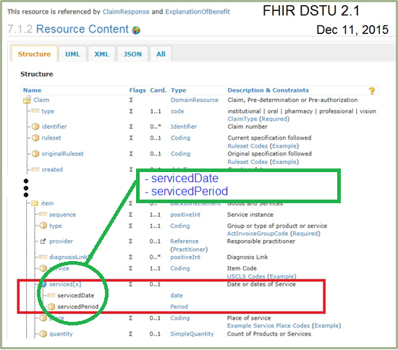
Industry Standards Development
AEGIS.net, Inc. - Powerful Results. Delivered.SM
32

Slide 33
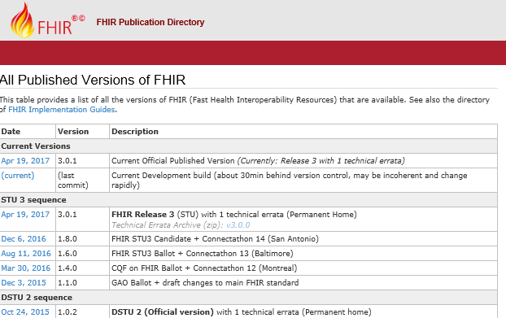
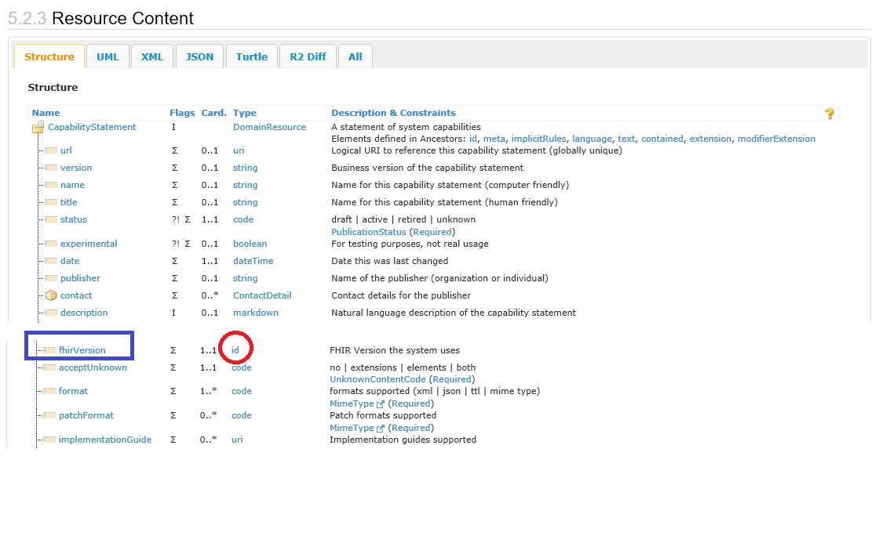
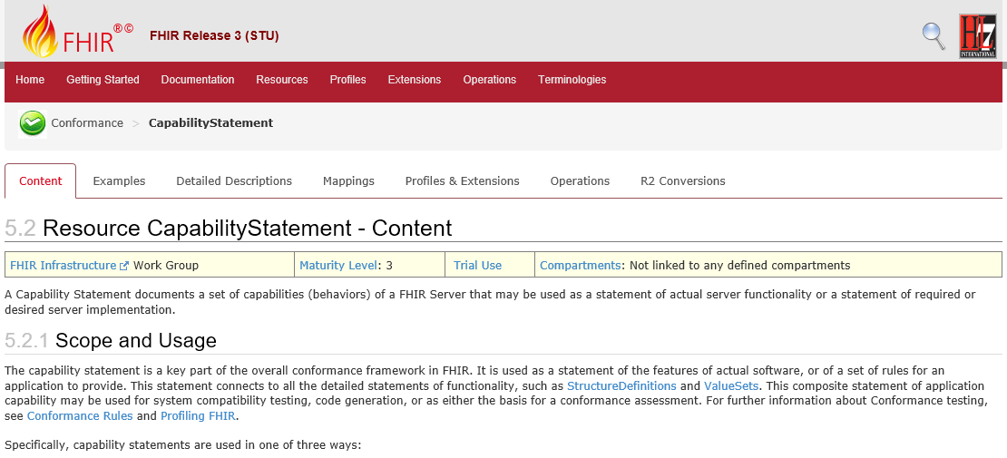
FHIR Version

Slide 34
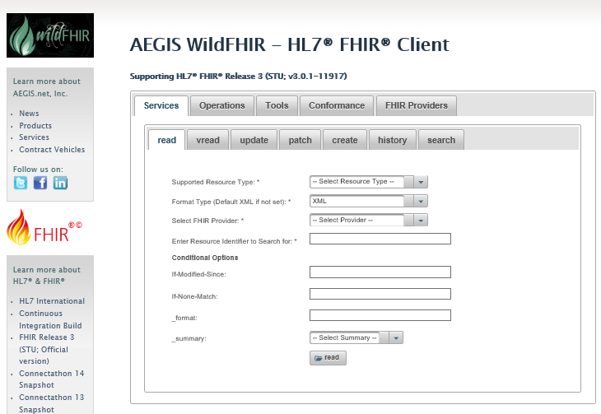
WildFHIR RI Client / Server
http://wildfhir.aegis.net/fhir3-0-1-gui/index.jsf

Slide 35
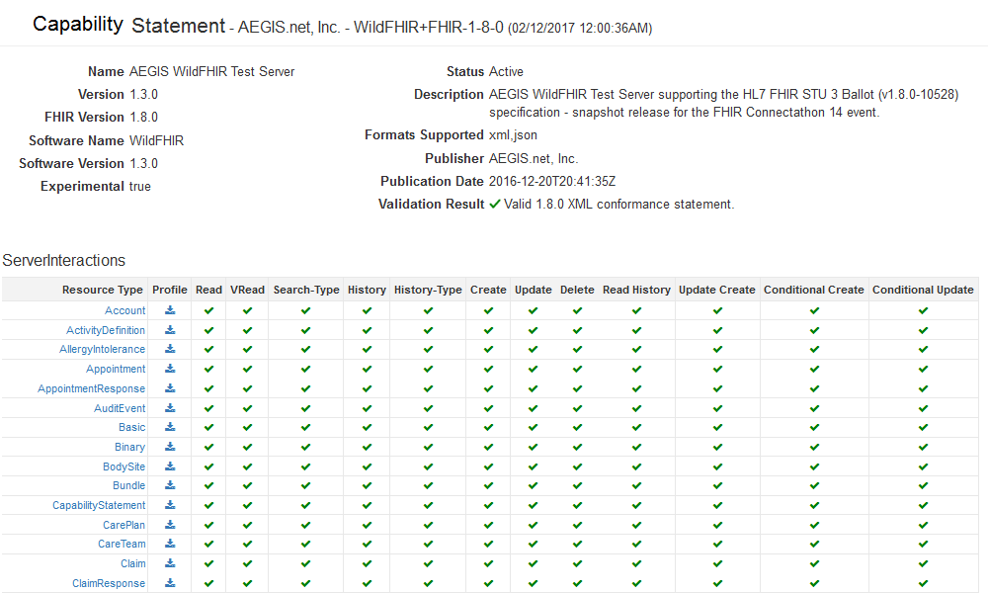
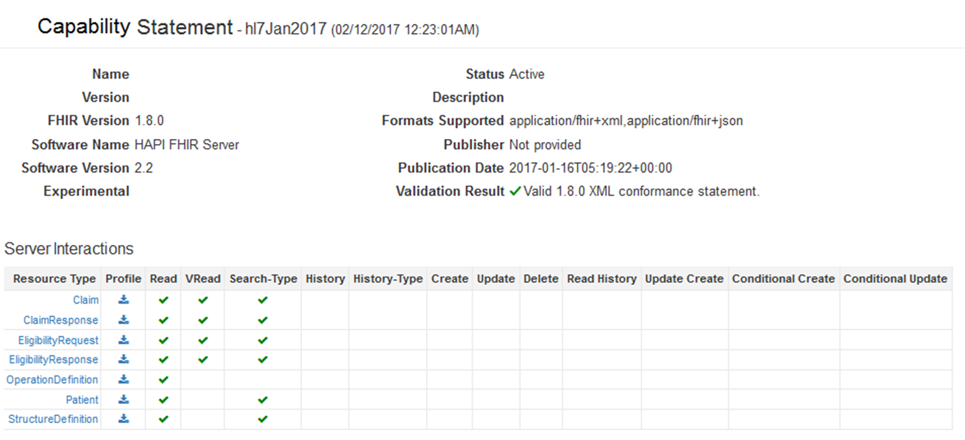
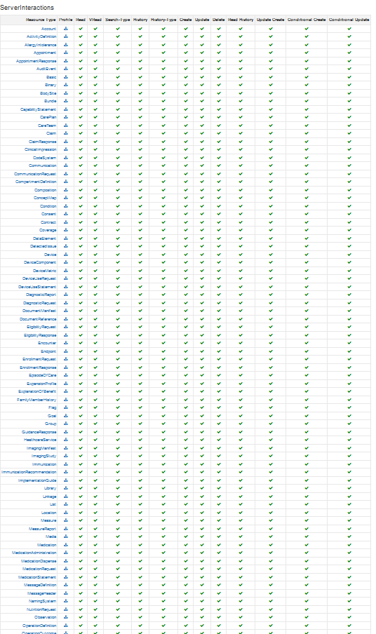
FHIR – Capability Statement
Capability Statement was not found or failed validation for
105 of 154 active FHIR
test systems

Slide 36
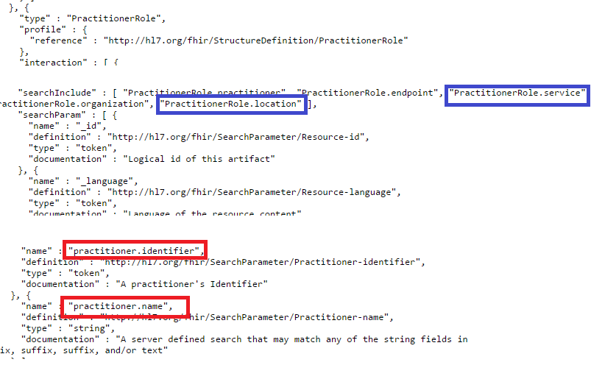
FHIR – Capability Statement

Slide 37
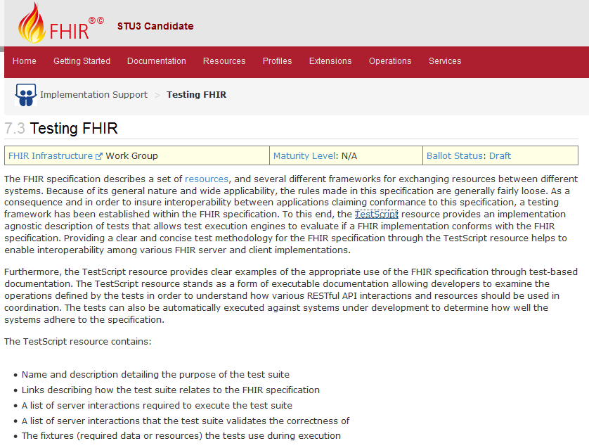
FHIR – Incorporates Testing

Slide 38
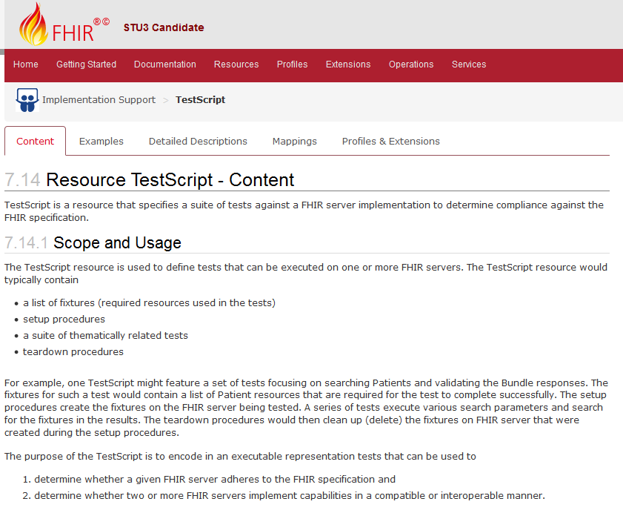
FHIR Test Script/Report Resources

Slide 39
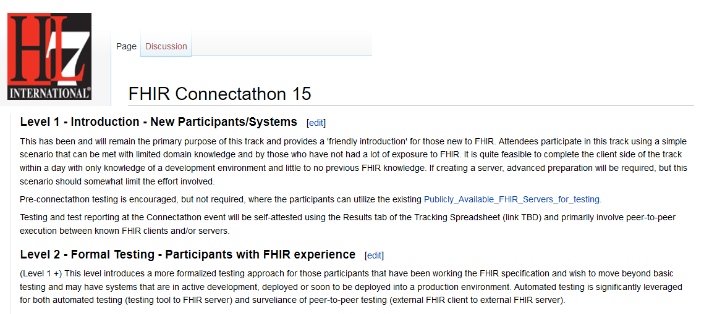
HL7 FHIR Connectathon 15)
AEGIS support HL7 FHIR Formal Testing Client and Server Testing

Slide 40
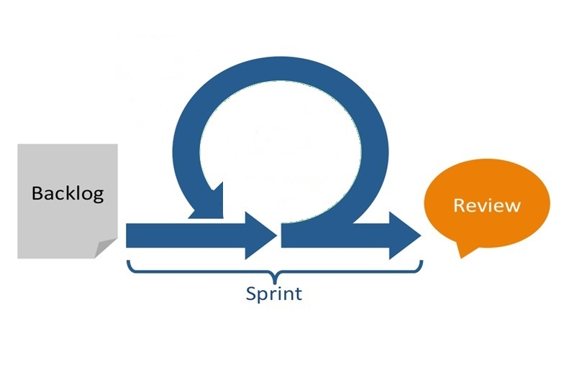
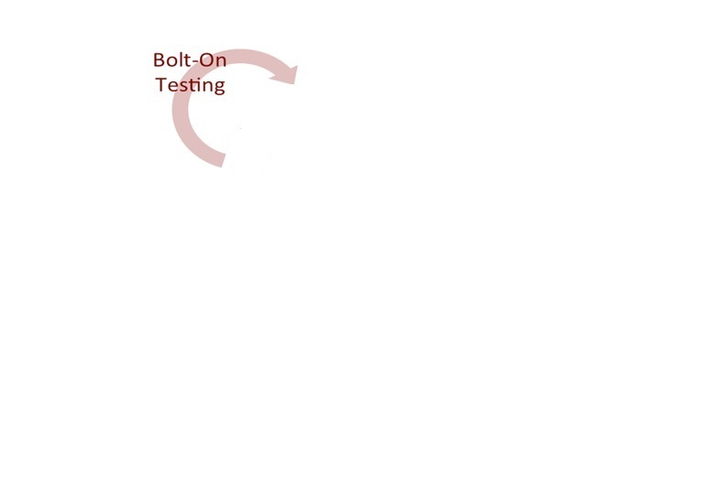
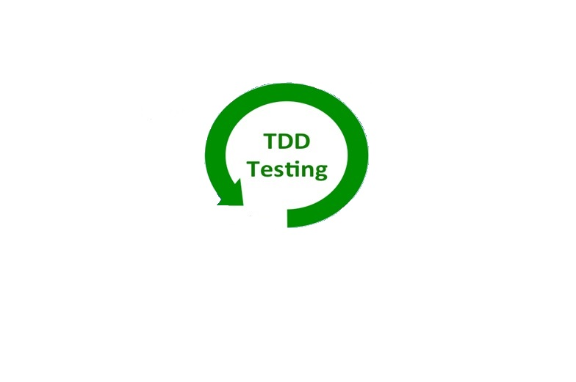
How to Integrate TDD into Agile Process
AEGIS.net, Inc. - Powerful Results. Delivered.SM
40

Slide 41
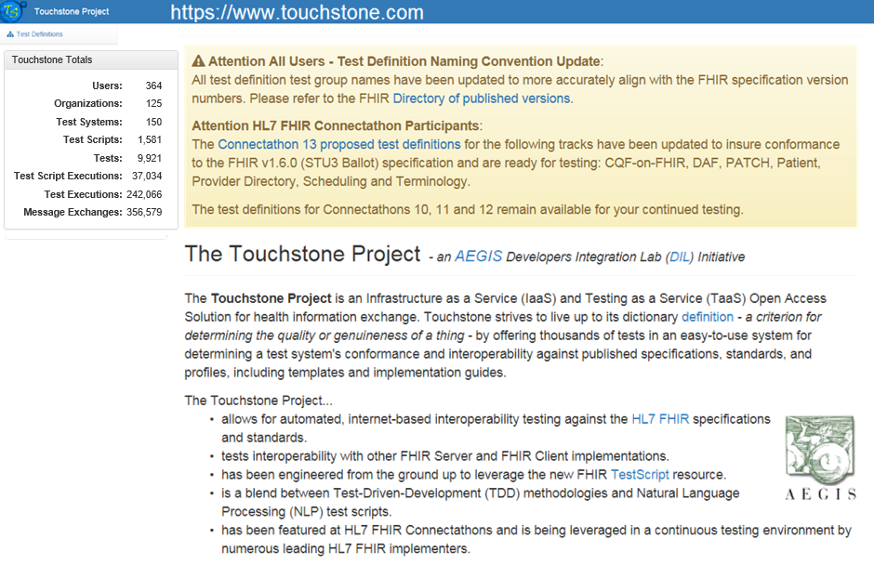
Touchstone Project (Review)

Slide 42
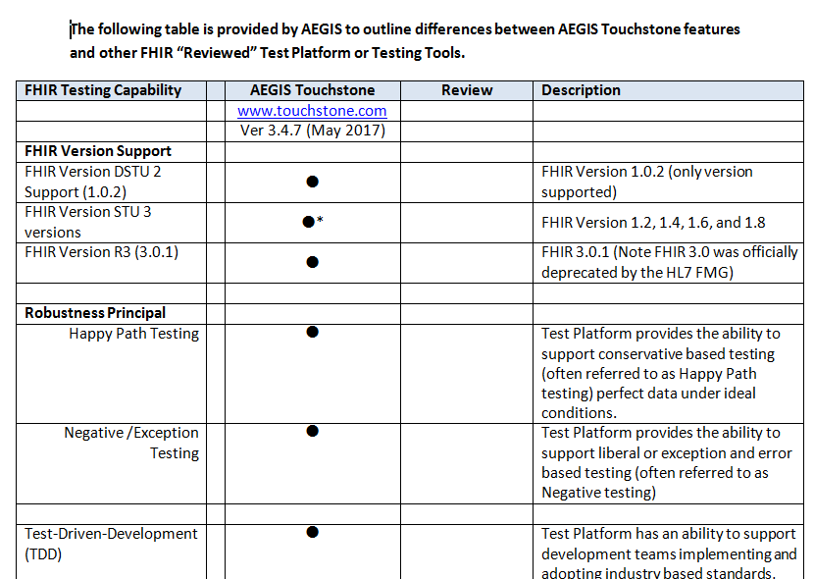
Touchstone Project (Review)

Slide 43
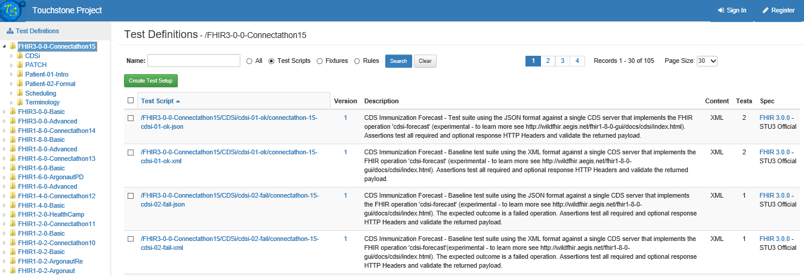
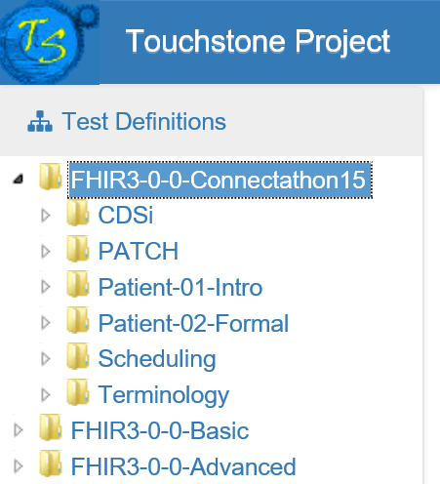
Touchstone HL7 FHIR R3 Support
12hrs
After
R3
Release

Slide 44
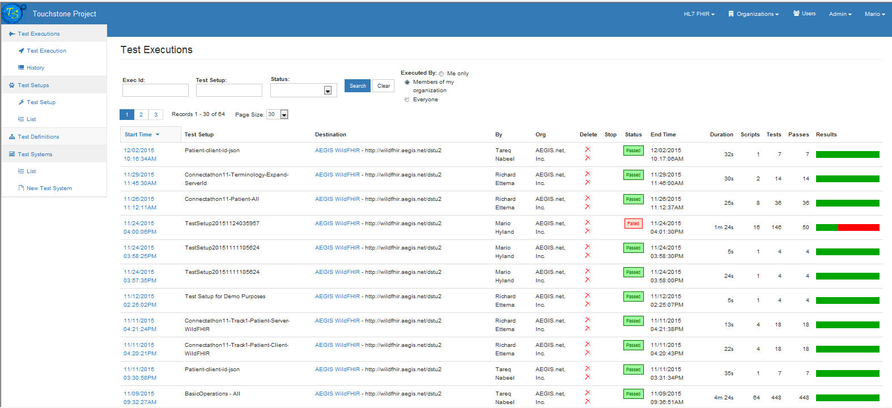
Touchstone Project
an AEGIS Developers Integration Lab (DIL) Initiative
AEGIS.net, Inc. - Powerful Results. Delivered.SM
44

Slide 45
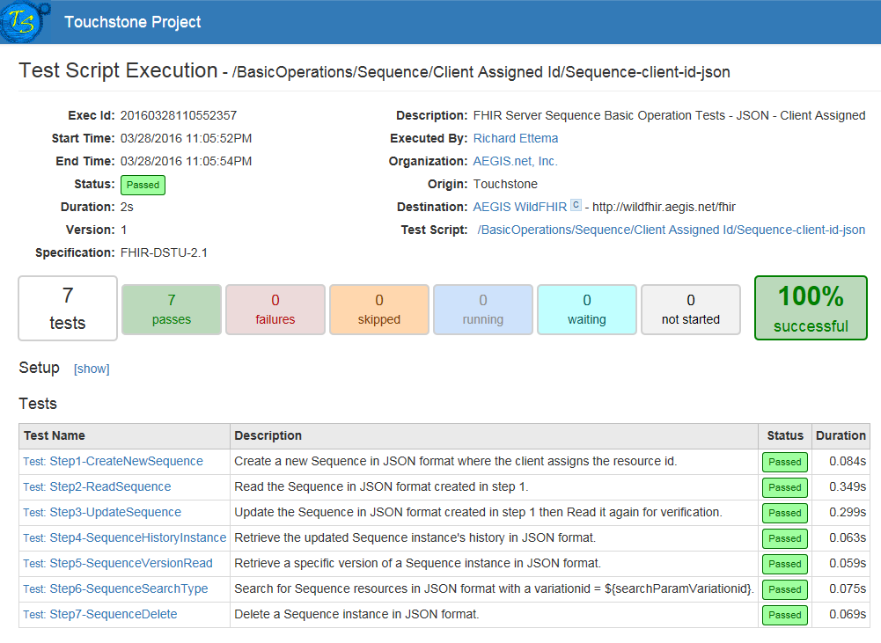
Touchstone Project

Slide 46
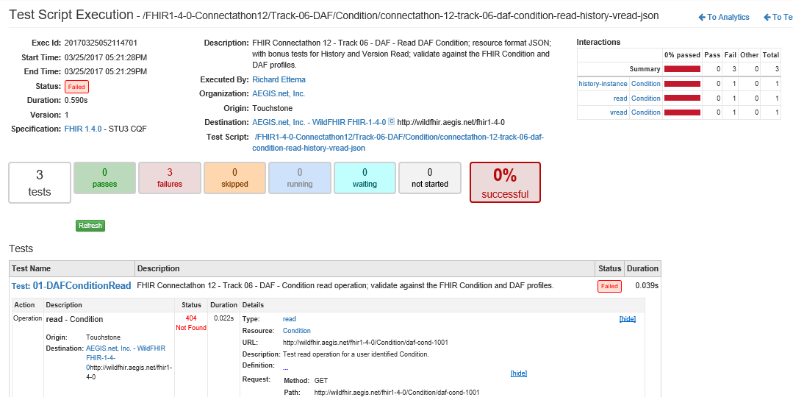
Touchstone Project (TDD)

Slide 47
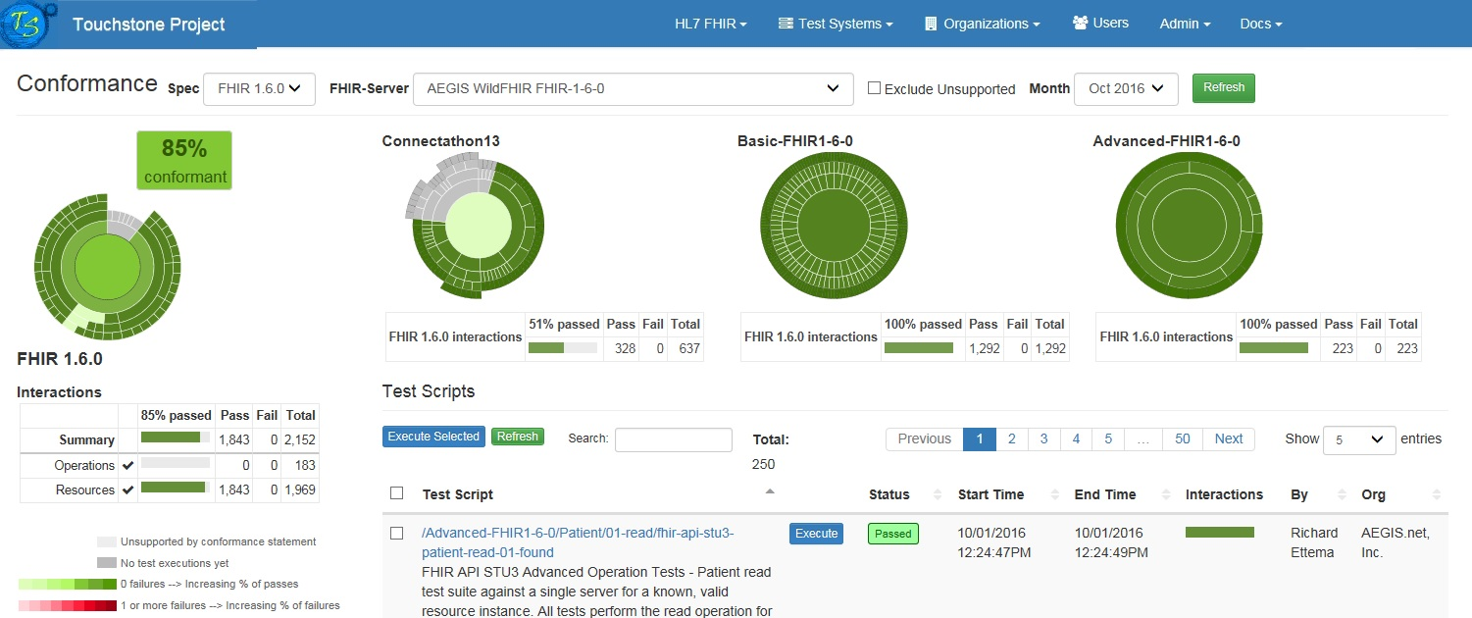
Touchstone – Analytics (All)

Slide 48
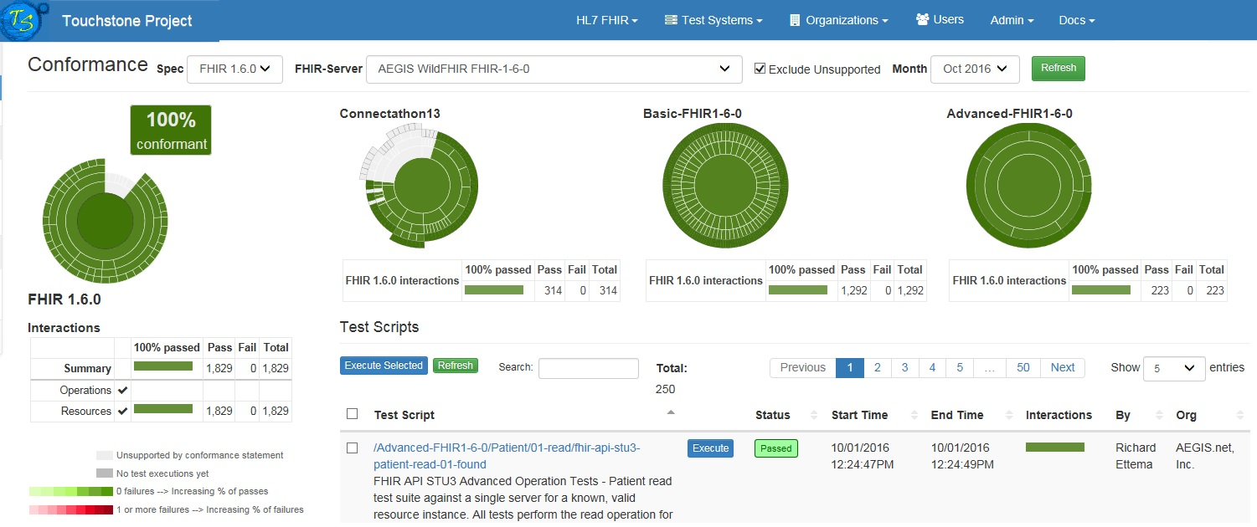
Touchstone – Analytics (Supported)

Slide 49
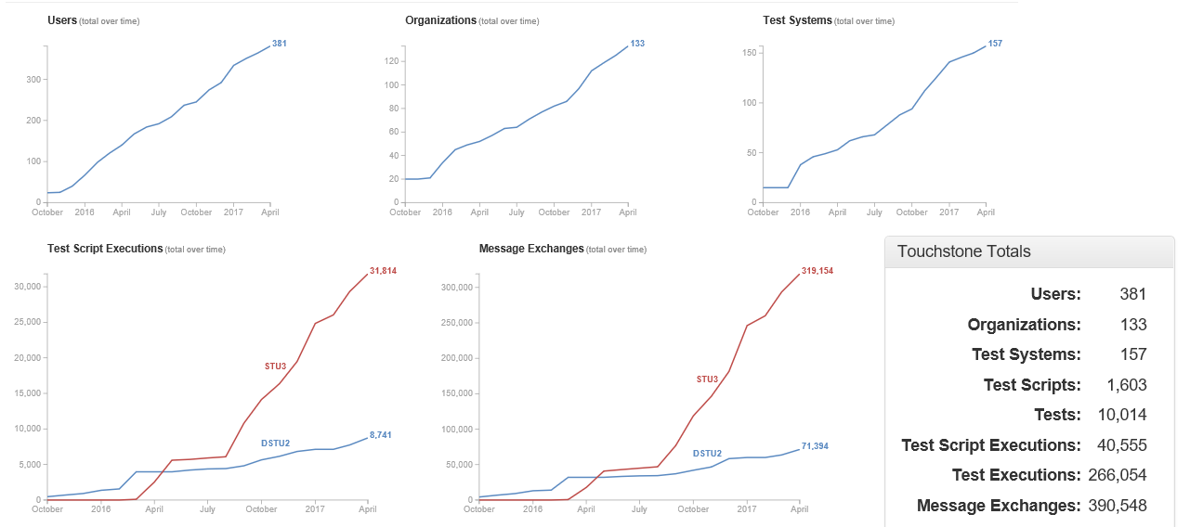
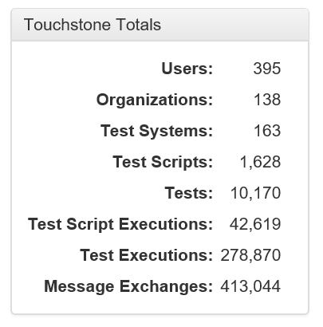
Touchstone – Global Statistics

Slide 50
Robustness Principle
“Be conservative in what you send,
be liberal in what you accept”
http://en.wikipedia.org/wiki/Robustness_principle
Conservative – Happy Path (Ideal World)
Liberal – Negative and Exception Path
(Things that happen everyday in the
Real World)
AEGIS.net, Inc. - Powerful Results. Delivered.SM
50

Slide 51
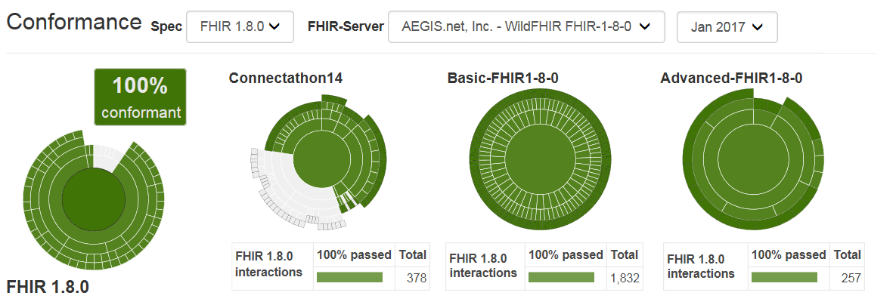
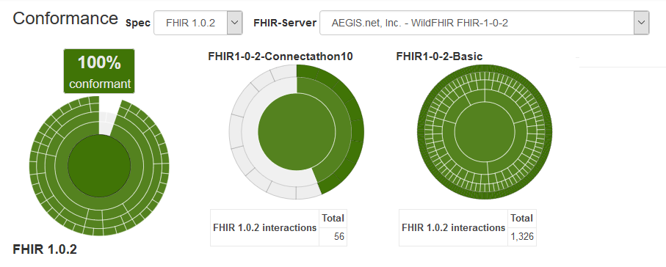
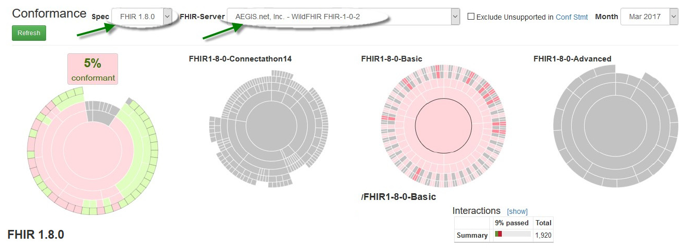
How Interoperable is FHIR?
“A lot will depend on the
Healthcare Industry”
Happy Path (Ideal World)
or Rigorously Tested EHR' s
(Ready for what happens everyday in the
Real World)

Slide 52
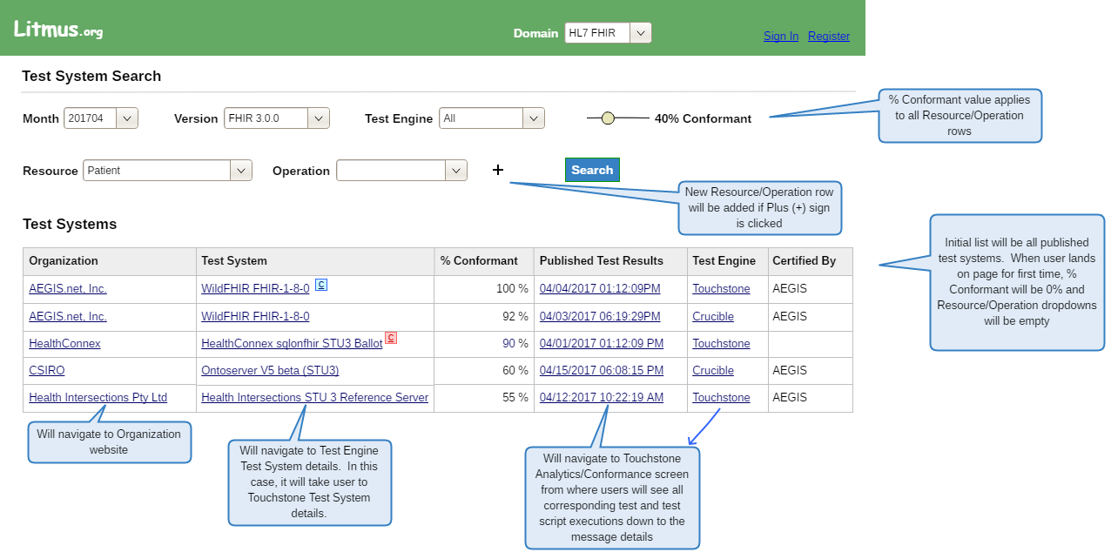
FHIR Product Registries

Slide 53
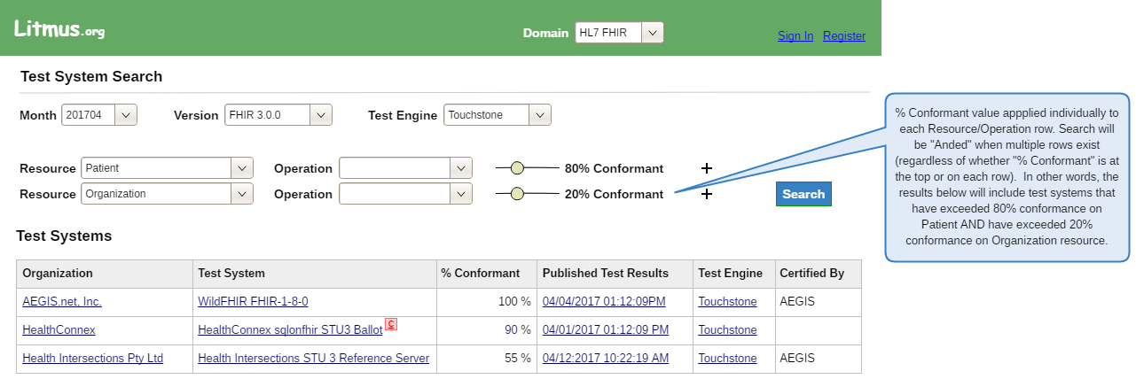
Litmus.org coming soon

Slide 54
How Important is Patient Safety?
AEGIS.net, Inc. - Powerful Results. Delivered.SM
54

Slide 55
Contact Us
“If Patient Safety is important
to you too!”
Mario Hyland
AEGIS.net, Inc.
Senior Vice President
mario.hyland@aegis.net
(703) 893-6020 x707
(301) 529-5466 (c)
@Interopguy
AEGIS.net, Inc. - Powerful Results. Delivered.SM
55

