Slide 1
HSPC Initiatives
HSPC Steering Committee
March 27, 2017

Slide 2
Initiatives
Be a provider led collaboration agent - Laura
Develop terminology and information models for true semantic interoperability - Susan
Create a reference implementation of common SOA - Rob
Support authoring and sharing of knowledge content – Peter/Emory
Healthcare Community Cloud – Keith/Oscar
Notes:
Terminology and Modeling
SOA Reference
Knowledge Authoring Reference Model
Health Care Community Cloud
Conformance and Certification - (What does it mean to be HSPC compliant)
Implementation of Standards (Model Adoption Database)
Development Environment and Resources
Community Engagement
Standards Implementation
HSPC Engagement in Public Policy
Not done – neutral marketplace….

Slide 3
Initiatives
Support conformance and certification testing - Stan
Obtain implementation and adoption of approved standards
  Model Adoption Database – Craig
  MOU update – Virginia
Development Environment and Resources - Scott
HSPC Engagement in Public Policy - Frank
Notes:
Terminology and Modeling
SOA Reference
Knowledge Authoring Reference Model
Health Care Community Cloud
Conformance and Certification - (What does it mean to be HSPC compliant)
Implementation of Standards (Model Adoption Database)
Development Environment and Resources
Community Engagement
Standards Implementation
HSPC Engagement in Public Policy

Slide 4
Community Engagement
Membership
Marketing
Meetings
Website/Wiki/Communication tools
Finances
Notes:
Membership
Marketing – HIMSS
Meetings
Website/Wiki
Finances

Slide 5

HSPC Terminology and Information Model Initiatives
Susan Matney, PhD, RNC-OB, FAAN (Initiative Lead)
3/27/2017

Slide 6
  Terminology and Tooling Initiative:
Develop terminology and information models as a foundation for true semantic interoperability
  Based on real world, technical, high priority use cases brought to us by the member community.

Slide 7
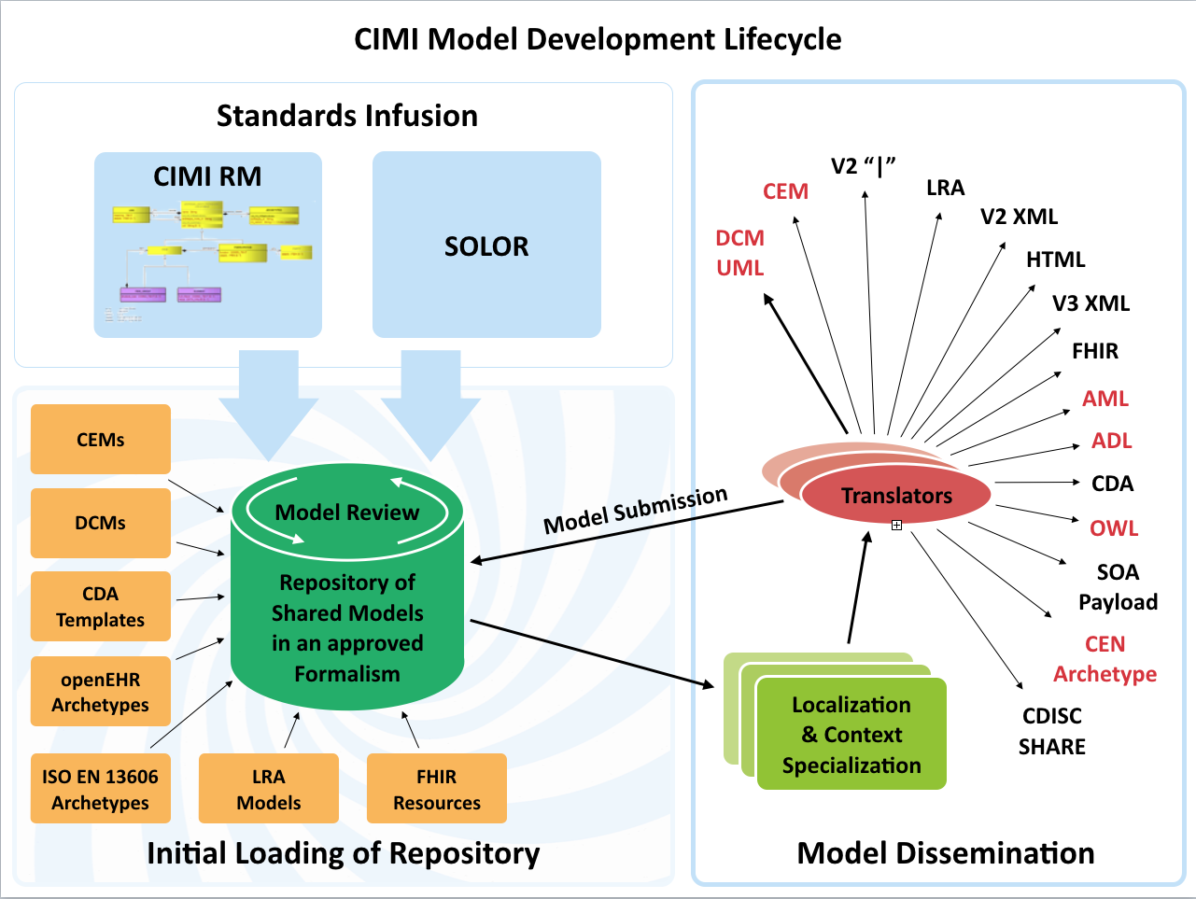

Slide 8
Deliverable 1: Develop the CIMI Content Architecture
(overseen by HL7 CIMI WG)
Goal 1: Develop the high level reference archetypes (patterns) and ballot
    Assigned to : Susan/Claude
  CIMI Model Style Guide v1 in Jan. HL7 ballot
  Archetypes included: Actor, Organization, Encounter, Evaluation Result, Procedure, Assertion
Goal 2: Finalize and ballot the CIMI Reference and Foundational Archetypes
    Assigned to : Claude Nanjo – done and in ballot
Notes:
Need to discuss order of how patterns are created. Move 2 to 1

Slide 9
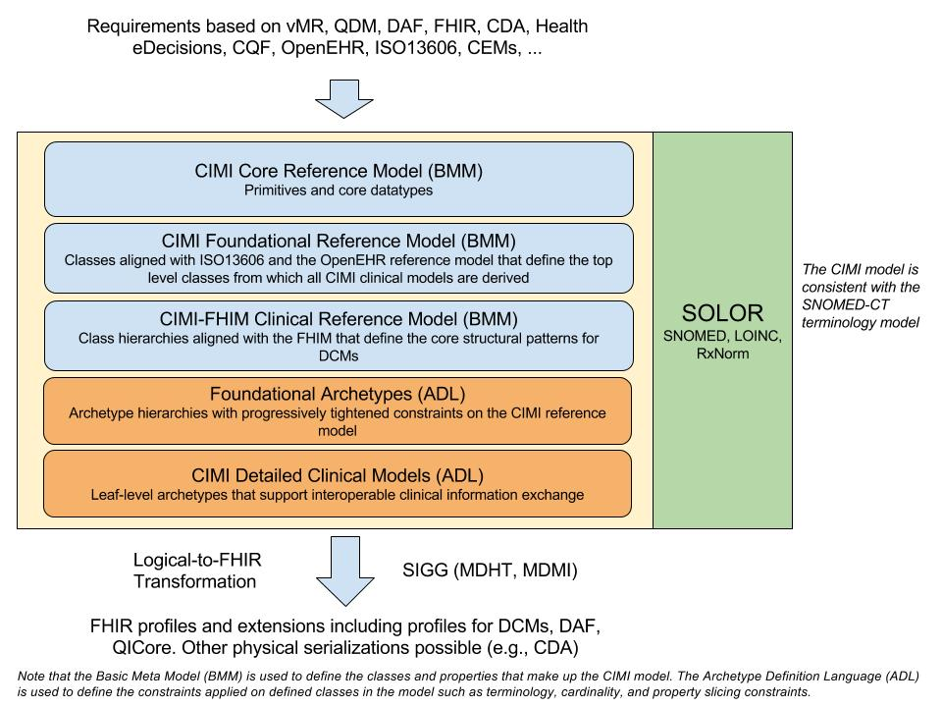
Model Driven Architecture Vision to seamlessly support developers and implementers
Notes:
Claude Nanjo, https://docs.google.com/drawings/d/1xQF5SZxwi8DiFG1C7uI9eBo6RkgYtA3iIekeuDOC8Es/edit
The core reference model which define the very foundations of the model. Right now, it is very generic. It can almost be compared to FHIR's Structure Definition with some of its datatypes, etc... At this time, it is really a meta-model layer.
The foundational archetype layer - these are closely aligned to ISO13606 and the OpenEHR reference model and provide the foundation for a clinical document more generally and a clinical record in the case of CIMI. This is important because KNARTs can use this same foundation as well which is key when we define a logical model for CQF.
The reference archetype layer - these will consist in the case of CIMI of the 'schematic anchors' so to speak (to borrow Richard Esmond's term) from which detailed clinical models will be derived. Requirements for this layer will come from FHIM, vMR, QDM, QUICK, FHIR DAF, SDC, etc... The goal is to define this layer so that the transformation cost to FHIR profiles is lowest despite some divergence which we know we will have. Note that within the hierarchy of archetypes that will make up this layer, we will derive the DAF and QICore profiles. However, I would not call this layer the FHIM/DAF/QICore layer. It is more than that. Also, as Galen pointed out, not all of the expressivity of FHIM will carry over to CIMI given the models' different requirements.
The detailed clinical model layer which, ideally, are simply constraining profiles on the layer above to create families of archetypes that only vary in their terminology bindings and cardinality constraints.
An additional note on the Reference Archetype Layer: There will ultimately be two general categories of archetypes in this layer - the CIMI archetypes which we are working on now as part of the CIMI/FHIM effort - and the HeD archetypes which will consist of those archetypes that define the CQF logical model. Note that for both of these categories, there might be common archetypes used for both CIMI and HeD (e.g., the procedure topic of a clinical statement in CIMI can also be used as a definitional archetype for a procedure order item - ActivityDefinition - in an order set for instance).
Then, from layers 1-4, we would define the set of transformations to generate the corresponding FHIR profiles including DAF and QICore. Note that FHIR profiles can be generated from the various levels of the archetype hierarchy depending on requirements. The lower down the hierarchy, the more prescriptive the profile in terms of constraints.
It is important to note that some FHIR profiles may be derived from the Reference Archetype Layer (e.g., DAF, some QICore profiles, some CQIF profiles on PlanDefinition, Questionnaire and ActivityDefinition, etc...) and others from the DCM Layer (e.g., bilirubin, HgA1c, etc...). In other words, the arrow for FHIR Profiles stems out of the outer box rather than the last of the inner boxes (the DCM box).
CQIF is an implementation guide that stems out of the CQF initiative. I hope this helps.

Slide 10
Goal 3: Create detailed clinical models to test the reference archetypes and implement
  Project Updates
  OPA/ACOG Family Practice Annual Report (FPAR)
    Analysis ~90% complete
    Alignment with IHE C-CDA
  Skin/Wound Assessment
    Project with the VA and HL7, using FHIM wound assessment models (also aligning with Tissue Analytics)
    Initial CIMI model in ballot
    Working on encoded content in SOLOR

Slide 11
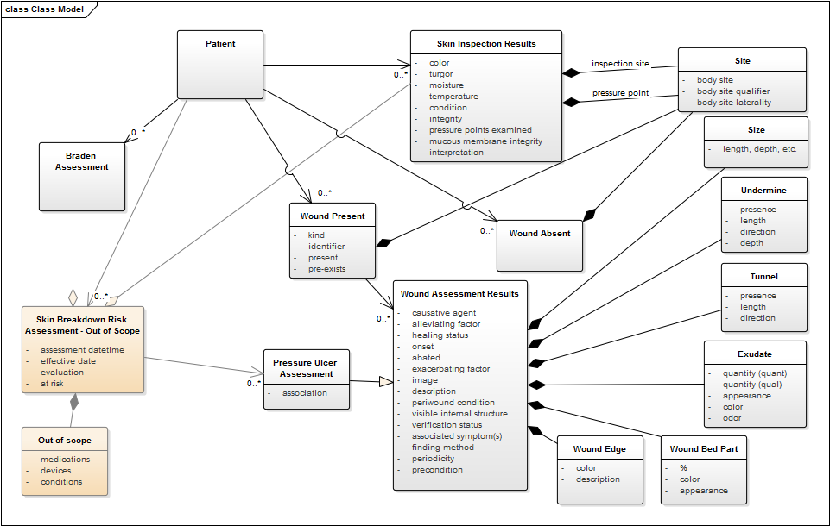
Skin Assessment Model

Slide 12
Deliverable 2: Develop Model Transform Methodologies
(overseen by HL7 CIMI WG)
Goal 1: Develop Transforms to CIMI
  CEM to CIMI transform (Assigned to: Joey Coyle)
  FHIM UML to CIMI transform (Assigned to: JP Systems/Claude Nanjo)
Goal 2: Transforms out of CIMI
  CIMI to FHIR Profiles (Assigned to: Dave Carlson, Claude Nanjo)
  CIMI to FHIM UML (Assigned to: JP Systems/Richard Esmond)
Goal 3: CEM Transforms to FHIR
  CEM to FHIR Profiles (Assigned to: Joey Coyle)

Slide 13
Deliverable 3: Define Model Development Pipeline
Goal 1: Model Request Process Model Development
      Assigned to : Susan/Saritha
  Define Scope Templates (Using SBAR)
  Use Case Template Development
  Define Analysis Process
  Identify content curation process (Working with HDD Team/SOLOR)
  Define and Document Model Development Process
Goal 2: Model Prioritization
    Assigned to : Stan/Susan

Slide 14
The Interoperable App Development Process
Domain Analysis
Create Logical Models (CIMI)
Approve Models
Model Repository
Create Physical Artifacts (FHIR Profiles)
Project Needs
Pediatric Growth Chart
Neonatal Bilirubin
Comm Acq Pneumonia
OPA Data Collection
MQIP
ACC registries
Terminology
Server
(SOLOR)
Conformance Testing
Create Software (Apps, Services, CDS)
Artifact Repository (FHIR Profiles)

Slide 15
Deliverable 4: Provide SOLOR terminology support (overseen by Keith Campbell)
Goal 1: Determine Terminology Editing Environment
    Assigned to : Keith Campbell
  Identify provider and location – Using termSpace
  Determine content – based on projects
  Develop long term maintenance process (future)
Goal 2: Define process for terminology development
    Assigned to : Monique van Berkum, John Kilbourn
Goal 3: Determine Terminology Services required for model binding
    Assigned to : CIMI Pattern Development Subgroup (Susan will lead)
Goal 4: Implement Terminology Services for model binding
    Assigned to : XXX (discuss on Wednesday)
NEW Goal 4: Identify and implement terminology server
    Assigned to : Keith

Slide 16
Deliverable 5: Define versioning and governance processes for terminology and models
Goal 1: Terminology Versioning and Governance Processes
    Assigned to: Keith Campbell
  STAMP – (Status, Time, Author, Module, Path) will be used for versioning and maintenance of Clinical-Knowledge content
Goal 2: Model Versioning and Governance Processes
    Discussing in the meeting
Notes:
Move to knowledge content initiative

Slide 17
Deliverable 6: Define terminology and modeling tooling roadmap (Overseen by Keith and Craig)
Terminology Tools (assigned to: Keith Campbell)
Goal 1: Determine tooling required for terminology development and maintenance
Goal 2: Develop and implement terminology tools
Modeling Tools (assigned to: Craig Parker)
Goal 3: Determine tooling required for model development and maintenance
Goal 4: Develop and implement modeling tools
Model Transform Tools (assigned to: Craig Parker)
Goal 5: Develop implement and transform tooling

Slide 18
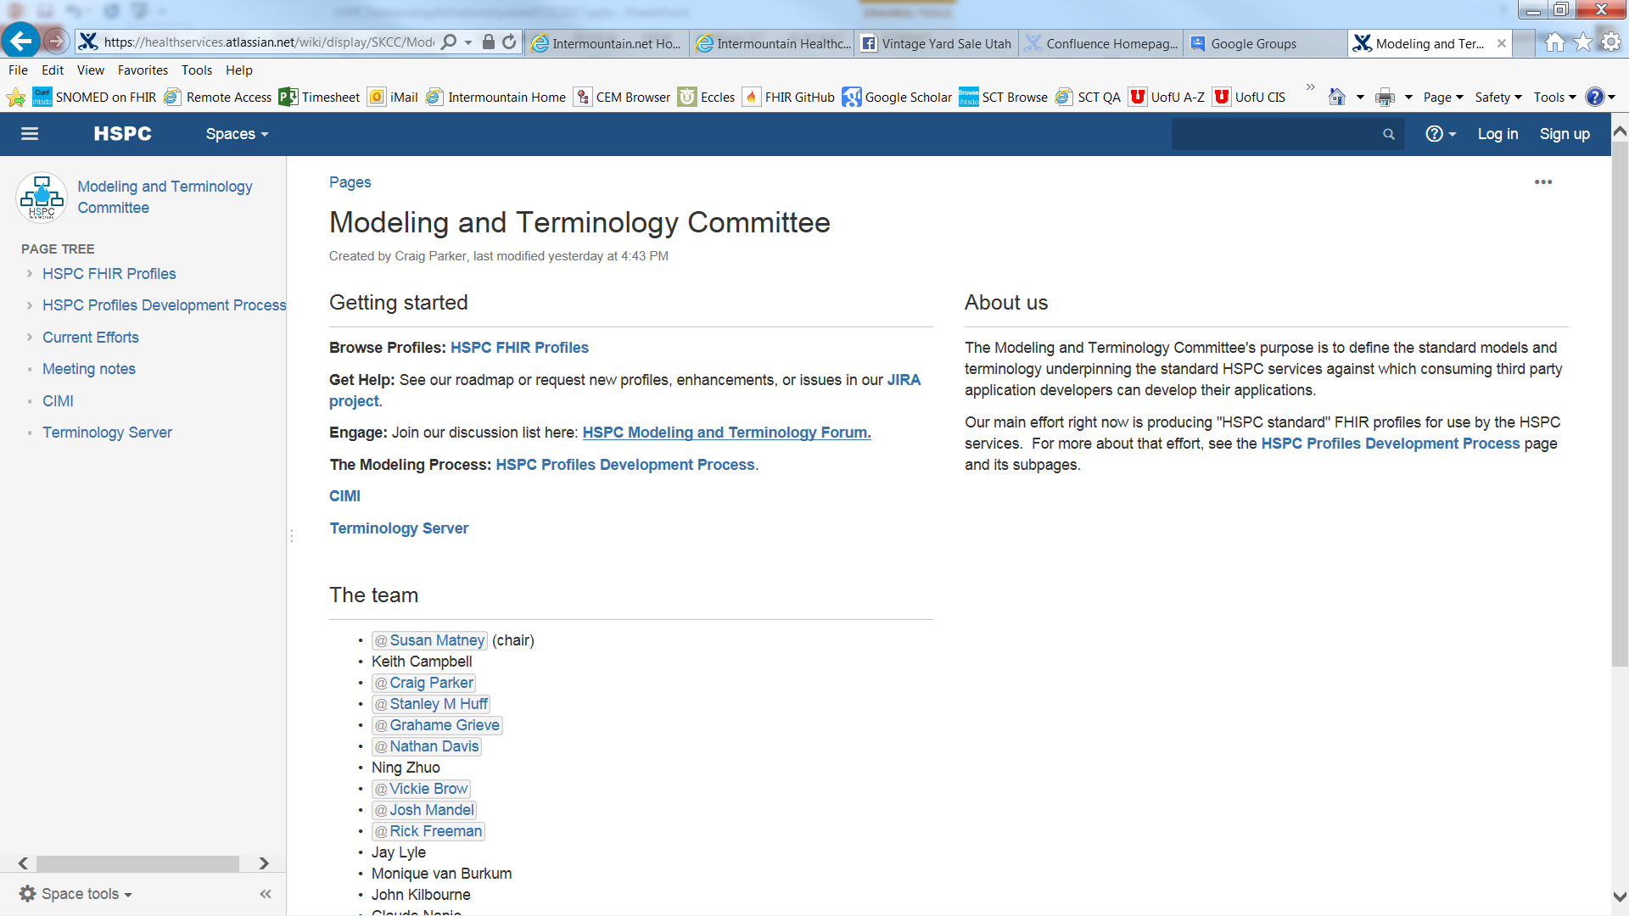
Confluence Page Overview

Slide 19

Questions

Slide 20
Create a reference Implementation of Common SOA
Rob Reynolds

Slide 21
Support Authoring and Sharing of Knowledge Content
Peter Haug
Emory Fry

Slide 22

Knowledge Authoring Reference Model
Leveraging Standards to Author Healthcare Applications
Peter Haug, MD; Intermountain Healthcare
Emory Fry, MD; Cognitive Medical Systems

Slide 23
Sources of Potential Authoring Tools
Health Level 7
  FHIR Specifications
  Knowledge Artifact Specification
  Arden Syntax
  CIMI Activities
Object Management Group
  Health Business Process Management (BPM) "Field Guide“
  Health BPM Use Case Development and Evaluation
HSPC Tooling
  Ontoserver
Etc.
What is the relationship between the HL7 and OMG Standards?

Slide 24
Authoring a CDSS for Complex Electronic Protocols
Business Process (Knowledge) Management Tools
  Business Process Modeling and Notation 2.0
  Decision Modeling Notation 1.1
  Case Management and Notation 1.1
Configuration Tools for Services from EHR (FHIR)
Configuration Tools for Special Services
    To Manage Data Models
    To Provide Added Inferencing Capability
      Physiologic Models
      Predictive Models (Bayesian Networks)
      NLP Services
      Custom Java-Based Tools
Configuration for a Client (UI) Integrated with Hosting EHR

Slide 25
Designing a CDSS for Complex Electronic Protocols
Human Task Client Framework
Protocol Execution Environment
BPMN2 Engine
DMN Engine
HumanTask Processor
Terminology/ Ontology Services
Business Process Management Tools
Standard User Communication Model(WS-Human Task)
Appropriate Services from EHR (FHIR, HSP?)
Special Services
  To Manage Data Models
  To Provide Added Inferencing Capability
    Physiologic Models
    Predictive Models (Bayesian Networks)
    NLP Services
    Custom Java-Based Tools
Client (UI) Tightly Integrated with Hosting EHR
Antibx
Penicillins
Amoxicillin
Dicloxic..
Aminogly..
Gentimyc..
MetaData
Custom Service Tasks
CMMN Engine
User Interface Generator
Data Transformation Services
NLP Services
Extended Inferencing Services
Etc…
Case
Human Tasks
Data Services
Etc.
Order Communications Services
Patient Identification Services
Data Write Services
Data Read Services
Publish/
Subscribe Services
(Data Drive)
Hosting
EHR
EHR-Based Resources

Slide 26
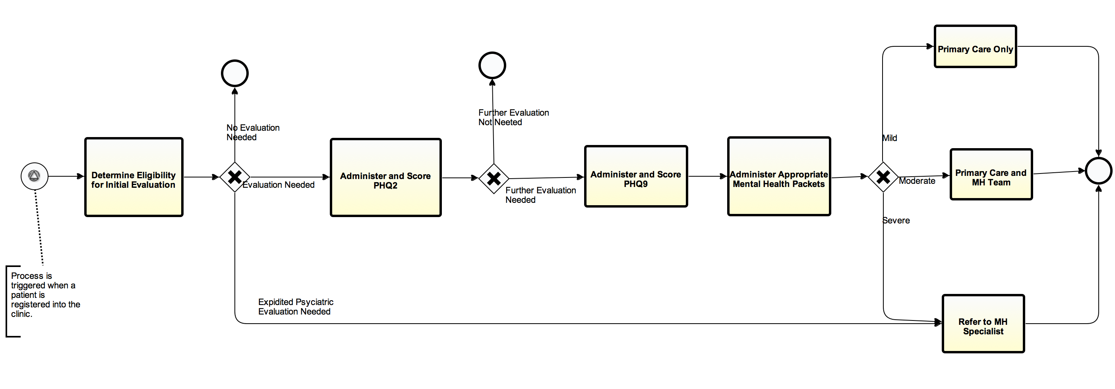
High Level BPMN for Mental Health Integration

Slide 27
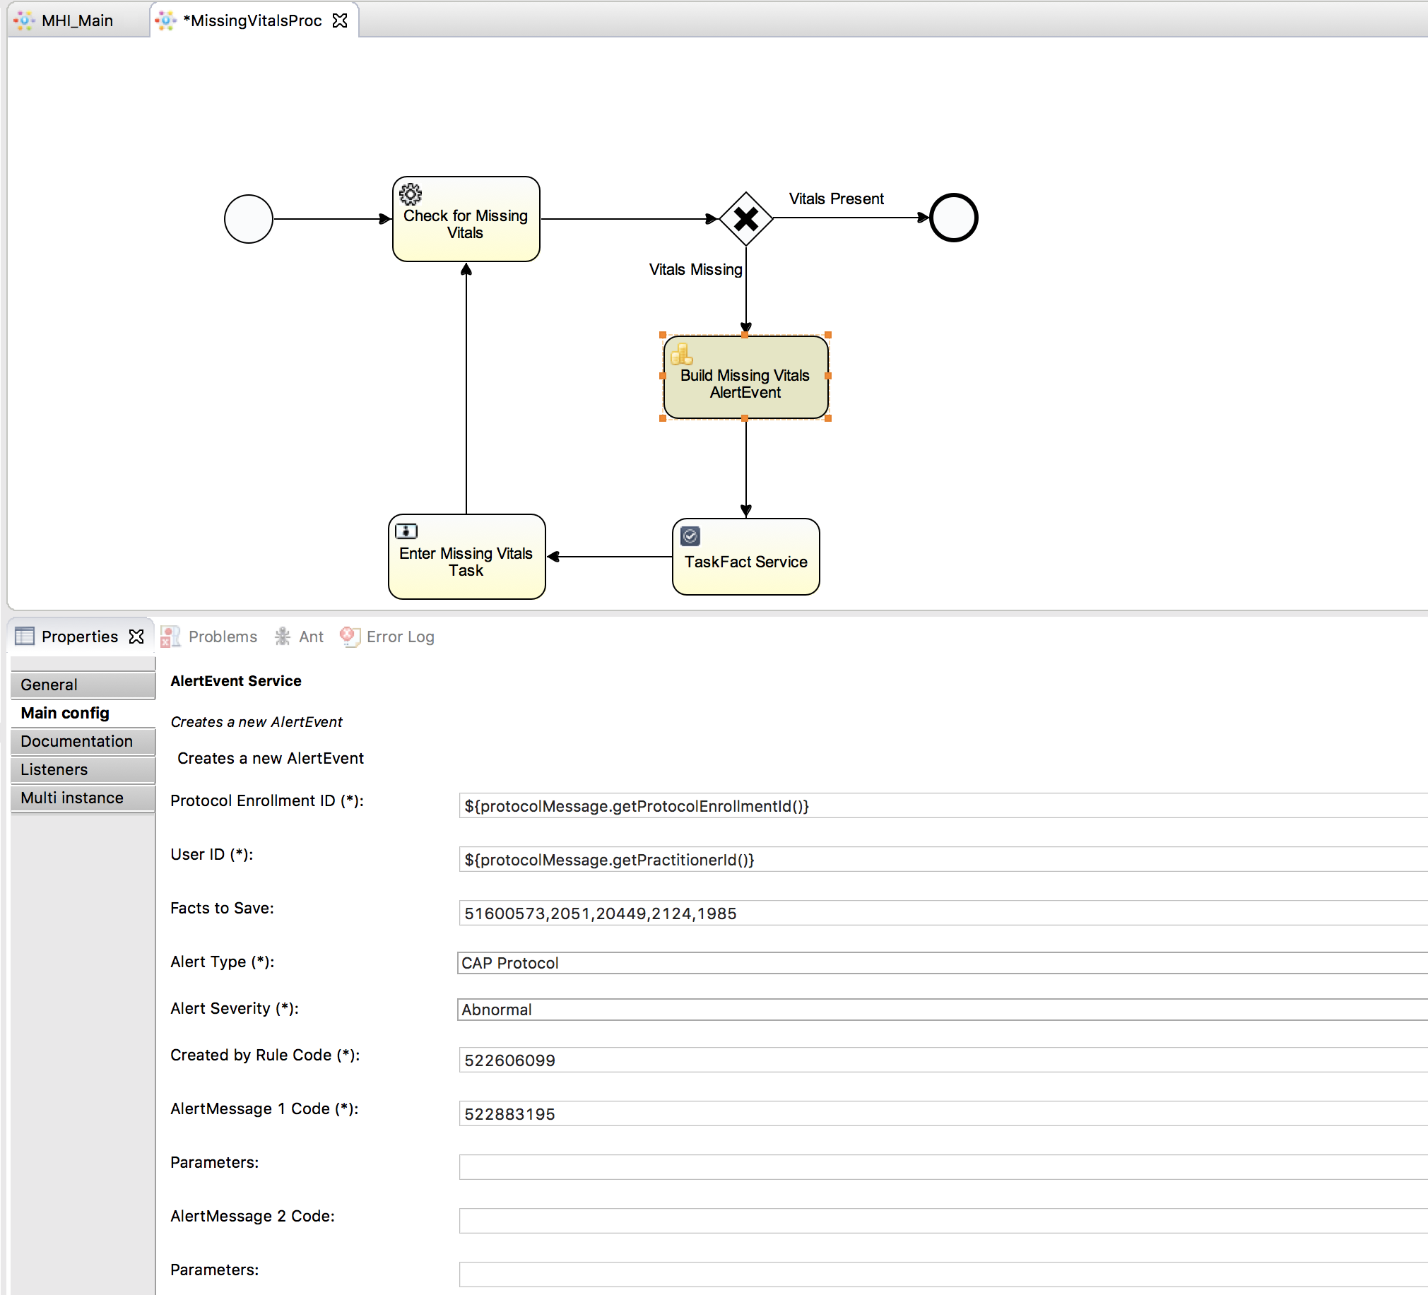
Configuring Data Access Services

Slide 28
Systems Components
Two types: EHR supplied and part of Innovation Platform
EHR Supplied
  Focus on Standards-Based Services
  Use HL7 FHIR Definitions
Platform-based
  Standards-Based as far as Possible
  Business Process Management Standards-OMG
  FHIR Standards-HL7
  Terminology Standards
  Etc.

Slide 29
EHR Supplied Services
Component | Description
EHR Supplied Services
Data Read Services | These allow an external application, running in a web application server, to access data through EHR-based service calls. Preferably, they conform to the HL7 FHIR service definitions.
Data Write Services | Simple data write services allow typical clinical data collected in external applications to be written back into and stored in the hosting EHR. While simple, these services should still appropriately trigger internal CDS and other data-driven EHR actions.
Publish and Subscribe Services | The EHR should provide publish services to enable publish and subscribe activities in the web application server environment. (Since other applications may also publish there, it should be able to subscribe to events of interest found here.)
Ordering Services | Ordering services are more difficult. These should allow external applications to order all orderable items. The services should provide all the functionality needed. For instance, for medication orders, the service should do allergy and drug interaction checking, routing to pharmacy, adding to medication administration system, etc.
User Interface Integration Services | The EHR will need to provide a mechanism for an externally hosted application to display a user interface in an appropriate place in the workflow. The SMART on FHIR and CDS-Hooks technologies are examples.

Slide 30
Platform Supplied Services
Component | Description
Hosting Platform Supplied Services
Subscribe Services | To support subscription to the events published by the EHR.
Terminology Services | A well designed data dictionary will make identifying and accessing necessary data much easier. A good deal of medical knowledge is also embedded here.
Business Process Management (BPM) Services | These are Business Process Modeling and Notation 2.0, Decision Modeling and Notation 1.1, and Case Management Modeling and Notation 1.1. They provide two important functions: 1) Each provides a graphical authoring environment that is used to design and maintain the application. 2) Each specifies an executable form of the application that can be executed at runtime in an appropriate execution engine.
Communication Services | Services to support interactions with users. They can include pager services, faxing services, etc. The BPMN 2.0 standard suggests the WS-Human Task standard as the specification for managing interactions with users.
Data Storage Services | A service to store relevant information external to the hosting EHR. This may include log files, process data, and some clinical data for which there is not a good storage model in the EHR.
Role Management Services | Since the BPM services will be management processes involving care teams, it is necessary to manage and provide access to the roles necessary for the care models.
Inferencing Services | The BPM and DMN environments are ideal for deploying a variety of inferencing tools including mathematical models, classification and prediction systems, Physiologic models, etc.
Custom Services | Special purpose services (such as natural language processing tools) can be accessed as a part of the care delivery workflow.

Slide 31
Comments and Questions
Questions???

Slide 32
Healthcare Community Cloud
Keith Toussaint
Oscar Diaz

Slide 33
HSPC Services Evolution
Healthcare Community
Cloud
Certification Platform
Marketplace
Business Model
Seed with First Ecosystem
Run as a non-profit service
Commoditize Cost
Vendor Neutral
Shared Resources
Inform with help from AWS, C4MI and other industry architects
In longer term, develop HSPC partner led delivery
Business Model
Share resources and models with OSHERA, C4MI, AEGIS and others
Create common services models that allow content and knowledge sharing
Deliver Gold Standard
Maintain Gold Standard and Certification Sandbox
Business Model
Vendor Neutral
Maintain services libraries
Provide application Sharing Libraries
Deliver legal structure for Collaboration, sharing of assets and general distribution
Support Open Source, Public Domain and Proprietary models

Slide 34
Support Conformance and Certification Testing
Stan Huff

Slide 35

What is HSPC Compliance?
HSPC General Meeting
New Orleans, LA
March 27, 2017
Stanley M. Huff, MD

Slide 36
Functions of the Consortium (1/23/2014)
Set the standards for interoperable services
  Standards for models, terminology, security, transport protocols, etc.
  Publish the models, and development instructions
Provide testing, conformance evaluation, and certification of software
  Gold Standard Reference Architecture and its Implementation
Enable development “sandboxes”
Set up an actual “App Store”
Create a business framework to support collaborative development
  Pre-agree on IP, ownership, co-investment, allocation of revenue
  Try to avoid unique contracts for each development project
Provide a way for people to invest (Venture capital)

Slide 37
The Compliance Pyramid
HSPC Compliance
Argonaut Compliance
HL7 FHIR Compliance
HL7 Version 2 Compliance

Slide 38
The Interoperable App Development Process
CIMI
Domain Analysis
Create Logical Models (CIMI)
Approve Models
Model Repository
Create Physical Artifacts (FHIR Profiles)
Project Needs
Pediatric Growth Chart
Neonatal Bilirubin
Comm Acq Pneumonia
OPA Data Collection
MQIP
ACC registries
Terminology
Server
(SOLOR)
HSPC+
Conformance Testing
Create Software (Apps, Services, CDS)
Artifact Repository (FHIR Profiles)
HSPC

Slide 39
We Need to Define What It Means to Be HSPC Compliant
Modeling and Terminology
  Use an implementation that is compliant with CIMI logical model content
    CIMI Core Reference Model and data types
    Expressed in ADL or AML
    Terminology Bindings to LOINC, SNOMED CT, and RxNorm (SOLOR)
    HSPC approved model(s) – from the CIMI collection
Service API
  Use an HSPC approved API
    Initial offering is HL7 FHIR, others to follow?
EHR integration
  Initial offering is SMART, others to follow?
SOA Architecture
Knowledge Sharing

Slide 40
Model Repository and Model Adoption
Model Repository
Model Id | Status | Version | Isosemantic Family | Model content | Meta data
Hematocrit | DSTU | 2 | 2123 | XXXX | YYY
Blood Pressure | Incomplete | 1 | 4578 | XXXX | YYY
Heart Rate | In Use | 3 | 4190 | XXXX | YYY
White Cell Count | In Use | 5 | 1789 | XXXX | YYY
Serum Glucose | DSTU | 2 | 3675 | XXXX | YYY
Serum Bilirubin | In Use | 3 | 5367 | XXXX | YYY
Model Adoption
Model Id | Realm | Use Case | Meta data
Heart Rate | US | Public Health Reporting | YYY
Hematocrit | AUS | Standard Lab Results | YYY
Serum Glucose | US | MU Quality Measure | YYY
Serum Glucose | International | CIMI | YYY
Serum Glucose | International | openEHR | YYY
Serum Bilirubin | HSPC | Neonatal Bilirubin App | YYY

Slide 41
Model Adoption Database
Craig Parker

Slide 42
MOU Update
Virginia Riehl

Slide 43






MOU UPDATE
Status: MOU Signed, Press Release
Projects: CIMI, CIIC, Coordination of Care Service with OMG
Status: MOU Approved
Project: Coordination of Care Service, Healthcare BPM
Status: Mutual Membership Agreement
Status: Exploring Areas for Collaboration
Status: Exploring Areas for Collaboration
Status: Exploring Areas for Collaboration

Slide 44
Development Environment and Resources
Scott Narus

Slide 45
HSPC Engagement in Public Policy
Frank Opelka

