Slide 1
HSPC, A Revolutionary Strategy for Interoperability
Developer’s Conference
March 30, 2017
Stanley M. Huff, MD

Slide 2
Healthcare Services Platform Consortium
MISSION
Improve health by creating a vibrant, open ecosystem of interoperable applications, content, and services
Notes:
First meeting held Aug 5, 2013
Incorporated as a not-for-profit corporation on Aug 22, 2014
3 Benefactor members
Veterans Administration
Louisiana State University Health
Intermountain Healthcare
Key alliances
Center for Medical Interoperability (C4MI)
OSEHRA
3 Associate (organizational) members
Regenstrief
Motive
Allscripts
11 Individual members
Society Members: AMA, MHII and ACOG

Slide 3
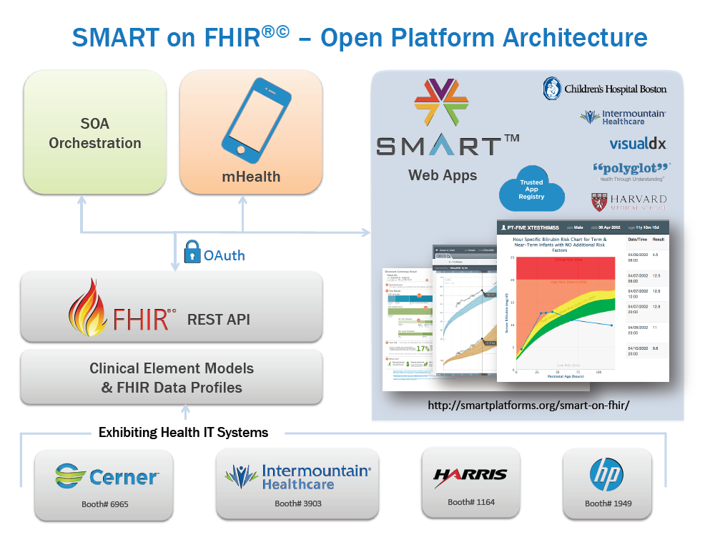
FHIR Profiles from
CIMI models
Heterogeneous Systems
Others…
3

Slide 4
The path to plug-and-play interoperability
4

Slide 5
FHIR: Core Resources
AdverseReaction
Alert
AllergyIntolerance
CarePlan
Composition
ConceptMap
Condition
Conformance
Device
DeviceObservationReport
DiagnosticOrder
DiagnosticReport
DocumentReference
DocumentManifest
Encounter
FamilyHistory
Group
ImagingStudy
Immunization
ImmunizationRecommendation
List
Location
Media
Medication
MedicationAdministration
MedicationDispense
MedicationPrescription
MedicationStatement
MessageHeader
Observation
OperationOutcome
Order
OrderResponse
Organization
Other
Patient
Practitioner
Procedure
Profile
Provenance
Query
Questionnaire
RelatedPerson
SecurityEvent
Specimen
Substance
Supply
ValueSet

Slide 6
Observation Resource
Observation (DomainResource)
identifier : Identifier [0..*]status : code [1..1]« ObservationStatus! »
code : CodeableConcept [1..1] « LOINC ?? »
subject : Reference [0..1]« Patient|Group|Device|Location »
encounter : Reference [0..1] « Encounter »
effective[x] : Type [0..1]« dateTime|Period »
value[x] : Type [0..1]
« Quantity|CodeableConcept|string|Range|Ratio|SampledData|
Attachment|time|dateTime|Period »
interpretation : CodeableConcept [0..1] « Observation Interpretation+ »
method : CodeableConcept [0..1] « Observation Methods?? »
specimen : Reference [0..1] « Specimen »
device : Reference [0..1] « Device|DeviceMetric »
Observation
subject <patient identifier>
code (test code) from LOINC
value <the result of the test>
Observation
subject: Doe, John; #12345 code: 8480-6, Systolic BP
value: 120 mmHg

Slide 7
Example: Fetch a systolic blood pressure
GET https://open-api.fhir.me/Observation/8567?_format=json
{
"resourceType": "Observation",
"text": {
"status": "generated",
"div": "<div>1999-07-02: Systolic blood pressure = 109 mm[Hg]</div>"
},
"name": {
"coding": [
{
"system": "http://loinc.org",
"code": "8480-6",
"display": "Systolic blood pressure"
}
]
},
"valueQuantity": {
"value": 109.0,
"units": "mm[Hg]",
"code": "mm[Hg]"
},
"appliesDateTime": "1999-07-02",
"status": "final",
"subject": {
"reference": "Patient/1186747"
}
}
Resource (unique) ID
Resource Type
Semantics
Clinical Values
URL to Patient

Slide 8
Profile for “Blood pressure”
Observation = Blood Pressure
Subject.reference: Patient URL
Coding: LOINC 55284-4
Related:
type: has-component
target.reference:
Observation URL
type: has-component
target.reference:
Observation URL
Observation = Systolic BP
name: “Systolic”
coding: LOINC 8480-6
value.units: “mmHg”
Observation = Diastolic BP
name: “Diastolic”
coding: LOINC 8462-4
value.units: “mmHg”

Slide 9
Progress
FHIR is easy to implement
FHIR has unprecedented support from EHR vendors
SMART on FHIR really works!
Applications at Intermountain Healthcare
In use - Pediatric growth chart, Pediatric drug card, BP Centiles
In development – HIE viewer, Pulmonary Embolus diagnosis and management
University of Utah collaborations
ONC Challenge grant: Neonatal bilirubin app
ONC High Impact grant: Surgery transition app

Slide 10
People Use LOINC Codes Differently
Variations on use of methodless and method specific codes
Confusion on blood versus serum or plasma
Confusion on properties
Confusion on NAR vs NOM
Etc.

Slide 11
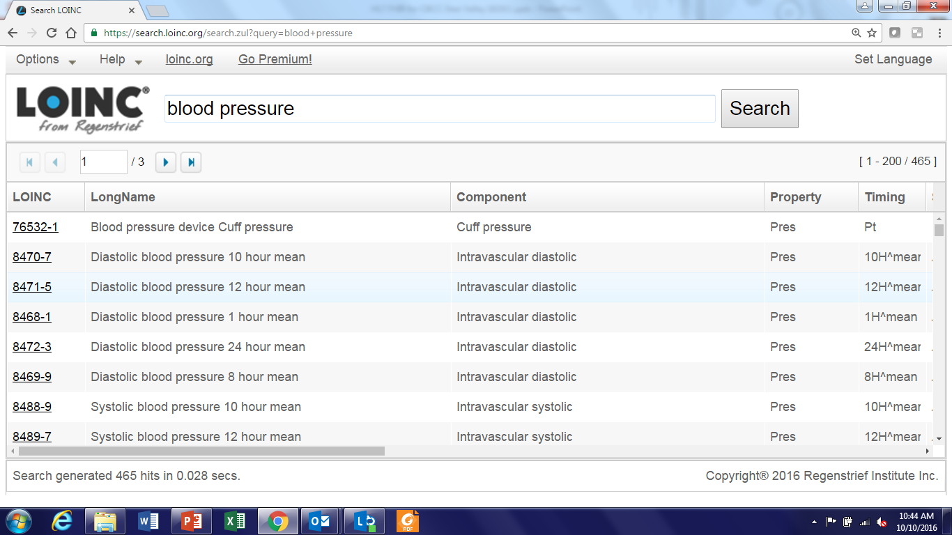
LOINC Codes for Blood Pressure

Slide 12
Terminology Entropy
No true interoperability because
Provider organizations use different models/profiles
Professional organizations use different models/profiles
Vendors use different models/profiles
Government agencies use different models/profiles

Slide 13
The Compliance Pyramid
HSPC Compliance
1 Preferred structure, extensions, explicit LOINC and SNOMED, units, magnitude, …
Argonaut Compliance
Structure(s), extensions and some specific LOINC and SNOMED
HL7 FHIR Compliance
Structure(s), Generic LOINC
HL7 Version 2 Compliance
Structure, No terminology Constraints

Slide 14
Comments
We are not proposing any changes to existing HL7 interfaces, only use of HSPC compliance in new workflows and applications as appropriate
The success of FHIR is essential to the success of HSPC
We support everything that is being done by the Argonauts
HSPC is a voluntary coalition of folks that want to realize the value of true plug-and-play interoperability by use of very explicit information models (FHIR profiles)
We can’t boil the ocean!
One small step (application or service) at a time

Slide 15
FHIR Profiles from
CIMI models
The Hard Work of Standardizing
Heterogeneous Systems
Heterogeneous Systems
Others…
15

Slide 16
Argonaut Level Interoperability
Application
Application
and User
Standard Terms
(Non-standard Structure)
Term
Translators
Local databases,
CDA, HL7 V.2, etc.

Slide 17
HSPC Level Interoperability
Application
Application
and User
Standard Structure
AND Standard Terms
(As defined by CIMI Models)
Requirements
Term and
Structure
Translators
Local databases,
CDA, HL7 V.2, etc.

Slide 18
Reasons to do it on the server side
Person writing the translation is most likely to understand the meaning of the data in their own database.
The person writing the translation only has to understand their own data and the preferred model.
They can optimize query execution for their own system
The query for the data is simpler. If the application has to write a query that will work for all shapes, the query will be inefficient to process by every system.

Slide 19
We walk a fine line
The risk/danger – we shoot too high and it is too much work, and we don’t get adoption of any HSPC level interoperability
The risk/danger – we shoot too low, and we don’t get the benefits that everyone (patients, government agencies, congress) is expecting from interoperability

Slide 20
What I hope happens
HSPC tests/certifies both services and applications as “HSPC compliant”
Customers realize the value of true interoperability and ask for (and are willing to pay for) HSPC level services from their platform vendors
Developers produce HSPC compliant apps because they have a larger potential market (they can sell to all customers that have platforms that supply HSPC compliant services)
Customers value HSPC level interoperability in applications that they buy because they are less expensive and higher quality
App galleries (market places), offer a diverse set of applications: FHIR compliant, Argonaut compliant, HSPC compliant so customers have a choice
Intermountain (and everyone else) can purchase and install HSPC compliant apps independently of their platform vendor

Slide 21
The End

