Slide 1
Service-oriented Architecture: A Public Health Perspective
HSP Consortium 14th General Meeting
New Orleans, LA
March 27, 2017

Slide 2
Challenges for Public Health
2,500+ public health agencies in the US…
… so they cannot/do not speak with one voice
There is no Federal public health “law”
… so the legal framework is state (or even county) specific
Most public health is Federally-funded (CDC & others)…
… so there are strong incentives to comply with their guidelines
CDC primarily funds program by program…
… so jurisdictions develop “stovepipe” systems
Technical infrastructure is increasingly centralized…
… so programs are less in control of what/how they deploy

Slide 3
Data Integration vs Application Integration
Presenting a unified view of data to a user through an application
Forming valid relationships between data sources

Slide 4
Agency-wide Integration
Three models:
Centralized
Cooperative
Distributed (de facto for most)
Can be implemented agency-wide or on a sub-organizational level
Success will vary by Organizational, Technical, and Process attributes
Noam H. Arzt with Susan Salkowitz, Evolution of Public Health Information Systems: Enterprise-wide Approaches, July 2007.
http://www.hln.com/assets/pdf/UT-White-Paper-Final.pdf

Slide 5
Example: Data and Application Integration

Slide 6
Typical Advice to Public Health Agencies
Embrace national standards
Enable “special functions” in your systems to the broader healthcare ecosystem
Organize a formal informatics program and invest in informatics training

Slide 7
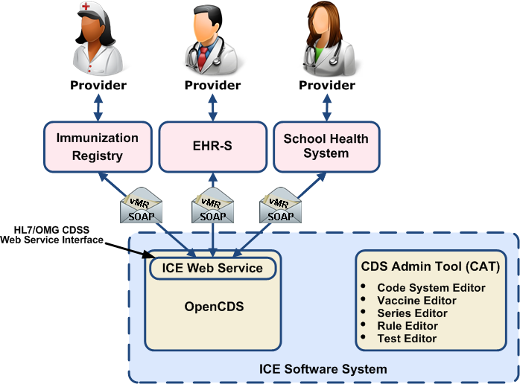
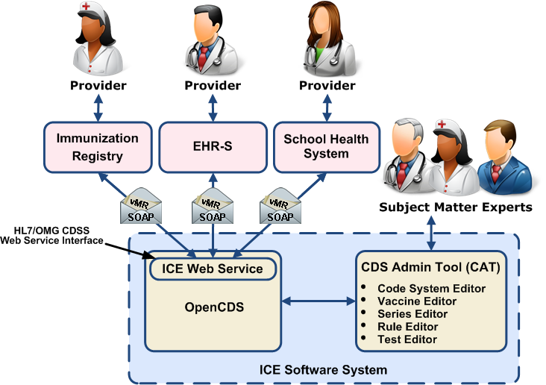
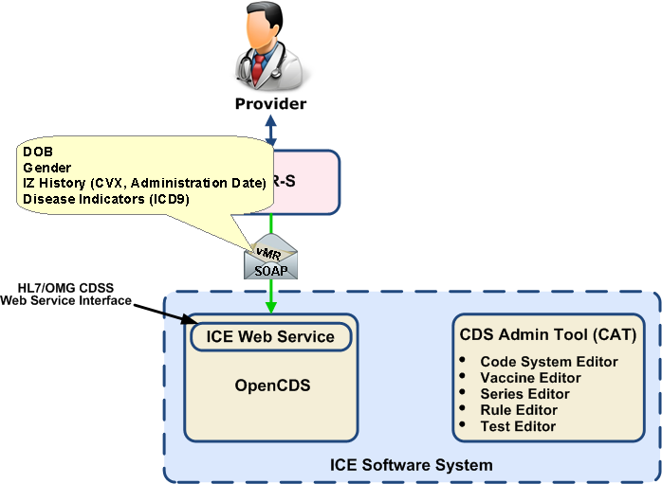
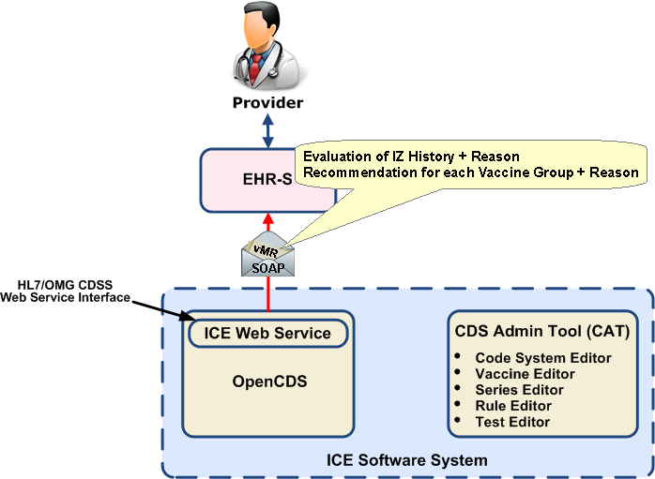
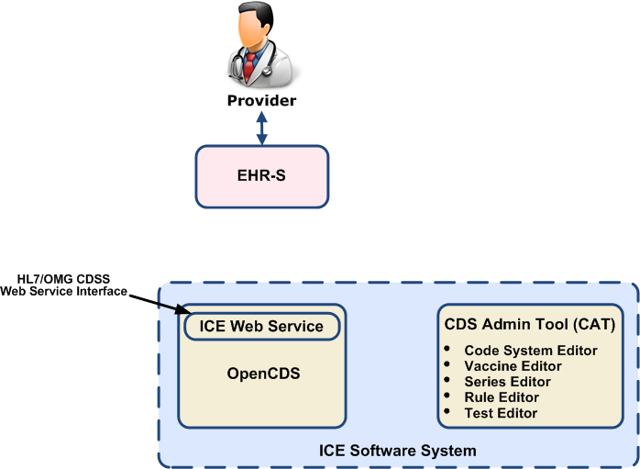
Case Study: IZ Calculation Engine (ICE)
https://www.hln.com/ice/

Slide 8
Shift to Interoperability
We can’t even agree on what Interoperability means
It is hard to agree on scope
Multiple world views
Multiple audiences
We should measure interoperability outcomes not process or capability
Lack of a compelling business case
Ambiguity over the role of HIEs (noun) and State government
It is very hard to ignore self-interest
We (in the US) tend to ignore the rest of the world
We tend to reinvent the wheel
Our timelines are too aggressive. Or are they too lax?
Different paces for different participants
The tension between being too broad versus too granular
Standards change too often
A “common data set” has limited usefulness
Monetization of data
Some folks just don’t get it. Or do they?
Consent law differences are a bug to some, a feature to others
Governance - Still
Conclusions:
Being skeptical of the notion of “consensus”
Leveraging the past with an eye to the future
Recognizing that this is more about the pace of change than the substance of change
In the meantime, focus on semantics
The Interoperability of Things, Journal of Healthcare Information Management, 29(4), Fall 2015. https://www.hln.com/wp-content/uploads/2016/03/JHIM-InteroperabilityOfThings-Fall-2015.pdf

Slide 9
Interoperability Case Study: IIS
CMS EHR Incentive Programs
IIS Interoperability Model, June 2008.
https://www.hln.com/assets/pdf/IIS-Interop-Model.pdf

Slide 10
Public Health Interoperability
https://www.ncbi.nlm.nih.gov/pmc/articles/PMC5049940/

Slide 11
Take Away Messages
Public health is an active player in the SOA space
Lots of need for internal systems integration as well as external interoperability
CMS EHR Incentive Programs have pushed many of these activities to the forefront but they were always there and often legally mandated
Technical standards are about the only thing that can drive public health to uniformity

Slide 12
Contact Information
Noam H. Arzt
President, HLN Consulting, LLC
858-538-2220 (Voice)
858-538-2209 (FAX)
arzt@hln.com
http://www.hln.com/noam/
@noamarzt

