Slide 1
by Rick Freeman
Sr. Consultant to Intermountain Healthcare & HSPC
President & CEO of iSalus Solutions
3/28/2017

Slide 2
OUR MISSION
Improve health by creating a vibrant, open ecosystem of interoperable platforms, applications, and knowledge assets.

Slide 3
OUR VISION
Be a provider-led organization that accelerates the delivery of innovative healthcare applications that improve health and healthcare.

Slide 4
OUR GOAL
Our goal is to create an open marketplace featuring the industry’s first vendor-neutral Healthcare Marketplace and to foster a vibrant entrepreneurial community to deliver the best solutions quickly, easily and seamlessly to improve the quality of today’s accountable care.
Achieving the gold standard of true semantic interoperability, our services platform seeks to dramatically augment today’s standards efforts by providing a ground-breaking collaborative platform and real world laboratory to advance the native interoperability of healthcare applications.

Slide 5
ABOUT HSPC
The Healthcare Services Platform Consortium (HSPC) is a provider-driven organization of leading healthcare organizations, IT vendors, systems integrators, and venture firms dedicated to unlocking the power of entrepreneurial innovation to improve healthcare outcomes.
Through HSPC’s open marketplace and services platform, we seek to foster a new level of provider-vendor collaboration and innovation to meet one of the industry’s greatest needs -- accelerating the creation, sharing and delivery of promising software applications at the point of care.

Slide 6
HSPC Developers Portfolio
HSPC Developers Portal
The resources needed to jump start any health app project: guides, tutorials, code samples, open source libraries, dev forums, etc.
HSPC Sandbox
A personal instance of a SMART on FHIR platform in the cloud, complete with tools and sample data to help developers build and test health apps
HSPC Gallery
HSPC's Gallery shows off some of the best SMART on FHIR applications. Browse or even take them for a spin with our live demo feature.

Slide 7
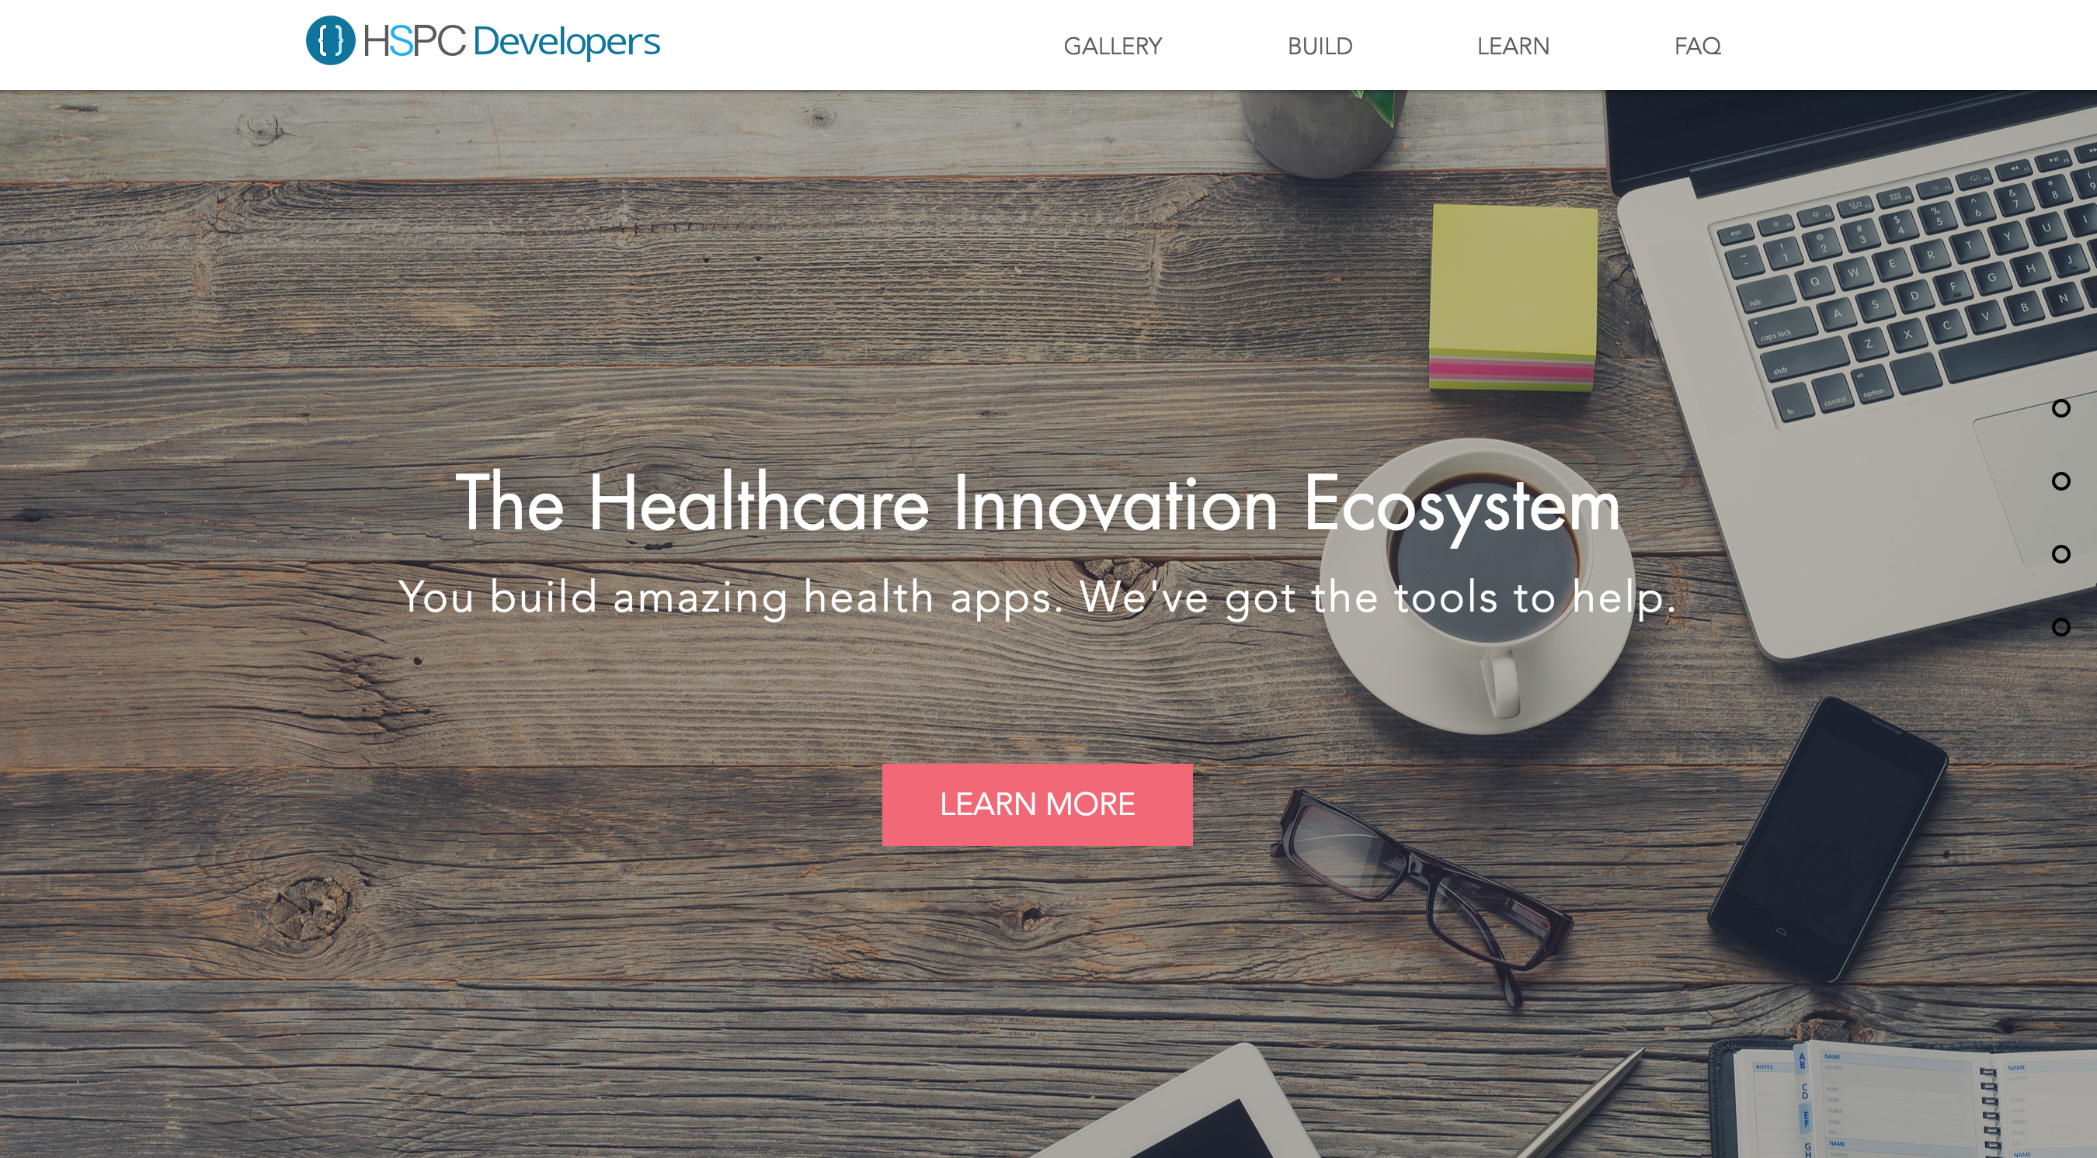
Portal

Slide 8
HSPC Developers Portfolio Features
SDK’s & Libraries
With HSPC and SMART's integration libraries, you can focus on building great apps and less on data transmission and security code.
Samples & Tutorials
Not sure how to get started? With our samples and tutorials library, you'll be up and running in no time.
Documentation
Need to dive deeper into FHIR, SMART on FHIR, or HSPC's SDKs? Our documentation library will help.

Slide 9
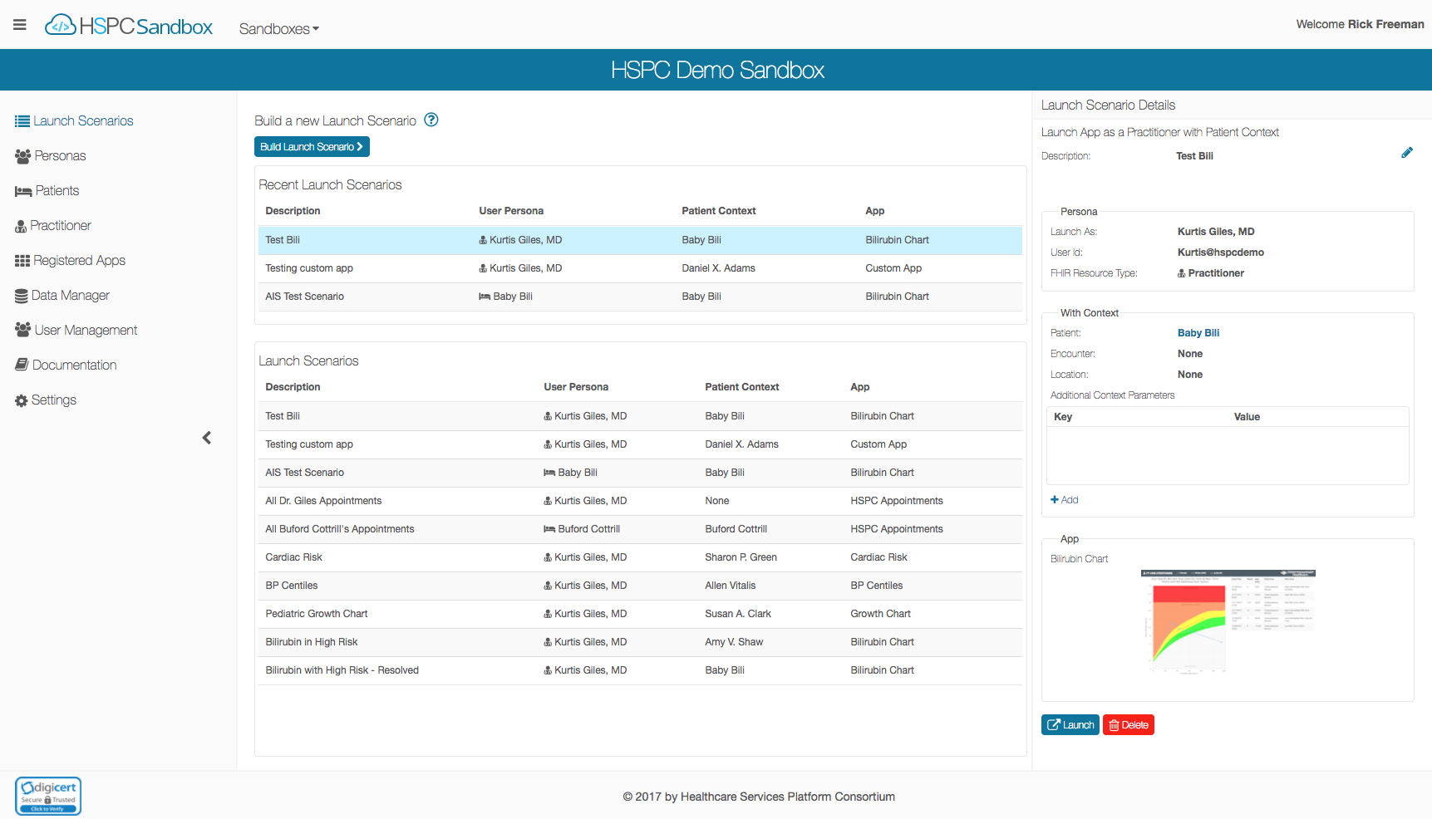
Introducing

Slide 10
HSPC Sandbox Goals
Accelerate development of health apps by providing:
Development focused reference implementation hosted in the cloud
SDKs
Tools & Utilities
Tutorials, Implementation Guides, Samples, and Documentation
Reduce time to integrate with commercial HSPC and/or SMART on FHIR capable platforms (such as EHRs, HIEs, etc.)
Contribute to the Health IT Community:
Free to use (membership in HSPC is not required)
Funded by Intermountain Healthcare & HSPC
Open source: https://bitbucket.org/hspconsortium/

Slide 11
HSPC Sandbox Features
The HSPC Sandbox is a personal instance of a SMART on FHIR platform in the cloud, with tools and data to help build and test health apps.
Create your own cloud-based sandbox, w/default data set, in a few clicks.
Run against your own FHIR server (open or secured).
Support for DSTU2 or STU3 (1.8, 1.9, 3.0 coming soon )
Invite your team to join and collaborate with you on your sandbox.
Create or import clinical data to test your apps.
Test apps by creating Personas and Launch Scenarios.
Support for mobile, embedded web, stand-alone, and back-end.
Verify your app follows the SMART security and launch context standards.

Slide 12
327
261
Sandbox Users
Unique Sandbox
2x
74
HL7 FHIR Roundtable
Award Winner
New Users
Past 30 days

Slide 13
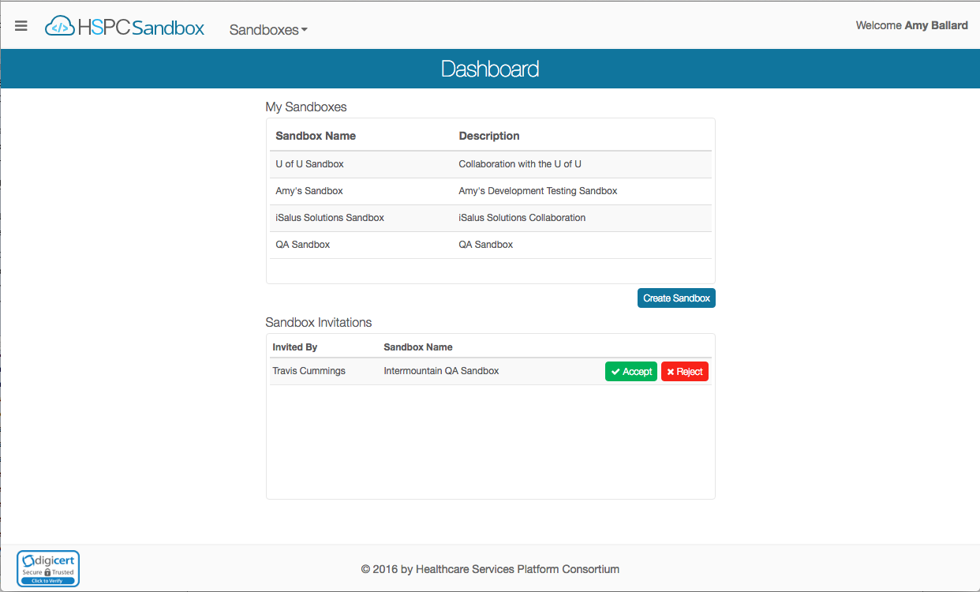
Demo of HSPC Sandbox

Slide 14
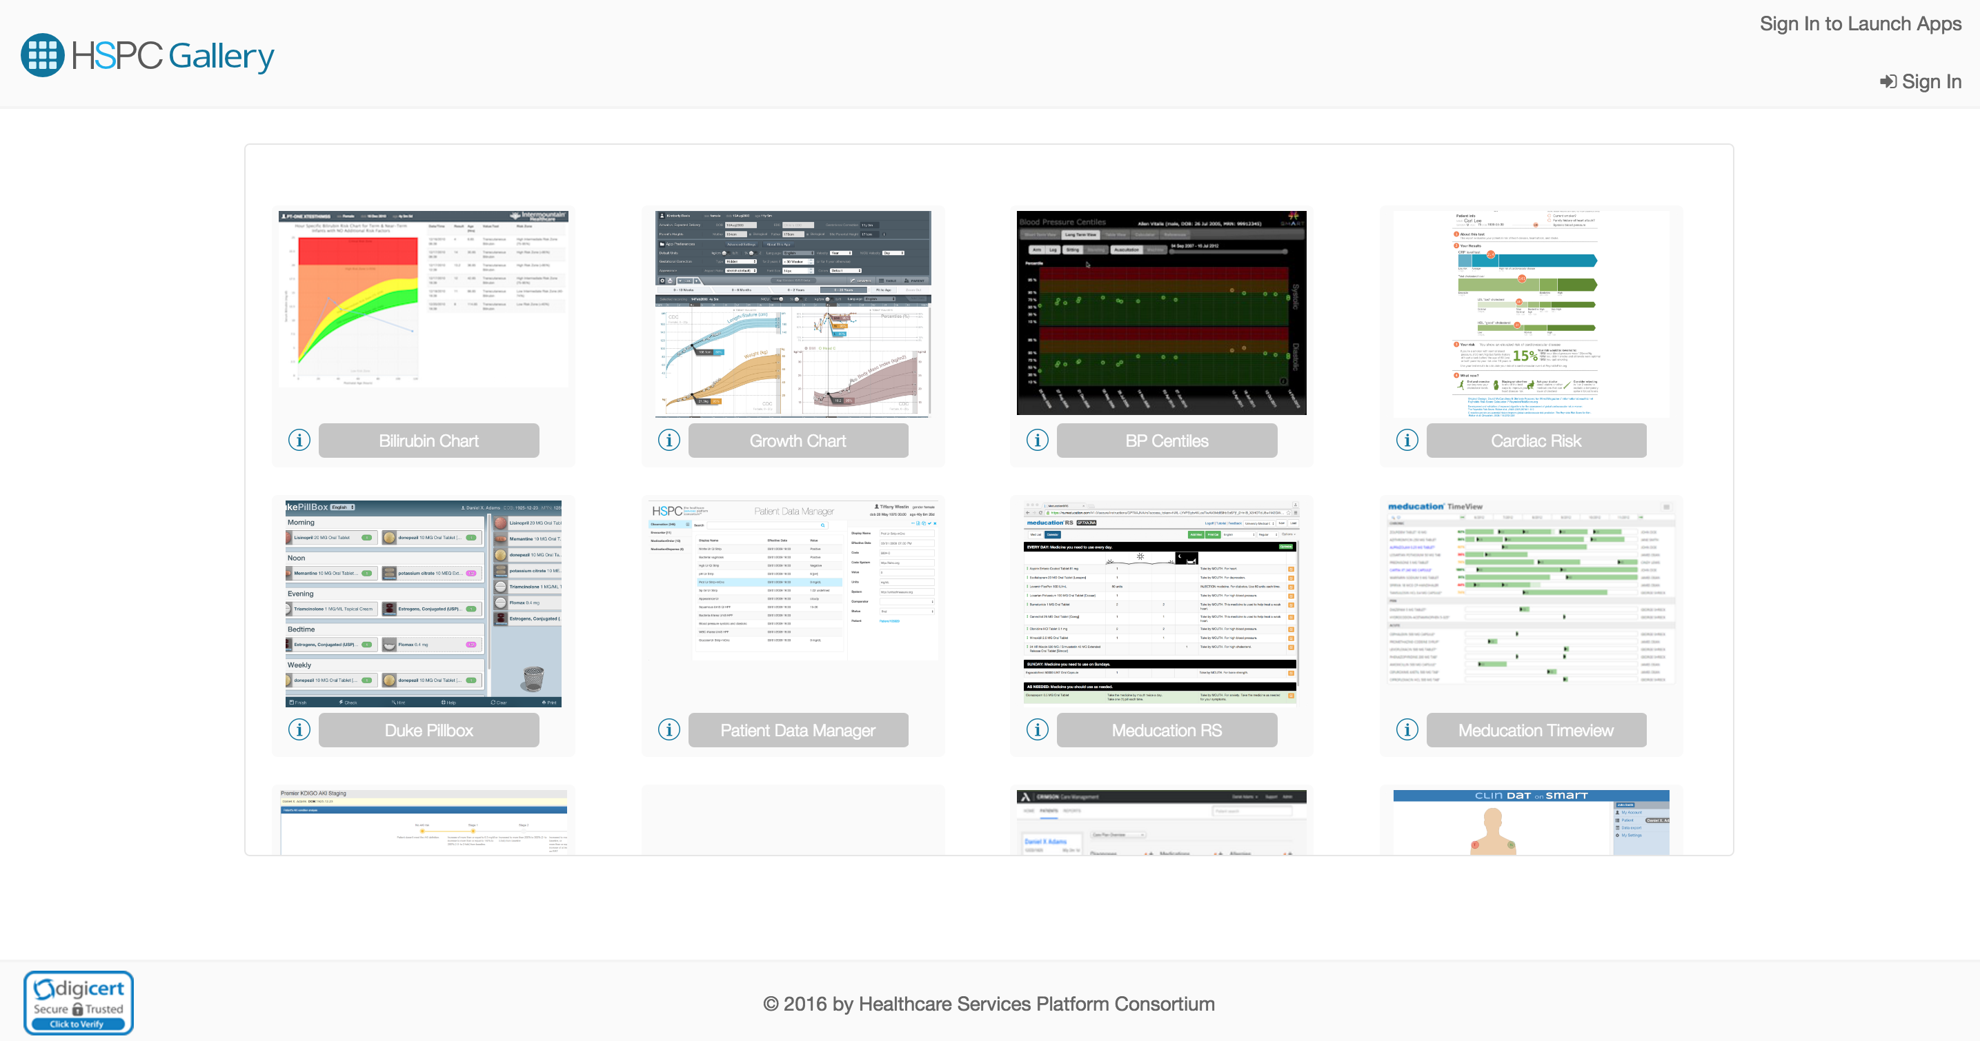
Introducing

Slide 15
Questions?

Slide 16
Next Steps
Standardizing app/artifact registration
Marketplaces, galleries, sandboxes, etc.
Participants: Cerner, Epic, Allscripts, Google, Intermountain, iSalus Solutions
https://bitbucket.org/hspconsortium/registration
Simulate and/or test app/artifact’s compatibility with various platform implementations.
FHIR Profile support (tools and resources) for developers
Data management tools
Import criteria based, realistic data
Take your data with you
Provide a realistic, large enterprise/population data set (Synthea, SyntheticMass, etc.)
CDS Hooks simulation and developer resources

Slide 17
HSPC Developer Resources
HSPC Developers: http://developers.hspconsortium.org
HSPC Sandbox: http://sandbox.hspconsortium.org
HSPC Gallery: http://gallery.hspconsortium.org

Slide 18
Questions?

