Slide 1
HSPC and CIIC
July 30, 2018

Slide 2
Who is here today?
clinical society
Provider organization
Academic institution
Government
Vendor
Non-profit

Slide 3
Why?
“To help people live the healthiest lives possible.”

Slide 4
Why interoperability ?
Improve the quality and safety of care
Decrease the cost of care
Enable a Learning Health System
Make providers happier and more effective
Make patients happier and healthier
There are many more reasons…
Notes:
Ensure that we context this with Intermountain and Cerner.

Slide 5
Patient

Slide 6
Sir Cyril Chantler
Medicine used to be simple, ineffective, and relatively safe
Now it is complex, effective, and potentially dangerous.
Neal G. Reducing risks in the practice of hospital general medicine. In Clinical Risk Management, 2nd edition. British Medical Journal, 2001.
Chantler, Cyril. The role and education of doctors in the delivery of health care. Lancet 1999; 353:1178-81.

Slide 7
Core Assumptions
‘The complexity of modern medicine exceeds the inherent limitations of the unaided human mind.’
~ David M. Eddy, MD, Ph.D.
‘... man is not perfectible. There are limits to man’s capabilities as an information processor that assure the occurrence of random errors in his activities.’
~ Clement J. McDonald, MD

Slide 8
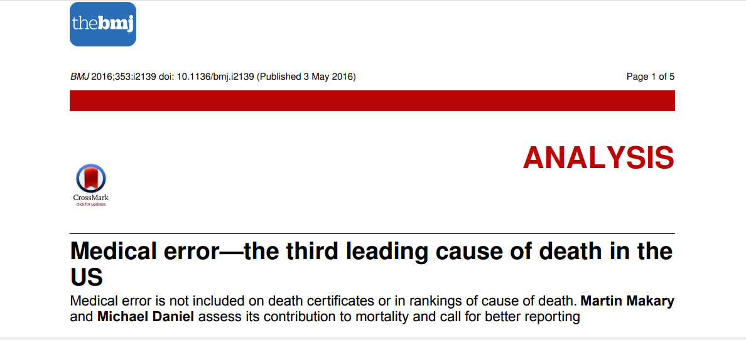
Medical errors

Slide 9
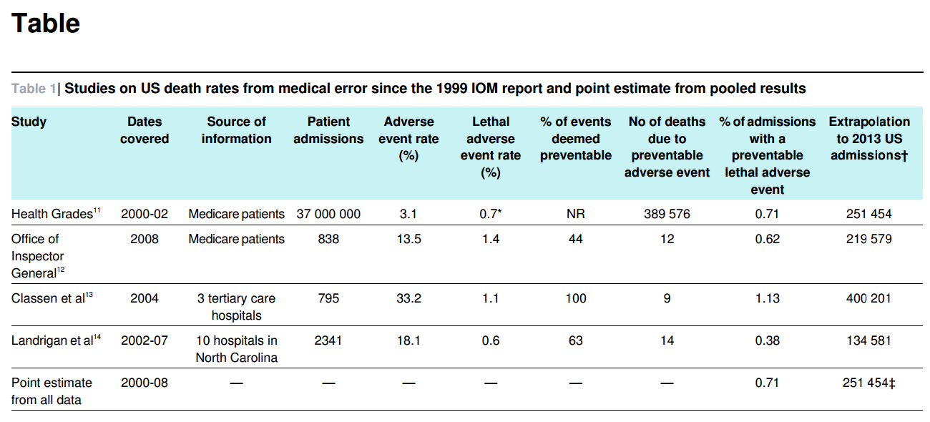
Deaths during inpatient admissions: ~251,454

Slide 10
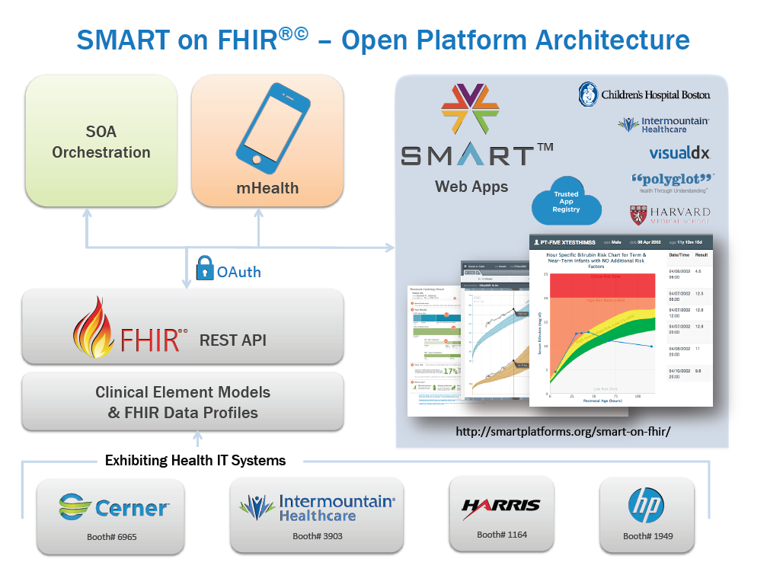
Real Impact
Occult sepsis
Community Acquired Pneumonia
Pulmonary Embolus
ICU Glucose
Ventilator management
FHIR Profiles from
CIMI detailed clinical models
Heterogeneous Systems
Others…
10

Slide 11
Open, shared repository of detailed models
Standards Infusion
Core Reference Model
SOLOR
SNOMED CT
LOINC
RxNorm
HL7 FHIR Profiles
FPAR
Application
Development
Practicing Clinical
Subject Matter Experts
Translators
Model Review
Repository of
Shared Models
in an approved
Formalism
FPAR
Application
ACOG – OPA
modeling
Model Dissemination
Notes:
We talked about the model development process earlier today. Now I want to briefly explain how that modeling process integrates into the healthcare software development cycle.
SOLOR – integrated and non-redundant combination of SNOMED, LOINC, and RxNorm.

Slide 12
Service architecture and reference implementation
Security
Auditing
Data Drive,
Time Drive
Pub - Sub
Notification, Etc.
Knowledge Services
Core
Shared
Services
BPMN2
Engine
Terminology
Ontology
DROOLS
More…
CE ICU
(EFS)
Enterprise Service Bus
EHR
SMART on FHIR
App
Finance
SMART
Payers
RIS/PACS
Etc.
FHIR
Other
Enterprise
Apps and
Services
Core EHR

Slide 13
The Interoperability Pyramid (voluntary adherence to a higher standard)
HSPC Compliance
1 Preferred structure, standard extensions, explicit LOINC and SNOMED, units, magnitude, …
Argonaut Compliance
Common resources, extensions and some specific LOINC and SNOMED
HL7 FHIR Compliance
Structure(s), Generic LOINC
HL7 Version 2 Compliance
Structure, No terminology Constraints

Slide 14
About HSPC and CIIC

Slide 15
HSPC History
HSPC was incorporated as a not-for-profit corporation on August 22, 2014
Meetings (two or three each year)
May 2013 Salt Lake City
…
July 2016 Washington DC, hosted by the ACS
November 2016 New Orleans, hosted by LSU Health
March 2017, New Orleans, hosted by LSU Health
August 2017, Washington DC, hosted by the ACS
November 2017, Indianapolis, hosted by Regenstrief Institute

Slide 16
HSPC Mission
Improve health by creating a vibrant, open ecosystem of interoperable applications, content, and services.
Be a provider-led organization that accelerates the delivery of
innovative healthcare applications that improve health and healthcare.
HSPC Vision
Organizational Guiding Principles
Provider-driven
Patient-centered
Standards based
Business focused
Open Architectures
Accelerated Innovation
Vendor-agnostic
Collaborative
Adaptable
Sustainable

Slide 17
Clinical Information Interoperability Council (HL7 hosted first meeting in 2009)
We want to create ubiquitous on demand sharing of standardized data across the breadth of medicine for:
Direct patient care
Research and learning
Public health
Clinical trials
Data from devices
Post market surveillance
Quality and disease specific registries
Billing and health administration
Any where that we share health related data and information …..

Slide 18
The July 13th 2017 CIIC meeting in Bethesda
Jointly sponsored by HL7 and HSPC
Keynote speaker – Don Rucker, MD (National Coordinator for HIT)
About 120 attendees
Representing – AAN, AAO, ACOG, ACS, ACC, ACP, APTA, ANA, FDA, CDC, NCI, AHRQ, NIAID, DoD, VA, PCPI, AMIA, SPM, HIMSS and many other organizations
Presentations and breakout groups
Conclusion: There was important work we could do and we should continue

Slide 19
Tasks for expert clinicians
Determine what data should be collected
It will be different for different situations
Determine a preferred information model for a given kind of data
How should the data be modelled? Two fields or one (the degree of pre and post coordination)
Define what the data means
Make computable definitions for diabetes mellitus, myocardial infarction, heart failure, chronic renal failure, etc.

Slide 20
How do we relate to other interoperability activities?
Argonauts
We build on the HL7 FHIR profiles that the Argonauts create
Sequoia
We depend on Sequoia to create the network, trust agreements, and data exchange infrastructure
SMART
We depend on SMART for integration into EHRs
HL7
FHIR – the approved API for sharing patient data
CIMI – provides the detailed information models that are essential for interoperability
Federal Health Information Model (FHIM)
We use FHIM classes as the pattern for CIMI models
NLM Value Set Authority Center (VSAC)
we are aligning and placing SOLOR refsets in VSAC
SOLOR
SOLOR is the source of coded concepts used in CIMI models
SDOs (HL7, OMG, NCPDP, X12, ISO, CEN)
We use their standards whenever possible
Commonwell, Center for Medical Interoperability, AMA Integrated Health Model Initiative, CDEs, openEHR, OMOP (OHDSI)
We want to work together as partners with all groups with whom we have overlapping interests

Slide 21
Merger Background and Context

Slide 22
High Level Motivation for the Merger
Achieving “true” interoperability requires many activities
Two key activities are:
Front line clinical expertise and support (as represented by CIIC)
Technical innovation including modeling, terminology, SOA, platform, tooling, and knowledge sharing (as represented by HSPC)
Other important activities: security, privacy, access, policy, regulation, legislation and other issues
High degree of overlap in leadership and activities of the two organizations
CIIC needed a business entity to transact business and hold IP
Conclusion: We neednto merge the two activities and get more done and make faster progress

Slide 23
Mission Alignment
HSPC
CIIC
Our mission is to improve health by creating a vibrant, open ecosystem of interoperable applications, knowledge, content, and services.
We want to create ubiquitous sharing of standardized data and knowledge across the breadth of medicine for:
Direct patient care
Patient entered data and outcomes
Research and learning
Public health
Clinical trials
Data from devices
Post market surveillance
Quality and disease specific registries
Billing and health administration
Anywhere that we share health related data and information …..
CIIC’s mission is encompassed in HSPC’s mission

Slide 24
Products/Services/Assets
HSPC
CIIC
Developer’s sandbox
Roadmap
Creation and Sharing of Applications and Services "Operations"
Reference Implementation of a Common SOA
Terminology and Information Models
Authoring and Sharing of Knowledge Content
Conformance and Certification Testing
Vendor and Provider Neutral Marketplace
Tooling
Expert knowledge to modelers
Process for clinically approved data models
Forums for collaboration
Education and training resources
Projects underway as proof of concept
Ability to impact policy to drive incentives to implement common clinical data models and have knowledge that is transferable across systems
HSPC provides the technical framework and infrastructure to implement CIIC’s clinical data models

Slide 25
Benefits to HSPC and CIIC of a Merger
HSPC
CIIC
Clinically driven authoritative source for models
Clinically driven projects add business value
Societies can help drive adoption
Opportunity to put clinical leadership at the helm of HSPC
Expands the stakeholders involved in HSPC
Clinical societies can demonstrate value with implementations
Reduce duplication of meetings for overlapping efforts
Reduces confusion on the difference between the efforts
Get a business entity – legal structure, agreement models, 501c3, finance structures
Technical and informatics support
Bridge to standards community
Process and administrative support
Efficiency of working together
Working together creates a stronger message of what “we” do
Complete solutions that address CIIC member problems

Slide 26
Merger Activities and Plans

Slide 27
Merger Committee
12 individuals agreed to be part of merger committee
April 19, 2018 face-to-face meeting in Washington
Conference calls every two weeks
Topics of discussion
Adding clinical representatives to the HSPC Board
Purpose of the Board
Organizational structure of the merged organization
Staffing
Funding and financial stability
A (new) name for the merged organization

Slide 28
Merge Discussion Participants
Oscar Diaz - HarmonIQ
Emory Fry - Cognitive
Steve Hasley - ACOG
Stan Huff – Intermountain
Chuck Jaffe – HL7
Laura Heermann Langford - Intermountain
Russell Leftwich - Intersystems
Jonathan Nebeker - VA
Frank Opelka - ACS
Jimmy Tcheng – Duke, ACC
Steve Waldren - AAFP
Keith White – Imaging, Intermountain

Slide 29
Transition Board
Current board members approve additional new members
Current HSPC board members remain
3 Benefactors and CEO Ex Officio (Stan Huff, Wayne Wilbright, Jonathan Nebeker, Oscar Diaz)
Initial board for approximately 2 years
The Initial board will then select new board members as the organization evolves
Proposed new Board members
Clinical representatives = 3 (Frank Opelka – ACS, Steve Waldren – AAFP, Jimmy Tcheng – ACC)
2 board advisors (Steve Hasley – ACOG, Keith White – Imaging (I4)

Slide 30
Board
Develop and ensure that the mission and values of the organization are carried out
Drive strategy
Ensure financial viability
Advocacy
Hires and fires senior management
Audit
Represents entity back to external community
Board members represent the entity, not the stakeholder group that they come from
Executive Leadership
Clinical Steering Committee
Specialty Societies
Provider Organization
Nominates Candidates to Board
Technical Steering Committee
Nominates Candidates to Board

Slide 31
Things that we plan to work on next
Governance and organizational structure
Including staff positions and organization
Plan for funding and financial sustainability
Evolve and strengthen the organization
Engagement with Weber Shandwick
Supported by contributions from the American College of Surgeons
Three phase plan for growing the organization
Create a new name for the combined organization

Slide 32
The incredible value of interoperability?
Save 100,000 lives a year?
Make the right decision 80% of the time?
Save $5 billion in chart abstraction costs?
Learn something from the $3.2 trillion that we spend each year on healthcare?
Install a new EHR for millions instead of billions?

Slide 33
Clinician Panel

Slide 34
Thoughts from Clinical Societies
Oscar Diaz – moderator
Panelists
Steve Hasley, MD, ACOG
James (Jimmy) Tcheng MD, ACC
Steve Waldren MD, AAFP
Keith White MD, Imaging

Slide 35
Questions and Discussion

