Slide 1

Knowledge, Content, and Clinical Process Sharing
Leveraging Standards to Author Healthcare Applications
Ken Rubin, Peter Haug, Emory Fry

Slide 2
OMG-Sponsored Projects
Field Guide to Sharable Clinical Pathways
  BPMN, CMMN & DMN in Healthcare
  Medical Adaptation of BPM Models and Model Reuse
Motivating Use Cases
  Care in Pregnancy
    Start with Simple Model: Workflow Model of a Normal Pregnancy
  Depression in Veterans
    Model Response to Depression and Suicide

Slide 3
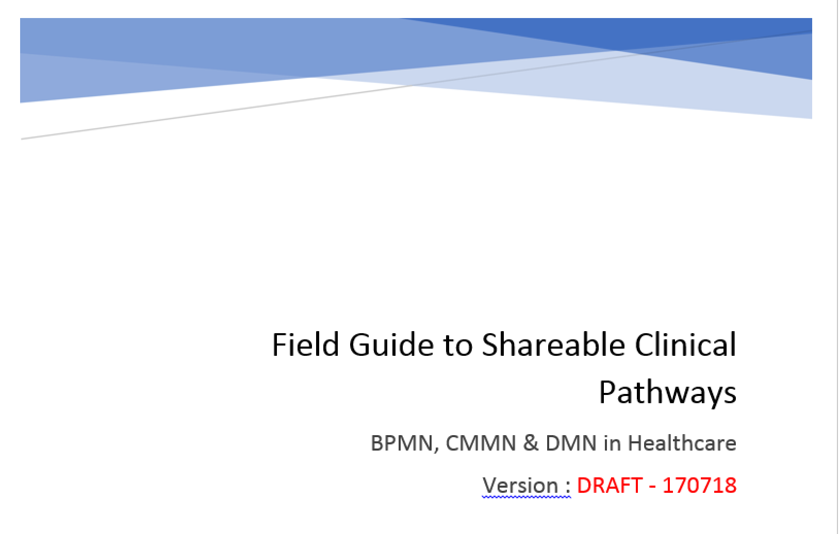
Contents
Introduction
Scope
Reference Examples and Patterns
Producing Models
Consuming Models
Sustainment and Governance
Appendices

Slide 4
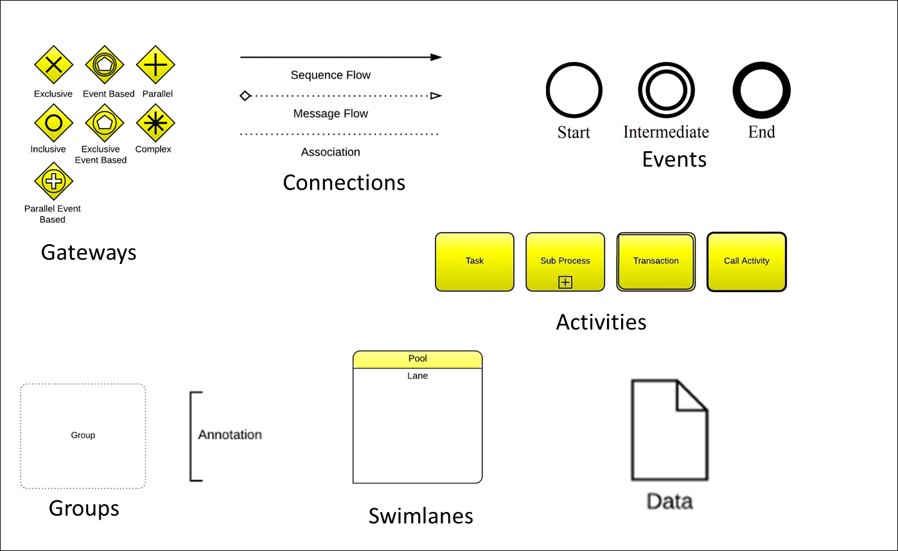
Business Process Management Languages
Developed by the Object Management Group (OMG)
Describe Processes rather than Decisions
Graphical Authoring Tools
Executable Code/Multiple Commercial Engines

Slide 5
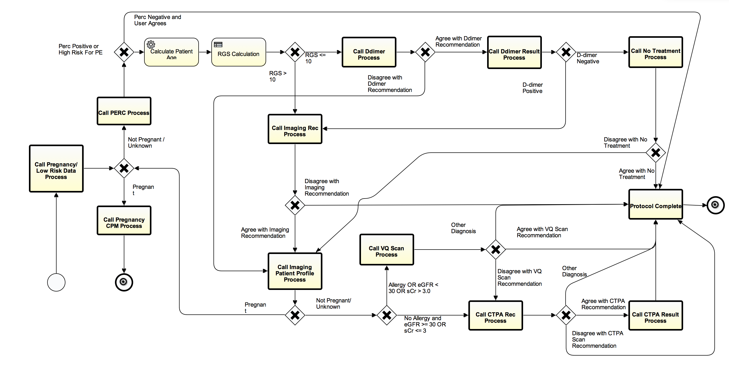
Three Process Management Tools
Business process modeling notation 2.0
  Tools for modeling workflows
Decision modeling notation 1.1
  Authoring and executing decision
  logic
Case management modeling notation 1.1
  Flexible support for processes
  managed by knowledge workers
Diagnosing Pulmonary Embolism

Slide 6
Components Necessary to Make BPM Computable
Two types: EHR supplied and part of External Platform
EHR Supplied
  Focus on Standards-Based Services
  Use HL7 FHIR Definitions
Platform-based
  Standards-Based as far as Possible
  Business Process Management Standards-OMG
  FHIR Standards/CDS Standards-HL7
  Terminology Standards
  Etc.

Slide 7
Designing a CDSS for Complex Electronic Protocols
Human Task Client Framework
Protocol Execution Environment
BPMN2 Engine
DMN Engine
HumanTask Processor
Terminology/ Ontology Services
Business Process Management Tools
Standard User Communication Model(WS-Human Task)
Appropriate Services from EHR (FHIR, HSP?)
Special Services
  To Manage Data Models
  To Provide Added Inferencing Capability
    Physiologic Models
    Predictive Models (Bayesian Networks)
    NLP Services
    Custom Java-Based Tools
Client (UI) Tightly Integrated with Hosting EHR
Antibx
Penicillins
Amoxicillin
Dicloxic..
Aminogly..
Gentimyc..
MetaData
Custom Service Tasks
CMMN Engine
User Interface Generator
Data Transformation Services
NLP Services
Extended Inferencing Services
Etc…
Case
Human Tasks
Data Services
Etc.
FHIR Order-Com Services
FHIR Patient ID Services
FHIR Data Write Services
FHIR Data Read Services
FHIR Publish/
Subscribe Services
(Data Drive)
Hosting
EHR
EHR-Based Resources

Slide 8
Component | Description
EHR Supplied Services
Data Read Services | These allow an application, running external to and EHR, to access data through EHR-based service calls. Preferably, they conform to the HL7 FHIR service definitions.
Data Write Services | Simple data write services allow typical clinical data collected in external applications to be written back into and stored in the hosting EHR. While simple, these services should still appropriately trigger internal CDS and other data-driven EHR actions.
Publish and Subscribe Services | The EHR should provide publish services to enable publish and subscribe activities in the web application server environment. (Since other applications may also publish there, the EHR should be able to subscribe to events of interest found here.)
Ordering Services | Ordering services are more difficult. These should allow external applications to order all orderable items. The services should provide all of the functionality needed. As an example, medication orders require more processing than simply storing in and EHR’s data repository. A medication ordering service should provide components sub-services including allergy and drug interaction checking, routing to pharmacy, adding to medication administration system, etc.
User Interface Integration Services | The EHR will need to provide a mechanism for an externally hosted application to display a user interface in an appropriate place in the workflow. The SMART on FHIR and CDS-Hooks technologies are examples.
EHR Supplied Services

Slide 9
Component | Description
Hosting Platform Supplied Services
Subscribe Services | To support subscription to the events published by the EHR.
Terminology Services | A well designed data dictionary will make identifying and accessing necessary data much easier. A good deal of medical knowledge is also embedded here.
Business Process Management (BPM) Services | This category refers to Business Process Modeling and Notation 2.0, Decision Modeling and Notation 1.1, and Case Management Modeling and Notation 1.1. They provide two important functions: 1) Each provides a graphical authoring environment that is used to design and maintain the application. 2) Each specifies an executable form of the application that can be executed at runtime in an appropriate execution engine.
Communication Services | Services to support interactions with users. They can include pager services, faxing services, etc. The BPMN 2.0 standard suggests the WS-Human Task standard as the specification for managing interactions with users.
Data Storage Services | A service to store relevant information external to the hosting EHR. This may include log files, process data, and some clinical data for which there is not a good storage model in the EHR.
Role Management Services | Since the BPM services will be management processes involving care teams, it is necessary to manage and provide access to the roles necessary for the care models.
Inferencing Services | The BPM and DMN environments are ideal for deploying a variety of inferencing tools including mathematical models, classification and prediction systems, Physiologic models, etc.
Custom Services | Special purpose services (such as natural language processing tools) can be accessed as a part of the care delivery workflow.
Platform Supplied Services

Slide 10
Time Line
Current-Workgroups Develop Chapters
September-Alpha Version Ready for Broader Review
December-First Release (Essentially Usable Beta) Ready
Etc.

Slide 11
Comments and Questions
Questions???

Slide 12
Examples

Slide 13
An Authoring Environment for Electronic Protocols
Business Process (Knowledge) Management Tools
  Business Process Modeling and Notation 2.0
  Decision Modeling Notation 1.1
  Case Management and Notation 1.1
Configuration Tools for Services from EHR (FHIR)
Configuration Tools for Special Services
    To Manage Data Models
    To Provide Added Inferencing Capability
      Physiologic Models
      Predictive Models (Bayesian Networks)
      NLP Services
      Custom Java-Based Tools
Configuration Site Specific Information

Slide 14
Business Process Management Notation (BPMN)
Orchestrating workflows
  Part of the work is done by computers
  Part of work done by people
Authoring environment produces executable output
  Workflow execution engines will run the process specification
Diagnosing Pulmonary Embolism

Slide 15
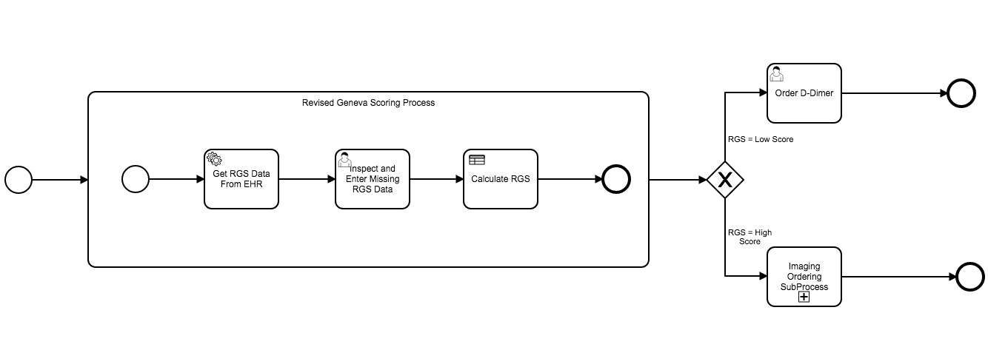
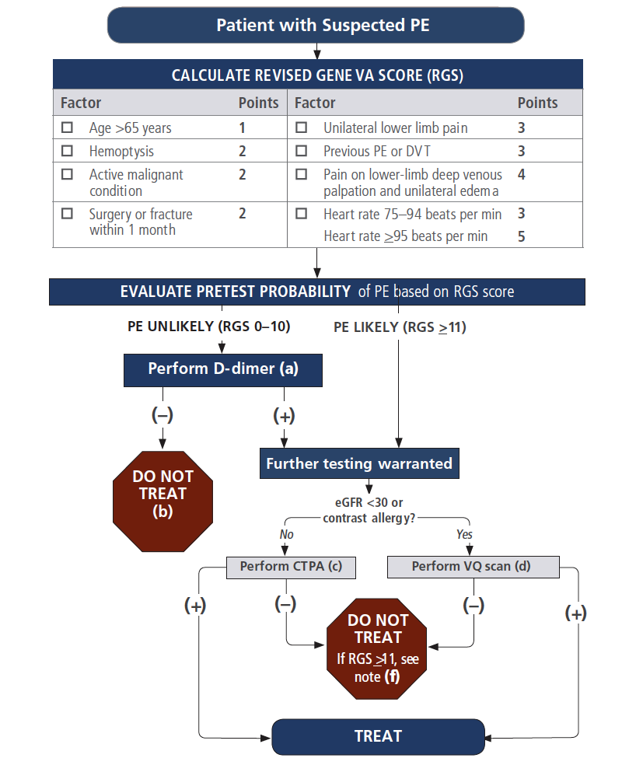
Example: Testing for Pulmonary Embolism
Decision logic requires 8 data elements
Each is weighted according to diagnostic importance
Testing decisions are based on the total of weights
Imaging Study

Slide 16
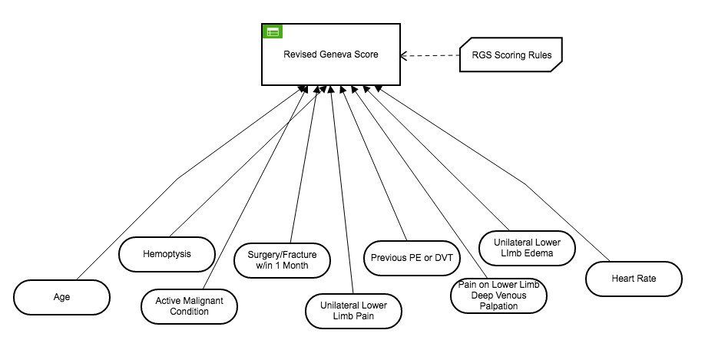
Decision Modeling Notation (DMN)
Documents the Logic of Decisions
  Enumerates Necessary Data Elements
  Captures Compositional Logic
Authoring System uses Graphics and Decision Tables
Produces Executable Output

Slide 17
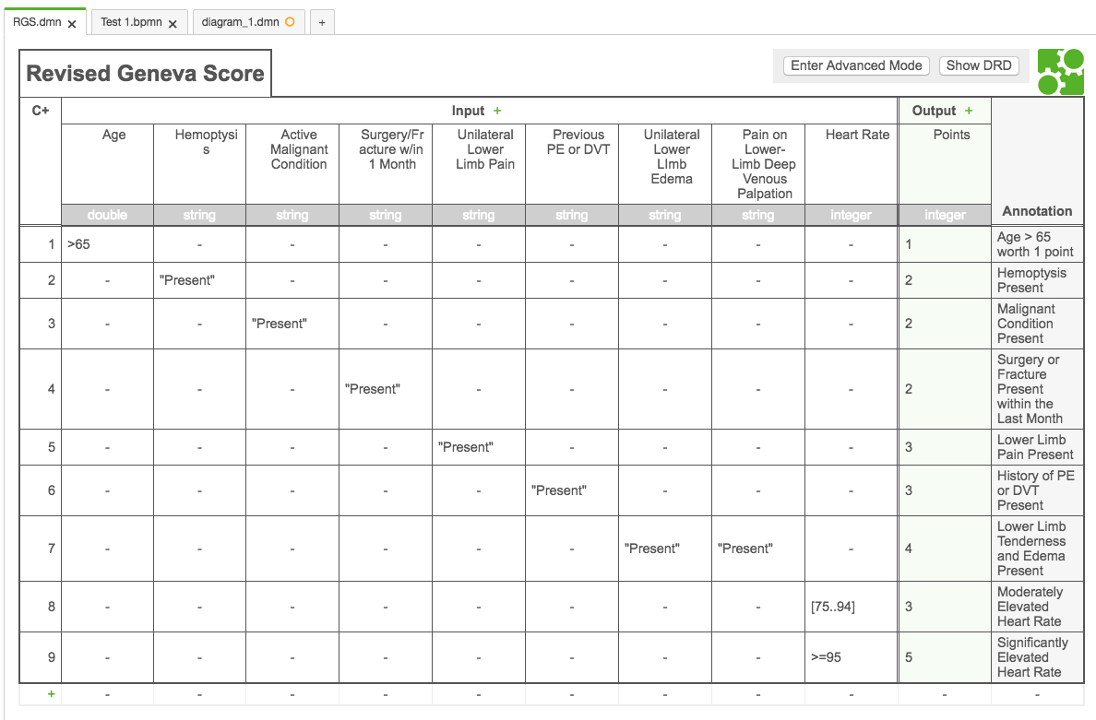
Decision Modeling Notation: Decision Tables
Specific Logic Described in Decision Tables
  Simplifies Designing, Critiquing, Maintaining Logic
Can be Supplemented (or Replaced) by Expressions
  Several Expression Languages available
Notes:
Multiple, Flexible Table Designs
Friendly Enough Expression Language (FEEL)

