Slide 1
Healthcare Interoperability:
Towards a Unified Perspective
Viet Nguyen, MD
8/2/2017

Slide 2
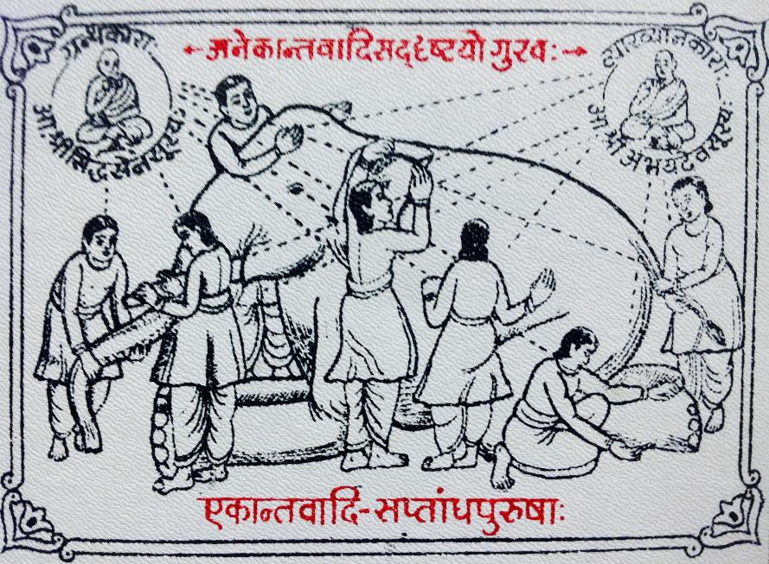
By romana klee from usa - sammati tarka prakarana, CC BY-SA 2.0, https://commons.wikimedia.org/w/index.php?curid=59461928
Notes:
Side
Leg
Trunk
Tusk
Ear
Tail

Slide 3
US Healthcare
US GDP $18.57 Trillion (2016)
$3.8 trillion a year on health care
17.6 percent of the gross domestic product (2015)
US Citizens spend $9024/yr (avg 2016) vs. OECD Average $3620/yr (2016)
US Life Expectancy 78.8 yrs vs. OECD median 81.2yrs (2015)
US Infant Mortality 6.1/1000 live births vs OECD median 3.5/1000 live births (2013)
Notes:
Foreign Policy Magazine 3/24/2017
Organization for Economic Cooperation and Development. U.S. citizens spend an average of $9,024 per year
OECD average of $3,620 according to the OECD’s data on healthcare from 2016
http://www.commonwealthfund.org/publications/issue-briefs/2015/oct/us-health-care-from-a-global-perspective

Slide 4
Trends in Society
Aging population
Millennials
Technology advances
Mobile devices
Internet of Things (IoT)
Machine Learning, Big Data, and Analytics
Blockchain
Autonomous/Semi-autonomous vehicles
Notes:
Aging population
Millennials
Technology advances
Mobile devices
Internet of Things (IoT)
Machine Learning, Big Data, and Analytics
Blockchain
Autonomous/Semi-autonomous vehicles

Slide 5
Trends in Healthcare
Increasing management of chronic conditions
Transition from fee-for-service to value-based care
ACA, MACRA and MIPS
Accountable care organization and risk
Patients as consumers
Advances in technology
Remote patient monitoring
Telemedicine
Targeted therapy
Gene editing - CRISPR
Drive towards precision medicine and genomics

Slide 6
Lessons From Travel
https://www.youtube.com/watch?v=5J67xJKpB6c
Notes:
Limitations of metaphor
No other domain except intelligence with a similar level of volume, variety, velocity and especially in healthcare, the need for VERACITY
If travel was like healthcare
http://www.ebizmba.com/articles/travel-websites
1. Booking,.com – 40M unique visitor a year
2. Tripadvisor – 30M
3. Yahoo Travel – 36M
4. Expedia – 25M
5. Priceline – 20M
Travel took 20 years to go from the early integrated air/hotel/rental care booking platform (Travilcon, 1992) To Expedia & Travelocity (1996), Kayak (2004)
What if healthcare was more like travel?

Slide 7
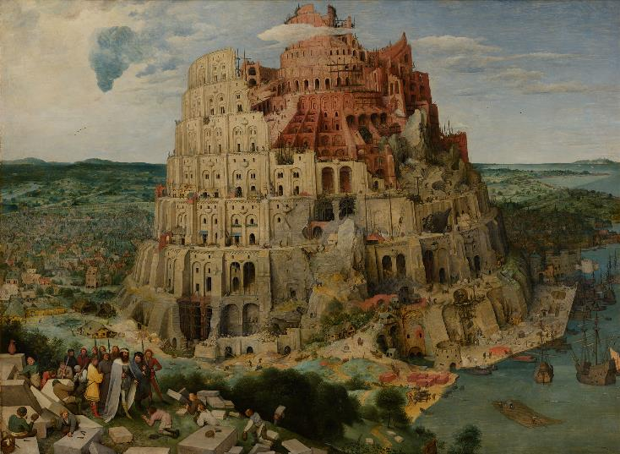
Informatics Observations
Notes:
No more Tower of Babel
Terminology is well underway
Moving towards higher level information and knowledge
A new generation of physicians who don’t know a time before the Internet
A generation who accepts that technology is part of their life and practice of medicine (residents and students change locations every 4-6 weeks)
A generation who expects more from technology, even if they don’t recognize the historical perspectives and complexity
HITECH - Now that we have data we can work with it and improve it. Even when we recognize it’s not ideal quality
Growth and recognition of Clinical Informatics as a valuable skill set to bridge the gap between layers
But the pipeline is long -

Slide 8
Health IT Stack
Policy and Governance
Business Processes (Clinical & Administrative)
Safety
Security
Interoperability
Privacy
Applications and Analytics
Data and Knowledge Representation
Infrastructure
Notes:
Offer of another model that I’ve used for years that aligns well with HSPC’s view
Helps to explain our role as informaticists within the healthcare system

Slide 9
Where do we go from here?
Notes:
As we begin this HSPC meeting, hear more about the work that’s been done and work yet to do.
Let’s not be like the blind men and see healthcare from only one perspective
Please add your perspective and hear the perspective of others
SO that we can work together as we travel together down the road towards a learning health system that provides high-quality, cost-effective care .

Slide 10
Thank You!

