Slide 1
HSPC Terminology and Information Model Initiative Update
Susan Matney, PhD, RNC-OB, FAAN (Initiative Co-lead)
Keith Campbell, MD, FACMI (Initiative Co-lead)
8/02/2017

Slide 2
Terminology and Modeling Initiative:
Develop terminology and information models as a foundation for true semantic interoperability
Based on real world, technical, high priority use cases brought to us by the member community.
Notes:
Keith wants to “tweak” information models, CIMI and CEMs are “instance models” could be contextual models too.

Slide 4
Deliverable 1: Develop the CIMI Content Architecture (overseen by HL7 CIMI WG)
Goal 1: Develop the high level reference archetypes (patterns) and ballot
Assigned to : CIMI
CIMI Model Style Guide in Sept ballot
Archetypes included: Actor, Organization, Encounter, Evaluation Result, Procedure, Assertion, Medication, Device
Goal 2: Create and ballot the CIMI Reference and Foundational Archetypes
Assigned to : Claude Nanjo/Joey Coyle
Patterns above developed and in ballot
Architecture guide in ballot
Future patterns (Orders, Procedure specializations…)
Notes:
DCM reuse will be a metric of success, could be around forms/templates/registries with the number completed and reuse
Tooling repository dependency (Model Repository Tool)

Slide 5
Deliverable 2 Pilot Projects
OPA/ACOG Family Practice Annual Report (FPAR)
119 FHIR Profiles Created
Working in Implementation Guide
SMART on FHIR app final deliverable (contracting in process)
Skin/Wound Assessment
Using this project to develop SOLOR content and processes
Reference sets developed in Termspace
Jira project developed and tracking
Starting Projects
Vital Signs – common models compared and data set created
Common labs – met with HL7 Orders & Observations
Notes:
Need to articulate all these things and how they relate to each other
Simplify it

Slide 6
Deliverable 3: Define Model Development Pipeline
Goal 1: Model Request Process Model Development
Assigned to : Susan/Keith
Process diagrammed (analysis, terminology and model mapping, content creation)
Define Scope Templates
Use Case Template Development
Define Analysis Process
Identify content curation process (SOLOR)
Define and Document Model Development Process
Goal 2: Model Development Process
Assigned to : Susan/Claude/Jay
Identifying common principles and processes during SOLOR development – document started
Model request spreadsheet being evaluated and refined

Slide 7
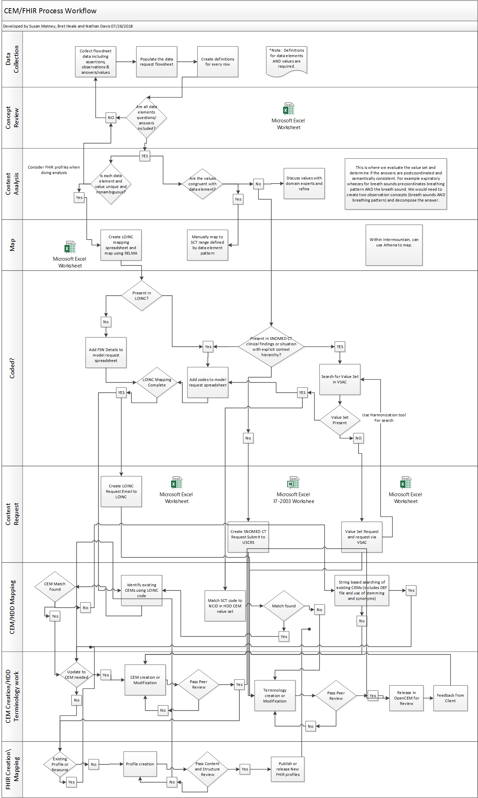
Request to CIMI to FHIR
Data Collection
Content Review
Content Analysis
Mapping
Encoding and Content Request
Model Mapping
Model Creation
FHIR Creation

Slide 8
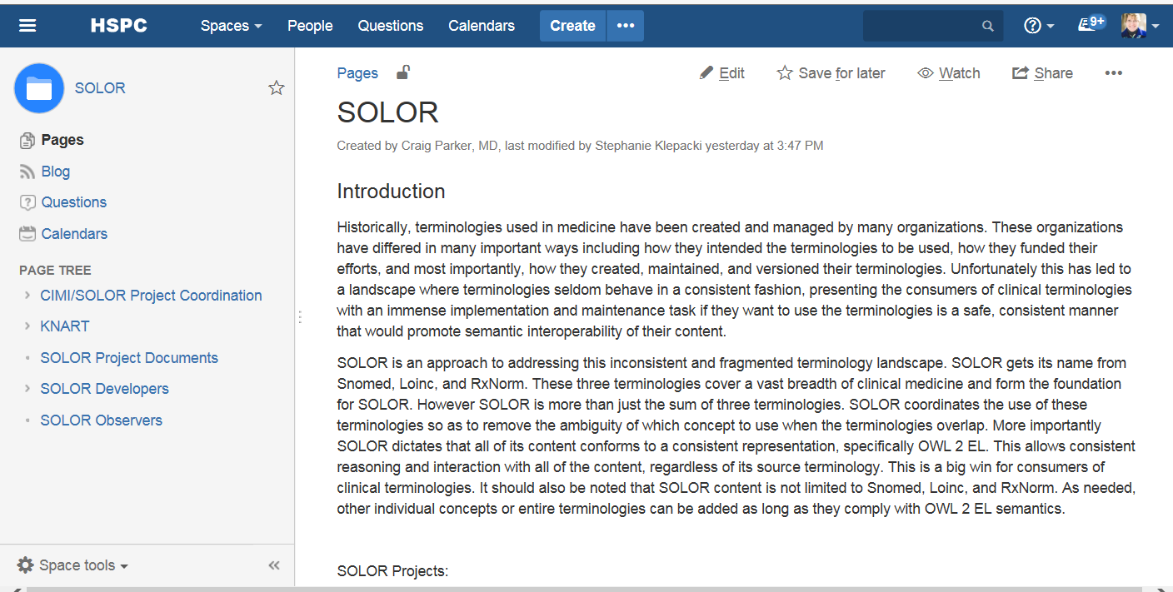
Confluence/Jira
https://healthservices.atlassian.net/wiki/spaces/SOLOR

Slide 9
Deliverable 4: SOLOR terminology editing environment (overseen by Keith Campbell)
Goal 1: Determine Terminology Editing Environment - done
Assigned to : Keith Campbell
Using termSpace and HSPC SNOMED CT extension namespace
Content creation is based on projects
Develop long term maintenance process (in progress)
Goal 2: Define process for SOLOR terminology development
Assigned to :Keith/John Kilbourn
Tasks defined in Jira
Biweekly meeting with CIMI/SOLOR
Notes:
Notes from John – needs to be further refined, concerns about resources

Slide 10
Deliverable 4: Provide SOLOR terminology services (overseen by Keith Campbell)
Goal 3: Determine Terminology Services required for model binding
Assigned to : CIMI Pattern Development Subgroup (Susan will lead)
Goal 4: Identify and implement terminology server
Assigned to : Keith
Contract signed for Ontoserver
Populated with SNOMED and LOINC
Goal 5: Implement Terminology Services for model binding
Overseen by : Keith
Recently delegated to Cognitive
Notes:
Notes from John – needs to be further refined, concerns about resources

Slide 11
Deliverable 5: Define versioning and governance processes for terminology and models
Goal 1: Terminology Versioning and Governance Processes
Assigned to: Keith Campbell
STAMP
Status, Time, Author, Module, Path
Goal 2: Model Versioning and Governance Processes
Assigned to: Claude/Jay/Stan
Notes:
Move to knowledge content initiative

Slide 12
Questions

