Slide 1
VA KNART
Clinical Decision Support (CDS) Content & HL7-Compliant Knowledge Artifacts

Slide 2
Program Overview
VA Knowledge Based System contract
Centered on the HL7 Knowledge Artifact Specification (KAS)
Produce near 100 singleton KNARTs (document templates, order sets and ECA rules) in multiple specialty domains
Produce several ”Composite KNARTs” which are bundles of individual KNARTs designed to support requested consult workflows
Conduct research/gap analyses in several areas:
Terminology and information models need to represent the requested domain knowledge accurately
Lifecycle /governance requirements and methodology
Roadmap Recommendations for future versions of the standard to support additional artifact types, ”composite KNARTs”, model validation/conflict resolution/prioritization

Slide 3
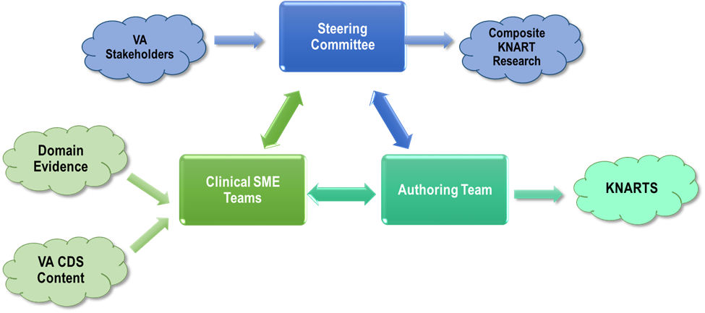
KNART Program Teams

Slide 4
KNART Lifecycle
Clinical Whitepaper
Conceptual Structure
XML Authoring
Validation
Model Definition

Slide 5
HL7 PSS
HL7 CDS Working Group PSS: Composite KNART Investigation
https://www.uberconference.com/jgoodnough
Use VOIP Audio rather than HL7 conference line of dial 541-275-1101
Definition of common elements that apply to the entire composite.
Potential extension of KNARTs for relationship with other KNARTs, and the related metadata.
How to harmonize / de-duplicate/ prioritize.
Review technology bindings (CQL, etc.).
Assess extension of artifact types and classification by purpose.
Explore specification of post-coordinated concepts across terminologies.
Gap analysis of the current XML-based KNARTs and newer FHIR-based Clinical Reasoning Resources.

Slide 6
Questions?

Slide 7
Touro NICU Pilot

Slide 8
Framework Must Address Core Challenges
Semantics
&
Structure
Analytics
&
Workflow Integration
Visualization
&
Usability

Slide 9
Framework must facilitate orchestration
Patients
Providers
Organizations

Slide 10
Neonatal Intensive care Project
Security & Policy Enforcement
Services
Transformation Services
Reporting & Analytics Services
Reports & Registries
Medical Devices
real-time device data
Service Bus
Touro Sorian
Medical history
Medications, I&Os, Labs, etc
Data Subscription Services
Inferencing & Process Orchestration Services
Unified Communication
Service
Bedside Workstation
(Companion App)
Attending Inbox
(Mobile)
Other Data Sources
Clinical Knowledge Bases
Administrative Knowledge Bases
Feeding Guidelines
Neonatal Abstinence
ABX
Selection
Hospital
Policies
Workflow Procedures
MD Preferences

Slide 11
NICU Protocols in development
Vit D & Iron Supplementation
Feeding Advancement
NEC Risk Assessment & Management
Apnea & Bradycardia Management
Discharge Planning
Breast Milk Utilization
Antibiotic Selection

Slide 12
Status
Clinical narrative for Vit D/Fe supplementation, feeding advancement protocol defined and documented.
Other protocols being scheduled.
Information model analysis to start early fall.
Pilot ”KNARTs” will not be HL7 compliant initially.
Work progressing on two related engineering efforts:
Knowledge artifact tooling for authoring, persistence, retrieval and governance.
How standard compliant artifacts, especially complex composites, can be ”ingested” and transformed from logical representations into executable runtime code.

Slide 13
Questions?

