Slide 1
by Rick Freeman
Sr. Consultant to Intermountain Healthcare & HSPC
President & CEO of Interopion
8/3/2017

Slide 2
OUR MISSION
Improve health by creating a vibrant, open ecosystem of interoperable platforms, applications, and knowledge assets.

Slide 3
OUR VISION
Be a provider-led organization that accelerates the delivery of innovative healthcare applications that improve health and healthcare.

Slide 4
OUR GOAL
Our goal is to create an open marketplace featuring the industry’s first vendor-neutral Healthcare Marketplace and to foster a vibrant entrepreneurial community to deliver the best solutions quickly, easily and seamlessly to improve the quality of today’s accountable care.
Achieving the gold standard of true semantic interoperability, our services platform seeks to dramatically augment today’s standards efforts by providing a ground-breaking collaborative platform and real world laboratory to advance the native interoperability of healthcare applications.

Slide 5
ABOUT HSPC
The Healthcare Services Platform Consortium (HSPC) is a provider-driven organization of leading healthcare organizations, IT vendors, systems integrators, and venture firms dedicated to unlocking the power of entrepreneurial innovation to improve healthcare outcomes.
Through HSPC’s open marketplace and services platform, we seek to foster a new level of provider-vendor collaboration and innovation to meet one of the industry’s greatest needs -- accelerating the creation, sharing and delivery of promising software applications at the point of care.

Slide 6
HSPC Developers Portfolio
HSPC Developers Portal
The resources needed to jump start any health app project: guides, tutorials, code samples, open source libraries, dev forums, etc.
HSPC Sandbox
A personal instance of a SMART on FHIR platform in the cloud, complete with tools and sample data to help developers build and test health apps
HSPC Gallery
HSPC's Gallery shows off some of the best SMART on FHIR applications. Browse or even take them for a spin with our live demo feature.

Slide 7
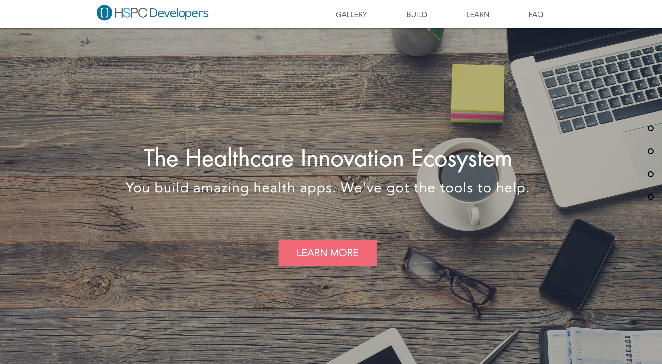
Portal

Slide 8
HSPC Developers Portfolio Features
SDK’s & Libraries
With HSPC and SMART's integration libraries, you can focus on building great apps and less on data transmission and security code.
Samples & Tutorials
Not sure how to get started? With our samples and tutorials library, you'll be up and running in no time.
Documentation
Need to dive deeper into FHIR, SMART on FHIR, or HSPC's SDKs? Our documentation library will help.

Slide 9
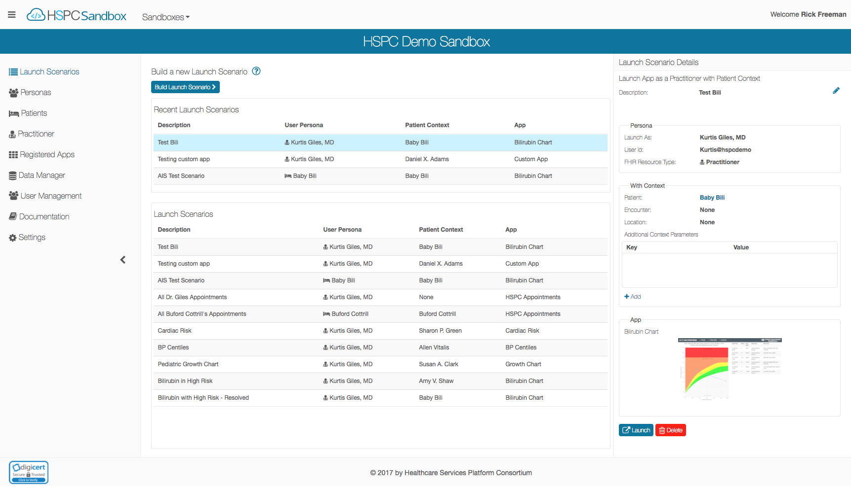
Introducing

Slide 10
HSPC Sandbox Goals
Accelerate development of health apps by providing:
Development focused reference implementation hosted in the cloud
SDKs
Tools & Utilities
Tutorials, Implementation Guides, Samples, and Documentation
Reduce time to integrate with commercial HSPC and/or SMART on FHIR capable platforms (such as EHRs, HIEs, etc.)
Contribute to the Health IT Community:
Free to use (membership in HSPC is not required)
Funded by Intermountain Healthcare & HSPC
Open source: https://bitbucket.org/hspconsortium/

Slide 11
HSPC Sandbox Features
The HSPC Sandbox is a personal instance of a SMART on FHIR platform in the cloud, with tools and data to help build and test health apps.
Create your own cloud-based sandbox, w/default data set, in a few clicks.
Run against your own FHIR server (open or secured).
Support for DSTU2 or STU3 (1.8, 1.9, 3.0 coming soon )
Invite your team to join and collaborate with you on your sandbox.
Create or import clinical data to test your apps.
Test apps by creating Personas and Launch Scenarios.
Support for mobile, embedded web, stand-alone, and back-end.
Verify your app follows the SMART security and launch context standards.

Slide 12
777
499
Sandbox Users
Unique Sandbox
Up from 386 in March 2017
Up from 313 in March 2017
2x
78
HL7 FHIR Roundtable
Award Winner
New Users
Past 30 days

Slide 13
New Features
Available Now
In the Works
Social Login (Google, Twitter, etc.)
App “embedded in EHR” simulator
Standardized App Registration
HSPC led: Epic, Cerner, Allscripts, Intermountain, SMART, and Interopion
FHIR 3.0.1 Support (STU3)
Persona Launch
Terms of Use & Privacy Agreement
CDS Hooks Support & Collaboration
Enhanced ”embedded mode”
Argonaut FHIR Profile Support
Developer Guide for FHIR Profiles
Access to large, realistic data sets
Enhanced synthetic data generation

Slide 14
CDS Hooks Collaboration
Effort 1
Effort 2
CDS-Hooks.org to be backed by HSPC Sandbox
HSPC Sandbox launches demo.cds-hooks.org as a SMART App from a private HSPC Sandbox
In Progress
In Progress
Effort 3
Effort 4
Initiative 2 + User’s Hooks Configuration/Context is stored in user’s sandbox and passed to CDS-Hooks.org at launch
Initiative 2 + app-link cards can launch SMART Apps registered in launching HSPC Sandbox
To Do
To Do

Slide 15
HIT Dev Conference
2 Day Conference in New Orleans, March 2017
70+ attendees
Presentations by Cerner, Epic, Allscripts, RelayHealth, SMART, CDS Hooks Lead, HSPC

Slide 16
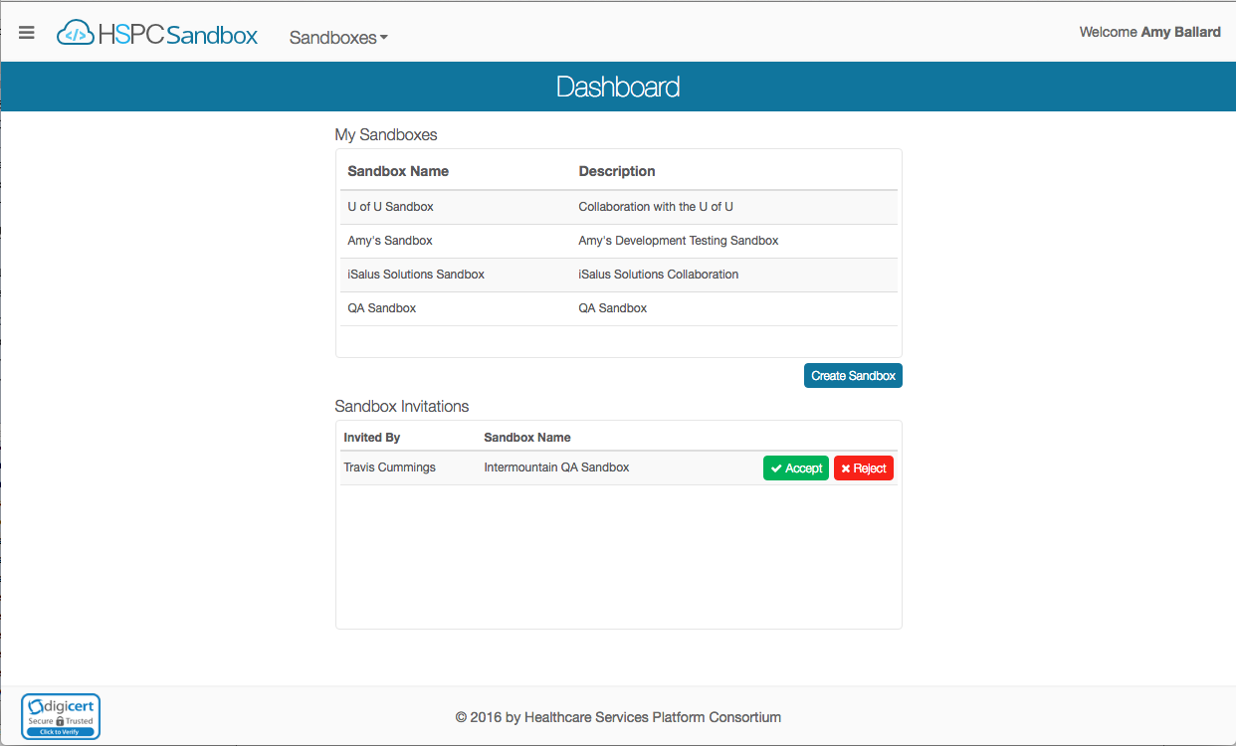
Demo of HSPC Sandbox

Slide 17
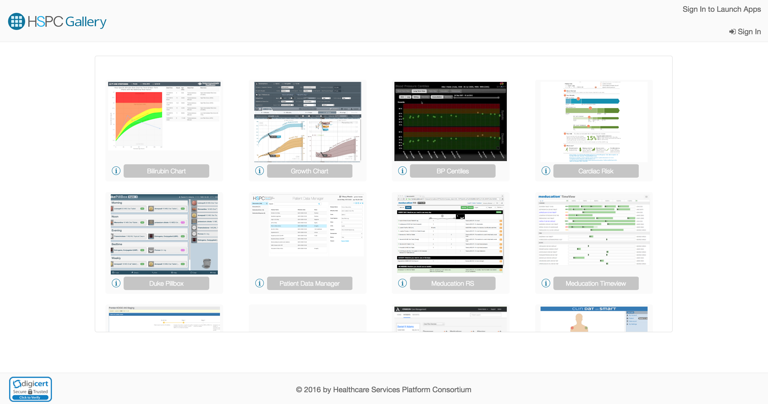
Introducing

Slide 18
HSPC Developer Resources
HSPC Developers: http://developers.hspconsortium.org
HSPC Sandbox: http://sandbox.hspconsortium.org
HSPC Gallery: http://gallery.hspconsortium.org

Slide 19
News about iSalus Solutions
iSalus Solutions & MedAppTech merged in June 2017 to form Interopion.
Founded in 2012
Notable work:
SMART on FHIR Reference Implementation
Bilirubin Risk Chart
HSPC Developers Program
Supports SMART Sandboxes for HSPC & SMART
Supported many clients take some of the first SMART Apps into production
Founded in 2012
Built the original SMART on FHIR apps
First SMART app in production
Notable apps:
Pediatric Growth Chart
BP Centiles
Cardiac Risk Factors
Duke Pillbox
Concentegy
Engagily
Merge Announcement

Slide 20
Questions?

